Slide 1

QUALAMANTIS // SERVICE OFFERING
Business Transformation Program
Turn quality from a hidden cost into competitive advantage.
AUTHOR
Qualamantis Consulting
DATE
2026
PER ASPERA AD ASTRA

Slide 2
THE STAKES
Poor quality is already costing you — quietly
Recurring defects, slow launches and constant firefighting rarely show up as one line on the P&L. They surface as eroded margin, missed deadlines and lost customers — a tax most companies pay without ever measuring it.
The real question is not whether you can afford to transform quality — it is how much the status quo is costing you every year.
QUALAMANTIS // 2 / 25

Slide 3
THE PROGRAM
One program, three moves that compound
1
2
3
Gap Assessment
Action Plan
Cost Improvement
See clearly where you stand — and what it is costing you today.
Build the processes and the people that make quality stick.
Drive product cost down across all processes — with or without a quality problem.
Diagnose → Build → Capture value
QUALAMANTIS // 3 / 25

Slide 4
01
AXIS ONE
Gap Assessment
See how your business really runs — and where value leaks out.

Slide 5
AXIS 1 // GAP ASSESSMENT
Start with the truth, not assumptions
Together with your leadership we run a company-level Gap and SWOT analysis — covering quality performance and product cost as two independent lenses. We surface the structural, organizational and cultural factors that quietly drive, or block, both.
One honest picture — quality and product cost, independently assessed — before you spend a euro on change.
QUALAMANTIS // 5 / 25

Slide 6
AXIS 1 // METHOD
A diagnostic that looks where both quality and cost value leak
◆
Gap & SWOT analysis
Strategic strengths, weaknesses and blind spots.
Business process assessment
Whether your core processes deliver on Quality AND Cost.
Hidden-factor assessment
The culture and behaviours that shape real outcomes.
Lean & digital maturity
Where waste, missing data and improvement process gaps slow you down.
QUALAMANTIS // 6 / 25

Slide 7
AXIS 1 // OUTCOME
You leave with a baseline and a direction
Maturity baseline
Prioritised findings
Strategic direction
Where you stand today — objectively scored, not guessed.
Risks and opportunities ranked by euro impact.
The shortest path from today to a value-driven system.
QUALAMANTIS // 7 / 25

Slide 8
02
AXIS TWO
Action Plan
Turn the diagnosis into processes and people that hold.

Slide 9
AXIS 2 // THE ACTION PLAN
Seven workstreams that turn insight into action
Not a report to file away. We turn the diagnosis into a plan with clear owners and KPIs, built around seven typical workstreams:
1
Critical-to-quality & business processes
APQP, MOC, PPAP, CCM, supplier approval and more.
5
Problem solving & continuous improvement
Zero Defect, DMAIC and Six Sigma.
2
Short-term risk management
Contain today's risks before they reach the customer.
6
Digitalization
Digitalize core business processes and quality data.
3
Quality management system
A QMS that supports the business — ISO and IATF aligned.
7
Operational support
Hands-on help to keep momentum and embed the change.
4
Competence development
Close capability gaps across quality and engineering.
QUALAMANTIS // 9 / 25

Slide 10
AXIS 2 // WORKSTREAM 1 · PROCESSES
The processes that keep quality from slipping
APQP
MOC
PPAP / ISIR / FAI
Launches that go right the first time.
Changes that never introduce new risk.
Production signed off before it starts.
CCM
ERM
Supplier Approval
Complaints resolved fast — and prevented next time.
Risk priced in before you commit to a contract.
Partners who meet your standards, not just your price.
QUALAMANTIS // 10 / 25

Slide 11
AXIS 2 // WORKSTREAMS 4 & 5 · CAPABILITY
Processes only last if your people own them
We close the competence gaps with hands-on, coaching-led training across two domains:
Q
Quality
6
Six Sigma
— Critical-to-quality processes (APQP, MOC, CCM)
— Quality management systems & ISO standards
— Auditing techniques: internal, supplier, process
— Risk management & FMEA facilitation
— Problem solving, MSA & SPC
— DMAIC — Green Belt & Black Belt
— Design for Six Sigma (DfSS)
— Reliability engineering & testing
— Robust design & Design of Experiments
— Statistical modelling & tolerancing
QUALAMANTIS // 11 / 25

Slide 12
03
AXIS THREE
Cost Improvement Program
A stand-alone program to engineer product cost down — across all processes, with or without a quality problem.

Slide 13
AXIS 3 // TWO COMPLEMENTARY ENGINES
CIP as the engine — CoNQ as one of its tools
CoNQ
CIP
Diagnostic tool inside CIP
Engineer out tomorrow's cost
DMAIC / Lean Six Sigma
Design for Six Sigma
Complaints
Scrap
Loss & rework
Design & built-in quality
Supplier cost reduction
The CIP is a stand-alone program covering product cost across all business processes — activatable even without a quality problem. CoNQ is one of its diagnostic instruments: it quantifies quality losses and feeds them back as improvement targets.
QUALAMANTIS // 13 / 25

Slide 14
AXIS 3 // CoNQ WITHIN CIP
Quantify losses — and feed them into the CIP as targets
CoNQ is one of the CIP’s diagnostic instruments. It measures the financial weight of quality failures — complaints, scrap and rework — and converts them into prioritized improvement targets inside the CIP.
◆
Complaints
Faster resolution and root-cause fixes that stop recurrence.
◆
Scrap
Cut the material and capacity lost to defective output.
◆
Loss & rework
Eliminate the hidden hours spent fixing what should be right.
QUALAMANTIS // 14 / 25

Slide 15
AXIS 3 // COST IMPROVEMENT PROGRAM
Stand-alone program, real savings
Run as a structured Cost Improvement Program, the typical prize is:
3–10%
12 mo
of product cost — identified in detail and taken through to implementation.
to embed the new way of working, with your own CIP experts trained in each product line.
QUALAMANTIS // 15 / 25

Slide 16
AXIS 3 // WHERE SAVINGS COME FROM
Three levers — and the question each answers
1
2
3
Product specifications
Sourcing & price
Technical solutions
“Do my products have the right features?” → prioritize what customers truly value.
“Am I buying at the right price?” → clean-sheet target costing, part by part.
“Is there a lower-cost design?” → teardown-driven redesign of product and process.
QUALAMANTIS // 16 / 25

Slide 17
AXIS 3 // HOW IT WORKS
A co-located team with a mandate to act
⟳
A co-located, cross-functional team
Engineering, purchasing, manufacturing, sales & quality — working to shared stretch targets.
★
Clear top-management commitment
Quick decisions, resources allocated, barriers removed.
◆
Dedicated resources & gates
Around two FTE, a shared budget and structured gate reviews.
Fuelled by competitor benchmarking and supplier workshops — and aimed at all three margin drivers: value, cost and sales.
QUALAMANTIS // 17 / 25

Slide 18
EXECUTION // DIGITALIZATION
Digitalize the processes that run quality
Once the plan is set, we digitalize your core business processes — turning manual quality work and scattered data into connected, real-time workflows.
Connected processes
Quality data you can trust
Less manual effort
One flow from enquiry to delivery — not disconnected tools and spreadsheets.
Real-time, single-source metrics for faster, better decisions.
Automate checks and reporting; free your people for higher-value work.
QUALAMANTIS // 18 / 25

Slide 19
04
AXIS THREE
Digitalisation
Increase efficiency implementing one or more digital platform to support your non-ERP- driven business processes

Slide 20
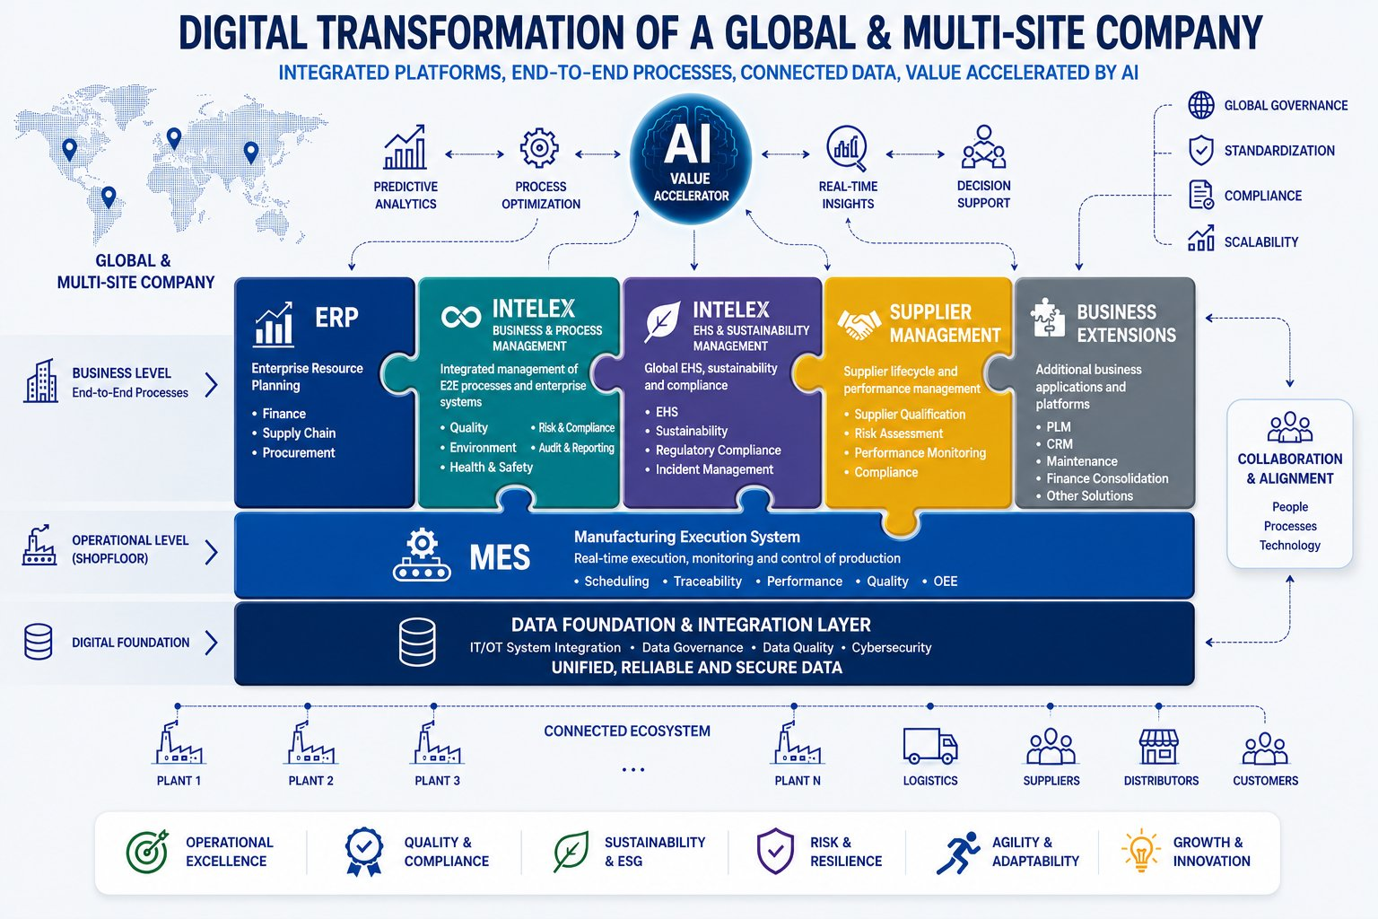
EXECUTION // TARGET LANDSCAPE
A connected, AI-accelerated landscape
QUALAMANTIS // 19 / 25

Slide 21
THE JOURNEY
Three axes, one compounding loop
01
02
03
→
→
Gap Assessment
Action Plan
Cost Improvement
Once the plan is set, cost reduction and digitalization run in parallel — and each cycle resets the baseline higher.
QUALAMANTIS // 20 / 25

Slide 22
HOW WE ENGAGE
A clear path, from first look to lasting change
1
2
3
Diagnose
Design
Deliver
Typically 4–6 weeks
Typically 4–8 weeks
Typically 6–12 months
A gap assessment and a quantified baseline of where you stand.
A prioritized action plan with clear owners and leading KPIs.
Implementation alongside your teams — capability transferred, not rented.
Scaled to your size and ambition — we co-resource alongside your team, we do not replace it.
QUALAMANTIS // 21 / 25

Slide 23
WHY QUALAMANTIS
We design the change — and stay to make it real
“
Not a one-size-fits-all model — a partnership that builds quality into how your business runs, from the boardroom to the shop floor.
✓
Senior practitioners who have led quality in global industry
✓
A focus on savings that reach the P&L, not just the report
✓
Quality, cost and sustainability driven as one agenda
QUALAMANTIS // 22 / 25

Slide 24
THE TEAM
Senior practitioners, not slideware
SR
BD
DD
FZ
RJ
Silvio Rubatto
Bryan Dodson
Domenico Ducci
Filippo Zingariello
Rob Jenkinson
Business Quality executive
Product Quality & Reliability
Advanced Procurement
Product Dev & Technology
EHS & Sustainability leader
QUALAMANTIS // 23 / 25

Slide 25
WHERE TO START
Begin with a cross-functional diagnostic
1
A short Business Performance scan
2–3 weeks, covering quality and product cost as two independent lenses.
2
A quantified view of quality losses and product cost opportunities
Two independent prizes, both expressed in euros.
3
A board-ready recommendation
Where to act first — and what it is worth.
Low commitment, high clarity — see both prizes before committing to the full program.
QUALAMANTIS // 24 / 25

Slide 26
THANK YOU
Let’s talk.
CONTACT
qualamantis@gmail.com
PER ASPERA AD ASTRA

