Slide 1
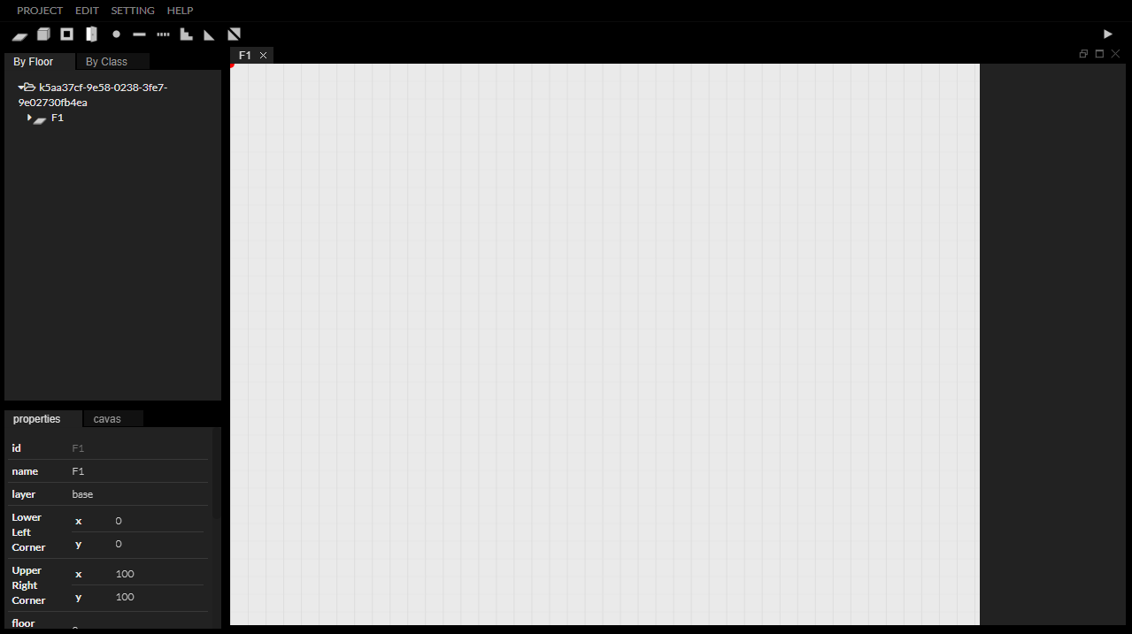


Slide 2

InEditor
InEditor is a web-based application designed to generate IndoorGML documents.
After the user draws the indoor space information on the canvas of InEditor, InEditor generates the IndoorGML document using that information.
Currently supported elements of IndoorGML in InEditor are CellSpace, CellSpaceBoundary, Transition, State, InterlayerConnection. (More information on IndoorGML is available at http://www.indoorgml.net.)

Slide 3




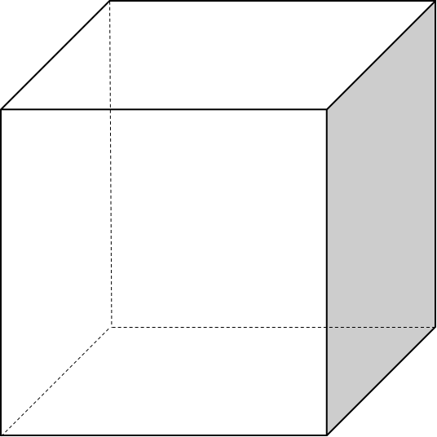
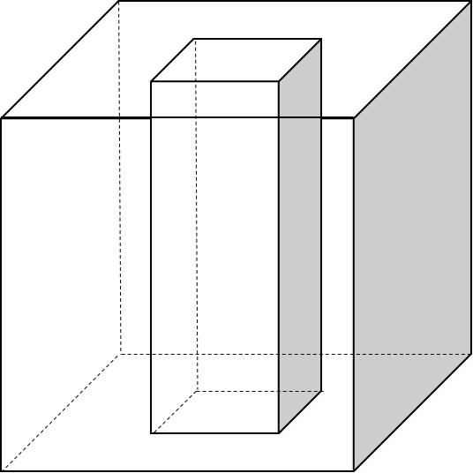
Geometry in IndoorGML
Geometry provided by InEditor
A. Geometry and GML Object
 | CellSpace | CellSpaceBoundary | State | Transition
2D | Polygon | LineString | Point | LineString
3D | Solid | Polygon | Point | LineString
B. Geometry Type
Point | LineString | Polygon/Surface |  | Solid

Slide 4
Attributes in IndoorGML
Attributes provided by InEditor.
Some attributes are set automatically by InEditor and are not editable by the user.
A. Common
C. CellSpaceBoundary
name | desc | editable
id | the identifier of this feature. Need to be started with alphabet. | X
name | nickname of this feature | O
duality | id of dual space of object | X
description | additional information about object | O
name | desc | editable
externalReference | An external reference to describe geometry data | O
D. State
name | desc | editable
connected | array of Transitions’ id connected with this state | O
B. CellSpace
E. Transition
name | desc | editable
partial boundedBy | Array of CellSpaceBoundarys’ id which place at the geometric boundary of this CellSpace | X
external Reference | An external reference not defined in the current document. | O
name | desc | editable
connects | array of States’ id connected with this Transition | O
weight | Weight value on this transition as an edge of network | X

Slide 5
Thank You

