Slide 1

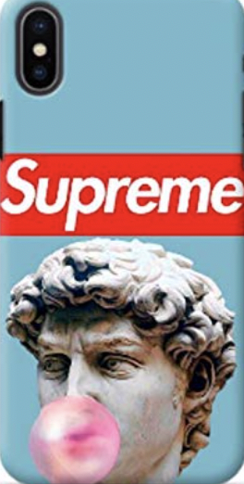
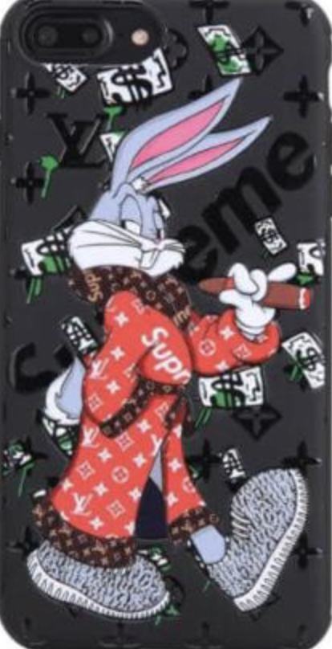
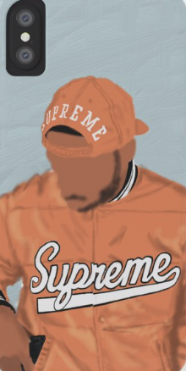
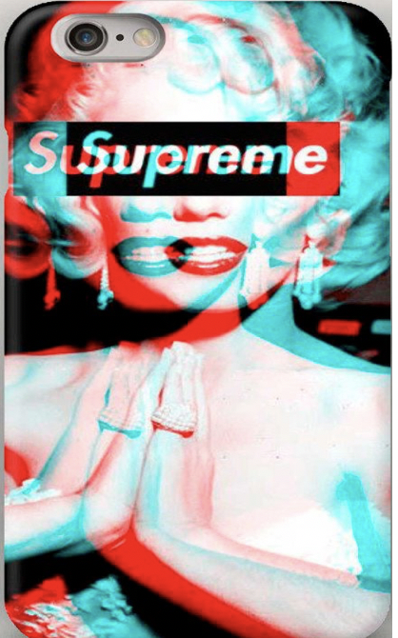
Crazy Cases
CEO’ s: Emiliano García and Leonardo Martínez

Slide 2

Executive Summary
Everyone likes Iphone, but they are fragile.
Everyone wants to have cool case that resists.
Very good service

Slide 3
Company Description
Protect something you use all of the time: Your Iphone.
Protect it in a cool way.
Great inventory with a lot of styles.
Fast 3 Day delivery

Slide 4
Market Analysis
A lot of companies sell cases.
We sell unique cases.
Most of Nuevo Laredo have an Iphone.

Slide 5
Organization and Management
Create and Design Cases.
Offer catalog and market of supreme.
Great service and delivery.

Slide 6
Service or product
Service of delivery.
New Products.
Quality and durable.

Slide 7
Marketing and sales

Slide 8
Funding Request
SWOT
Strenght
Weakness
Opportunities
Threats

Slide 9
Financial Projections
20-30 Dollars for the consumers
For us it costs about 10-20 dollars, so we must sell it 20-30 dollars
We are going to win about 10-15 dollars per case

