Slide 1
Virtual Compound Screens
Computer Aided Drug Design

Slide 2
Methodology
ChEMBL
Target: Estrogen receptor alpha
Download dataset of all compounds with Bioactivity measured in IC50 values n=3901
Clean dataset for unique compounds and non NaN IC50 n = 2250

Slide 3
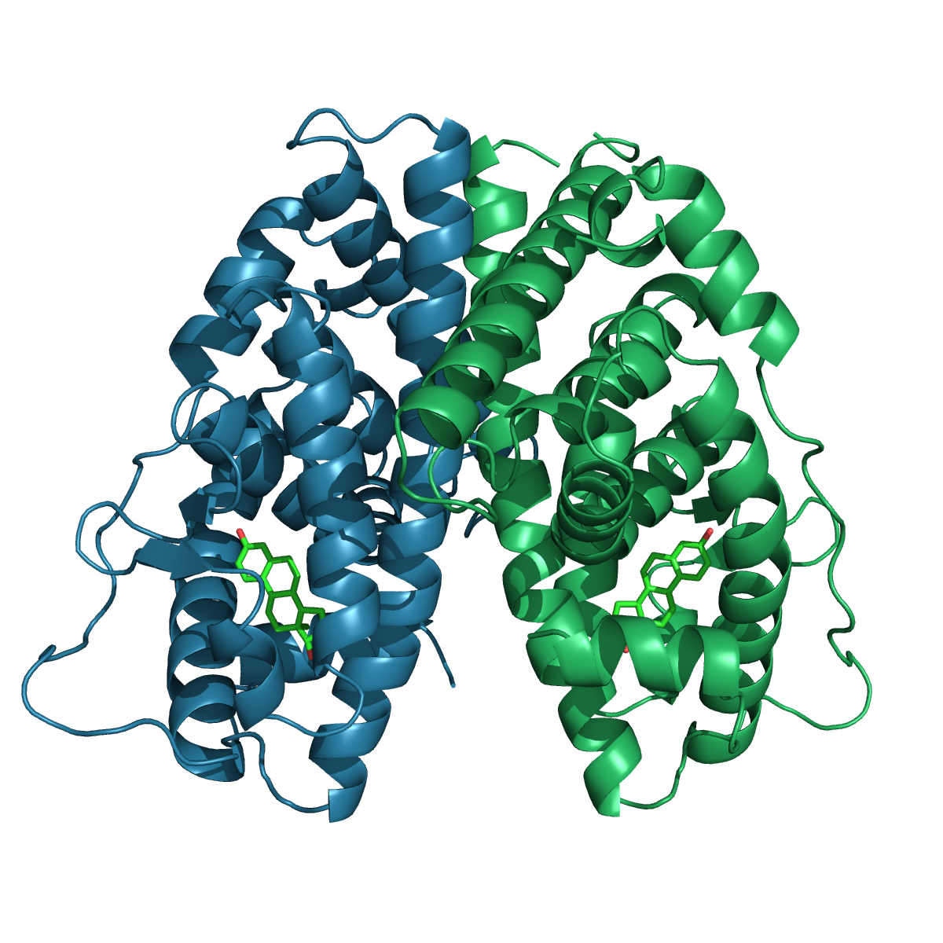

Estrogen Receptor in Breast Cancer
Estrogen
binding
Overstimulated Cell Growth
DNA binding

Slide 4
Small molecule library
First screening
Inhibitors
Optimisation Screening
Validated leads

