Slide 1







Final Presentation
Leonardo Navarro
25/03/2024

Slide 2



OUTLINE
Executive Summary
Introduction
Methodology
Results
Visualization – Charts
Dashboard
Discussion
Findings & Implications
Conclusion
Appendix

Slide 3

EXECUTIVE SUMMARY
Summary Of Methodologies
Data Collection via API, Web Scraping
Data Wrangling
Exploratory Data Analyses
Data Visualization with Python
IBM Cognos to Data Visualization
Summary of Results
Exploratory Data Analyses
Interactive Dash Boards
Final analysis and Conclusion

Slide 4

INTRODUCTION
Project Background and Context
The goal of this project is to show the current most relevant language for programming and the most relevant language for the coming years. The most used database and the one we most want to work with next year.
Problems that you want to find Answers
What is the most relevant program language and the most relevant language for next year?
What are the top 10 most relevant databases and the 10 most relevant databases for the next year?

Slide 5

METHODOLOGY
Summary Of Methodologies
Data Collection via API, Web Scraping
Data Wrangling
Exploratory Data Analyses
Data Visualization with Python
IBM Cognos to Data Visualization

Slide 6
RESULTS
The research shows that the top five languages work with is JavaScript, HTML/CSS, SQL, PowerShell, and Python in this respective sequence, and for the next year the programmers want to learn or migrate to a new language the top five languages are JavaScript, HTML/CSS, Python, SQL, TypeScript. We can see that the first position continued with JavaScript and HTML/CSS, but Python nowadays is the fifth language most used, for next year will jump for the third position.
In this research, we Analysed the top 10 most relevant databases which show MySQL is the most used today for the next year is PostgreSQL.
I hope this research helps people who are initiating this career and make the best choice to start.

Slide 7
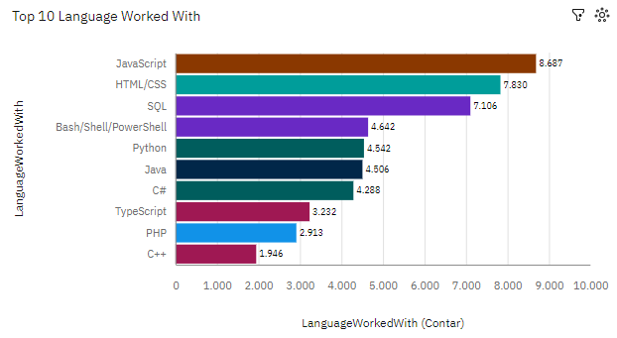
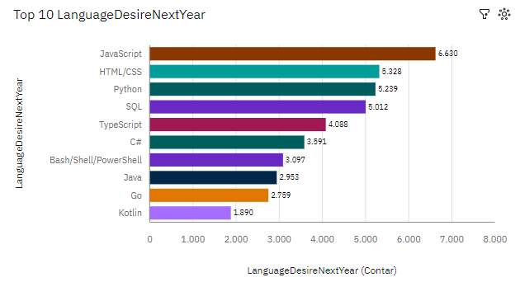
PROGRAMMING LANGUAGE TRENDS
Current Year
Next Year

Slide 8
PROGRAMMING LANGUAGE TRENDS - FINDINGS & IMPLICATIONS
Findings
JavaScript and HTML/CSS
Python
SQL
Implications
This language will keep in first and second position for the next year
Python is nowadays the fifth language most used, but next year will move to the third position, a lot of this is the demand for jobs for data analyses and scientist
SQL was entered in this list because of the high volume of jobs for data analysts available in the market

Slide 9
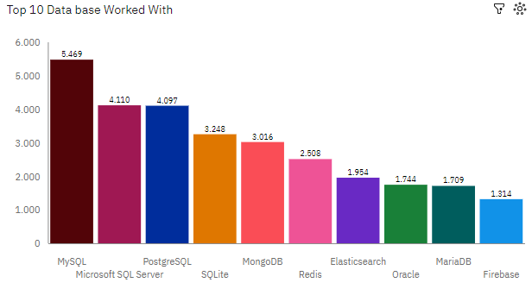
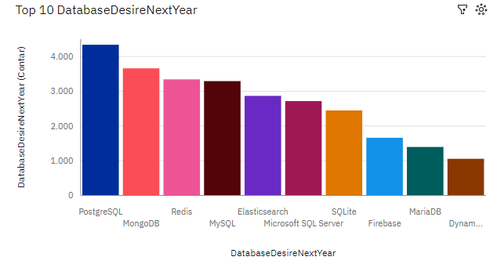
DATABASE TRENDS
Current Year
Next Year

Slide 10
DATABASE TRENDS - FINDINGS & IMPLICATIONS
Findings
MySQL
PostgreSQL
MongoDB
Implications
MySQL is the most used database currently, but in the coming years its use will fall, it will move from the first position to occupy the fourth most used database position in the coming years.
PostgreSQL is currently in third place, but in the coming years it will be the most used and studied database
MongoDB is an excellent database, currently in fifth place and in the coming years it will be the second most used

Slide 11

DASHBOARD
README.md/IBM Cognos Analytics test week 5.pdf at main · Leonavarro93/README.md (github.com)

Slide 12
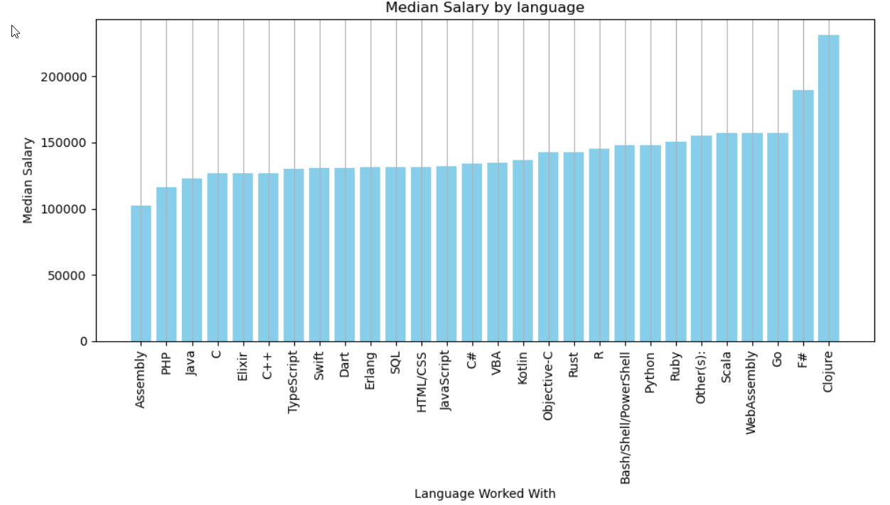
POPULAR LANGUAGES

Slide 13

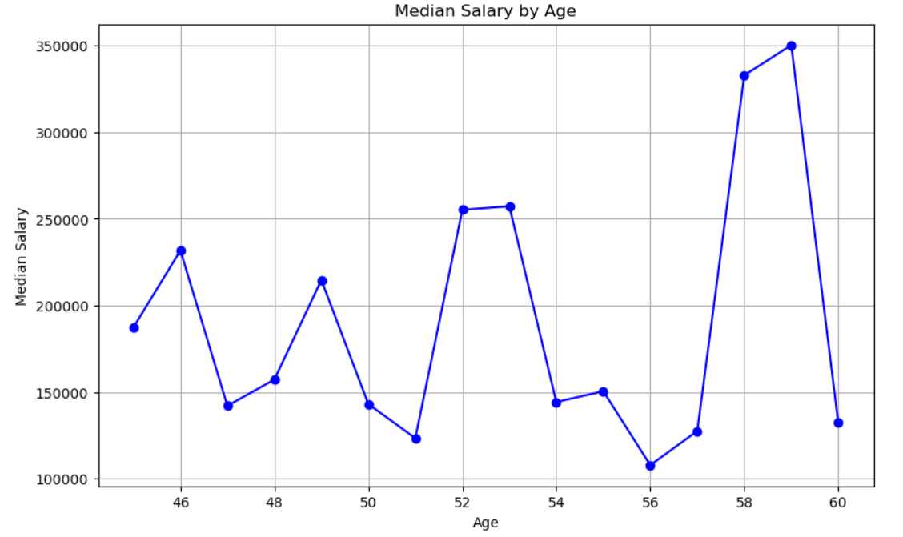
APPENDIX

Slide 14

CONCLUSION
In conclusion, JavaScript and HTML/CSS will be kept in the first and second position of most used program languages for the next years.
Python assumes the third position followed by SQL, in which we can see an increase in the work market looking for Data Analyst, Data Scientist and Python is among the 10 most well-payed languages
Database Trends - MongoDB is an excellent database, currently in fifth place and in the coming years it will be the second most used

