Slide 1


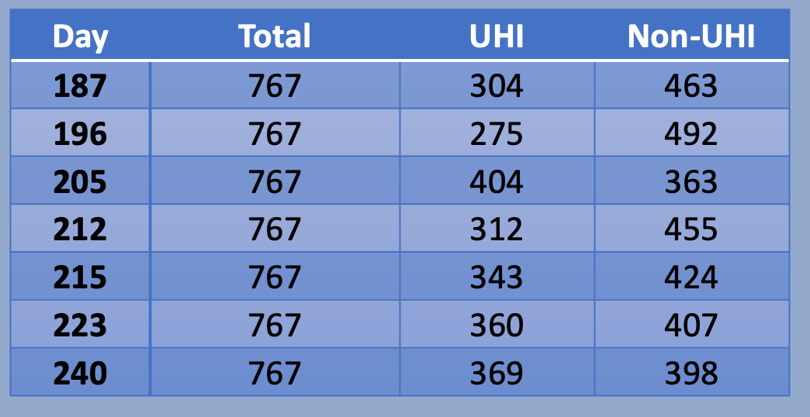
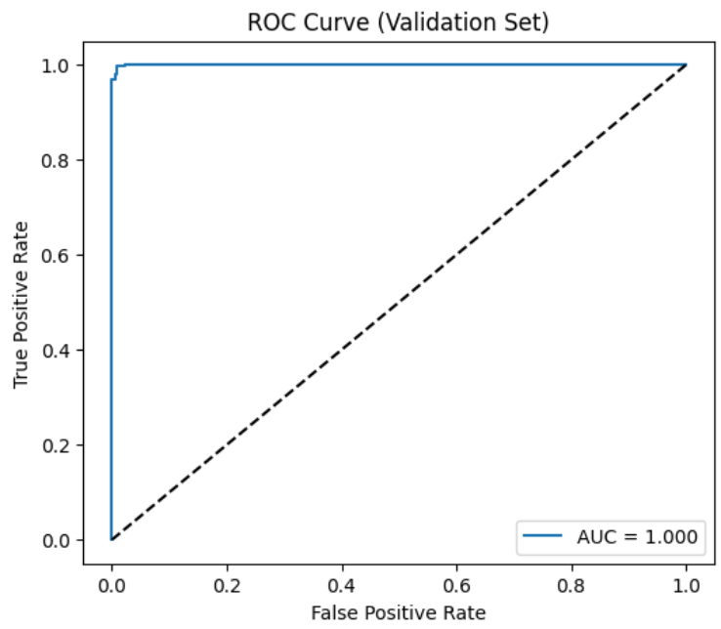
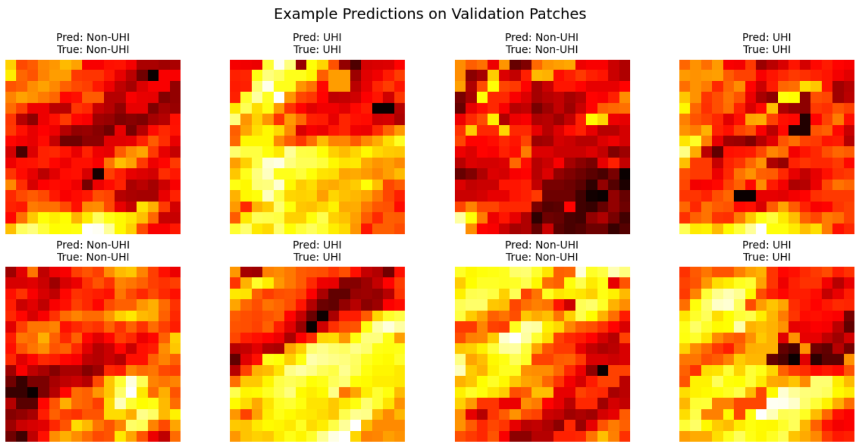
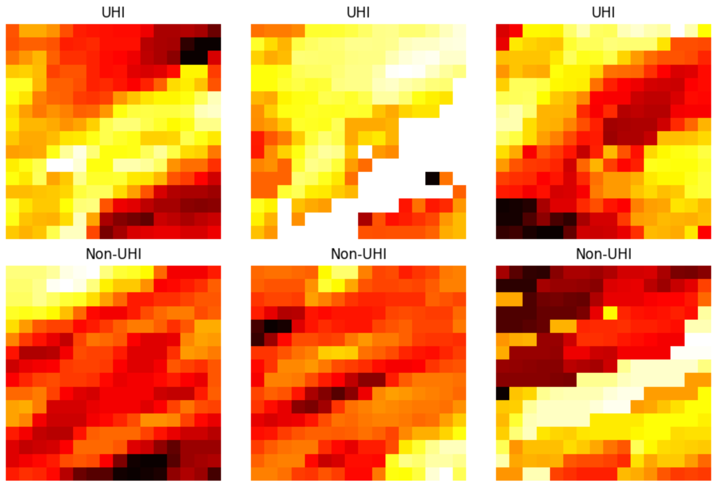
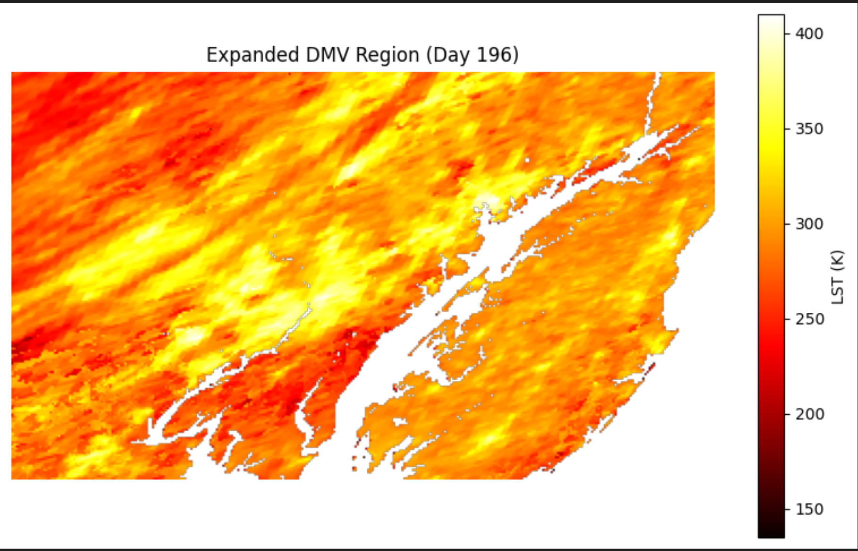
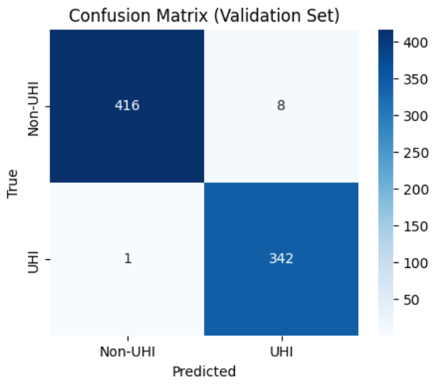
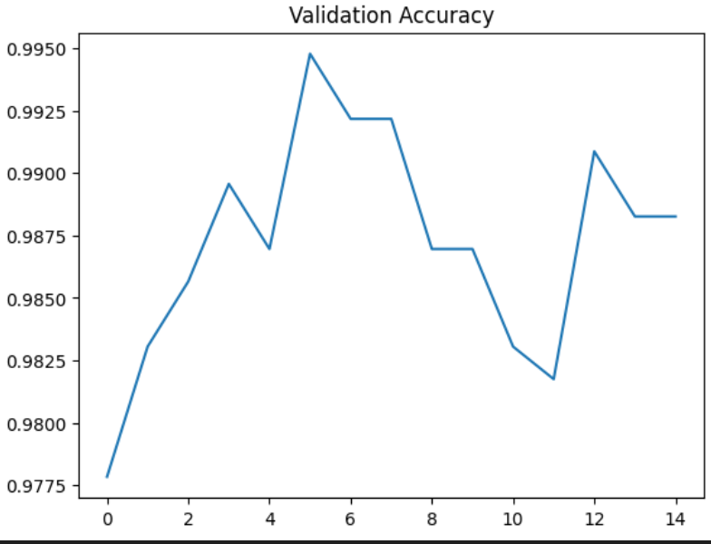
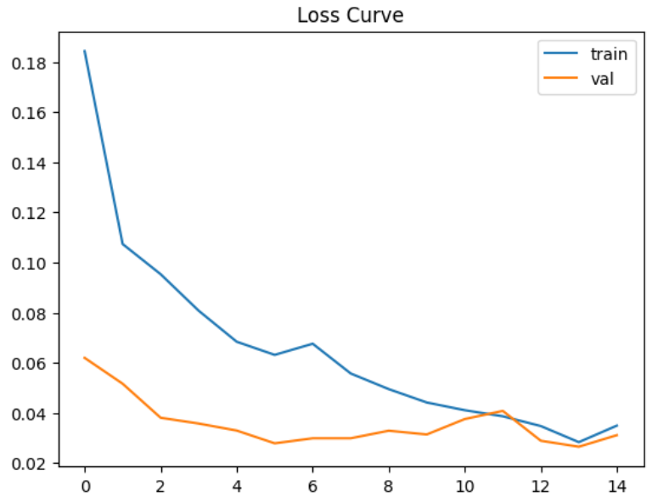
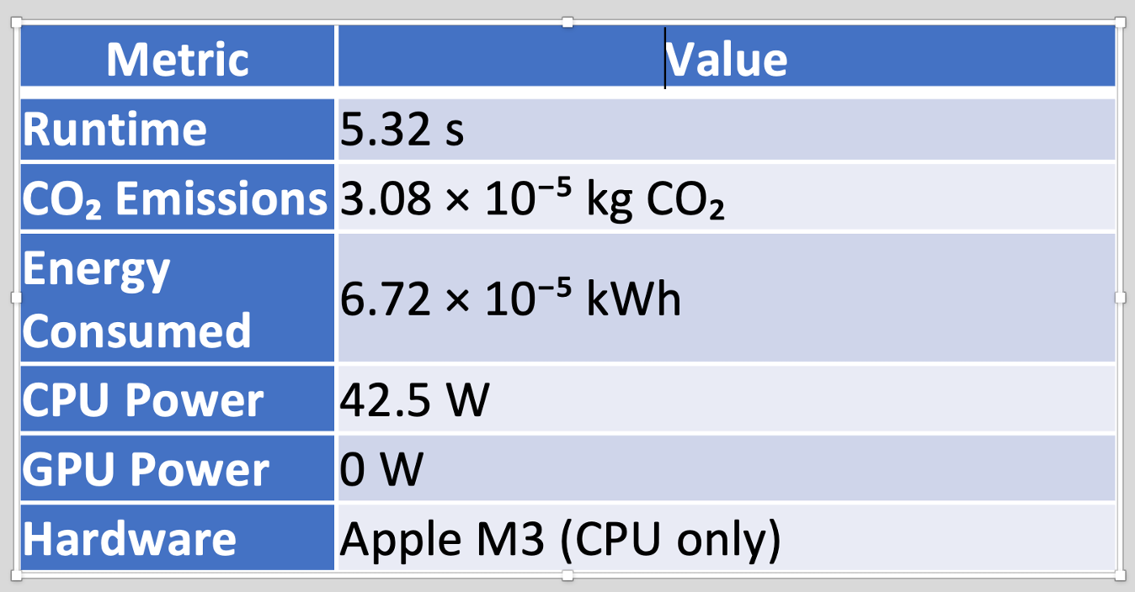
Urban Heat Island Detection from Satellite Imagery using Convolutional Neural Networks
Yuang Li
Instructor: Dr. Daniel Loehr
DSAN 5550-Data Science & Climate Change
Introduction
Preprocessing Pipeline
Clip ROI and mask invalid (≤0) temperature readings.
Drop patches with >30% NaN, fill remaining NaNs using patch means.
Combine patches from multiple training days (187, 196, 205, 212, 223, 240); use day 215 exclusively for validation.
Apply Z-score normalization using training-set mean and std.
ROC Curve
The ROC curve shows AUC = 1.000, indicating near-perfect class separability on the validation set.
Urban Heat Islands (UHIs) are localized hotspots in urban environments where land surface temperatures are significantly higher than those of surrounding rural areas. These temperature differences arise from reduced vegetation, dense impervious surfaces, and human activity. As climate change becomes even worse, UHIs exacerbate heat-related health risks, increase energy consumption, and affect long-term urban sustainability.
Therefore, detecting and analyzing UHIs is important for urban climate adaptation and planning. Satellite-derived Land Surface Temperature (LST) data provides a consistent and global method for detecting high-temperature regions. In this project, we apply Convolutional Neural Networks (CNNs) to automatically classify heat-prone regions from LST imagery, enabling data-driven decision-making for mitigation strategies such as green-space expansion, cool-roof initiatives, and heat-resilient infrastructure planning.
Methodology
This confirms that the learned features produce discriminative, stable predictions across temperature variations.
Overview
In this project, we train a CNN model to classify each 16 × 16 single-channel LST patch as UHI (1) or non-UHI (0).
Discussion
The CNN successfully learns spatial thermal patterns instead of relying solely on pixel-level thresholds.
Results generalize well to an unseen day (Day 215) despite daily LST variations, demonstrating temporal robustness.
Spatial aggregation of patch outputs could support city-scale UHI mapping and heat mitigation planning.
Model Pipeline
Input: normalized 16×16 LST patch
Two convolutional blocks for spatial feature extraction
Fully connected classifier → two-class logits
Softmax probability for UHI vs non-UHI
Dataset & Preprocessing
Data Source
We use the 1 km Global Land Surface Temperature (LST) Dataset (2020), published by Iowa State University on Figshare. Each GeoTIFF file provides daytime land surface temperature in Kelvin at a 1 km² spatial resolution, enabling large-scale and consistent thermal analysis across urban regions.
Evaluation & Results
Limitations
Labels are derived from a fixed 303 K threshold, rather than human-validated UHI ground truth.
1 km MODIS resolution is coarse and cannot capture neighborhood-scale or street-level micro-UHIs.
Cloud contamination and missing pixels require NaN handling that may introduce slight bias.
Region of Interest (ROI)
Classification Metrics
The CNN accurately distinguishes coherent UHI clusters from non-UHI regions, with near-perfect detection across both classes.
A subset covering the DMV area is extracted for this project. The raw LST image is clipped to the desired geographic boundary before model training.
Class | Precision | Recall | F1-score | Support
Non-UHI | 1 | 0.98 | 0.99 | 424
UHI | 0.98 | 1 | 0.99 | 343
Future Work
Incorporate multi-day LST sequences using temporal models (LSTM, 3D CNNs, Transformers).
Explore higher-resolution datasets (e.g., Landsat 30m, ECOSTRESS 70m) for finer UHI detection.
Combine LST with urban morphology features (impervious surface, building density).
Test cross-city generalization by applying the model to multiple metropolitan regions.
Confusion Matrix
The model achieves high sensitivity and high specificity , confirming robust generalization to unseen days.
Patch Generation
Clip each MODIS LST image to the DMV urban region.
Extract 16 × 16 patches with stride = 8, producing dense localized thermal samples.
Each patch captures a fine-scale spatial temperature pattern for supervised learning.
Label Creation
Apply a 303 K (~30°C) threshold.
A patch is labeled UHI (1) if >50% of valid pixels exceed 303 K; otherwise non-UHI (0).
This converts the task into a binary classification problem reflecting local heat intensity
Carbon cost
Using CodeCarbon, we tracked energy usage and CO₂ emissions during CNN training.
The model is extremely lightweight, producing near-zero carbon emissions and is suitable for frequent retraining or deployment in low-resource settings.

