Slide 1
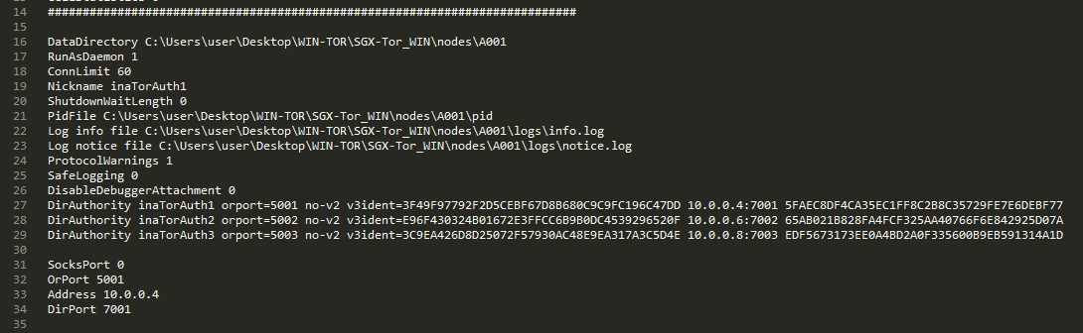
Change these to appropriate path
Copy and paste other machines fingerprint
Change these to appropriate port number and address

Slide 2
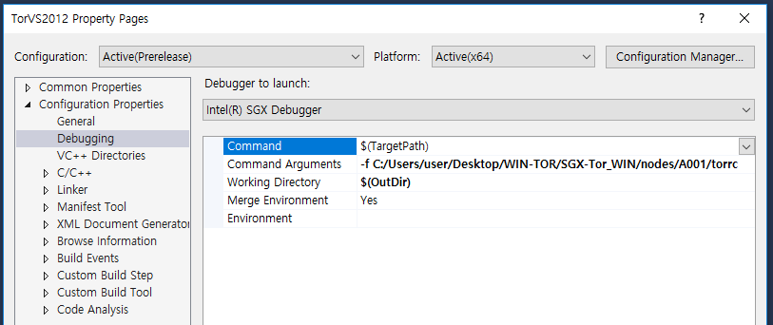
Set command Arguments.
Authority -> A00x/torrc, Client ->C00x/torrc

