Slide 1
Notes:
Plane flying through

Slide 2


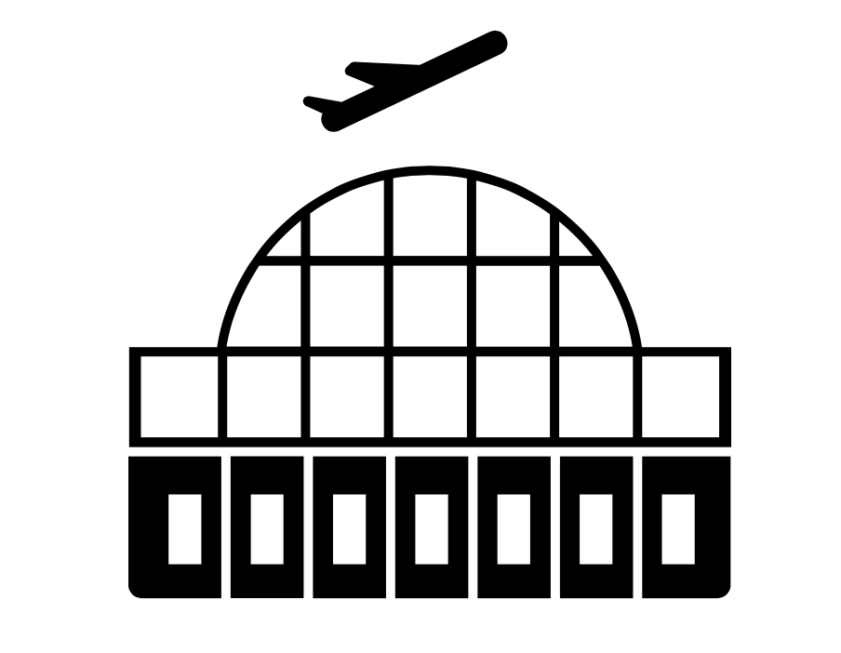



CHICAGO
NEW YORK CITY

Slide 3
Insert Video Delay Animation.
First single flight
Then whole table
Notes:
Delayed Animation

Slide 4

CHICAGO
NEW YORK CITY

Slide 5


CHICAGO
NEW YORK CITY

Slide 6








AIRPORT
WEATHER
AIRLINE
TRAFFIC
SECURITY
REPAIRS

Slide 7
Insert Tableau Airport Analysis Video

Slide 8
Insert Tableau Airport Analysis Video

Slide 9
Insert Weather Animation for JFK snowfall

Slide 10
Insert Tableau Airline Analysis Visualization

Slide 11
Show delay in terms of time of day

Slide 12
Any ideas or skip?

Slide 13
Show that UA carrier delays depend on age of aircraft

Slide 14
Add predictive models

Slide 15
Final Recommendations for Bob

Slide 16
Video of Infoboard turning from “delayed” to “in time”

