Slide 1
Absolute camera localization Leonhard Feiner, Alexander Ziller

Slide 2
Introduction
Input:
Test time: Camera images (stereo)
Train time: Semantic labels, Poses, (Depth Images)
Output:
Camera position and orientation (3x translation, 3x log quaternion)
Goal:
Test if multitask learning with semantic segmentation improves camera localization accuracy
Motivation:
Multiple robotics applications
Autonomous driving

Slide 3
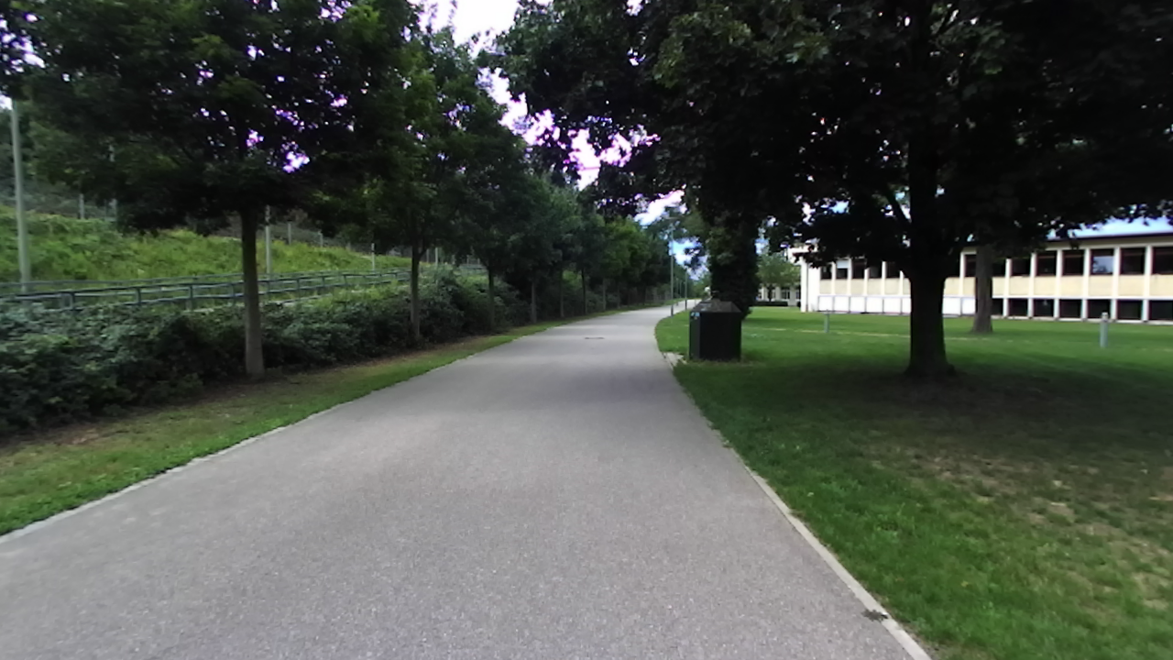
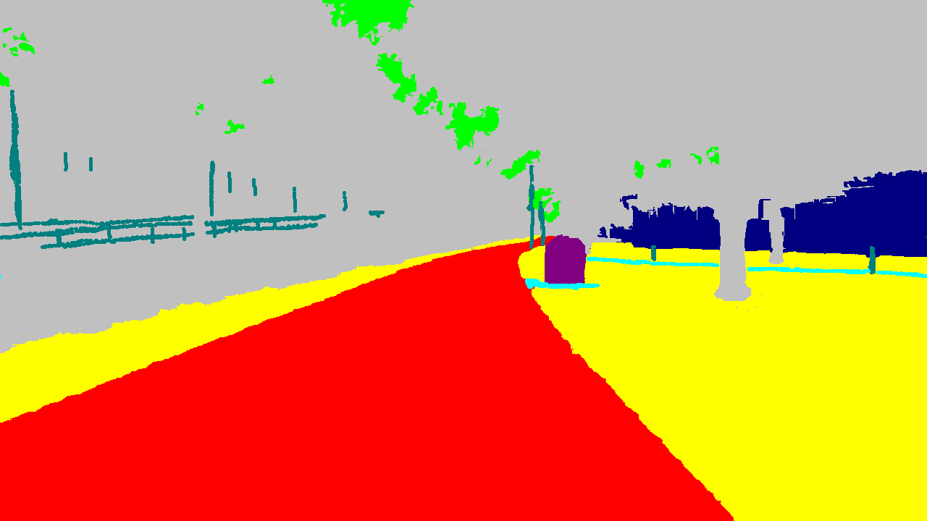
Dataset
Dataset we use is called DeepLoc
Consists of:
Stereo Images
Depth Image
Semantic labels (every second image)
Poses (ground truth)
58 GB overall
2737 (1367) training points
1173 (586) validation points

Slide 4
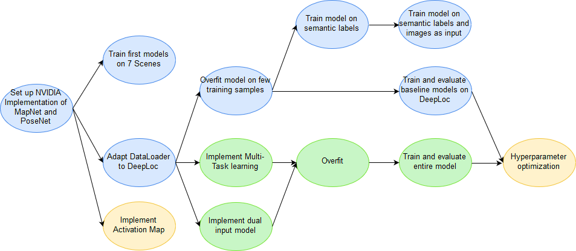
Project plan

Slide 5
Original architecture
input
image
feature extractor
pose decoder
loss
Notes:
Require semantic labeles for inference

Slide 6
Dual input architecture
concatenation
reuse of MapNet
input
image
feature extractor
pose decoder
loss
input
semantics
feature extractor
Notes:
Require semantic labeles for inference

Slide 7
Multi-task architecture
reuse of MapNet
semantics decoder
Feature extractor (ResNet-34)
input
image
loss
pose decoder
Notes:
Require semantic labeles for inference
Multitask doesn‘t require semantic labels for inference

Slide 8
Preliminary results
A few remarks on results we give now:
Same number of images for baseline and our models is used
Initialization influences results significantly
No hyperparameter optimization so far
Notes:
we use equal amount of images for baseline and our models
initialization has a big effect on results
we need to train multiple models
Either use mean and variance of results
Or show best of them
we haven't performed hyperparameter optimization so far
not comparable to papers yet

Slide 9
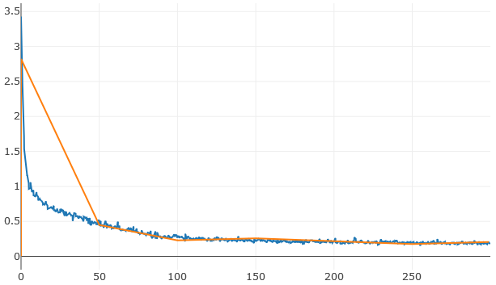
Preliminary results
PoseNet on DeepLoc
Validation Error Loss curve
Our
^{[1]} VLocNet++
Training
Validation
Epochs
^{[1]} Radwan, Noha, Abhinav Valada, and Wolfram Burgard. "Vlocnet++: Deep multitask learning for semantic visual localization and odometry." arXiv preprint arXiv:1804.08366 (2018).
Notes:
Here You can see our result of posnet in comparision with the ones mentioned in the vlocnet++ paper
One hand translation worse, ohter hand rotation bit better
Maybe with hyperparametertrainnig
On the one hand our translation a bit worse than the results from the paper but on the other hand rotation is a bit better
Maybe with some hyperparameter tuning we could reach the results

Slide 10
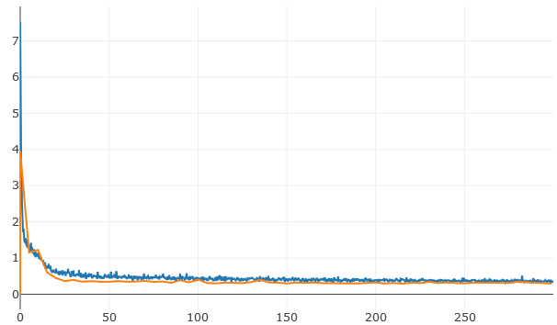
Preliminary results
MapNet on DeepLoc
Validation Error Loss curve
Training
Validation
Epochs
Notes:
Mapnet should be better than posenet, <> don‘t differ much
These Mapnet results can be seen as our baseline, because
We use mapnet as base for our models

Slide 11
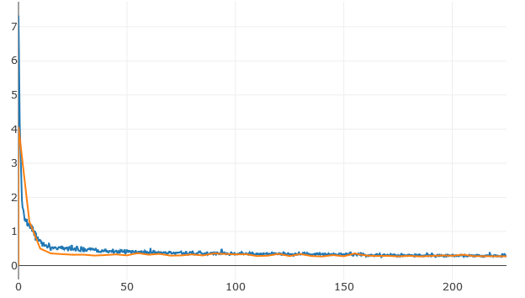
Preliminary results
Dual-Input on DeepLoc
Validation Error Loss curve
Training
Validation
Epochs
Notes:
We implemented several models with dual input
They use images and semantic labels as input of the network
One problem: We require pretrained weights for the feature extractor, because we have only >1000
, it is somehow difficult to include an extra input
Therefore we tried different possibile approaches
This was our best result
All errors are slightly smaller than mapnets errors

Slide 12
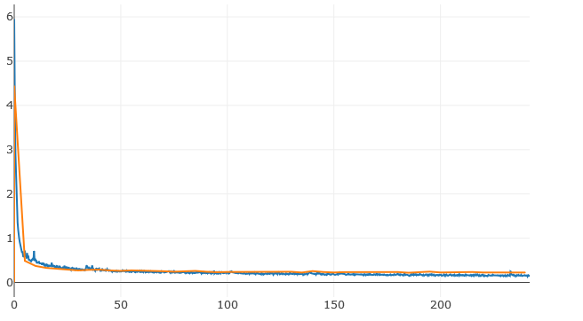
Preliminary results
Multitask on DeepLoc
Validation Error Loss curve
Training
Validation
Epochs
Notes:
Our multitask approach improved the results a lot
It has two outputs, one for the poses and one for the semantic labels
For example the median translation error was above 3 m for other models
Here we have a translation error of 1 m

Slide 13
Preliminary results
Overview validation errors
^{[1]} Radwan, Noha, Abhinav Valada, and Wolfram Burgard. "Vlocnet++: Deep multitask learning for semantic visual localization and odometry." arXiv preprint arXiv:1804.08366 (2018).
Notes:
This table shows a overview of all models
Additionaly we added the results of VLocNet and VlocNet++
They used a more complicated network architecture and more features like depth images.

Slide 14
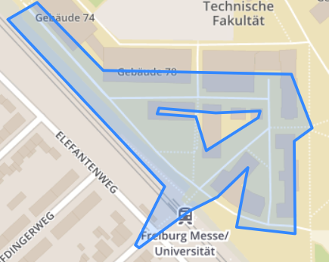
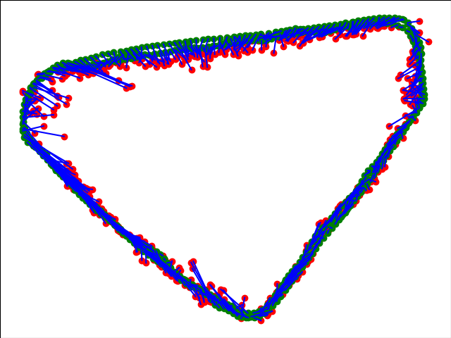
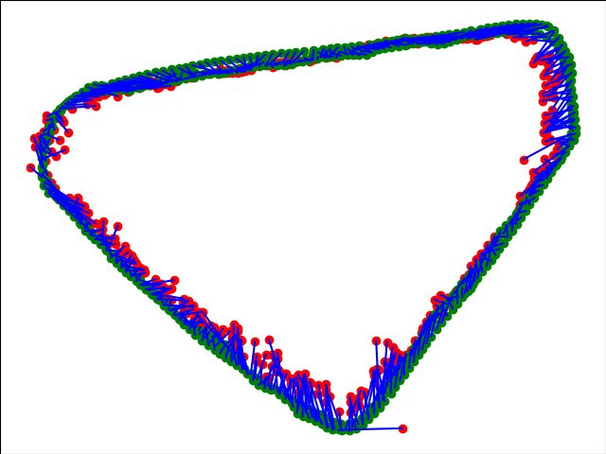
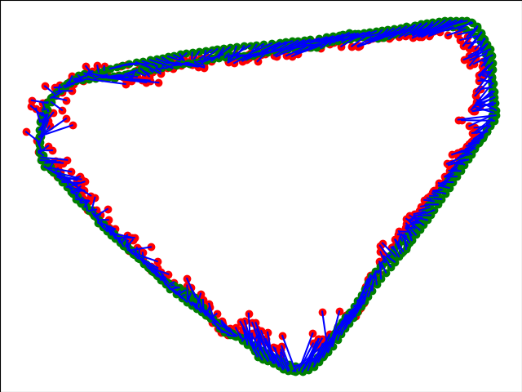
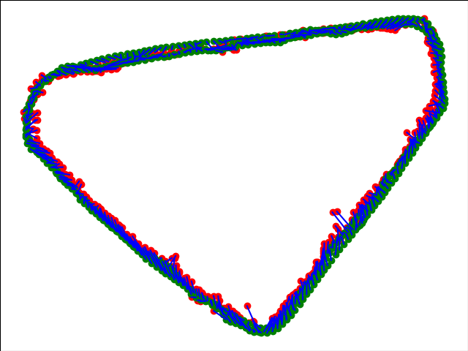
Preliminary results
PoseNet
MapNet
Dual-Input
Multitask
Notes:
pose graphs
The green points are the gt
The red points are the predicted locations
Blue lines connect a predictino with ist associated gt

Slide 15
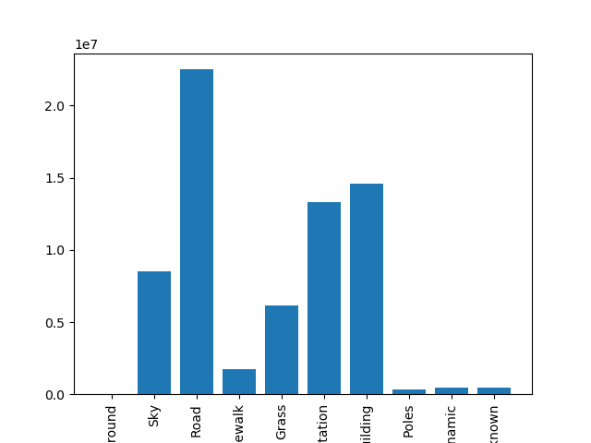
Preliminary results
Segmentation results
Segmentation results are relatively independent of pose regression
Multi-task model and semantic model achieve similar results
Notes:
Additionaly evaluated segmentation results
Therefore we took the multitask arichitecture and removed every part which is only used for pose regression as comparision
Values quite similar
Seems that multitask is slightly better in most categories
To less to claim that poses are helpful for semantic labeling

Slide 16
Preliminary results
Problems we encountered
Major error in Dataset until 2 weeks ago
Training was not deterministic
Datasets and code originally do not include test set
Notes:
Problems
the results of our current code on the old dataset are really bad
Median rotation errors twice as high, mean errors round about 4 times
Training was not deterministic
Same config produced different result
Variation quite large
Datasets and code originally do not include test set
Other papers use same set for test and validation
To assure comparability we did not adjust this
However, it is bad practice

Slide 17
Conclusions
Semantic information can improve pose regression
Useful as additional semantic input or output
Dual-input profits less from pretraining
Multitask gains additional insights about environment
Pose prediction improves due to enforced generalization
Notes:
Dual-input and Multi-task model architecture perform well
However we have to optimize hyperparameters to push all architectures to their limits
To Do: hyperparameter optimization
So the goal of the project is to investigate how we can integregate the semantic information into the localization task, and to find out their relationship right? So that's also why i hope you can compare a bit simply learn semantic VS multitask. And try to explain on the results.

Slide 18
Thank you

