Slide 1


ErebosGheil regnum
Leonidas Ttofari

Slide 2

Introduction
Background:
Rapid evolution of the gaming industry.
Rise of visual novels emphasizing narrative and player choices.
AI's influence on game development.
Objective:
Explore integration of AI tools in visual novel development.
Create an engaging, interactive game using AI.

Slide 3

Project Overview
Game Title: Erebos Gheil Regnum
Genre: Visual Novel
Setting: Fantasy-themed academy
Key Components:
Welcoming home screen
Name customization screen
Dialogue system
Comprehensive scene management
Credits screen

Slide 4
Methodology
Preproduction:
Defining game concept, storyline, characters, and design.
Production:
Roles: Programmer, writer, artist, and designer.
Tools: Unity, Visual Studio, Photoshop, Aseprite, Git.

Slide 5
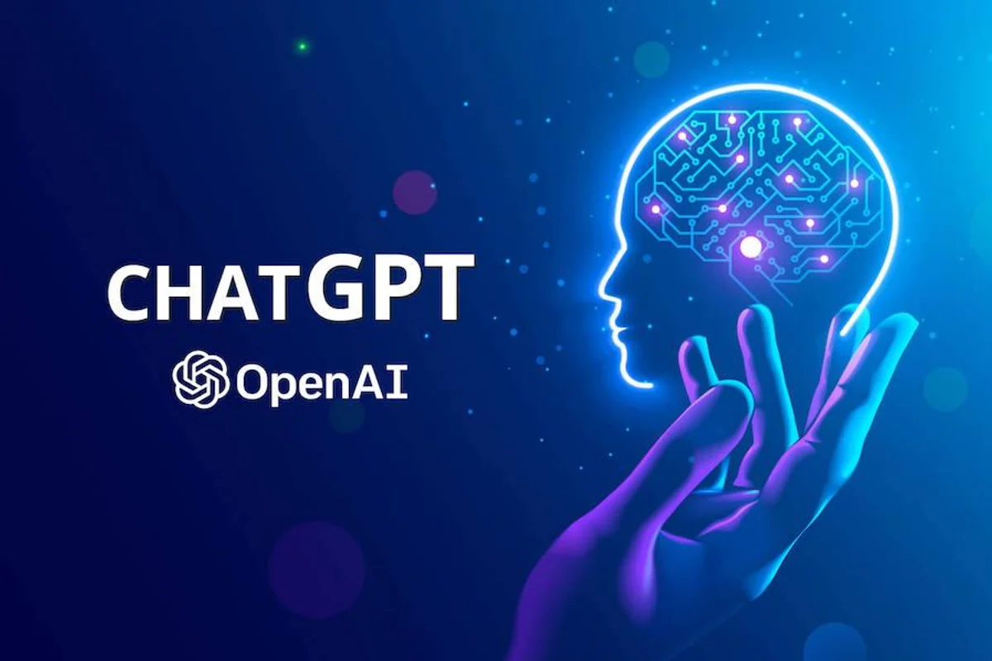

AI Tools Integration
ChatGPT-4:
Dialogue improvement and coding assistance.
Stable Diffusion:
High quality character and scene artwork.
Suno and Soundraw:
Music composition.
AI Background Removers:
Efficient background removal for assets.

Slide 6
Game Architecture
Components:
Home Screen: Entry point with game options.
Name Customization Screen: Personalized player experience.
Dialogue Screen: Core visual novel experience with interactive buttons.
Credits Screen: Acknowledgments and roles.

Slide 7
Dialogue System
Structure:
Scene management with transitions.
Dynamic character images and backgrounds.
Typewriter effect for dialogue text.
User Interface:
Buttons for dialogue control, saving/loading, and settings.

Slide 8
Results and Discussion
Gameplay Experience:
Immersive narrative and character interactions.
User Feedback:
Positive reception, areas for improvement identified.
Performance:
Optimized for various hardware configurations.
Challenges and Solutions:
Asset quality consistency, dynamic dialogues, sole developer workload.

Slide 9
Conclusion
Key Findings:
AI tools significantly enhance game development.
Effective integration leads to a dynamic and engaging player experience.
Implications:
AI's potential in game development and other interactive content sectors.

Slide 10
Future Directions
Next Steps: Further refinement based on user feedback.
Exploration of additional AI tools for game development.
Potential expansions and new projects leveraging AI.

