Slide 1
DEPLOYING PHP APPLICATION USING AWS ELASTIC BEANSTALK
External training <EPAM>
made by: Nevmerzhitskiy Aleksandr

Slide 2



What will we use?

Slide 3







commit
webhook
Developer
GitHub
Jenkins

Slide 4
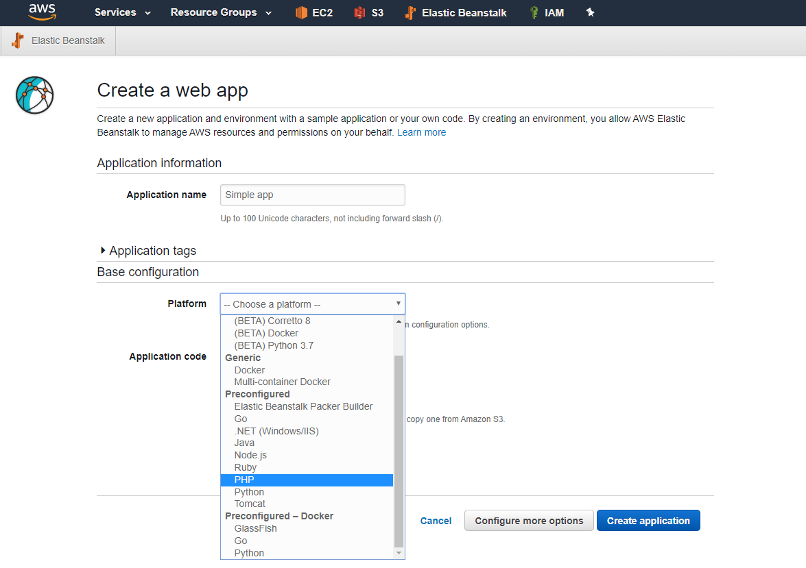
AWS Elastic Beanstalk provides preconfigured platforms that support running web applications developed for specific programming languages, frameworks, and web containers. Elastic Beanstalk offers one or more platform versions for each platform.

Slide 5
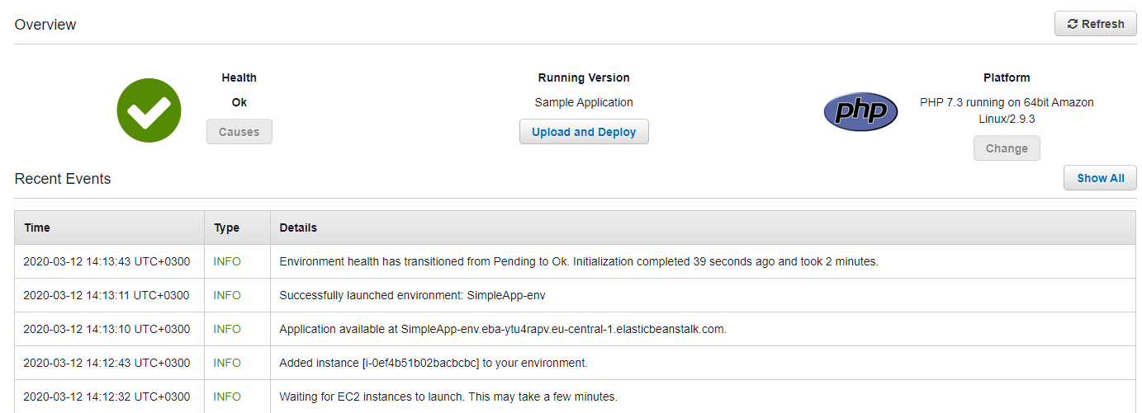
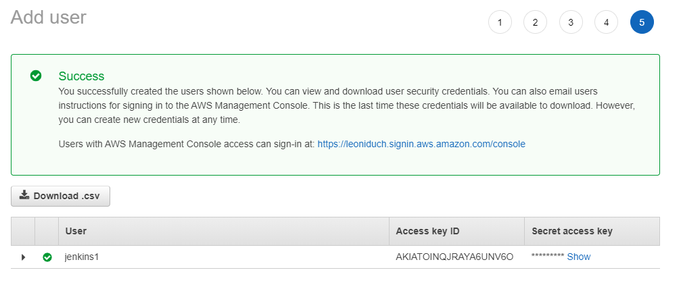
Preparations:
Setting all credential for Jenkins:

Slide 6
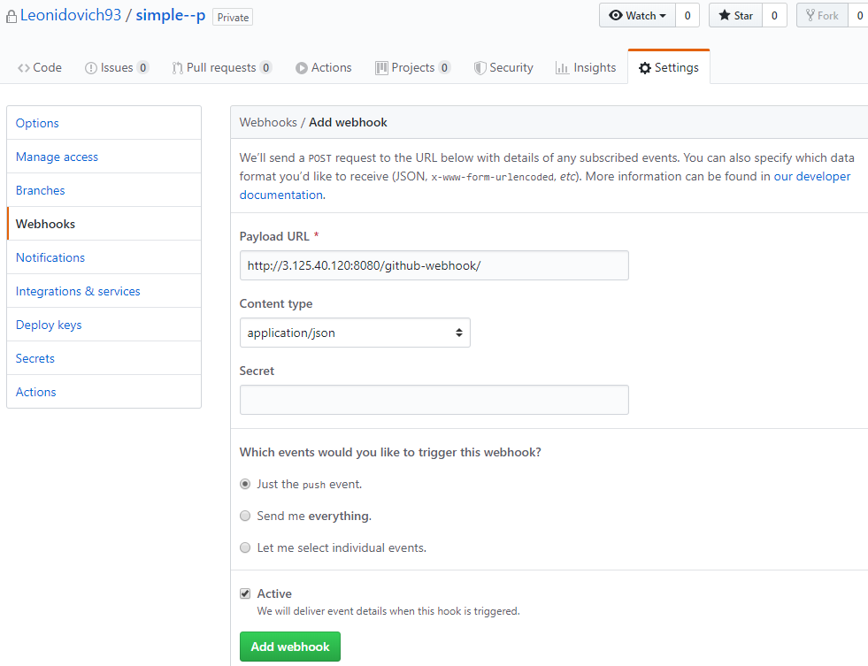
Adding webhook for Jenkins

Slide 7
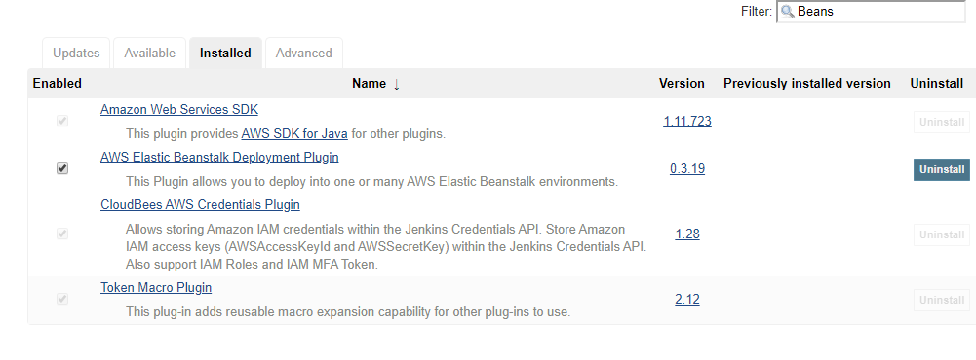
Add AWS Elastic Beanstalk Deployment Plugin in Jenkins.
This Plugin allows you to deploy into one or many AWS Elastic Beanstalk environments.

Slide 8
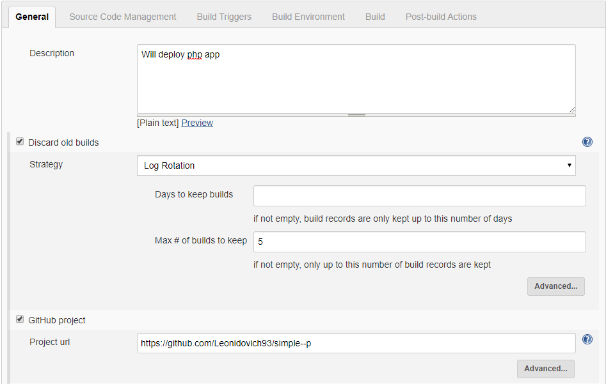
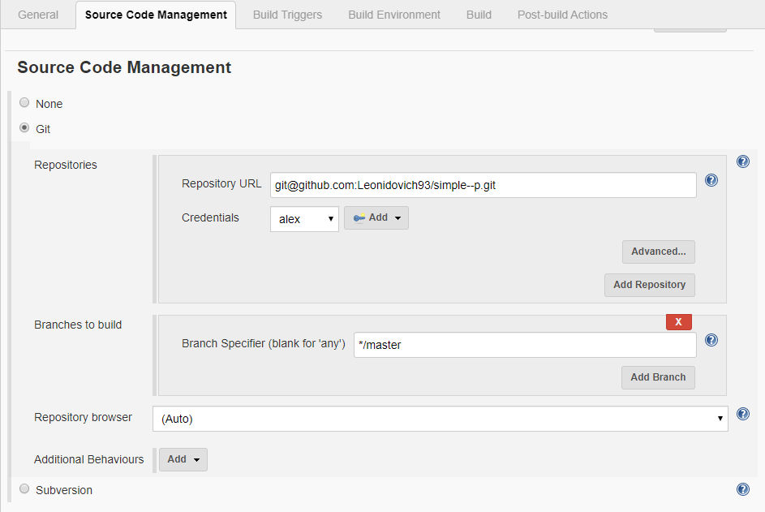
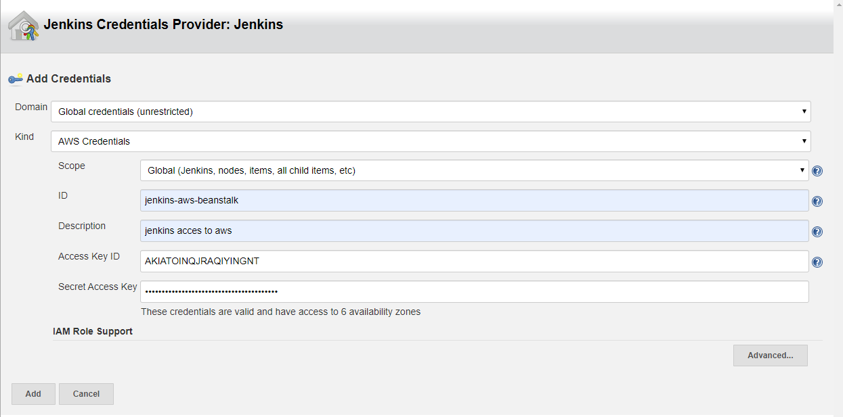
Creature Jenkins job:

Slide 9
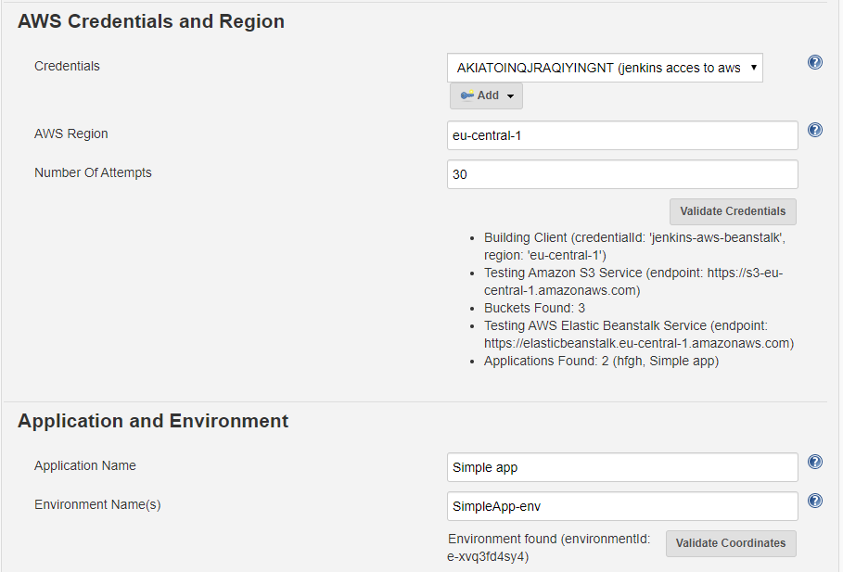
Adding AWS Credentials:

Slide 10
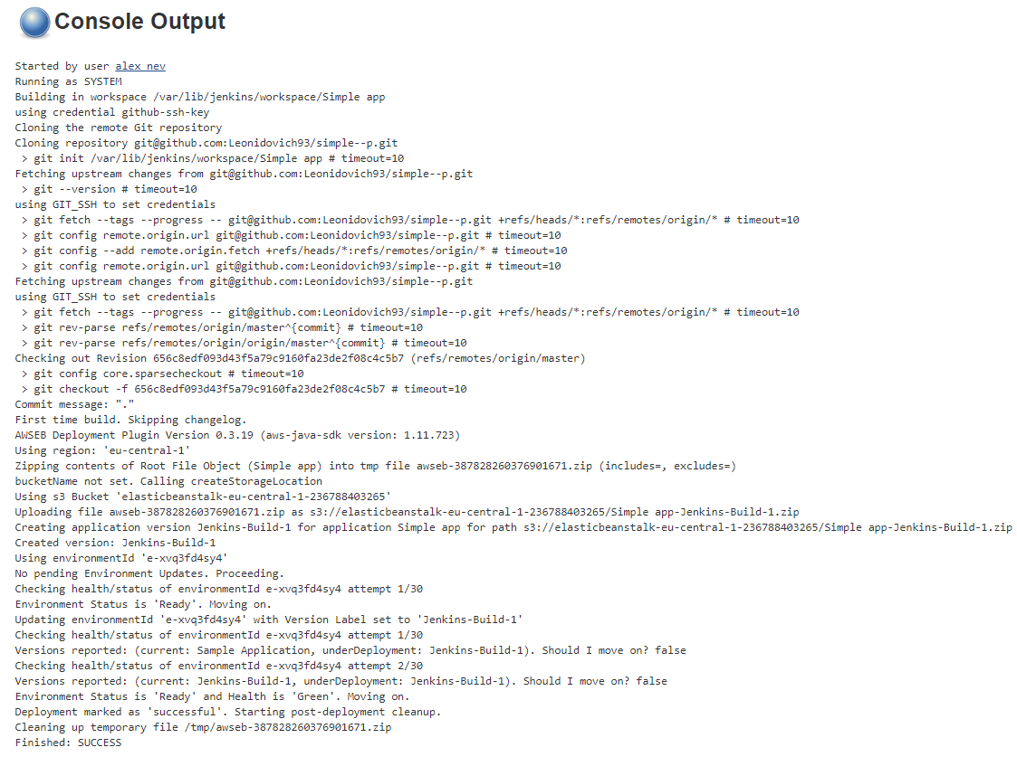
Waiting for deployment…

Slide 11
THE END
THANKS FOR ATTENTION

