Slide 1


























Slide 2











Slide 3























Slide 4













x = 5 print(x > 0 and x < 10)

Slide 5
























Slide 6




Slide 7






































Slide 8













Slide 9
Bit and byte appear to be very similar terms but there is a vast difference between them. They are the units that are used in computers. It is used in deciding the speed of data transmission between CPU and register, RAM and CPU, and so on. At the same time, it also decides the speed with which data is received in networking.
Example: 2Mbps or 1Gbps.
What is Bit?
In computing and digital communications, a bit (short for "binary digit") is the smallest and most fundamental unit of digital information. It can represent one of two possible states, typically represented as: 0 (zero) and 1 (one)
What is Byte?
A byte is a unit of digital information typically consisting of 8 bits. It is the smallest addressable unit of memory in most computer architectures and is commonly used to store a single character (like a letter or number), a small integer, or as a fundamental building block for larger data structures. It is used to represent 2^8 = 256 different values.

Slide 10











































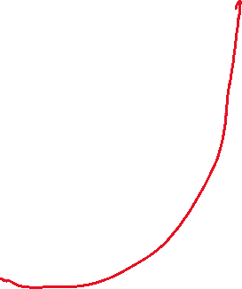










Slide 11


































Slide 12










Slide 13






































Slide 14











Slide 15
























Slide 16

















Slide 17






















Slide 18
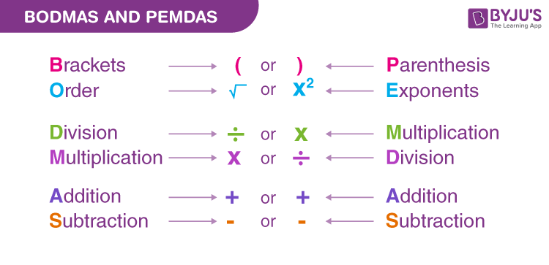

Slide 19






















Slide 20
















Slide 21


























Slide 22



























Slide 23





























Slide 24




















Slide 25























Slide 26
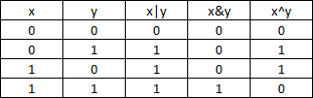





Slide 27



















Slide 28






















Slide 29































Slide 30













