Slide 1













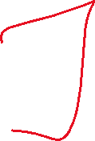















Slide 2




















The map() function applies a given function to all items in an
input list (or any other iterable) and returns a map object (an
iterator). This is particularly useful for transforming data in a list
comprehensively.

Slide 3















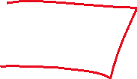

Slide 4
























Slide 5





















Slide 6



















The filter() function constructs an iterator from elements of an
iterable for which a function returns true. It is used to filter out
items from a list (or any other iterable) based on a condition.

Slide 7




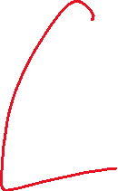



















Slide 8








































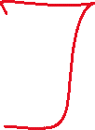

Slide 9











