Slide 1










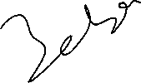




Slide 2






















Slide 3











Slide 4










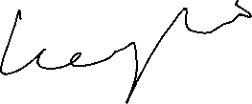















Slide 5


















Slide 6























Slide 7

























Slide 8




































Slide 9
























Slide 10











































conda create -p venv python==3.11
pip install -r requirements.txt

Slide 11






































conda create -p venv python==3.11
pip install -r requirements.txt

Slide 12
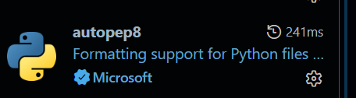

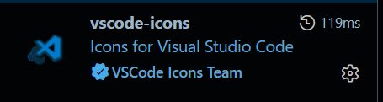
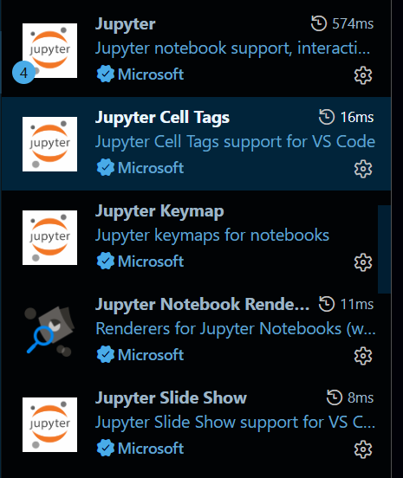
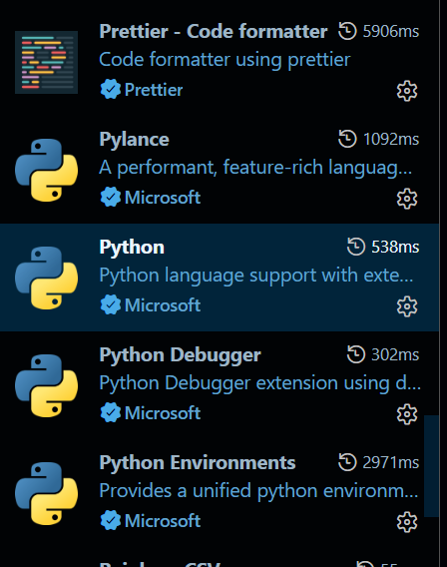








Slide 13


