Slide 1
















Slide 2
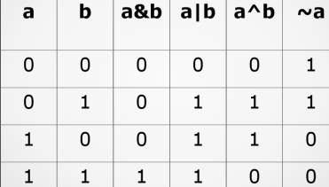

Slide 3















Slide 4




































Slide 5























Slide 6


























Slide 7




































Slide 8
Key Differences:
Composition: Homogeneous is uniform throughout; Heterogeneous varies throughout.
Visibility: Homogeneous components cannot be seen with the naked eye; Heterogeneous components are visible.
Phases: Homogeneous consists of one phase; Heterogeneous consists of two or more phases.
Separation: Heterogeneous mixtures are generally easier to separate physically.
Particle Size: Homogeneous particles are at atomic/molecular level; Heterogeneous particles are larger.

Slide 9




















