Slide 1



























Slide 2








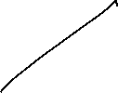











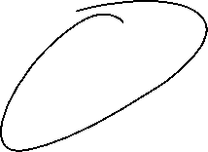














Slide 3





























Slide 4
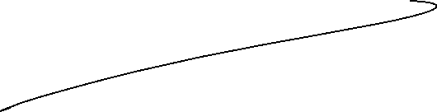


























Slide 5
























Slide 6




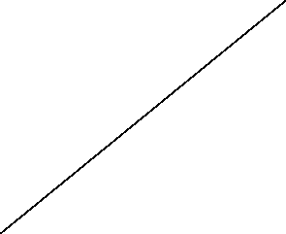

















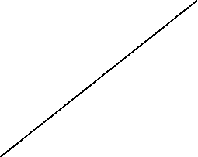

Slide 7
Bias: is the error that happens when a machine learning model is too simple and doesn't learn enough details from the data. It's like assuming all birds can only be small and fly, so the model fails to recognize big birds like ostriches or penguins that can't fly and get biased with predictions.
These assumptions make the model easier to train but may prevent it from capturing the underlying complexities of the data.
High bias typically leads to underfitting, where the model performs poorly on both training and testing data because it fails to learn enough from the data.
Example: A linear regression model applied to a dataset with a non-linear relationship.

Slide 8
Variance: Error that happens when a machine learning model learns too much from the data, including random noise.
A high-variance model learns not only the patterns but also the noise in the training data, which leads to poor generalization on unseen data.
High variance typically leads to overfitting, where the model performs well on training data but poorly on testing data.
https://www.geeksforgeeks.org/machine-learning/underfitting-and-overfitting-in-machine-learning/

Slide 9
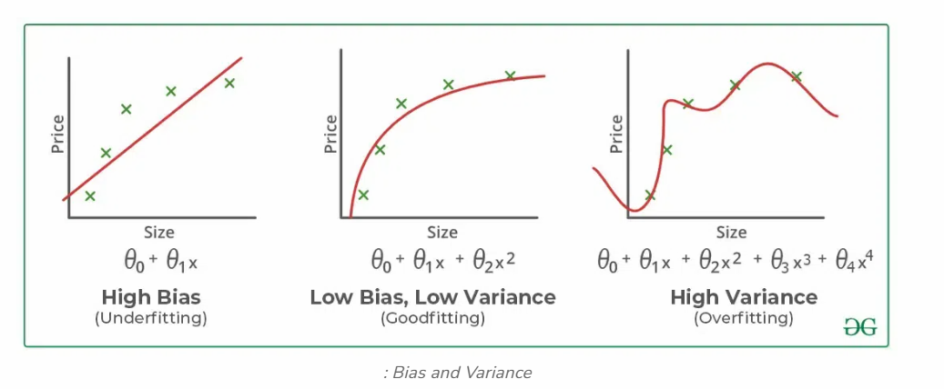

Slide 10















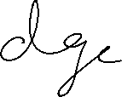














Slide 11










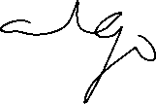


























Slide 12
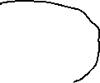







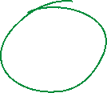
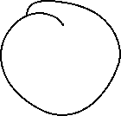










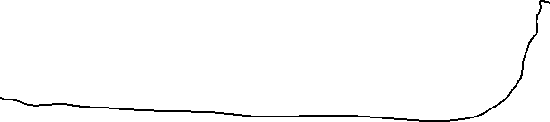


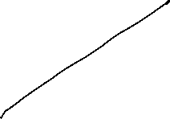













Slide 13


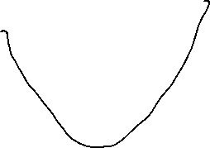




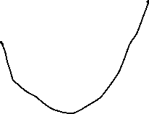







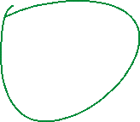







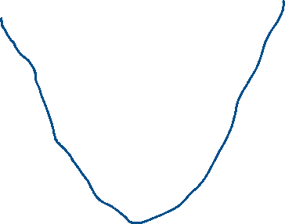




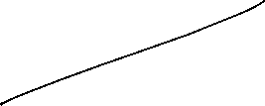


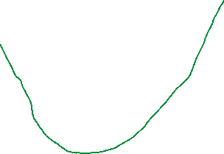





Slide 14

