Slide 1





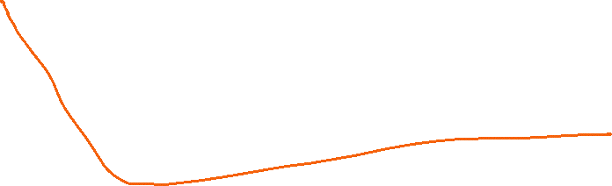







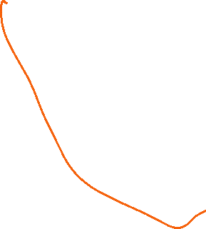



docker pull docker/getting-started
docker run -d -p 80:80 docker/getting-started

Slide 2











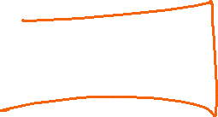













Slide 3









Slide 4





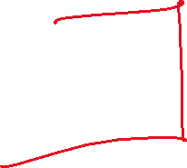



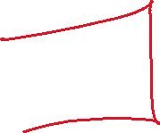


Slide 5
















docker build -t welcome-app .
docker run -p 5000:5000 welcome-app

