Slide 1


















Slide 2
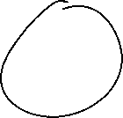



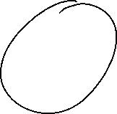
































Slide 3



























Slide 4





















Slide 5


















for i in range(5):
print(i)
count=0
while count<=5:
print(count)
count=count+1

