Slide 1






























Slide 2












Slide 3




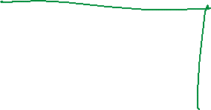






Slide 4



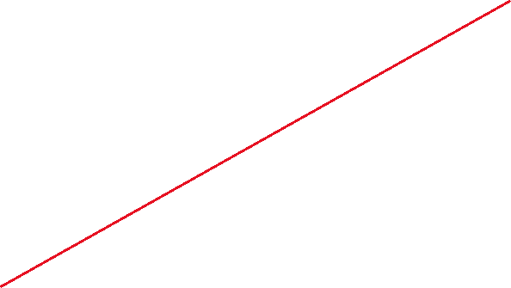














Slide 5


































Slide 6





























Slide 7


























Slide 8



































Slide 9













Slide 10


















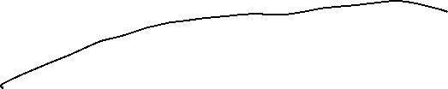


















Slide 11



































Slide 12

































Slide 13

























Slide 14
A confusion matrix is a 2X2 table that summarizes the accuracy of a classification model or diagnostic test by comparing predicted outcomes to actual outcomes. It shows where the model or test made correct predictions and where it was wrong. This summary helps you understand whether it confuses positive and negatives, helping you improve its accuracy.

Slide 15
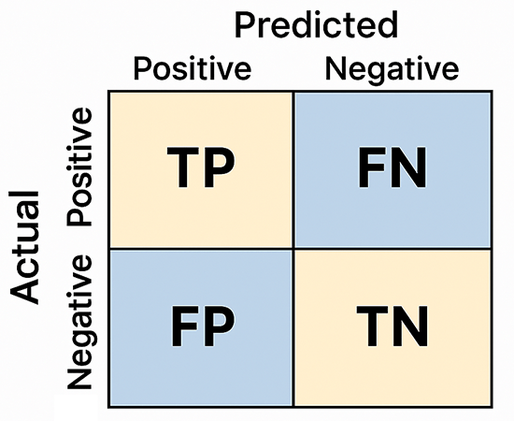












True Positive (TP): The model correctly predicts a positive case.
False Positive (FP): The model incorrectly when it is actually negative. predicts a positive case
False Negative (FN): The model incorrectly predicts a negative case when it is actually positive.
True Negative (TN): The model correctly predicts a negative case.

Slide 16















Slide 17























Slide 18















Slide 19

















































Slide 20



























Slide 21



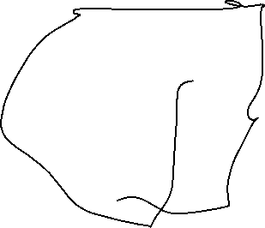














Slide 22





















Slide 23




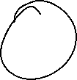














Slide 24





