Slide 1
What is a Voting Classifier?
A Voting Classifier is an ensemble learning technique that combines multiple classifiers and predicts the class based on a voting mechanism. This approach enhances model accuracy, reduces overfitting, and makes predictions more robust.
There are two types of voting classifiers:
Hard Voting: The final prediction is based on the majority vote of individual classifiers. For instance, if three classifiers predict [Class A, Class B, Class A], the final prediction will be Class A.
Soft Voting: Instead of counting votes, it averages the predicted probabilities of each classifier and selects the class with the highest probability.

Slide 2
Why Use Voting Classifiers?
Voting classifiers improve performance when individual models have different decision boundaries. Here are some key benefits:
Increased Accuracy: Aggregating diverse models reduces error rates.
Reduced Overfitting: If individual models overfit, combining them helps in generalization.
Diversity in Predictions: Different models capture different aspects of the data, leading to better decision-making.
However, to ensure an effective ensemble:
The base models should be diverse.
Each model should perform reasonably well (accuracy above 50%).

Slide 3
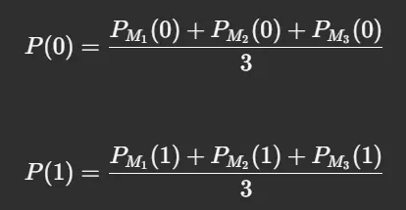
Mathematical Intuition Behind Voting Classifiers
Hard Voting
Consider three models M1,M2,M3 M_1, M_2, M_3 predicting a binary classification problem (Class 0 or Class 1). The votes are:
M1=0,M2=1,M3=0 M_1 = 0, \quad M_2 = 1, \quad M_3 = 0
Since Class 0 has the majority vote, the final prediction is Class 0.
Soft Voting
Instead of discrete votes, we take the average probability of each class:
If P(0)>P(1), predict Class 0, otherwise predict Class 1.

Slide 4
When to Use Voting Classifiers?
Voting Classifiers work best when:
You have diverse models: Combining different algorithms improves learning.
Models have similar performance: If one model is much stronger, it may dominate voting.
Reducing Overfitting is important: Combining models makes predictions more robust.
However, if:
A single model consistently outperforms others, using an ensemble may not help.
The dataset is small, the computational cost may not justify ensemble methods.
Conclusion
Voting Classifiers are a powerful ensemble method that combines multiple models to enhance performance. By leveraging both Hard Voting and Soft Voting, they offer a balance between diversity and accuracy. In this class, we:
Explored the intuition behind Voting Classifiers.
Understood the mathematical foundations.
wImplemented them in Python.
Compared their performance ith individual models.
If you’re working on a classification problem, Voting Classifiers are worth considering for improved accuracy and robustness. 🚀

