Slide 1


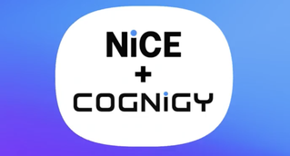














The Conversation Orchestration Landscape
Assisted
CONVERSATIONS
Unassisted
CONVERSATIONS
OPTOMISED FOR:
SPECIALISE IN:
MULTI-CHANNEL
Human-powered ⟶ AI Agent Supported
AI Agent-powered ⟶ Human supported
‘HUMAN IN THE LOOP’
EMPOWERED AGENTS | FASTER RESOLUTION | HIGHER FIRST-CONTACT SUCCESS
COMPLIANT I GOVERNED I IN-POLICY I SCALABLE I TRUSTED I CONSISTENT
Maximising UNASSISTED Conversation

