Slide 1
FINANCE 361 — Topic 13
Anomalies and
Factor Models
The CAPM failed empirically. What replaced it — and does the replacement hold up?
Dr. Zicheng (Leo) Xiao · University of Auckland · FINANCE 361: Modern Investment Theory

Slide 2
What Are We Doing Today
Topic 13 · Readings: Hou, Xue & Zhang (2018); Harvey, Liu & Zhu (2016); Geertsema & Lu (2020)
Factor Models
01
Survey the main benchmark models used in empirical asset pricing — from CAPM to the 5-factor models competing for dominance today.
Anomalies
02
Understand what an "anomaly" is: a sorted portfolio strategy that earns positive risk-adjusted returns unexplained by standard benchmark models.
Replication Crisis
03
Critically assess Hou, Xue & Zhang (2018): most published anomalies do not survive rigorous replication. Understand why — and what standards are required.

Slide 3
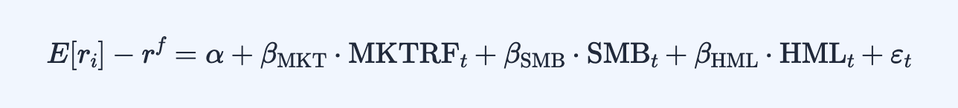
Fama-French 3-Factor Model (FF3)
Fama & French (1993) — the dominant successor to the CAPM
MKTRF
SMB
HML
Market Excess Return
Small Minus Big
High Minus Low (B/M)
The single CAPM factor. Return of the market portfolio minus the risk-free rate. Present in every benchmark model.
Long small-cap stocks, short large-cap stocks. Captures the size premium — small firms earn higher average returns.
Long value stocks (high book-to-market), short growth stocks (low B/M). Captures the value premium.
⚠ Unlike the CAPM, FF3 is not derived from economic theory. It is purely empirical. Whether SMB and HML represent risk compensation or mispricing remains deeply contested.

Slide 4
Extending FF3 — The Carhart 4-Factor Model (FFC4)
Carhart (1997) — adds momentum
UMD — Up Minus Down (Momentum)
Long recent winners (past 12–2 months return), short recent losers. The momentum effect — introduced by Jegadeesh & Titman (1993) — is one of the most robust anomalies: stocks that performed well recently continue to outperform for the next 3–12 months.
📌 Note
🔑 Key Point
SMB and HML use a two-way sort: stocks are independently sorted by size (2 groups) and book-to-market (3 groups), creating 6 intersection portfolios. The factors are weighted averages across these 6 sub-portfolios.
UMD has no consensus risk-based interpretation — yet features in multiple benchmark models. If you can't beat an anomaly, co-opt it into your benchmark. This is a recurring pattern in the "benchmark wars".

Slide 5
The Benchmark Wars — A Timeline
From CAPM to q5: the race to explain the cross-section of returns
1964 / 1972
CAPM
Market excess return (MKTRF) only. Theoretically grounded. Empirically poor.
1 factor
1993
FF3
Adds SMB (size) + HML (value). Purely empirical. Dominant for 20+ years.
3 factors
1997
FFC4 (Carhart)
Adds UMD (momentum). No risk-based interpretation for momentum.
4 factors
2015 (HXZ)
HXZ4 q-factor
Drops HML. Adds I/A (investment) + ROE (profitability). Theory-grounded.
4 factors
2015 (FF)
FF5
Keeps HML + adds CMA (investment) + RMW (profitability). Purely empirical.
5 factors
2018 / 2020
FF6 & q5
FF adds UMD. HXZ adds ΔROEᵉ (expected profitability growth). Arms race continues.
5–6 factors

Slide 6
Factor Model Comparison
Which factors appear in each benchmark model?
Factor
CAPM
FF3
FFC4
HXZ4
FF5
FF6
q5
MKTRF — Market excess return
✓
✓
✓
✓
✓
✓
✓
SMB — Size (Small Minus Big)
—
✓
✓
✓
✓
✓
✓
HML — Value (High Minus Low B/M)
—
✓
✓
—
✓
✓
—
UMD — Momentum (Up Minus Down)
—
—
✓
—
—
✓
—
I/A — Investment (HXZ)
—
—
—
✦
—
—
✦
ROE — Profitability (HXZ)
—
—
—
✦
—
—
✦
CMA — Investment (FF)
—
—
—
—
✦
✦
—
RMW — Profitability (FF)
—
—
—
—
✦
✦
—
ΔROEᵉ — Expected profit. growth
—
—
—
—
—
—
✦
Total factors
1
3
4
4
5
6
5
✓ = factor from predecessor model ✦ = new factor added in this model — = not included

Slide 7


HXZ4 vs. FF5 — Similar Solutions, Different Philosophy
Both address FF3's gaps on investment & profitability
HXZ4 — q-Factor Model
FF5 — 5-Factor Model
Drops HML entirely
Keeps HML "for continuity", despite it adding little
Motivated by the investment CAPM (theoretical foundation)
Still purely empirical — no theoretical foundation
I/A and ROE replace HML's explanatory role
CMA ≈ I/A and RMW ≈ ROE in different notation
Appears to have the edge in explaining anomalies
Currently the dominant benchmark in academic journals
🔑 Key Point
Both models target average realised returns, but realised ≠ expected returns. To explain cross-sectional return patterns → use FF5 or HXZ. To estimate required returns for valuation or corporate finance → the CAPM (with all its flaws) remains the most defensible starting point.

Slide 8
What Is an Anomaly?
Section 5 — The embarrassment of riches
Modern Definition
A sorted portfolio strategy that earns positive risk-adjusted returns even after controlling for standard benchmark models (CAPM, FF3, or FF5). Evidence that some characteristic x predicts returns in a way that existing models cannot explain.
An "anomaly" can refer to three distinct things:
1
A Firm-Level
Characteristic
2
A Factor Loading /
Beta
3
The Trading Strategy
Itself
e.g. profitability, asset growth, accruals. Used to construct the sorting variable in a sorted portfolio study.
The 5M1 portfolio return series. Note: RMW is simultaneously an anomaly and a benchmark factor in FF5.
e.g. beta on market volatility or credit spread changes. The sorting variable is the estimated beta from a time-series regression.
💡 "If You Can't Beat Them, Co-opt Them"
Most benchmark factors — SMB, HML, RMW, CMA, UMD — started life as anomalies. Researchers incorporated them into benchmark models, transforming "anomalies" into "risk factors". Ideally the factor has a risk-based interpretation, but this bar has become increasingly low.

Slide 9
The Anomaly Zoo — Harvey, Liu & Zhu (2016)
Hundreds of characteristics claimed to predict returns
Risk / Volatility
Total vol, Idiosyncratic vol, Distress risk, Beta², Downside risk, Coskewness, Jump beta, Credit rating
Value / Fundamentals
Book-to-market, E/P, CF/P, Dividend yield, Firm size, Long-term reversal, Asset growth, R&D capital
Momentum / Returns
Momentum, 52-week high, Return reversal, Industry momentum, Time-series momentum, Earnings announce. return
Profitability / Quality
Gross profitability, ROE, Accruals, Earnings quality, Org. capital, Earnings growth, DuPont analysis
Trading / Liquidity
Short interest, Illiquidity, Trading volume, Price delay, Bid-ask spread, Order imbalance, Short-sale constraints
Selected anomalies from Harvey, Liu & Zhu (2016) — the full paper documents 400+ factors. Scroll category for full list in the interactive HTML notes.

Slide 10
Are Anomalies Really Distinct? — Geertsema & Lu (2020)
"The Correlation Structure of Anomaly Strategies" · Journal of Banking and Finance
Key question: are hundreds of anomalies truly independent, or do many measure the same underlying economic phenomenon?
Method: Hierarchical Clustering
Applied hierarchical clustering to the correlation matrix of anomaly strategy returns (monthly 5M1 time-series) to identify groups of strategies that move together.
0.57
0.036
0.41–0.89
Avg within-cluster
correlation
Avg between-cluster
correlation
Within-cluster range (G&L clusters)
Anomalies within the same data-driven cluster largely move together — they likely pick up the same economic force.
Very different clusters are nearly uncorrelated — genuine economic diversity exists, but far fewer distinct forces than the zoo suggests.
Data-driven clusters are far more internally coherent than the HXZ theory-based categories (within-category range: 0.07–0.60).
Implication: Many documented anomalies are redundant — they capture the same few underlying forces. Clustering reduces the effective dimensionality of the anomaly zoo and helps identify genuinely distinct return predictors.

Slide 11
Hou, Xue & Zhang (2018) — "Replicating Anomalies"
Review of Financial Studies — Jan 1967 to Dec 2016, 452 anomalies
"Most anomalies fail to hold up to currently acceptable standards for empirical finance. With microcaps mitigated via NYSE breakpoints and value-weighted returns, 65% of the 452 anomalies... cannot clear the single test hurdle of |t| ≥ 1.96. Imposing the higher multiple test hurdle of 2.78 raises the failure rate to 82%... capital markets are more efficient than previously recognized."
— Hou, Xue & Zhang (2018, RFS)
452
65%
82%
96%
Anomalies attempted
Fail single test (|t|<1.96)
NYSE-VW methodology
Fail multiple test (|t|<2.78)
NYSE-VW methodology
Trading frictions anomalies
fail to replicate
Two methodological choices drive everything:
Breakpoints
Portfolio Weighting
①
②
NYSE-only breakpoints (stricter) vs. All-stock breakpoints. NYSE breakpoints prevent extreme quintiles being dominated by tiny microcap stocks.
Value-weighted (by market cap) vs. Equal-weighted. Value-weighting ensures large, economically important stocks drive portfolio returns.

Slide 12
Replication Rates by Methodology — HXZ (2018) Figure 2
Stricter methodology → far fewer anomalies survive
Reading the Chart
Blue bars
Single test threshold (|t| ≥ 1.96) — the conventional 5% significance level.
Grey bars
Multiple test threshold (|t| ≥ 2.78) — corrects for the fact that 452 tests were run simultaneously.
NYSE-VW
Strictest methodology (bottom two bars). Only 35% pass even the lenient single test.
All-EW
Most lenient methodology (middle bars). ~58% pass — inflated by microcap bias.
Source: Hou, Xue & Zhang (2018, RFS), Figure 2, Panel A. Jan 1967 – Dec 2016.

Slide 13
The Microcap Problem — Why Methodology Matters
Microcaps = bottom 20% of NYSE stocks by market cap
What are microcap stocks?
Effect on Anomaly Studies
Very small and illiquid — high transaction costs
All stocks + EW
Disproportionately numerous by stock count
Microcaps dominate extreme quintiles; inflates anomaly returns ↑
Very high equal-weighted returns (partly due to bid-ask bounce, data errors, and illiquidity premia)
NYSE breaks + VW
Tiny by market cap — near-zero weight in value-weighted portfolios
Microcaps contribute negligibly; returns reflect large-cap stocks ↓
CRSP Sample Construction — Standard Filters (Python)
crsp = crsp[crsp['shrcd'].isin([10, 11])] # Common domestic US stocks only
crsp = crsp[crsp['exchcd'].isin([1, 2, 3])] # NYSE, AMEX, NASDAQ
crsp = crsp.dropna(subset=['ret', 'mktcap']) # Require returns & market cap
nyse_p20 = nyse.groupby('date')['mktcap'].quantile(0.20) # NYSE 20th pctile
crsp['is_microcap'] = crsp['mktcap'] < crsp['nyse_p20'] # Flag microcaps
sample_vw = crsp[~crsp['is_microcap']].copy() # VW sample: drop microcaps

Slide 14
Four Best Practices for Rigorous Anomaly Research
What separates genuine signal from noise
①
NYSE Breakpoints
②
Value-Weighted Returns
Calculate quintile breakpoints using NYSE-listed stocks only. This prevents extreme portfolios from being stuffed with tiny NASDAQ/AMEX microcaps that inflate apparent returns.
Weight each stock by its market capitalisation. Equal-weighting gives identical weight to Apple and a $5M microcap. Report EW as a robustness check only.
③
Multiple-Testing Correction
④
Extended Sample Period
Use |t| ≥ 2.78 (not the naive 1.96) as the significance threshold. With 452 simultaneous tests, the expected number of false positives at 1.96 is enormous.
Verify results over the full extended sample, not just the original study period. Post-publication anomalies often decay as traders arbitrage them away.
Applying all four → 65% to 82% of published anomalies disappear. Capital markets are more efficient than the zoo suggests.

Slide 15
Final Thoughts — Three Confounding Forces
The hardest problem in empirical asset pricing
Untangling what drives average returns requires disentangling three distinct forces:
✅
⚠️
❌
Risk Compensation
Predictable Mispricing
Data Mining
Compensation for bearing systematic risk. Should be captured by benchmark pricing models. e.g. the size premium may reflect higher distress risk of small firms.
Persistent behavioural biases or institutional constraints preventing prices from reflecting fundamental value. Represents genuine alpha — should not be in benchmark models.
Results obtained by fitting models to noise. Running thousands of regressions until something looks significant. HXZ (2018) suggest this is responsible for a large fraction of published "anomalies".
🔭 Looking Forward — Financial Machine Learning (Topic 14)
Research has increasingly moved toward ML methods — random forests, gradient boosting, deep neural networks — that simultaneously consider hundreds of characteristics and their interactions, in ways that sorted portfolio methodology cannot.
Where Does This Leave Us?
• CAPM: theoretically elegant, empirically weak • FF5 / HXZ4: better empirically — but purely descriptive, not theoretical • Most anomalies: do not survive rigorous replication (HXZ 2018) • Benchmark wars: HXZ models have an edge for anomalies; CAPM remains the corporate finance default

Slide 16
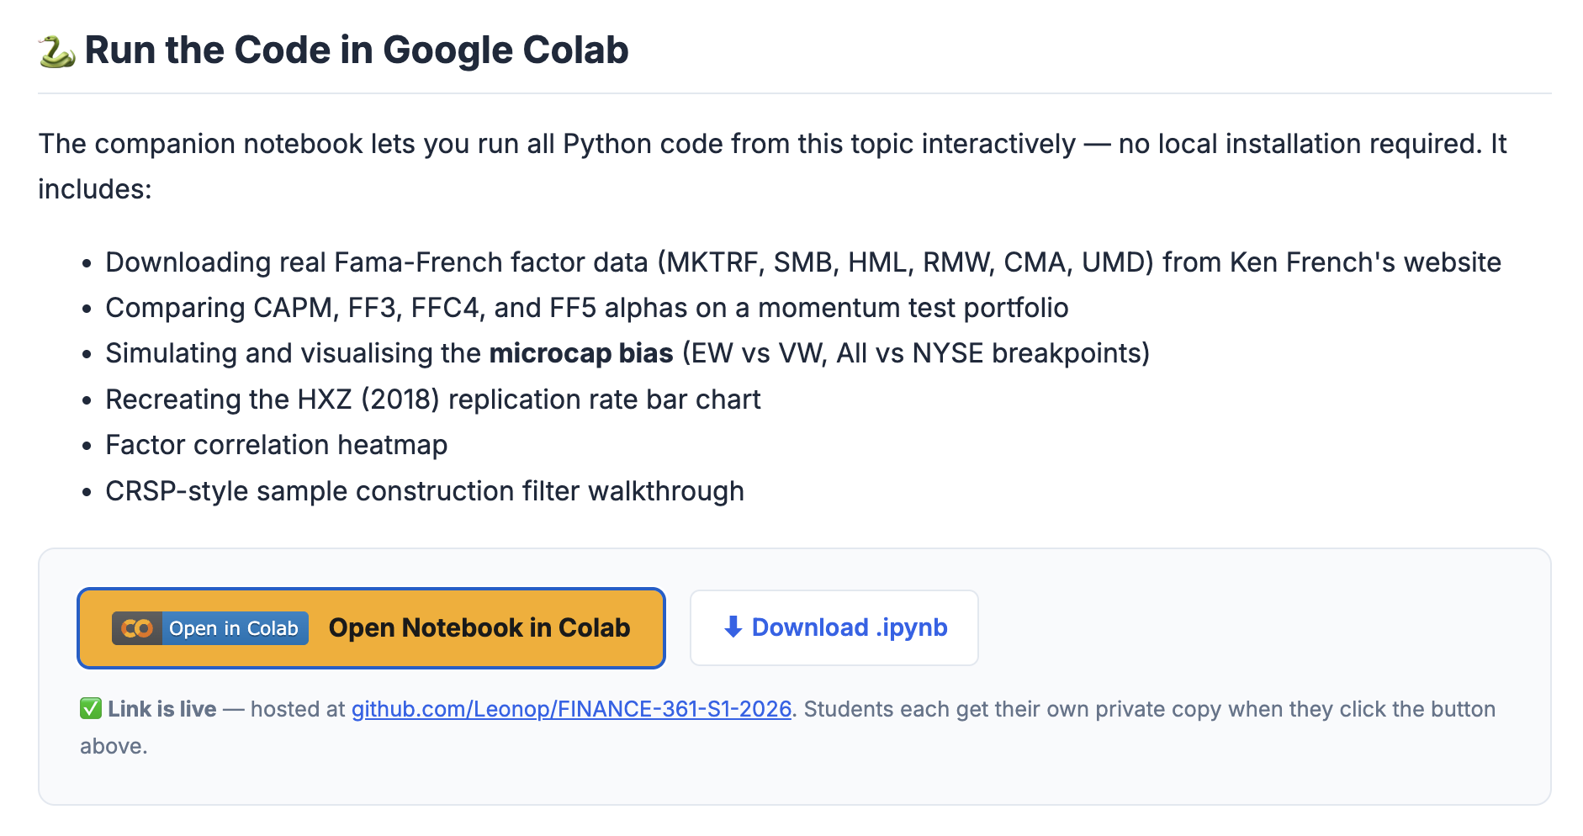

Slide 17
Key Takeaways
FF3 / FFC4 / FF5 / HXZ4 are empirical benchmarks — not theories of expected returns
Benchmark wars: HXZ4 and q5 appear to explain anomalies better than FF5; CAPM dominates in corporate practice
An anomaly = sorted strategy earning alpha unexplained by benchmark models. Most started as anomalies before being co-opted as factors
HXZ (2018): 452 anomalies tested — 65% fail at |t|≥1.96 and 82% fail at |t|≥2.78 under NYSE-VW methodology
Root cause: microcap contamination. NYSE breakpoints + value-weighting remove most apparent anomalies
Three confounding forces: risk compensation (legitimate), mispricing (genuine alpha), data mining (noise)
Next: Topic 14 — Financial Machine Learning (Gu, Kelly & Xiu 2020)

