Slide 1
FINANCE 361 — Topic 14
Financial
Machine Learning
ML is transforming empirical finance. This module covers what it is, why it is hard, and what GKX (2020) actually found.
Required reading: Gu, Kelly & Xiu (2020), "Empirical Asset Pricing via Machine Learning", Review of Financial Studies
Dr. Zicheng (Leo) Xiao · University of Auckland · FINANCE 361

Slide 2
What Are We Doing Today
Topic 14 · Required: GKX (2020) up to Section 1.4, pp. 2223–2235
01
What Is Machine Learning?
AI ⊃ ML ⊃ Deep Learning. The key distinction between traditional statistical models and data-driven learning. What ML can and cannot do.
02
9 Reasons Finance is Uniquely Hard
Extreme noise, reflexivity, the zero-sum game, black swans, finite data, no experiments, time decay, commoditized tools, talent arms race.
03
Actually Doing ML in Python
ML pipeline, bias-variance tradeoff, and a complete 27-line working example: download real data, train 5 models, compare out-of-sample MSE.
04
GKX (2020) Deep Dive
The landmark paper that brought ML into mainstream empirical asset pricing. Key findings: ML beats OLS, non-linearity matters, momentum/liquidity/volatility dominate.

Slide 3
What Is Machine Learning?
Three terms often used interchangeably — but not the same
🤖 Artificial Intelligence (AI)
Traditional Statistics vs. ML
Systems that exhibit aspects of intelligence — reasoning, perception, language, problem-solving.
Traditional OLS / Regression
Researcher specifies the model: which variables, what functional form, which interactions. Model is estimated given that fixed structure.
⚙️ Machine Learning (ML)
A branch of AI. Models that learn directly from data without being explicitly programmed with rules.
🧠 Deep Learning (DL)
Machine Learning
A branch of ML using multi-layer neural networks. Powers modern image recognition, LLMs, and more.
The data determines the functional form. A decision tree discovers its own non-linear breakpoints. A neural network learns its own feature representations through layers of transformation.
⚠ The cost: flexibility makes ML far more prone to overfitting — fitting noise in training data rather than the true signal.
AI ⊃ ML ⊃ Deep Learning — each inner ring is a specialisation of the outer one.

Slide 4
9 Reasons Finance Is a Uniquely Hard ML Domain
Signal-to-noise ratio ≈ 0.03 — almost no signal to find
1
Extreme Noise
2
Reflexivity
3
Zero-Sum Game
Signal-to-noise ≈ 0.03. Only ~3% of return variation is predictable; 97% is pure noise.
Trading on a model changes the data-generating process. Markets adapt, making patterns obsolete.
Short-term trading is zero-sum. Every dollar you gain is a dollar someone else loses.
4
Black Swans
5
Finite Data + Overfit
6
No Experiments
Fat tails — extreme events are far more common than normal distributions predict. ML models break catastrophically.
Financial data arrives one month per month. You cannot run randomised experiments to validate.
Regulators treat deliberate market experiments as manipulation. No A/B testing allowed.
7
Strategy Decay
8
Commoditized Tools
9
Talent Arms Race
By the time you confirm a strategy works, larger players have already arbitraged it away.
PyTorch, scikit-learn, XGBoost are free and open-source. What exactly is your edge?
Average ML skills are worthless in a zero-sum game. Alpha gets spent on retaining top talent.

Slide 5
Why Learn ML Despite the Challenges?
Signal-to-noise is low — but ignorance is worse
⚠ The uncomfortable truth
Workers who can use AI will replace workers who cannot. The goal of this module is not to train you to beat Renaissance Capital — it is to ensure you can understand, critique, and apply ML methods when they are relevant. That is a career-defining skill in 2025 and beyond.
💼 Industry Standard
📊 Research Tool
🔍 Critical Evaluation
GKX (2020) appeared in the Review of Financial Studies — the top finance journal. ML literacy is now expected of PhD students and researchers in empirical finance.
ML is now used routinely at major asset managers (Two Sigma, WorldQuant, Man AHL, Renaissance). Understanding these methods is required to communicate, evaluate, or work alongside quant teams.
You will encounter ML-generated outputs throughout your career — in reports, tools, and advice. Without understanding the method, you cannot identify when the output is wrong, overfitted, or misleading.
🧠 Signal-to-noise ≈ 0.03 means: ~3% of return variation is predictable; 97% is noise no model can predict. Even the best ML achieves very low R² on financial data.

Slide 6
The ML Pipeline
Every ML project follows this structure — understanding it matters more than knowing any specific algorithm
1. Load Data
→
2. Engineer Features
→
3. Train / Test Split
→
4. Fit Model
→
5. Predict on Test
→
6. Evaluate
1. Load Data
2. Engineer Features
3. Train / Test Split
Download or import raw data. In finance: CRSP, Compustat, q5 factors. In Python: pandas.
Create predictive variables (X). Cross-section rank transforms, lags, interactions. Crucial step.
Strict temporal split: training data comes BEFORE test data. No future data leakage allowed.
4. Fit Model
5. Predict on Test
6. Evaluate
Train the model on training data only. Choose algorithm: OLS, Ridge, GBM, Neural Net, etc.
Apply trained model to held-out test data. The model has never seen these observations.
Compute out-of-sample metrics: MSE, R², Sharpe ratio. Only this step tells you if the model works.
⚠ Critical rule: the model never sees test data during training. Data leakage (e.g. normalising using the full dataset) invalidates the evaluation — equivalent to look-ahead bias in sorted portfolios.

Slide 7
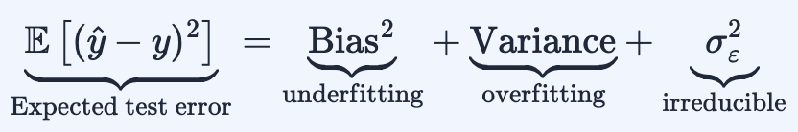
The Bias-Variance Tradeoff
The central challenge of supervised machine learning
Bias² (Underfitting)
Variance (Overfitting)
σ²ε (Irreducible)
Too-simple model
Too-complex model
Noise floor
Error from overly simplistic assumptions. A linear model fit to genuinely non-linear data has high bias. Model cannot capture the true pattern.
Error from excessive sensitivity to training data. A deeply grown decision tree memorises training noise. Fails completely on new data.
Noise inherent in the data that no model can eliminate. In finance with signal-to-noise ≈ 0.03, this is the dominant component by far.
📌 Finance context: signal-to-noise ≈ 0.03 pushes the optimal complexity point far to the left — very simple models win. Deep neural nets overfit catastrophically without heavy regularisation.

Slide 8
A Complete 27-Line Python ML Example
Download real data · train 5 models · compare out-of-sample accuracy
Task
Predict next month's market excess return (Rᴹᴷᵀ_{t+1}) using the current month's HXZ q5 factors (Rᴹᴷᵀ_{t} , Rᴹᴱ_{t} , Rᴵᴬ_{t} , Rᴿᴼᴱ_{t} , Rᴱᴳ_{t}) plus the risk-free rate (RF_{t}). Data from global-q.org.
Five competing models:
OLS
Ridge
Tree
GBM
NeuralNet
vs
vs
vs
vs
Linear regression
Regularised OLS (α = 2)
Single decision tree
Gradient boosted trees
MLP (early stopping)
import pandas as pd
from sklearn.linear_model import LinearRegression, Ridge
from sklearn.tree import DecisionTreeRegressor
from sklearn.ensemble import GradientBoostingRegressor
from sklearn.neural_network import MLPRegressor
from sklearn.metrics import mean_squared_error
df = pd.read_csv("http://global-q.org/...q5_factors_monthly.csv")
df["R_FWD_MKT"] = df["R_MKT"].shift(-1) # target: next-month mkt
D_train = df[df["year"] < 2000].dropna() # pre-2000 = train
D_test = df[df["year"] >= 2000].dropna() # 2000+ = test

Slide 9
Model Results — Out-of-Sample MSE
Modelz
Type
MSE
Rank
Lower MSE = better prediction. Test data: year ≥ 2000
GBM
Ensemble (gradient boosted trees)
18.41
🥇 Best
Ridge
Linear (regularised OLS)
19.39
2nd
OLS
Linear (ordinary least squares)
19.45
3rd
NeuralNet
Multilayer perceptron
19.82
4th
Tree
Single decision tree
37.14
❌ Worst
Interpretation
GBM wins — ensemble captures mild non-linearities while controlling overfitting through shallow trees.
Decision Tree loses badly — single deep tree memorises training noise. Test MSE ≈ 2× everyone else: textbook overfitting.
Ridge slightly beats OLS — even mild regularisation helps in a high-noise environment.
All models are bad in absolute terms — toy example with only ~600 observations and 5 features.

Slide 10
What We Did Not Do Properly — Toy Example Limitations
A real ML study requires all four of these
①
Tune Hyperparameters
②
Standardise Inputs
The alpha in Ridge and n_estimators in GBM were set arbitrarily. A real study selects them via cross-validation on a separate validation set — never the test set.
Neural networks require standardised inputs (mean=0, std=1). We skipped this. In GKX (2020), all 94 characteristics are rank-transformed to the cross-sectional uniform distribution.
GridSearchCV(Ridge(), {'alpha': [0.1,1,10]}, cv=5)
from sklearn.preprocessing import StandardScaler
③
More Features
④
More Observations
We used 5 macro factors. GKX (2020) use 94 firm-level stock characteristics. More features = more potential to capture non-linear interactions — but also more overfitting risk.
We have ~600 monthly data points. GKX use ~1 million stock-month observations. ML works best with large samples — ~600 points is barely enough for OLS, let alone deep networks.
# GKX uses 94 characteristics per stock
# GKX: ~1 million stock-month observations
The Colab notebook includes hyperparameter tuning, standardisation, and a larger prediction task on individual stock returns.

Slide 11
Gu, Kelly & Xiu (2020) — "Empirical Asset Pricing via Machine Learning"
Review of Financial Studies, 33(5) — the landmark paper that brought ML into mainstream finance
"We perform a comparative analysis of machine learning methods for the canonical problem of empirical asset pricing: measuring asset risk premiums. We demonstrate large economic gains to investors using machine learning forecasts, in some cases doubling the performance of leading regression-based strategies. We identify the best-performing methods (trees and neural networks) and trace their predictive gains to allowing non-linear predictor interactions missed by other methods. All methods agree on the same set of dominant predictive signals: momentum, liquidity, and volatility."
— Gu, Kelly & Xiu (2020, RFS)
Why This Paper Matters
Right framing
Proper methodology
"Measuring asset risk premiums" — not just "predicting returns". Subtle but critical for publication in top journals.
Rigorous train/validation/test splits. Hyperparameter tuning on held-out validation set. Standardised inputs via rank transform.
Economic interpretation
Genuine horse race
Variable importance scores identify which of the 94 characteristics matter most — bridging black-box ML with economic intuition.
Compared OLS, Ridge, LASSO, Elastic Net, PCR, PLS, GBRT, Random Forests, and Neural Networks on the same task and data.

Slide 12
GKX (2020) — Four Key Findings
~1 million stock-month observations · 94 firm characteristics · 1957–2016
✅
ML Beats OLS
✅
Non-Linearity Matters
ML methods outperform traditional regression-based strategies for return prediction out-of-sample. Economic gains are large — in some cases doubling Sharpe ratios of leading regression strategies.
The predictive advantage of ML over OLS traces specifically to capturing non-linear predictor interactions. OLS by construction cannot learn interactions unless they are manually specified.
✅
Best Methods: Trees & NNs
✅
Dominant Signals: MOM, LIQ, VOL
Gradient boosted regression trees (GBRT) and neural networks consistently outperform linear methods. Ridge/LASSO are better than plain OLS but fall short of the best ML approaches.
All models agree: momentum, liquidity, and volatility are the most important predictors. Consistent with the anomaly literature from Topic 13 — the same signals survive ML scrutiny.
🧠 Key insight from GKX: ML advantage is about functional form flexibility (non-linearity), not sample size. OLS with 1 million observations still cannot learn interactions it was never given.

Slide 13
GKX (2020) vs. Our Toy Example
Scale and rigour are everything
Dimension
Our Toy Example
GKX (2020)
Observations
~600 monthly
~1 million stock-months
Features (X)
5 macro factors
94 firm characteristics
Target (y)
Market-level return
Individual stock returns
Sample period
1967–2019 approx.
1957–2016 (59 years)
Hyperparameter tuning
None (arbitrary)
Full cross-validation on validation set
Input standardisation
No
Yes — rank-transform to uniform distribution
Interpretation
None
Variable importance, SDF construction
Number of models
5
9+ (OLS, Ridge, LASSO, EN, PCR, PLS, GBRT, RF, NN)
Concept Check Answer
🧠 GKX find ML outperforms OLS primarily because: ML methods capture non-linear predictor interactions that linear OLS models miss by construction. With 94 variables, there are thousands of potential pairwise interactions — OLS would need them all manually specified.

Slide 14
Critically Evaluating AI-Generated Answers
ML fluency = knowing when AI is wrong
🔍 AI Critique Exercise
A student asked an AI: "My decision tree has training R² = 0.91 and test R² = 0.02. What is wrong?"
🤖 AI-Generated Answer (Wrong)
✅ Correct Explanation
"Decision trees perform poorly on financial data because they use non-parametric methods. Non-parametric methods assume nothing about the distribution of the data, which makes them less effective for time-series problems where past patterns tend to repeat."
The problem is overfitting. Training R²=0.91, test R²=0.02 are classic symptoms: the tree memorised training noise rather than learning a generalisable pattern. The non-parametric claim is wrong — Random Forests and GBM are also non-parametric and work well.
Three fixes for an overfitting decision tree:
①
Constrain max_depth
②
Cross-validate depth
③
Use ensemble methods
DecisionTreeRegressor(max_depth=3)
GridSearchCV(tree, {'max_depth': range(2,10)})
GradientBoostingRegressor(n_estimators=100)
Limit tree growth so it cannot memorise individual training points.
Select optimal depth on a held-out validation set, not the test set.
Many shallow trees combined — same non-parametric flexibility, far less variance.

Slide 15
Where This Research Is Heading
Beyond GKX (2020) — the frontier of financial ML
Gu, Kelly & Xiu (2021)
"Autoencoder Asset Pricing Models" — Journal of Econometrics
Extends GKX using deep autoencoders to learn latent risk factors directly from data — replacing hand-crafted FF5/HXZ factors with data-learned representations.
Kozak, Nagel & Santosh (2020)
"Shrinking the Cross-Section" — Journal of Financial Economics
Shows that the factor zoo can be compressed to a few principal components using Bayesian regularisation — bridging ML and structural asset pricing.
Chen, Pelger & Zhu (2024)
"Deep Learning in Asset Pricing" — Management Science
Uses deep neural networks to learn the stochastic discount factor directly — a theoretically grounded approach versus the GKX prediction framework.
Industry Leaders
Leo's Research — NLP in Finance
Two Sigma · Renaissance Technologies (Medallion) · Man AHL · WorldQuant · Acadian
Text-based factors from earnings calls, 10-K filings, news articles. Interested in FinTech/textual analysis for thesis or PhD? Come talk!

Slide 16
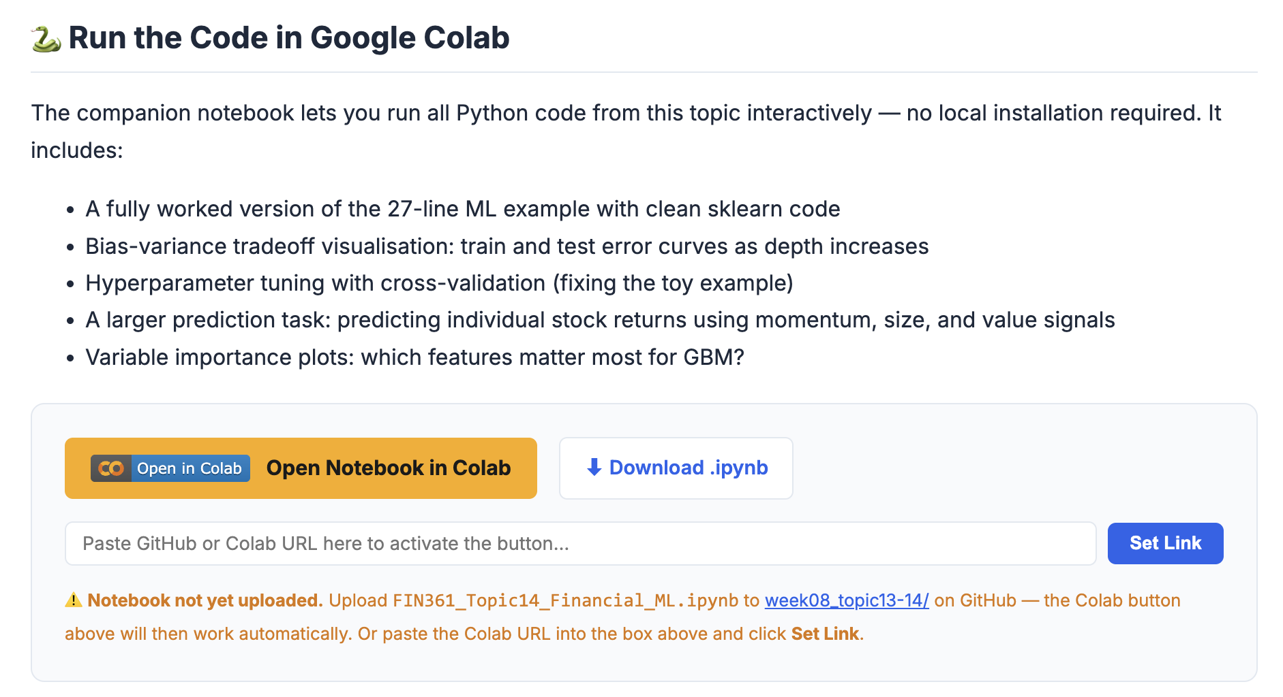

Slide 17
Key Takeaways
AI ⊃ ML ⊃ Deep Learning. ML = models that learn functional form from data, not from researcher specification
Finance has 9 structural obstacles for ML — the hardest is the signal-to-noise ratio of ~0.03 (97% noise)
The ML pipeline: Load → Features → Train/Test split → Fit → Predict → Evaluate. Test data never leaks into training
Bias-variance tradeoff: in finance, optimal complexity is very low — simple models win because noise dominates
GKX (2020): trees and NNs beat OLS; the advantage traces to non-linear interactions; dominant signals = momentum, liquidity, volatility
Critical evaluation matters: AI-generated ML explanations are often wrong. Know enough to spot the errors
Colab notebook: bit.ly/fin361-topic14 · GitHub: github.com/Leonop/FINANCE-361-S1-2026

