Slide 1
Serverless Search Architecture

Slide 2


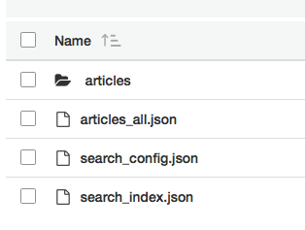



System Architecture
Amazon S3
Lambda function
search article
Document_Search
search config
search index
API Layer
Lambda function
on object create
search index
/search
/config
/add
Document_Indexer
all articles
Amazon API Gateway
Read the search_config for index info
Iterates through all uploaded articles
Uploads new search_index
Caches data in articles_all
Search Indexing and Querying powered by lunr.js
rlingineni/lambda-serverless-search

