Slide 1

PREDICTING PGA TOUR PLAYER'S CHANCE TO WIN A PGA TOUR TOURNAMENT USING MACHINE LEARNING

Slide 2


Hello!
I am Miguel Galarraga
I am here to present my Capstone’s project results.
You can find me at:
miguelangelgalarraga@gmail.com

Slide 3
IT’S TOUGH TO MAKE PREDICTIONS, BUT IT IS ALWAYS FUN!

Slide 4
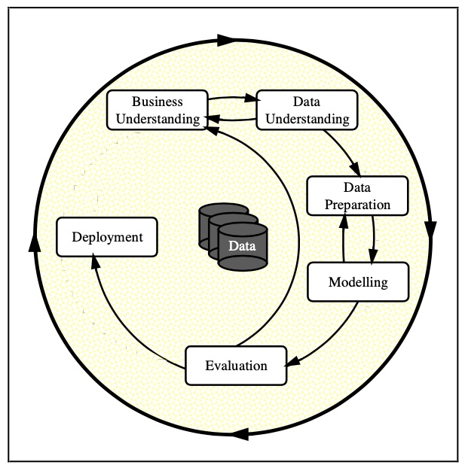
CRISP-DM Process Model for Data Mining followed

Slide 5
BUSINESS UNDERSTANDING

Slide 6
To Come up with a Supervized Machine learning classification model. These were tested: Logistic Regression, K-Nearest Neighbor, and Random Forest
The output is binary, meaning that a player must get 1 to have high chance to win, or 0 to have very small/zero chance to win a PGA tournament.
The dataset contains the statistics from 2011 through 2021, and it was obtained by doing web scraping in the official website of the PGA Tour (https://www.pgatour.com/stats).

Slide 7
DATA UNDERSTANDING

Slide 8
The dataset was scraped from the official website of the PGA Tour, covering only ten years span of tournaments (2011-2021). The statistics were averaged yearly for each player. The target/dependent columns is "Win" which is binary (0=did not win and 1 = won).

Slide 9
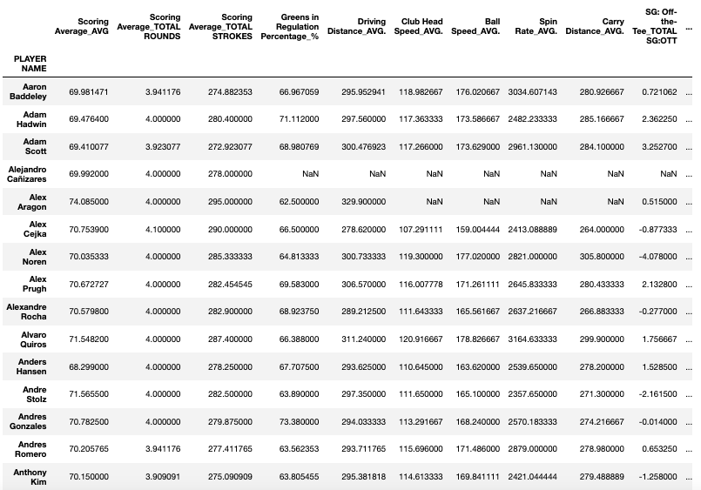
A PORTION OF DATASET AS SCRAPED FROM THE WEBSITE AND STRUCTURE AS A DATAFRAME

Slide 10
DATA PREPARATION

Slide 11
All the independent variables are numerical. Before cleaning the dataset, the index was reset, and the column: 'PLAYER NAME' was dropped, since the name of the pga players won't be needed, only their statistics for further analysis. The null values were identified, and dropped. Duplicates was observed in just one row. Initially, dataset was reduced to 29 columns and 3379 rows

Slide 12
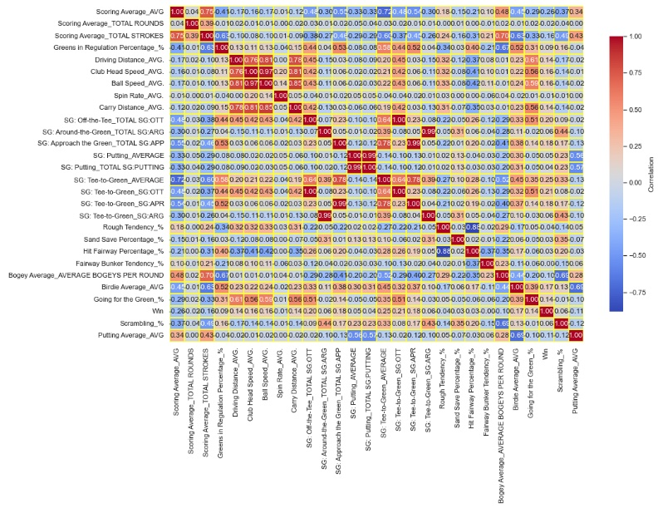
Correlation matrix analysis helped to drop out 7 independent variables

Slide 13
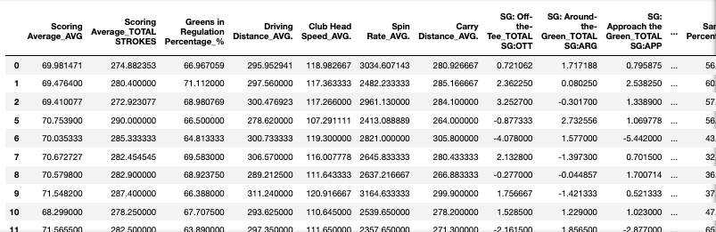
SOME STATISTICS OF SOME INDEPENDENT VARIABLES USED DURING THE MODELLING PHASE
Comments: Final dataset consists of 21 columns and 3379 rows, where 20 columns are independent variables, and one columns is the dependent/target variable.

Slide 14
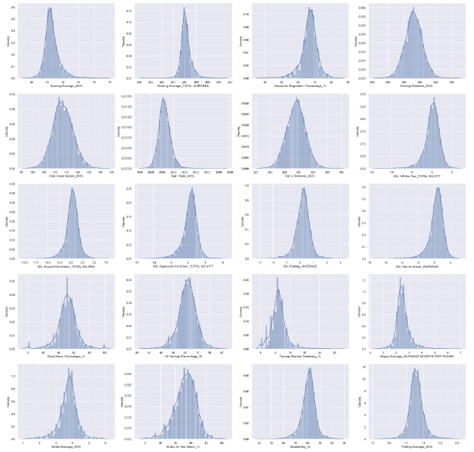
VALUES DISTRIBUTION OF THE INDEPENDENT VARIABLES USED DURING THE MODELLING PHASE
Comments: All 20 independent variables show a normal distribution values, also indication that there is not need for outliers removal.

Slide 15
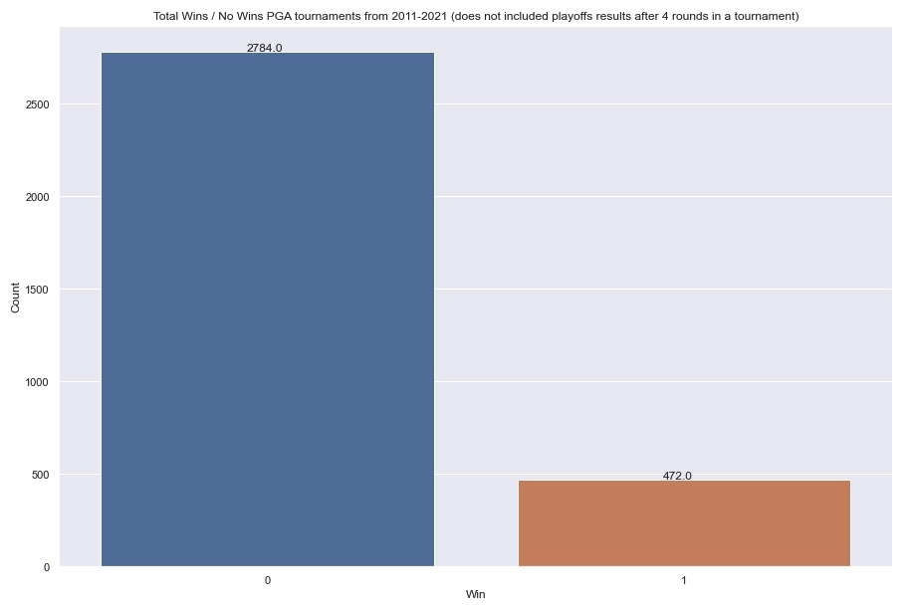
HISTOGRAM OF THE DEPENDENT VARIABLE: “WIN” USED DURING THE MODELLING PHASE
Comments: Histogram of dependent variable “Win” indicates its imbalance nature, representing a challenge for any Machine Learning Modelling.

Slide 16
MODELLING

Slide 17
ML CLASSIFICATION MODELS TESTED
Logistic Regression: Algorithm that performs binary classification by modeling a dependent variable (Y) in terms of one or more independent variables (X)
K-Nearest Neighbor: Algorithm that attempts to determine what group a data point is in by looking at the data points around it
Random Forest: Algorithm that creates multiple decision trees and then averaging their results
Comments: For each model, several parameters with a range of values were tested, so the final ones chosen optimized the predicted capability of each model.

Slide 18
EVALUATION

Slide 19
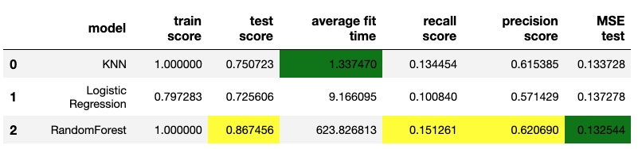
Metrics and Elapsed Time for the different models tested
Comments: The best model seems to be Random Forest by slight margin over the K-Nearest Neighbor. However, the major drawback to be emphatically named as the best model is that consumed a much significant elapsed time than that of the other two models, and also, the improvement in metrics (Precision, Recall, and MSE) was somewhat small . As a result, it is thought that K-Nearest Neighbor must be pointed as the best model.

Slide 20
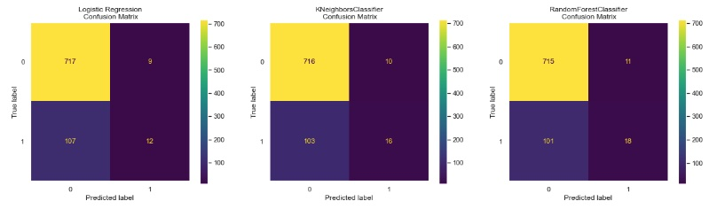
CONFUSION MATRIX FOR THE DIFFERENT MODELS TESTED
Comments: The number of the False Negatives (FN: 107, 103, and 101) is significant much larger than the number of True Positives (TP: 12,16, and 18). Therefore, improving recall: (TP/ (TP + FN) score is of paramount importance, since it will help to predict in a more confident and robust way who will win a PGA tournament

Slide 21
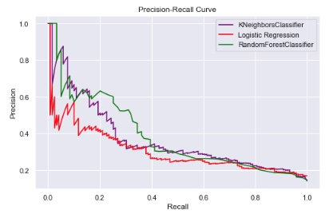
Precision-Recall Curve for the different models tested
Comments: This type of curve works much better for moderate to large imbalanced data. This curve indicates that the best model is the Random Forest (green line) by slight margin

Slide 22
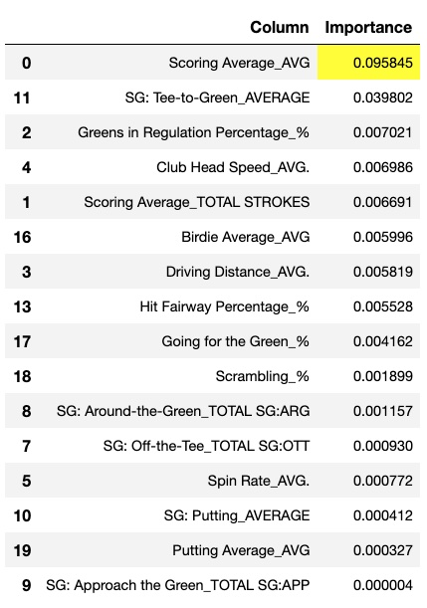
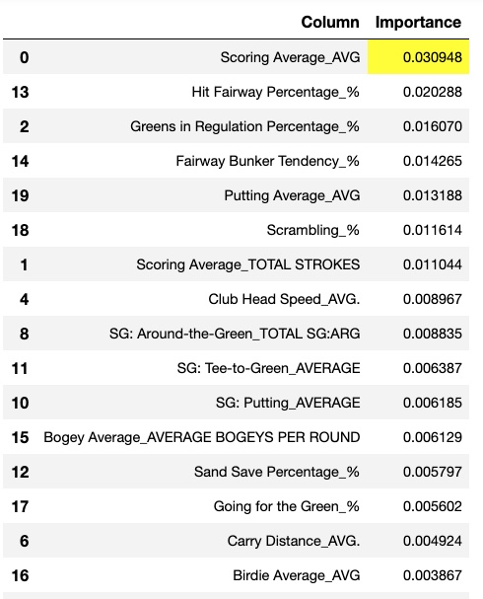
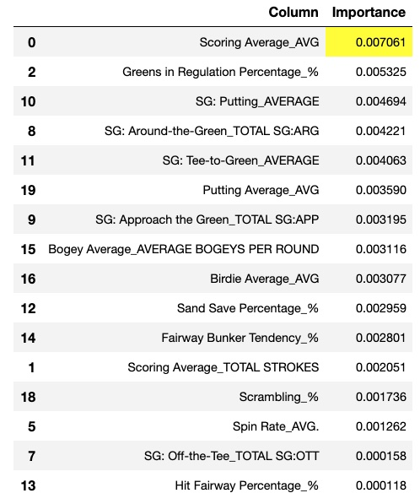
Ranking the importance of the independent variables
Logistic Regression
K-Nearest Neighbor
Random Forest
Comments: The three models shows that the independent variable: 'Scoring Average_AVG' ranked first, which makes sense, since players win tournament by shooting the lowest scoring average.

Slide 23
DEPLOYMENT

Slide 24
The code was written in Python, and it is available in a Jupyter Notebook that can be accessed in the following link: https://github.com/Leopard-2019/PREDICTING-PGA-TOUR-PLAYER-S-CHANCE-TO-WIN-A-PGA-TOUR-TOURNAMENT/blob/main/notebook/Capstone_Project_Data-Copy1.ipynb

Slide 25
CONCLUSIONS & RECOMENDATIONS

Slide 26

1.
The final dataset used as input for the modeling, after cleaning consists of 21 columns and 3379 rows (20 columns for independent variables, and 1 columns for dependent variable). The target columns was "Win" which stands for: ranking first (i.e, Win) in any PGA tournament during the period 2011-2021
2.
It is thought that the best classification model is a close call between the K-Nearest Neighbor, and Random Forest which ranks first in all metrics. However, the elapsed time spent by Random Forest is quite large compared to the amount of improvement achieved in the metrics. Also, K-Nearest Neighbor ranked top-five the most widely known important golf player's statistics to win a PGA golf tournament. As a result, it is thought that the winner must be K-Nearest Neighbor.
3.
All models performed relative poorly in the recall score, which is expected when dealing with an imbalanced dependent target variable.

Slide 27
4.
The most important independent variable was: “Scoring Average”' in all models tested. However, it is interesting that this variable is much more important in the Logistic Regression Model
5.
The results indicates that driving distance is not within the five most important independent variables., i.e., driving the ball longer does not guarantee that a player will win a tournament. This is a pretty interesting observation that sometimes is overlooked by people who want to initiate their career in golf.
6.
Consistency, i.e, shooting low score, and course management (off the tee,around the green, scrambling,etc) seem to be the most important aspects to win PGA golf tournaments

Slide 28
7.
The notebook provided in the GitHub project associated can be perfectly used to help assign odds to players when competing in any given PGA tournament. To do this, the user only need to collect the latest player's statistics before entering the PGA tournament. Recall that the statistics collected need to be the same categories used during the modeling phase in this project.
8.
Neural Network as classification technique is recommended to be tested.

Slide 29
Thanks!
Any questions?
You can find me at:
miguelangelgalarraga@gmail.com

