Slide 1
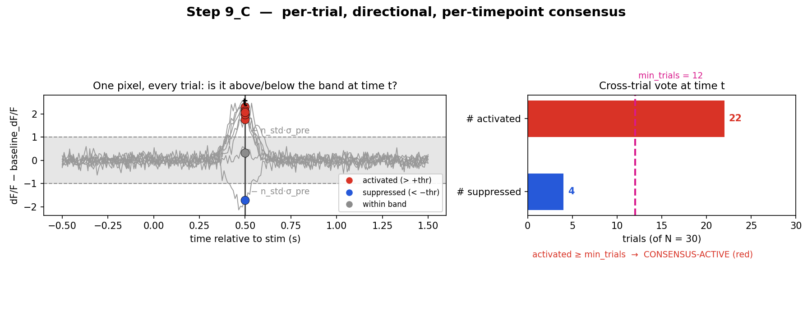
Step 9_C — per-trial directional consensus (single frame)
• Method 1 dF/F: dF/F(x,y,t) = [F − F_global] / F_global. For each trial, baseline_dF/F = its own pre-stim mean and σ_pre = its own pre-stim std.
• Directional test at every timepoint t: ACTIVATED if dF/F − baseline_dF/F > n_std·σ_pre ; SUPPRESSED if < −n_std·σ_pre. The two directions are counted separately.
• Consensus at t: a pixel is consensus-active if it is activated in ≥ min_trials trials OR suppressed in ≥ min_trials trials (one direction only). A mixed up/down split (e.g. 15/15) is treated as noise, not consensus.
• Stimulation-related region = pixels reaching consensus at any post-stim t. Maps are colored by the net count (activated − suppressed): red = activated, blue = suppressed, green/grey ≈ no consensus.

Slide 2
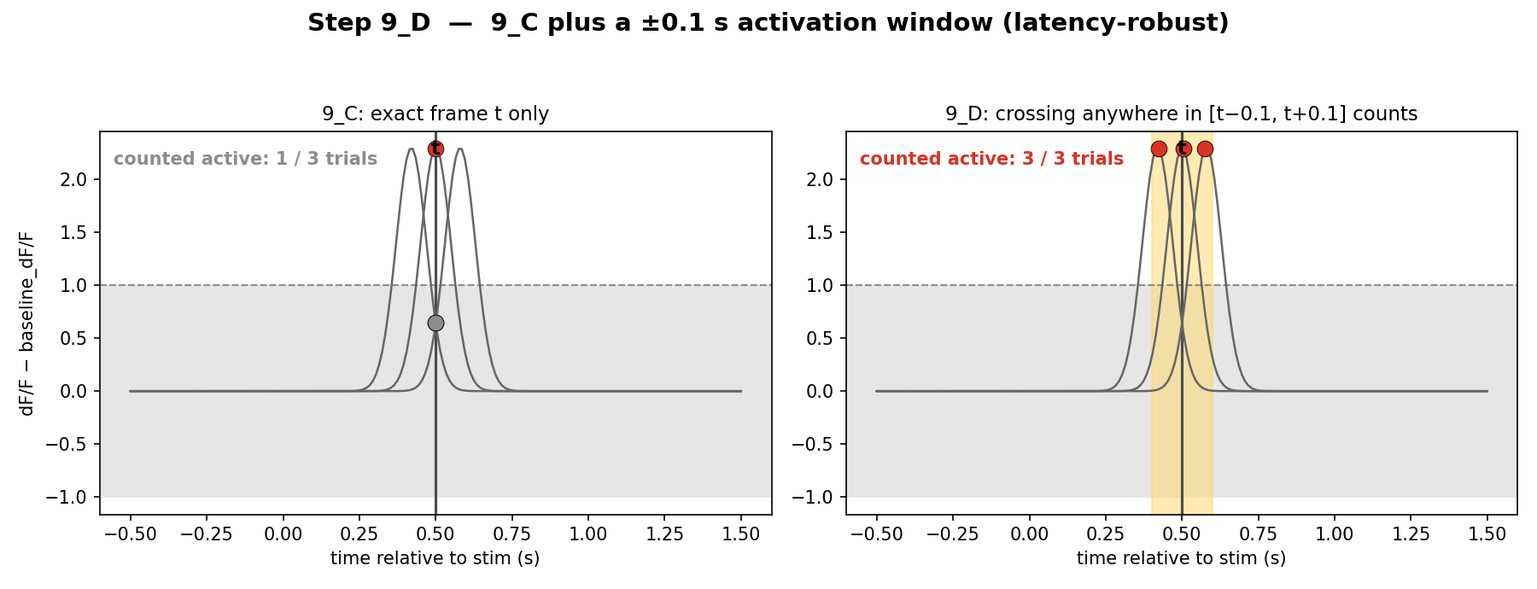
Step 9_D — 9_C plus a ±0.1 s activation window (latency-robust)
• Identical to 9_C, with ONE change to the activation test: at time t a pixel counts as activated/suppressed if it crosses threshold anywhere in the window [t − 0.1 s, t + 0.1 s] (±1 frame at 10 Hz), not only in the single frame t.
• Why: individual trials respond with slightly different latencies. The strict single-frame 9_C loses cross-trial agreement when a response lands a frame early or late; the window absorbs that jitter (see right panel: 3/3 vs 1/3).
• Implementation: a temporal max-dilation of each trial's activated/suppressed map by ±window_frames before the cross-trial counting.
• Effect: recovers more consensus than 9_C at the same n_std (more latency-robust). Everything else — directional consensus, min_trials, rainbow net-count maps, magenta contour, V1 overlay — is unchanged.

