Slide 2
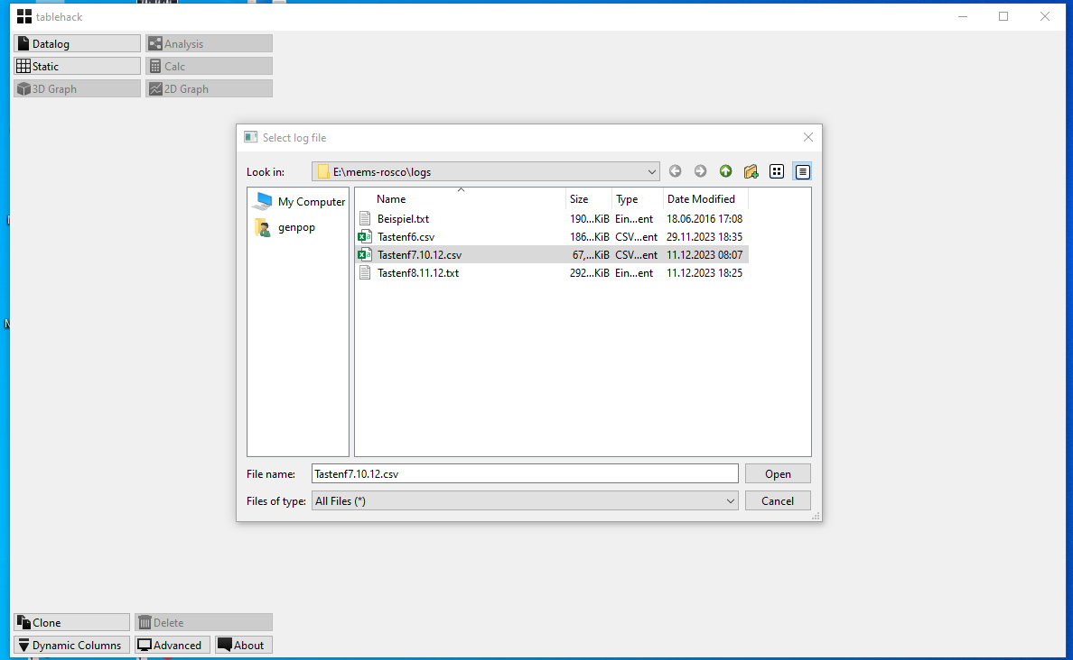

Slide 3
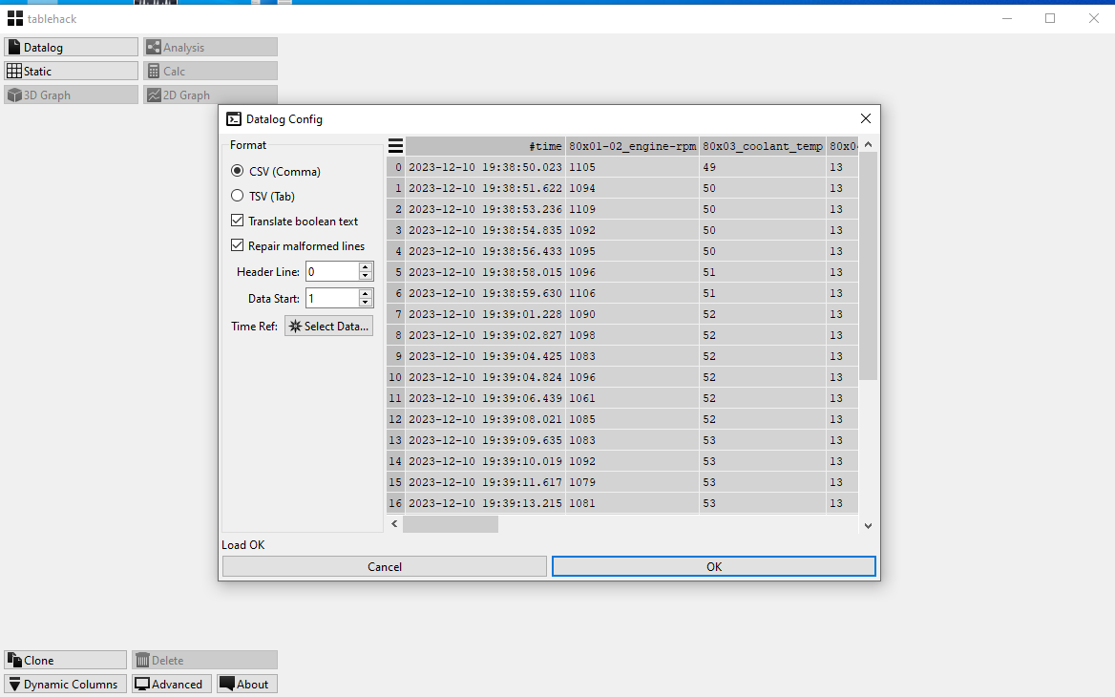

Slide 4
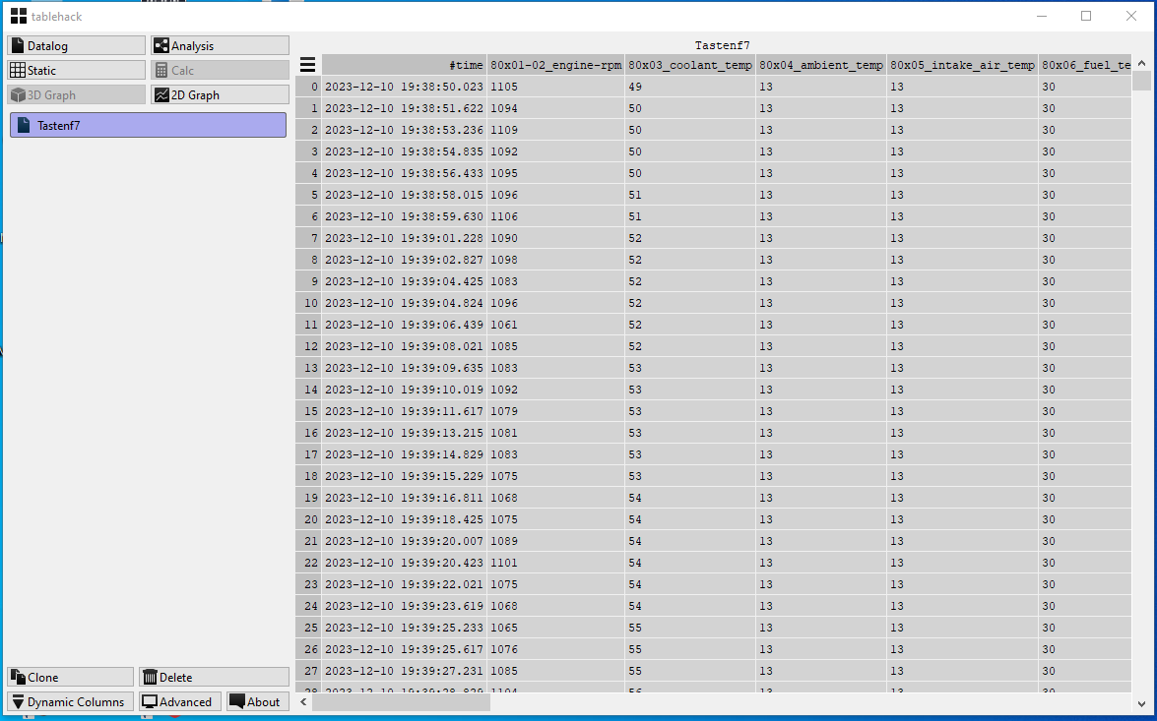

Slide 5
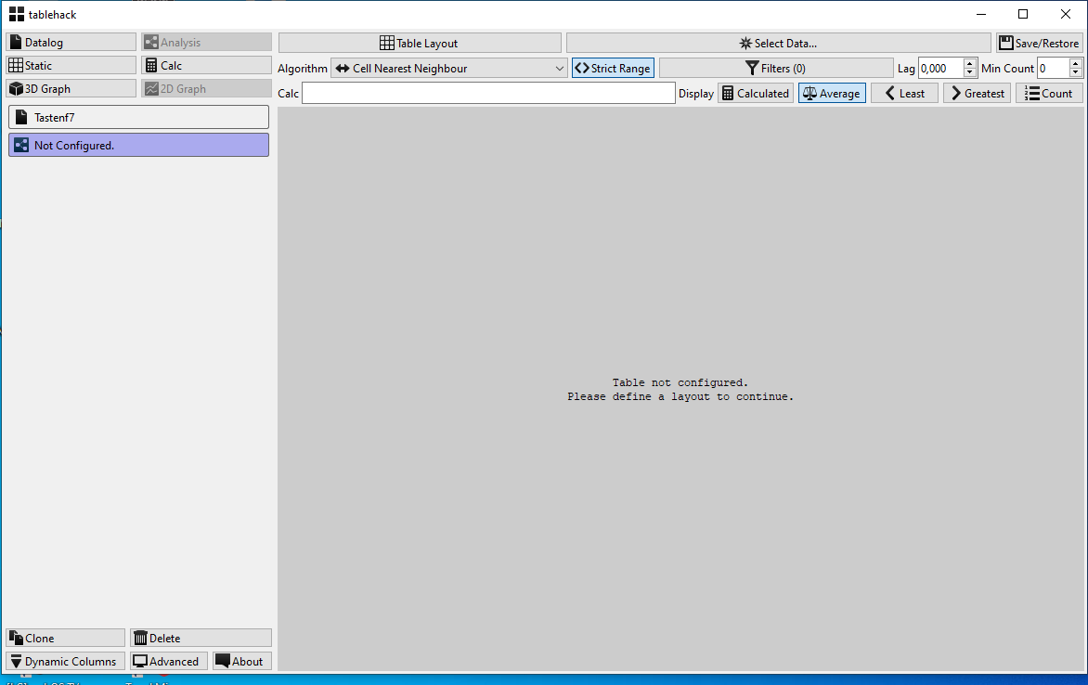
Analysis

Slide 6
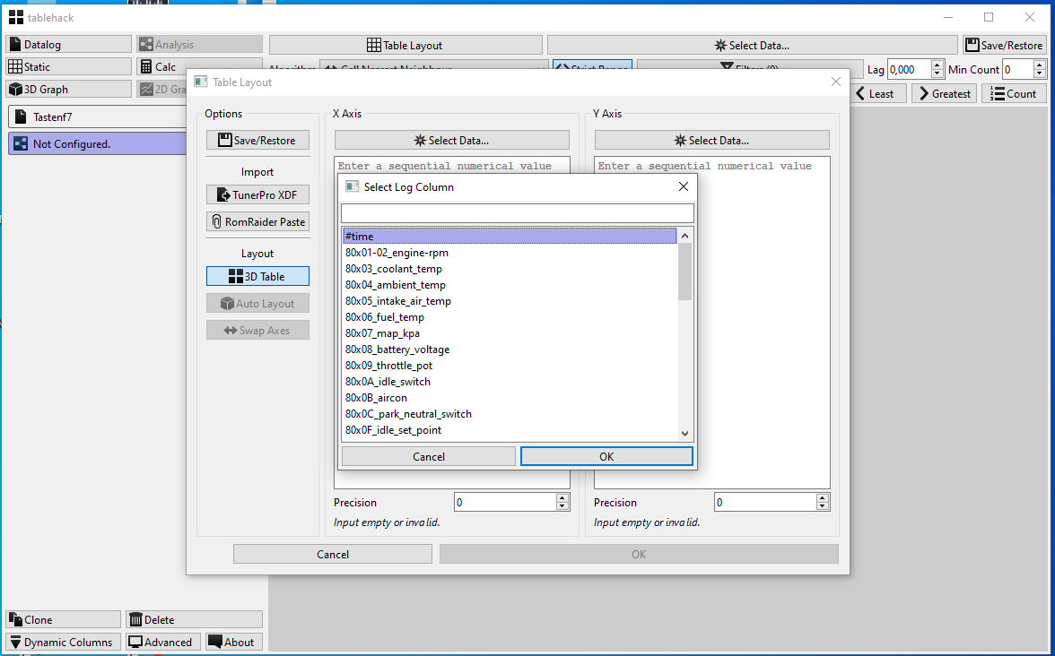

Slide 7
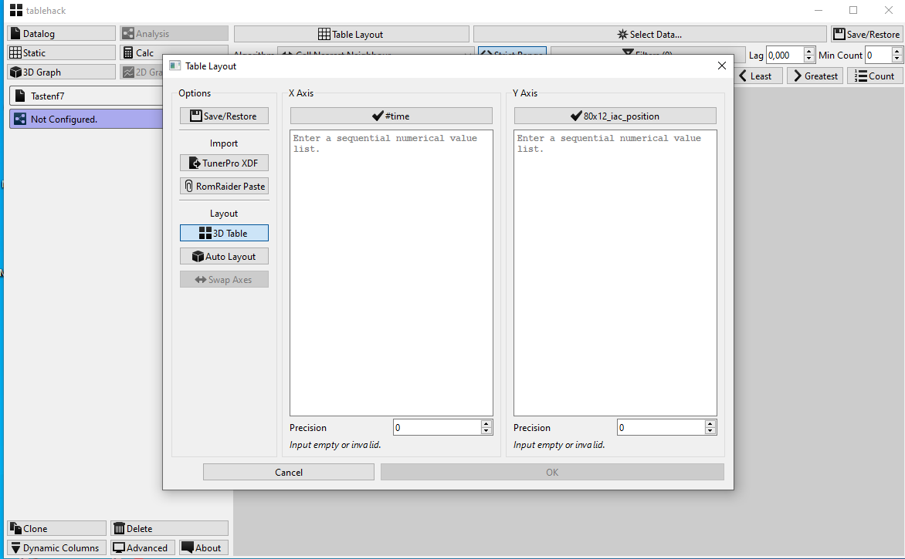

Slide 8
Now it stucks

Slide 9
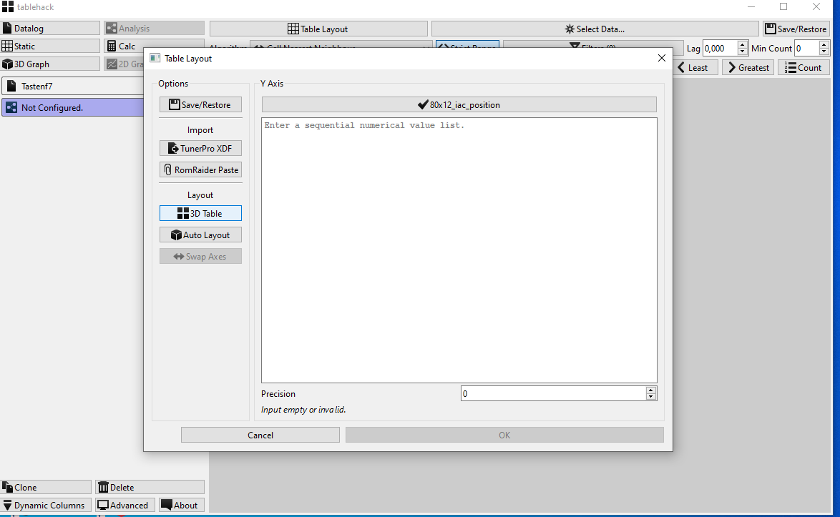
Even when I choose 3d Table , no more choice-Also when I choose a precision!

Slide 10
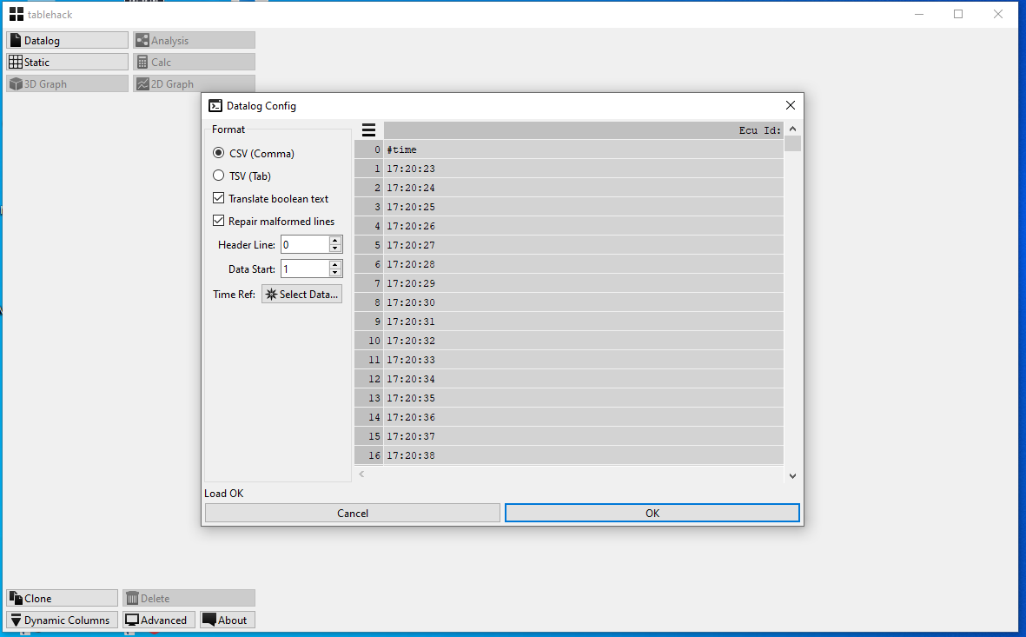
The txt file loaded as csv

Slide 11
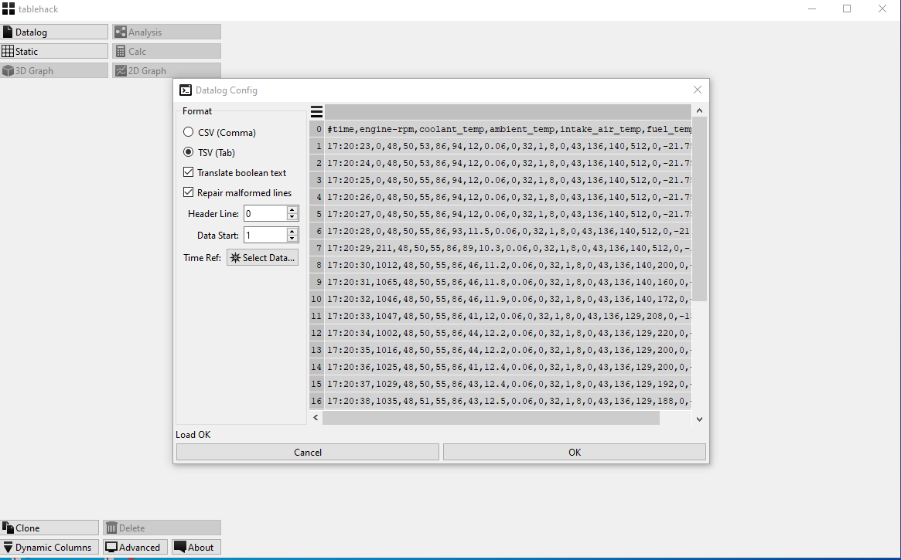
Txt as tsv

Slide 12
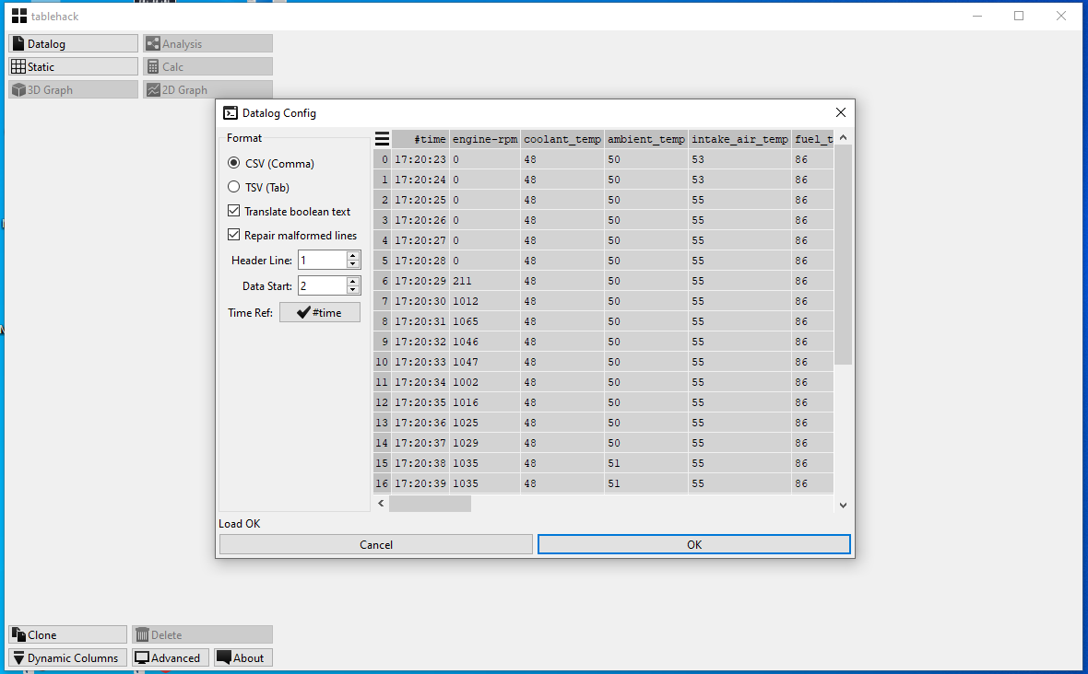
This time i choose header line 1 and data start 2,time reference #time

Slide 13
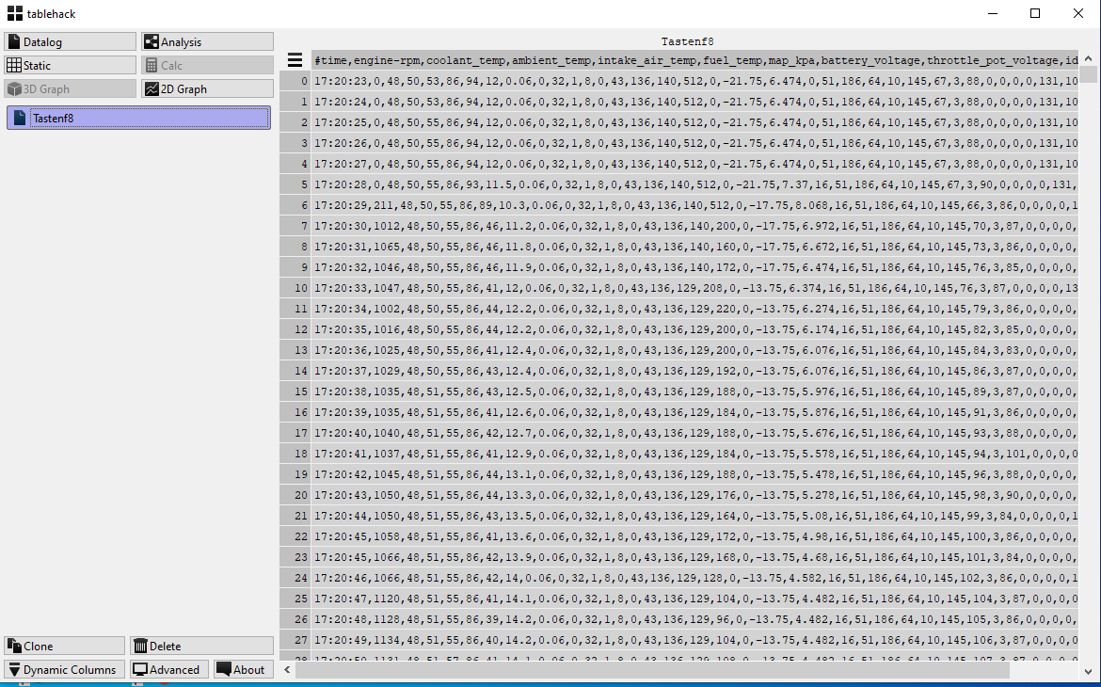
And stuck again

Slide 14
I fear i need a manual

