Slide 1
Fundamentals and Benefits of CI/CD
Achieve, Build, and Deploy Automation for Cloud-Based Software Products

Slide 2
What is Continuous Delivery?
Continuous Delivery is an engineering practice in which teams produce and release value in short cycles.
Continuous Integration + Continuous Deployment = Continuous Delivery

Slide 3
CI + CD = C. Delivery
Continuous Integration
The practice of merging all developers' working copies to a shared mainline several times a day. It's the process of "Making". Everything related to the code fits here, and it all culminates in the ultimate goal of CI: a high quality, deployable artifact! Some common CI-related phases might include:
Compile
Unit Test
Static Analysis
Dependency vulnerability testing
Store artifact
Continuous Deployment
A software engineering approach in which the value is delivered frequently through automated deployments. Everything related to deploying the artifact fits here. It's the process of "Moving" the artifact from the shelf to the spotlight. Some common CD-related phases might include:
Creating infrastructure
Provisioning servers
Copying files
Promoting to production
Smoke Testing (aka Verify)
Rollbacks

Slide 4
Why Continuous Delivery?
The following problems can be fixed with CI/CD:
Investing more time in a release cycle than delivering value
Going through integration hell every time we finish a feature
Code gets lost because of botched merges
Unit test suite hasn't been green in ages
Deployments contribute to schedule slip
Friction between ops and development departments
Only one engineer can deploy a system
Deployments are not cause for celebration

Slide 5
What Business value brings CI/CD?
CI/CD Benefit | Value | Translation
Catch Compile Errors After Merge | Reduce Cost | Less developer time on issues from new developer code
Catch Unit Test Failures | Avoid Cost | Less bugs in production and less time in testing
Detect Security Vulnerabilities | Avoid Cost | Prevent embarrassing or costly security holes
Automate Infrastructure Creation | Avoid Cost | Less human error, Faster deployments
Automate Infrastructure Cleanup | Reduce Cost | Less infrastructure costs from unused resources
Faster and More Frequent Production Deployments | Increase Revenue | New value-generating features released more quickly
Deploy to Production Without Manual Checks | Increase Revenue | Less time to market
Automated Smoke Tests | Protect Revenue | Reduced downtime from a deploy-related crash or major bug
Automated Rollback Triggered by Job Failure | Protect Revenue | Quick undo to return production to working state
https://blackswanfarming.com/value-a-framework-for-thinking/

Slide 6
Principles of Continuous Delivery.
1. Repeatable Reliable Process of Releasing/Deploying SW.
Automate Everything: No manual process necessary.
Version Control Everything: including Infrastructure, Configuration, Test Cases, Acceptance Tests, E2E Tests.
Bring the Pain Forward: if something is difficult, do that thing more often until it is not difficult anymore.
Build-in Quality: verify quality, keep metrics to alert the team if expected quality drops (Coverage, Complexity, Code Smells Code Style). Process should motivate team to improve metrics over time.
"Done" Means Released: A feature is only done, when it is running in production.
Everyone is Responsible: No Silos, when there is a problem everyone has to help.
Continuous Improvement: True north is perfection, small daily improvements are the steps towards that goal.
Source: https://www.amazon.com/dp/0321601912?tag=contindelive-20

Slide 7
Costs for adoption of CI/CD.
No more manual deploying to environments
No more modifying environment settings in GUI's
No more neglecting the unit tests
No more leaving broken code in place
Requires a high level of discipline
Requires additional skills to maintain and extend automation

Slide 8
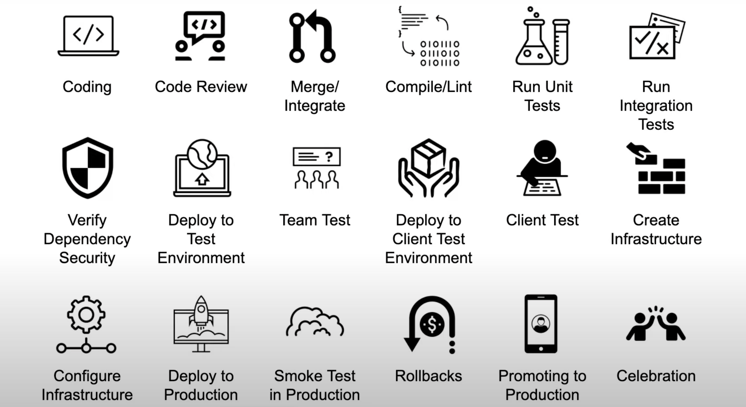
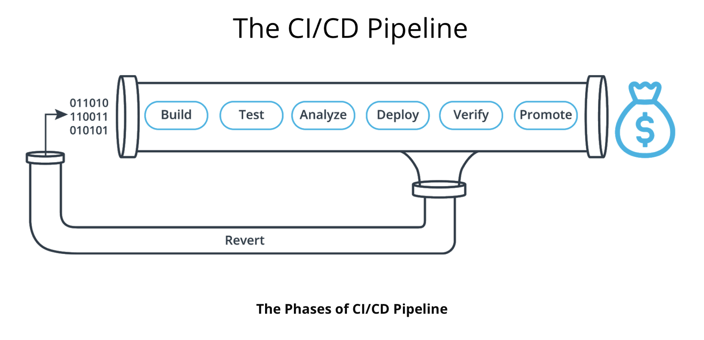
Process of Deploying to Production.

Slide 9
Steps to get closer to Continuous Delivery.
Expect collaborative, comprehensive grooming of features that include team and stakeholders
Ruthless slicing of features to smallest valuable increments
Build team-wide, deep understanding of each feature's requirements and characteristics before coding starts
Write comprehensive automated unit tests in front-end and back-end layers
Shoot for high coverage from automated back-end integration tests
Shoot for high feature critical-path coverage from end-to-end UI tests
Include automated smoke tests that can be run on production-candidates
Ensure all post-commit tasks and hand-offs must be automated in CI/CD
Strive for quick, reliable rollback if smoke tests fail

Slide 10
Best Practices for CI/CD.
Fail Fast
Set up your CI/CD pipeline to find and reveal failures as fast as possible. The faster you can bring your code failures to light, the faster you can fix them.
Measure Quality
Measure your code quality so that you can see the positive effects of your improvement work (or the negative effects of technical debt).
Only Road to Production
Once CI/CD is deploying to production on your behalf, it must be the only way to deploy. Any other person or process that meddles with production after CI/CD is running will inevitably cause CI/CD to become inconsistent and fail.
Maximum Automation
If it can be automated, automate it. This will only improve your process!
Config in Code
All configuration code must be in code and versioned alongside your production code. This includes the CI/CD configuration files!

Slide 11
Backup

Slide 12
Deployment Strategies.
Deployment Strategy | Description
Big-Bang | Replace A with B all at once.
Blue Green | Two versions of production: Blue or previous version and Green or new version. Traffic can still be routed to blue while testing green. Switching to the new version is done by simply shifting traffic from blue to green.
Canary | Aka Rolling Update, After deploying the new version, start routing traffic to new version little by little until all traffic is hitting the new production. Both versions coexist for a period of time.
A/B Testing | Similar to Canary, but instead of routing traffic to new version to accomplish a full deployment, you are testing your new version with a subset of users for feedback. You might end up routing all traffic to the new version, but that's always the goal.

Slide 13
Blue-Green Deployment.
Router Option | Description
Load Balancer | Instant switch for FE or BE, ideal router in most cases
CDN | Instant switch for front-end web apps.
DNS | A bit slow because of DNS propagation.
Step | Description
Integrate Code in a Build | Compile and create artifact
Run Tests | Run unit and/or integration tests
Ensure Infrastructure is Present | Create green infrastructure
Provision the Environment | Configure green instance, migrate DB, etc
Deploy Artifact | Copy artifact files to instance
Run Smoke Tests | Run a few tests that don't impact the prod server
Perform Rollback if Failure | Rollback here is more of a cleanup of green
Switch Router | Redirect traffic to new version
Run Sanity Test | Run a few tests that don't impact the prod server
Perform Rollback If Failure | Rollback here is switching the router back to blue and cleaning up green
Destroy Old Release Environment? | Clean up blue env (optional)
Notify The Team (Successful) | Celebrate!

Slide 14
Build Stages of CI/CD
Stage | Description
Build | Everything that has to do with making code executable in production (e.g. Compile). The goal is to produce an artifact.
Test | All automated tests that verify at the code level.
Analyze | Any static analysis on the code or checking of dependencies.
Deploy | Anything to do with creating server instances or copying pre-built application files to an instance.
Verify | Any tests that can be run against a running instance of the application, often against a pre-production instance.
Promote | Replacing the current production environment with the new version which was just built and deployed.
Revert | Rolling back or undoing changes in case any verification fails after deployment.

Slide 15
Key Terms
Pipeline: A set of data processing elements connected in series, where the output of one element is the input of the next one.
Continuous Integration: The practice of merging all developers' working copies to a shared mainline several times a day.
Continuous Delivery: An engineering practice in which teams produce and release value in short cycles.
Continuous Deployment: A software engineering approach in which the value is delivered frequently through automated deployments.
Infrastructure as Code: The management of infrastructure using code.
Provisioning: The process of setting up IT infrastructure.
Artifact: A product of some process applied to the code repository.
DevOps: A set of practices that works to automate and integrate the processes between software development and IT teams.
Testing: A practice that seeks to ensure the quality of the software.

