Slide 1
Analysis of Food and Beverage (F&B) Industry in Kuala Lumpur (KL), Malaysia
Utilized Foursquare API to explore the most common venues among all districts.
Co-ordinates were obtained from Wikipedia, Google Search and Foursquare.
K means clustering was applied to cluster the districts.

Slide 2
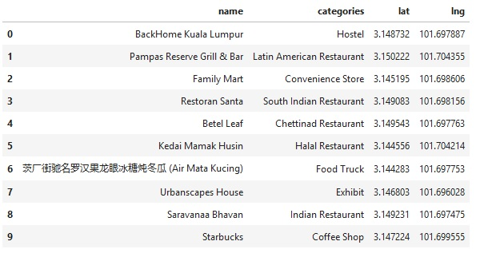
Explore features returning venues within KL

Slide 3
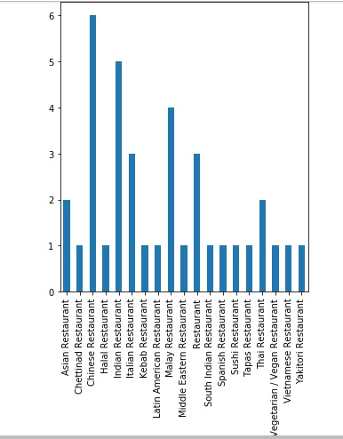
Bar graph visualizing the types of restaurants

Slide 4
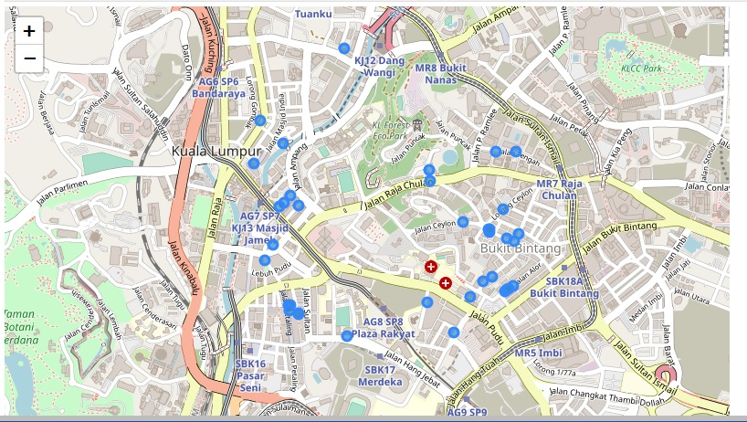
Map with markers indicating the restaurants locations.

Slide 5
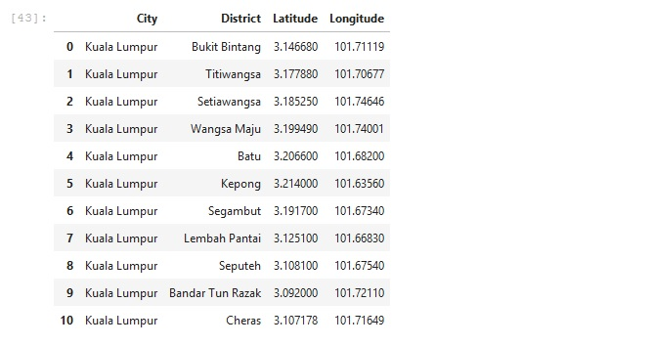
Co-ordinates of districts in KL

Slide 6
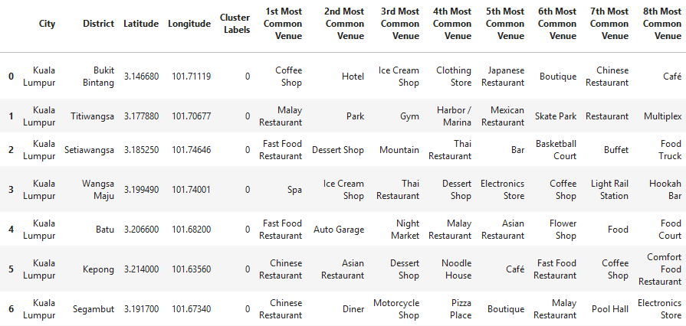
List of most common venues

Slide 7
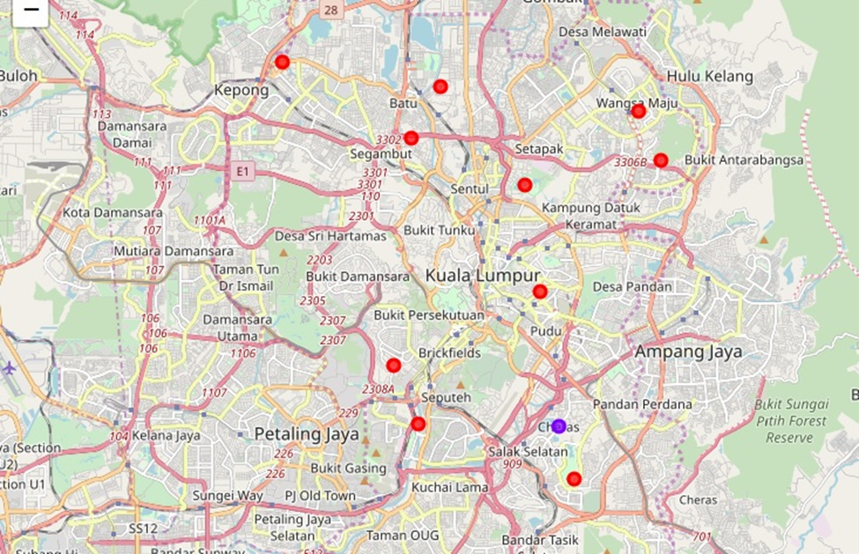
Map indicating the districts of KL

