Slide 1
Big Data analytics tools
Week 1
Day 1
Apache Spark SQL

Slide 2
What is Apache Spark

Slide 3
What is Apache Spark
Apache Spark is a unified computing engine and a set of libraries for parallel data processing on computer clusters.
The computing engine allows you the process any size dataset distributed or non-distributed

Slide 4
Unified Computing Engine
This means that you can use spark to perform a wide range of analytic task using the same APIs.
Data loading
SQL
Machine learning
Data Streaming
Batch processing

Slide 5
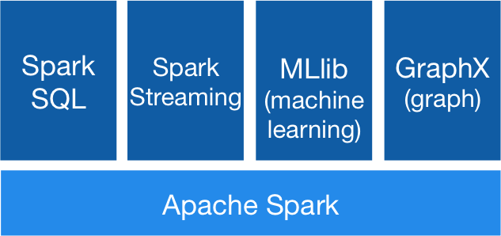
Spark Components The following diagram shows the major components of the spark framework
Image source: spark definite guide

Slide 6
Spark SQL
Spark SQL is used for processing with structured data
It provides Uniform Data Access to various data sources for example Hive, Avro, Parquet, ORC, JSON, and JDBC.
It allows you to use ODBC or JDBC to connect to data stored in relational databases or data store in hadoop

Slide 7
MLlib
MLlib is Apache Spark's scalable machine learning library
Runs on existing Hadoop clusters and data.
It can also run standalone, in the cloud or on HDFS.

Slide 8
SQL
What Is SQL?
SQL or Structured Query Language is a domain-specific language for expressing relational operations over data. It is used in all relational databases, and many “NoSQL” databases.
Spark implements a subset of the ANSI SQL:2003 Standard.
Spark SQL supports both ANSI-SQL as well as Hive QL queries.

Slide 9
Spark Dataframes and Datasets
Dataframes and Datasets are (distributed) table-like collections with well-defined rows and columns. Each column must have the same number of rows as all the other columns
You can think of spark Dataframes and datasets as being equivalent to tables in a relational database

Slide 10
Schemas
A schema defines the column names and types of a Dataframe. Schemas can be specified manually or be inferred from a data source .
Schemas are used to specify the type of data that is stored in the columns of the Dataframe i.e. Integer, String, Date etc.

Slide 11
Working with Structured data
You can create a Dataframe by using the following snippet of code:
val events_df = spark.read.format("csv").option("delimiter", "\t").
.load("/gdelt/data/raw/events.csv")
You can view the schema of this Dataframe by using :
events_df.printSchema()
This will show the name and types of columns in the Dataframe

Slide 12
DataFrame Transformations
In order for Dataframes to be useful they must all transformations. The main dataframe transformations are:
Creating Dataframes
Removing columns or Rows
Add rows or columns
Sort data by values in rows

Slide 13
Creating Dataframes
The code listing below shows how to create a dataframe when working with csv files.
val events_df = spark.read.format("csv")
.option("delimiter", "\t")
.load("/gdelt/data/raw/events/events.csv")
events_df.createOrReplaceTempView("events_table")
You can also create Dataframes from jdbc, odbc and many other data sources.

Slide 14
Removing Columns and Rows
It is not possible to remove a row or column from a Dataframe because Dataframes are immutable i.e. they can be changed after they are created.
However you can use select queries to create a new Dataframe without the row or column you which to remove. This is shown below
new_df = events_df.select("DEST_COUNTRY_NAME", "ORIGIN_COUNTRY_NAME")

Slide 15
Removing Columns
Rows are removed by using where clause or by filtering. The code listing below shows how this is done:
new_df = events_df.where(col("count") < 2).where(col("ORIGIN_COUNTRY_NAME") =!= "Croatia")
.show(2)

Slide 16
Adding Columns
You can add columns to and existing Dataframe using the command below. This will add a new column called numberOne to the events_df dataframe.
new_df = events_df.withColumn("numberOne", lit(1))

Slide 17
Adding Columns
You can add columns to and existing Dataframe using the command below. This will add a new column called numberOne to the events_df dataframe.
new_df = events_df.withColumn("numberOne", lit(1))

