Slide 1



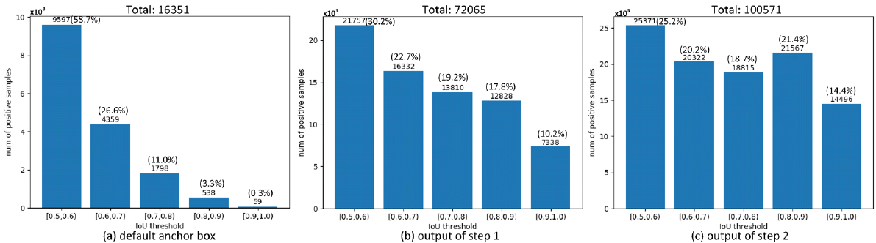
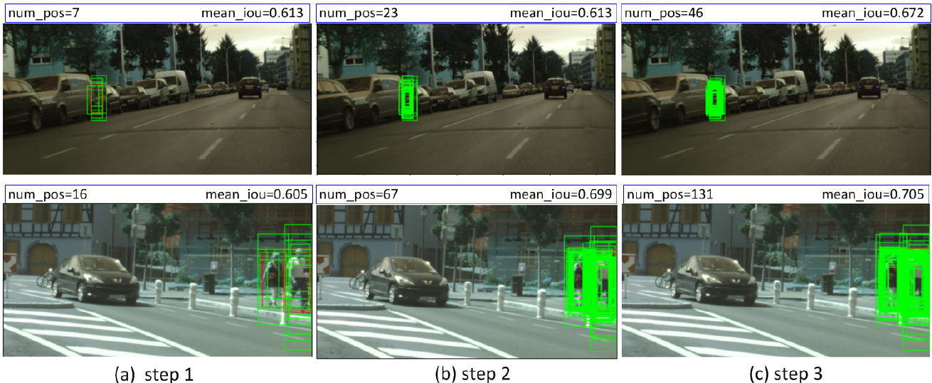
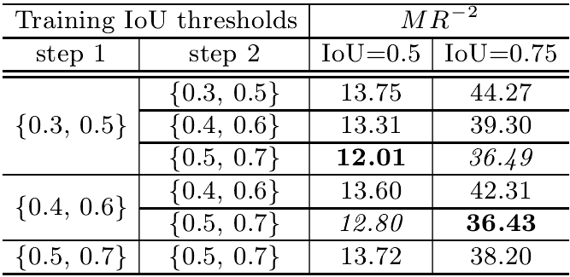
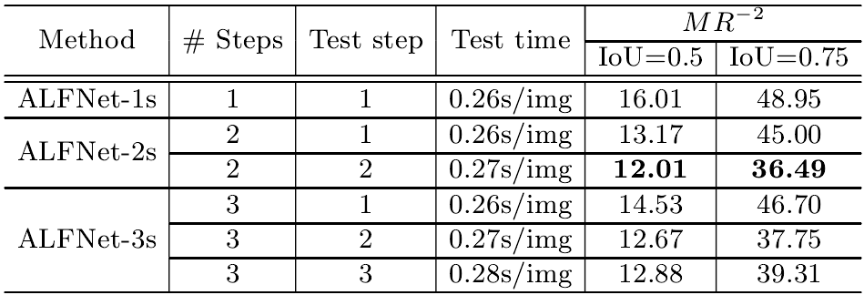
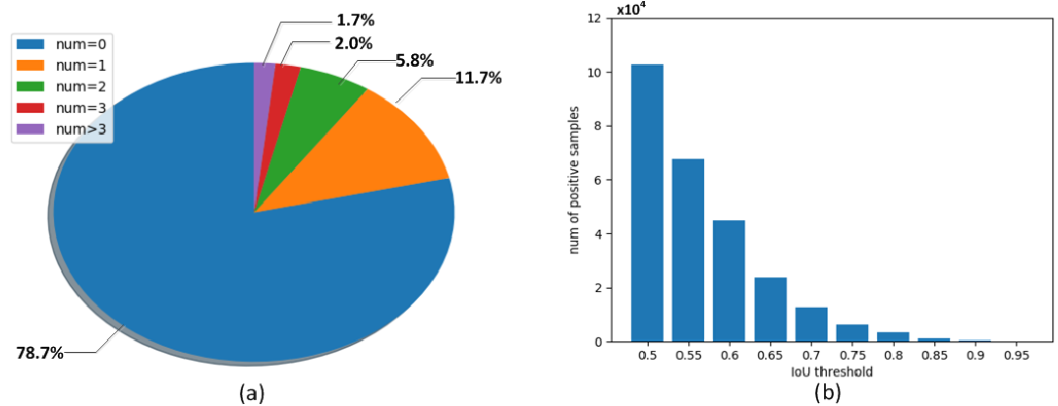
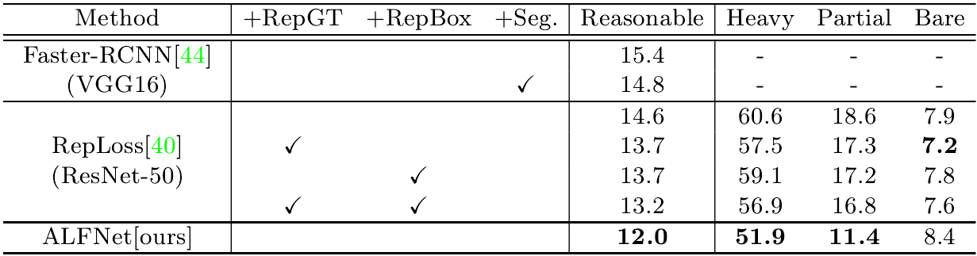
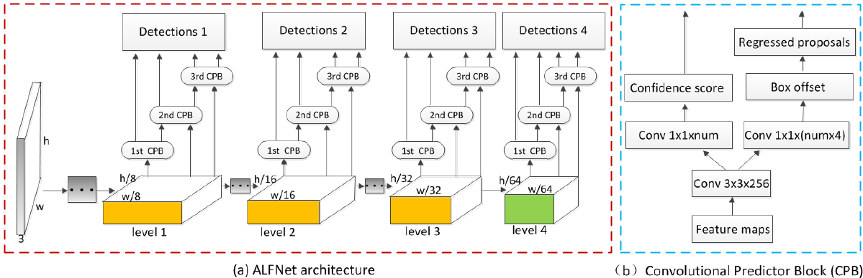
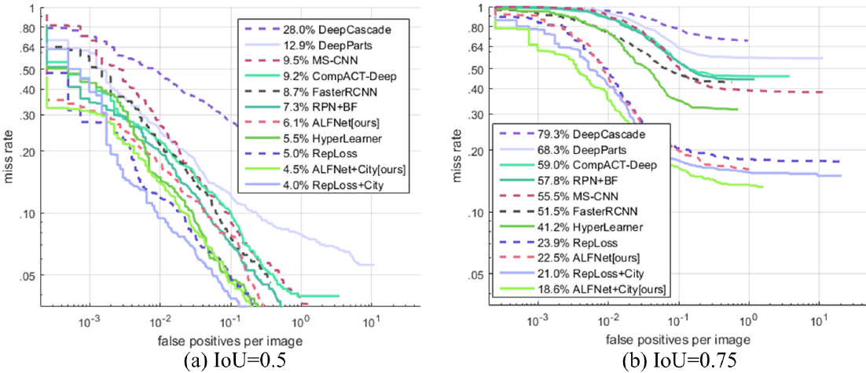
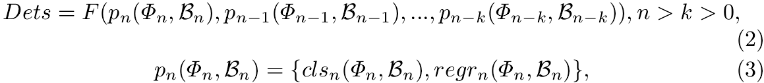
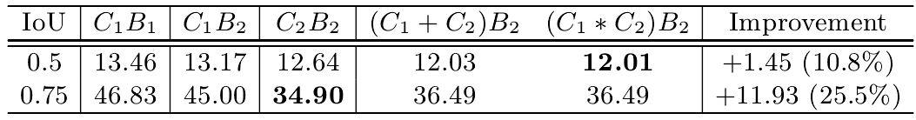
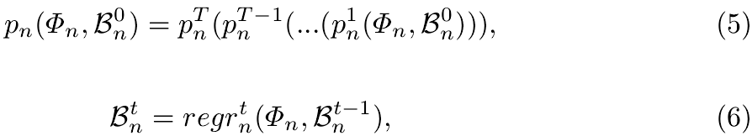
Learning Eﬃcient Single-stage Pedestrian Detectors by Asymptotic Localization Fitting
Wei Liu^{1,3}, Shengcai Liao^{*1,2}, Weidong Hu³, Xuezhi Liang^{1,2} and Xiao Chen³
¹Center for Biometrics and Security Research & National Laboratory of Pattern Recognition, Institute of Automation, Chinese Academy of Sciences, Beijing, China
² University of Chinese Academy of Sciences, Beijing, China
³National University of Defense Technology, Changsha, China
Introduction
Problems with Pedestrian Detectors
Two-stage: less efficient
Single-stage: less accurate
Pos/Neg samples: largely unbalanced
Contributions
A module called ALF is proposed to refine detections step by step
An efficient single-stage pedestrian detector is designed
State-of-the-art results on two benchmarks are achieved
Illustration examples
Green and red rectangles are anchor boxes and groundtruth boxes, respectively
Top left values: number of anchor boxes matched with the groundtruth boxes
Top right values: mean IoU with the groundtruth of all matched anchor boxes
Approach
IoU threshold for training
Number of stacked steps
Analysis of Caltech pedestrian detection dataset.
(a) Percentage of images with diﬀerent number of pedestrian instances
(b) Number of positive anchors w.r.t. diﬀerent IoU thresholds
With more ALF steps, the former predictor can hand over more anchor boxes with higher IoU to the latter one.
Comparison with the state of the arts
On CityPersons
Overall Framework
Inspiration: train the SSD in multi-steps with improving localization and increasing IoU thresholds
Asymptotic Localization Fitting (ALF)
Formulation
Multi-scale feature maps:
Detection:
On Caltech
Experiments
Ablation Analyses
ALF improvements
Code
* Ci: confidence score Bi: bounding box location.
https://github.com/VideoObjectSearch/ALFNet

