Slide 1
Nonlinear MPC for
Collision Avoidance and Control of
UAVs With Dynamic Obstacles
Björn Lindqvist, Sina Sharif Mansouri, Ali-akbar Agha-mohammadi, and
George Nikolakopoulos - 2020
Davide Alban - 344963
Davide De Bortoli - 344975
Leonardo Urbani - 344982

Slide 2
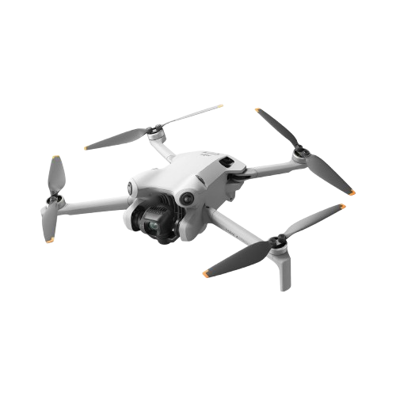
Paper presentation: objective
Collision avoidance
Moving obstacles
Safe operation in dynamic environments

Slide 3
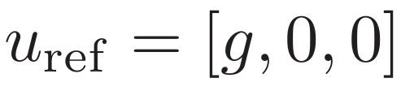
Paper presentation: cost function
Trajectory is computed minimizing this function
State cost: based on drone position wrt the desired one
Input cost: penalizes deviation from the steady-state input
Input smoothness cost: penalizes changes in successive inputs

Slide 4
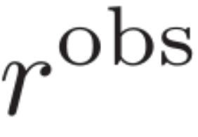
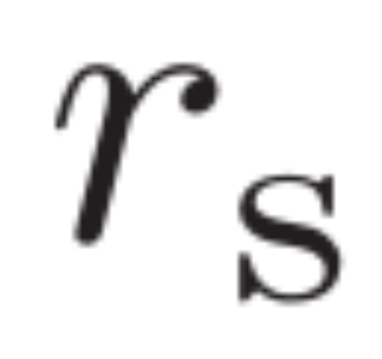
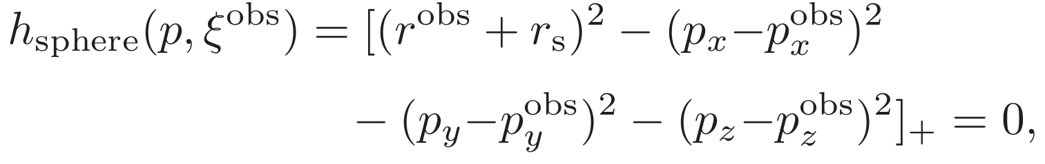
Paper presentation: soft constraints
SPHERICAL OBSTACLE
Growing sphere along the prediction horizon
: obstacle estimated radius
: safety radius linearly increasing along prediction

Slide 5
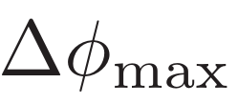

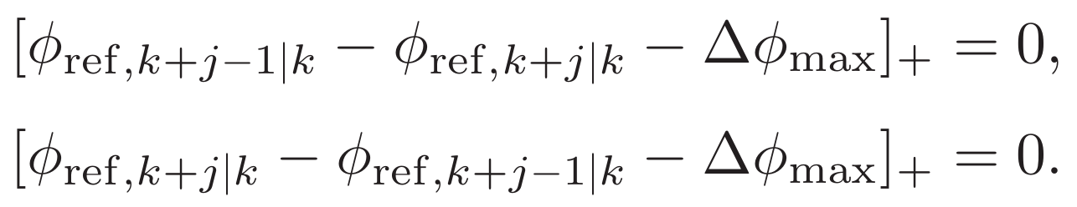
Paper presentation: soft constraints
2. CONTROL INPUT RATE
Avoiding aggressive or oscillatory behavior of the control inputs
and maximum change in input per time step

Slide 6
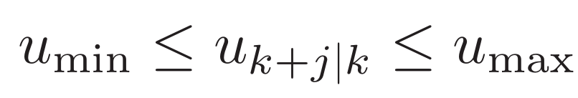
Paper presentation: hard constraints
3. INPUT CONSTRAINTS
Trust and tilting angles in a real UAV are limited.
This constraint cannot be broken!

Slide 7

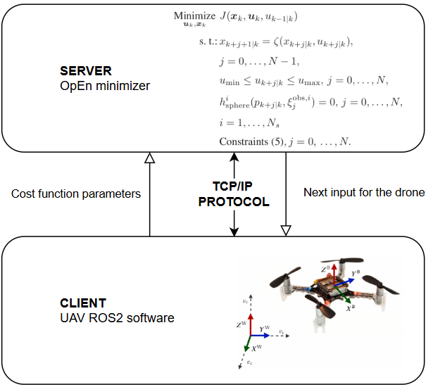
Paper presentation: OpEn minimizer
Main problem of NMPC control: Solver Time!
PANOC fast and light minimizer, suitable for UAV, has very low memory and computational footprint
Minimizer called using TCP/IP protocol from ROS2 node

Slide 8
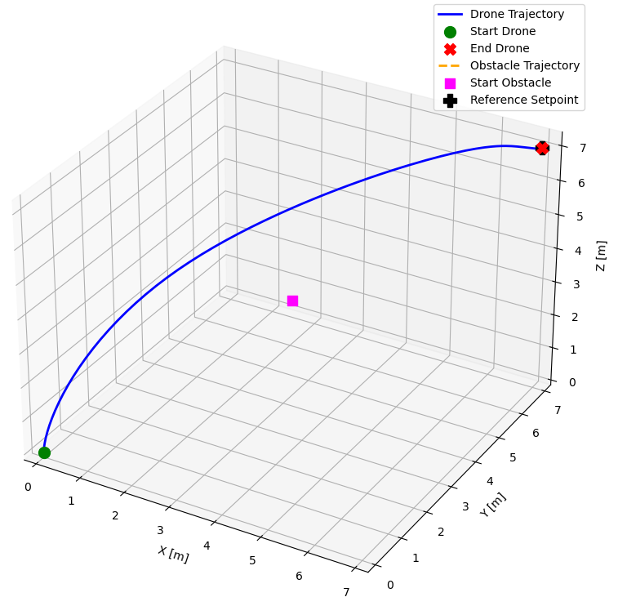
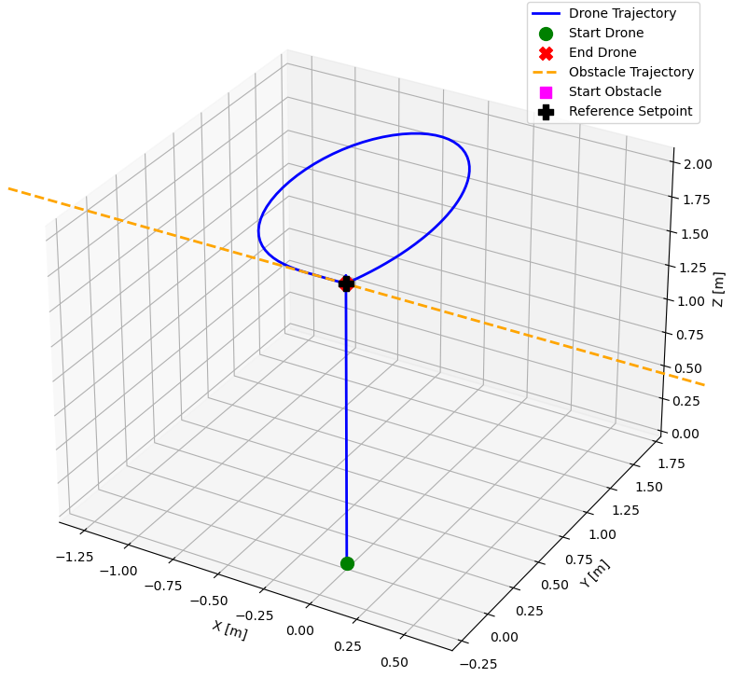
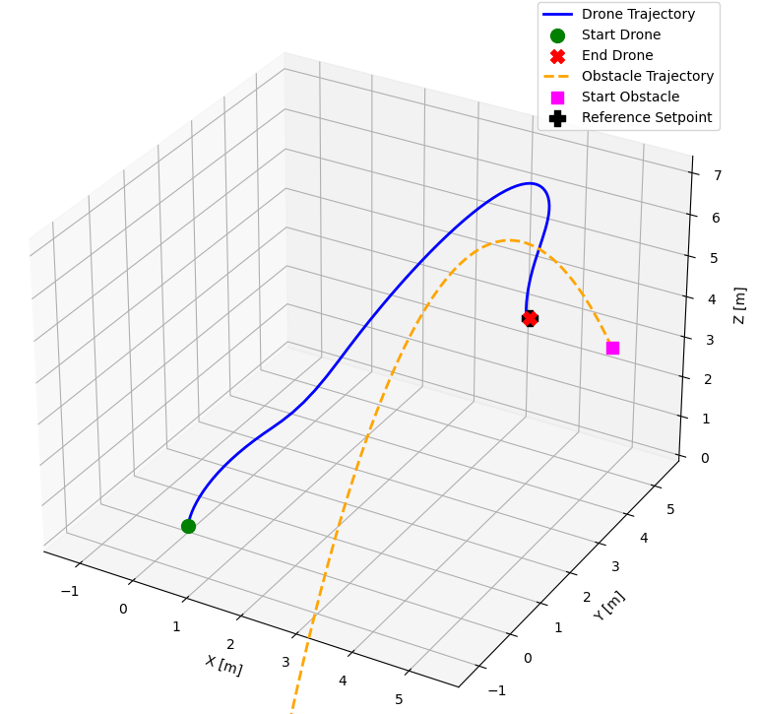
Paper presentation: Trajectory Identification
Possible obstacle trajectory:
STATIC
LINEAR
PARABOLIC

Slide 9
Project implementation: constraint formulation

Slide 10
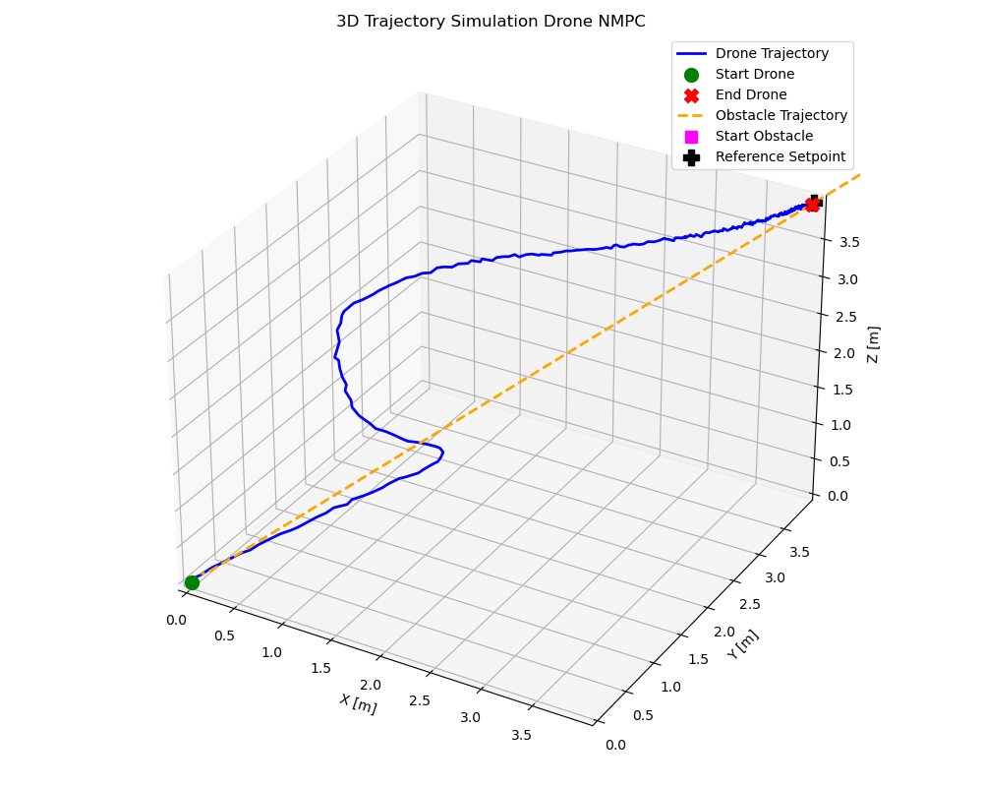
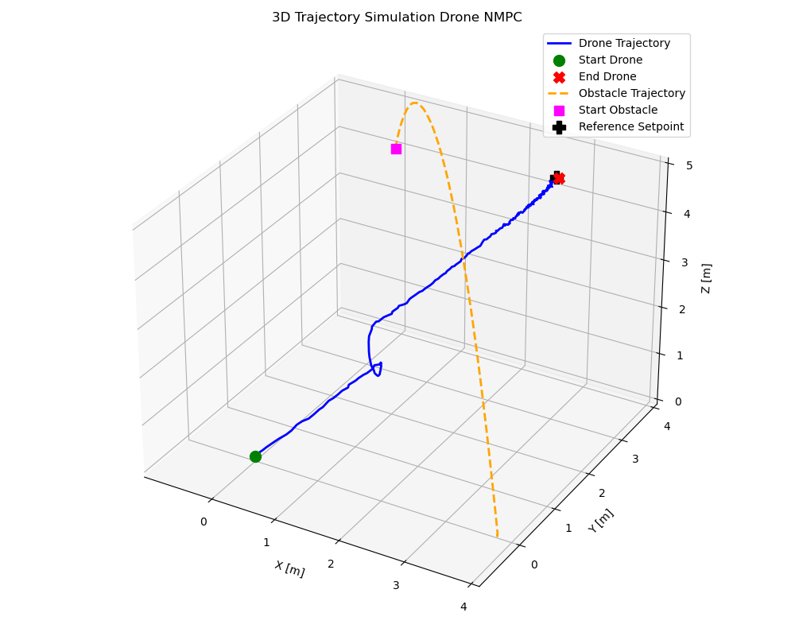
Project implementation
10
500

Slide 11
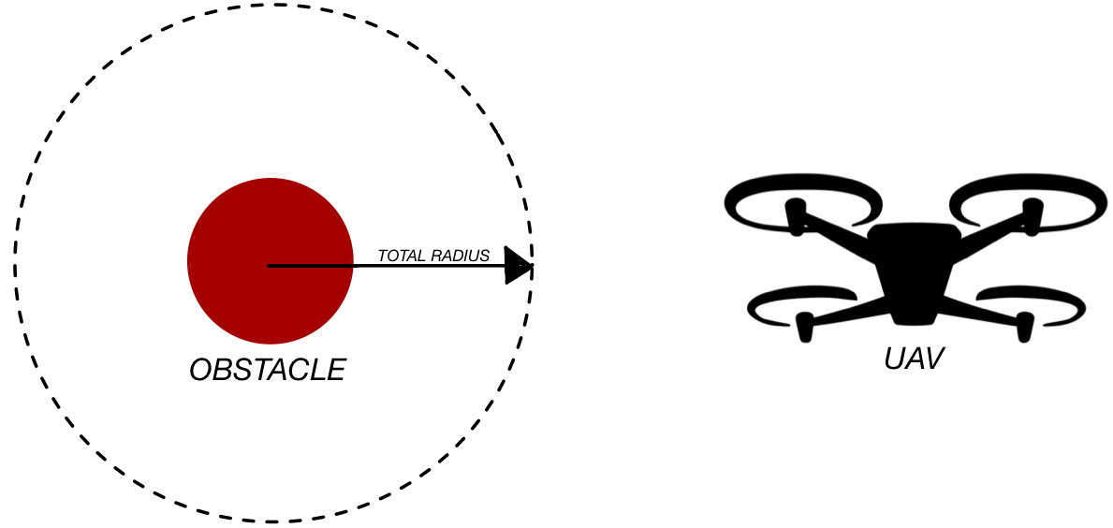
Project implementation

Slide 12
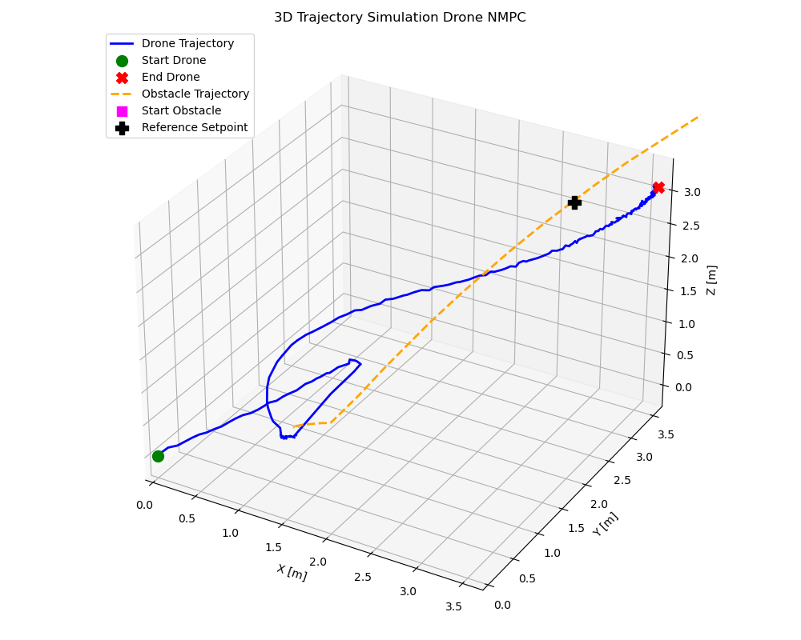
Project implementation
In case of collision:

Slide 13
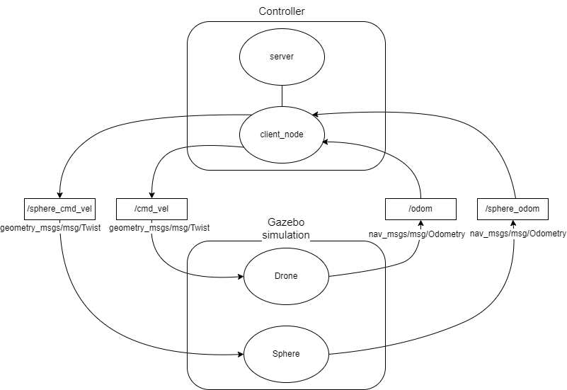
Code implementation: ROS2 - computation graph

Slide 14
Code implementation: ROS2 - packages and nodes

Slide 15
Code implementation: ROS2 - subscribers

Slide 16
Code implementation: ROS2 - publishers

Slide 17
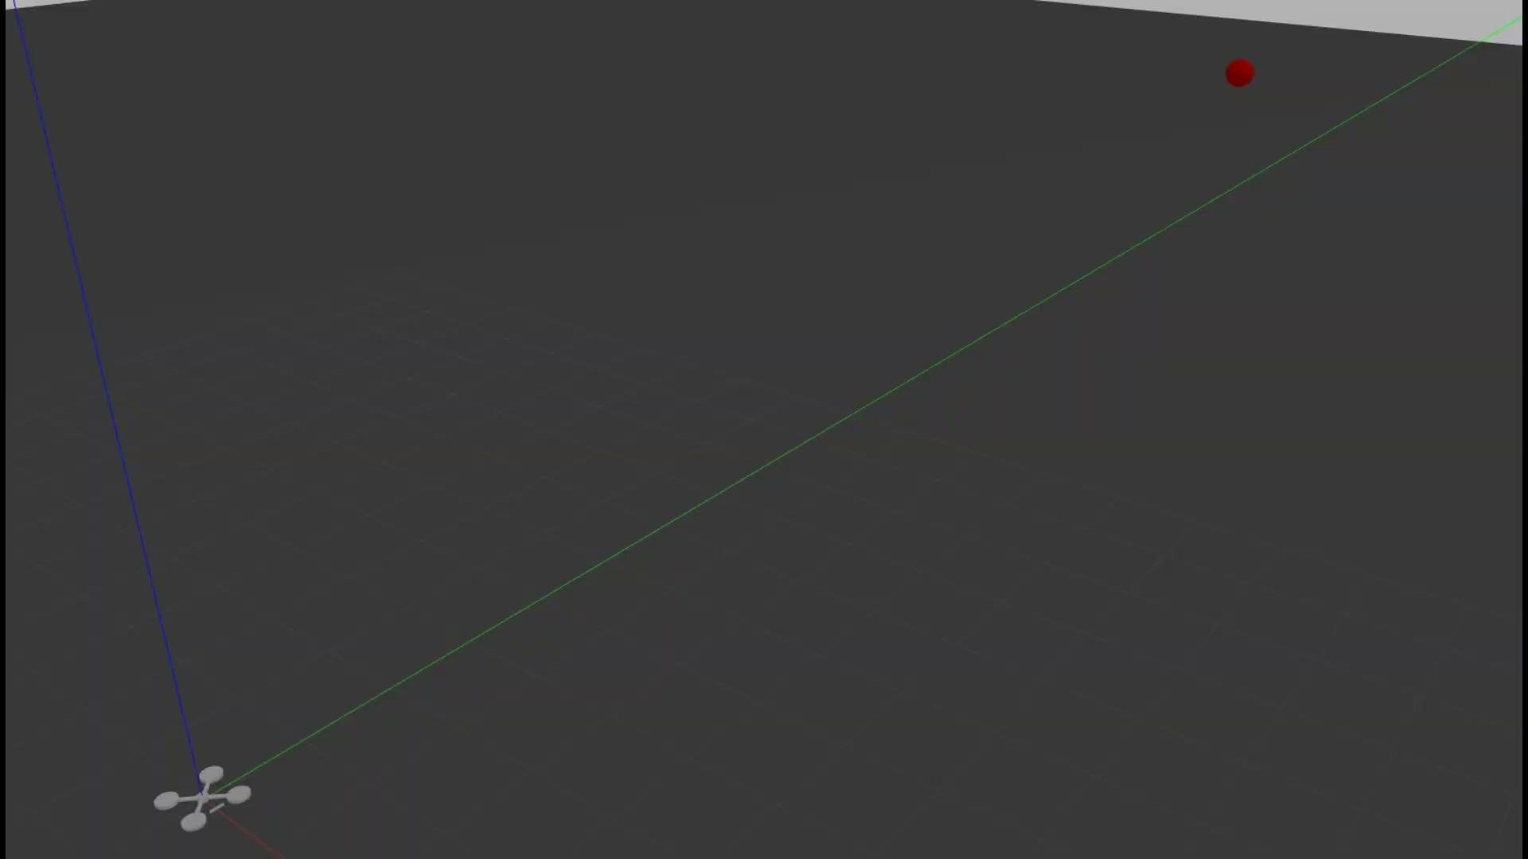
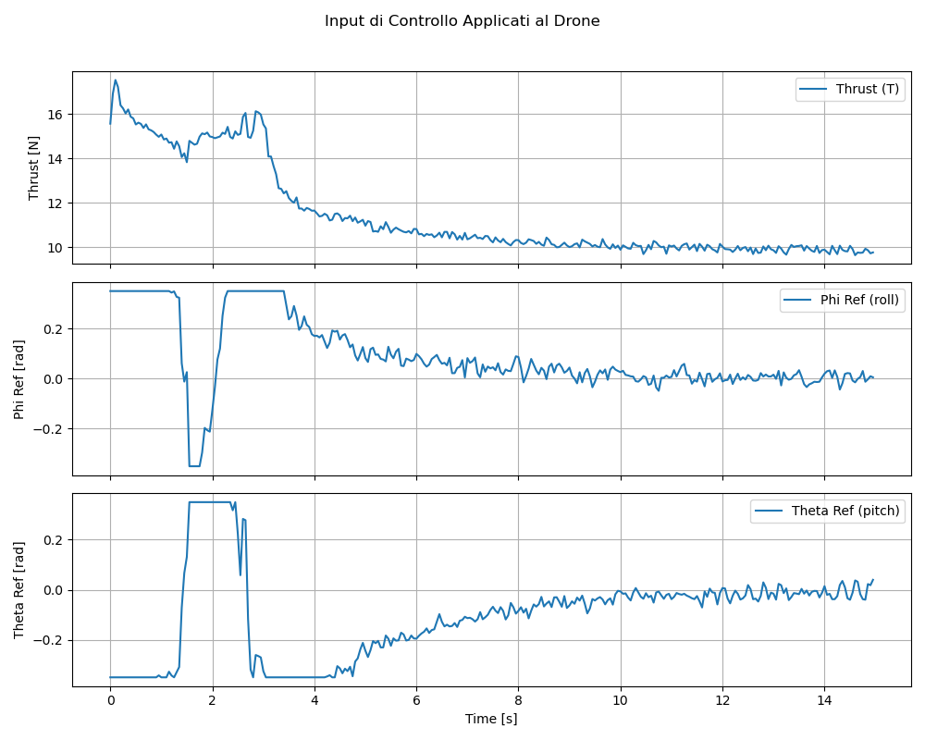
Simulation: Gazebo - linear trajectory

Slide 18
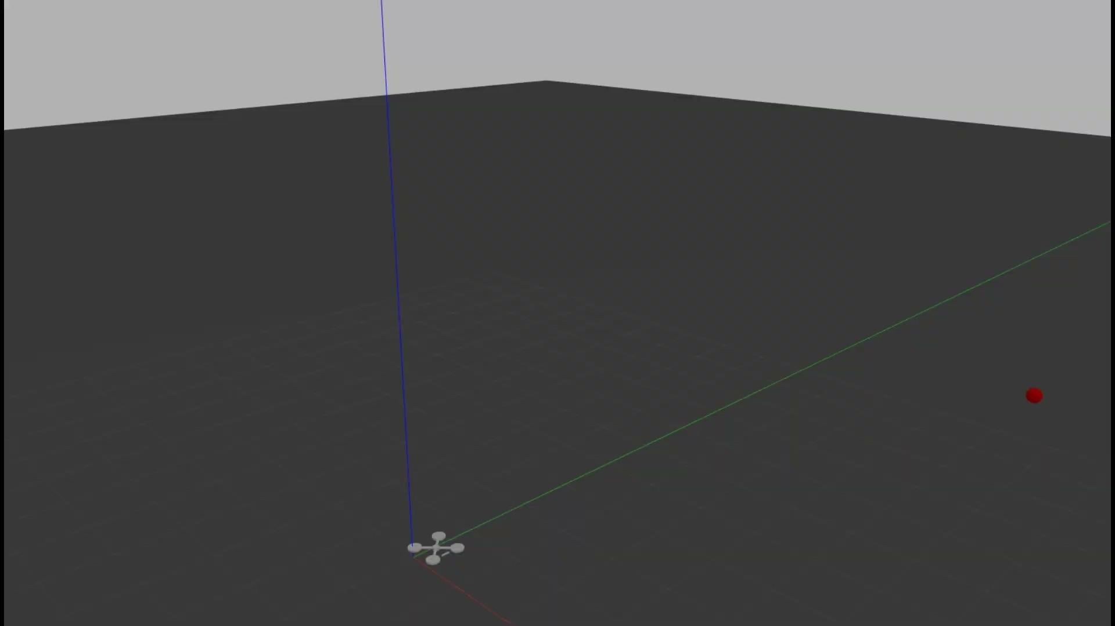
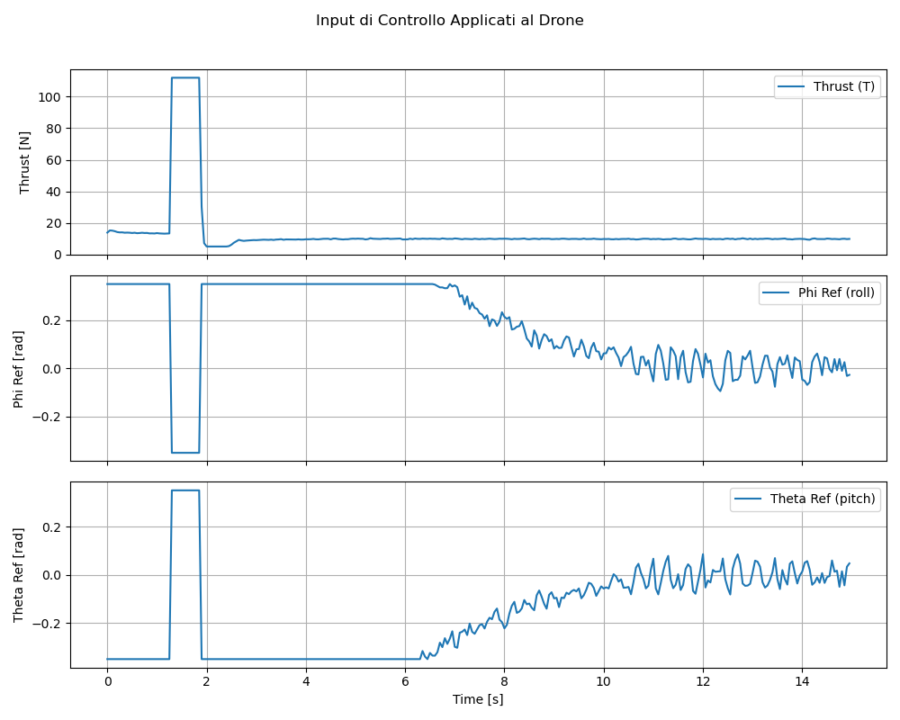
Simulation: Gazebo - parabolic trajectory

Slide 19
Future development
Sensors
Multiple-object avoidance
More trajectories

Slide 20
THANK YOU
FOR YOUR ATTENTION

