Slide 1
VPP overview

Slide 2
Agenda
Overview
Structure, layers and features
Anatomy of a graph node
Integrations
FIB 2.0
Future Directions
New features
Performance
Continuous Integration and Testing
Summary

Slide 3
Introducing VPP: the vector packet processor

Slide 4
Introducing VPP (the vector packet processor)
Accelerating the dataplane since 2002
Fast, Scalable and Determinisic
14+ Mpps per core
Tested to 1TB
Scalable FIB: supporting millions of entries
0 packet drops, ~15µs latency
Optimized
DPDK for fast I/O
ISA: SSE, AVX, AVX2, NEON ..
IPC: Batching, no mode switching, no context switches, non-blocking
Multi-core: Cache and memory efficient
Netconf/Yang
REST
...
Management Agent
Packet Processing: VPP
Network I/O

Slide 5
Introducing VPP
Netconf/Yang
REST
...
Extensible and Flexible modular design
Implement as a directed graph of nodes
Extensible with plugins, plugins are equal citizens.
Configurable via CP and CLI
Developer friendly
Deep introspection with counters and tracing facilities.
Runtime counters with IPC and errors information.
Pipeline tracing facilities, life-of-a-packet.
Developed using standard toolchains.
Management Agent
Packet Processing: VPP
Network I/O

Slide 6
Introducing VPP
Netconf/Yang
REST
...
Fully featured
L2: VLan, Q-in-Q, Bridge Domains, LLDP ...
L3: IPv4, GRE, VXLAN, DHCP, IPSEC …
L3: IPv6, Discovery, Segment Routing …
L4: TCP, UDP …
CP: API, CLI, IKEv2 …
Integrated
Language bindings
Open Stack/ODL (Netconf/Yang)
Kubernetes/Flanel (Python API)
OSV Packaging
Management Agent
Packet Processing: VPP
Network I/O

Slide 7
VPP: structure, layers and features

Slide 8
VPP: VPP Layering
VNET
VPP networking source
Devices
Layer [2, 3, 4]
Session Management
Overlays
Control Plane
Traffic Management
Plugins
Plugins can be in-tree:
SNAT, Policy ACL, Flow Per Packet, ILA, IOAM, LB, SIXRD, VCGN
Separate fd.io project:
NSH_SFC
VLIB
VPP application management
buffer, buffer management
graph node, node management
tracing, counters
threading
CLI
and most importantly …
main()
VPP INFRA
Library of function primitives, for
memory management
memory operations
vectors
rings
hashing
timers
VNET
VPP Infra
VLIB
Plugins

Slide 9
VPP: VNET Features
Devices
AF_PACKET
Layer 2
DPDK v16.11, HQOS, CryptoDev
NETMAP
SSVM
vhost-user
Ethernet, MPLS over Ethernet
HDLC, LLC, SNAP, PPP, SRP, LLDP
VLAN, Q-in-Q
MAC Learning
Split-horizon group support/EFP Filtering
VTR – push/pop/Translate (1:1,1:2, 2:1,2:2)
ARP : Proxy, termination
IRB: BVI Support with Router/MAC assignment
Flooding
Input ACLs
Interface cross-connect
Bridging
Layer 3
Source RPF
Thousands of VRFs
Controlled cross-VRF lookups
Multipath – ECMP and Unequal Cost
IPSec
IPv6
FIB 2.0
Recursive FIB lookup, failure detection
IP MPLS FIB
Shared FIB adjacencies
Neighbor discovery
Router Advertisement
Layer 4
UDP
TCP
Sockets: FIFO, Socket PreLoad
Multimillion scalable FIBs
Overlays
GRE
MPLS-GRE
NSH-GRE
VXLAN
VXLAN-GPE
L2TPv3
Segment Routing
Traffic Management
Mandatory Input Checks:
TTL expiration, Header checksum, L2 length < IP length, ARP resolution/snooping, per interface whitelists
Multiple million Classifiers, arbitrary N-tuple
Lawful Intercept
Policer
GBP/Security Groups classifier support
Connection tracking
LISP
NSH
iOAM
DHCP
Control Plane
MAP/LW46
SNAT
MagLev-like Load Balancer
Identifier Locator Addressing (ILA)
High performance port range ingress filtering
IKEv2

Slide 10
VPP: anatomy of a graph node

Slide 11
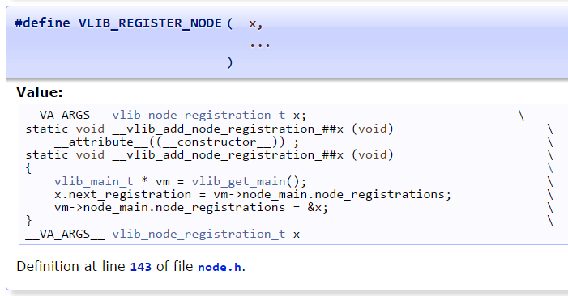
VPP: anatomy of a graph node
VLIB_REGISTER_NODE, macro to declare a graph node.
Creates:-
a graph node registration vlib_node_registration_t <graph node>
initializes values in <graph node>
a construction function __vlib_add_node_registration_<graph node> to register the graph node at startup.
vlib_node_registration_t
Type | Name | Description | User visible?
vlib_node_function_t * | function | Vector processing function for this node
char * | name | Node name | see `show run`
u16 | n_errors | Number of error codes used by this node.
char ** | error_strings | Error strings indexed by error code for this node. | see `show error`
u16 | n_next_nodes | Number of next node names that follow.
char * | next_nodes[] | Names of next nodes which this node feeds into.

Slide 12
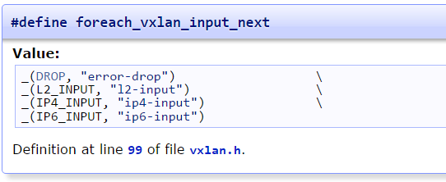
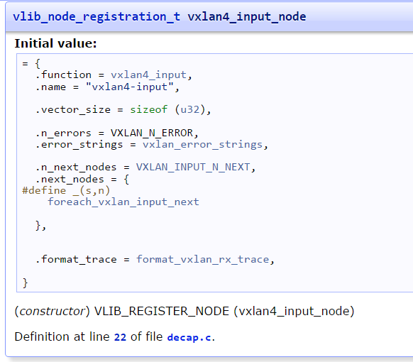
VPP: anatomy of a VXLAN graph node
VLIB_REGISTER_NODE registers `vxlan4_input_node` node
vxlan4_input is the vector processing function.
vxlan errors strings.
no such tunnel.
add next node strings.
error-drop – no such tunnel.
l2-input – layer 2 input.
IPv4-input – IPv4 input
IPv6-input – IPv6 input

Slide 13
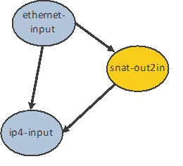
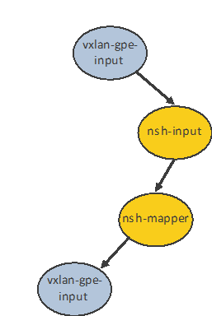
VPP: graph node interfaces
Each feature; collection of graph nodes expose a binary API and CLI
API
Multiple language bindings
Python
Java
LUA
Implementation
High-performance shared-memory ring-buffer
Asynchronous callback
CLI
Accessible via UNIX Channel, see vpp_api_test (VAT).
Runtime composed list of commands.
Typical CLI features; help system (?), command history etc.
vl_api_snat_add_address_range_t_handler()
vl_api_nsh_add_del_entry_t_handler()
vl_api_vxlan_gpe_add_del_tunnel_t_handler()

Slide 14
VPP: How does it work?
1
vhost-user-
input
af-packet-
input
dpdk-input
… graph nodes are optimized to fit inside the instruction cache …
2
ethernet-
input
Microprocessor
mpls-input
lldp-input
arp-input
cdp-input
l2-input
ip4-input
ip6-input
Packet 0
Packet 1
Packet 2
Packet 3
Packet 4
Packet 5
Packet 6
Packet 7
Packet 8
Packet 9
Packet 10
...-no-
checksum
Instruction Cache
3
ip4-lookup
ip4-lookup-
mulitcast
Data Cache
4
mpls-policy-
encap
ip4-load-
balance
ip4-rewrite-
transit
ip4-
midchain
interface-
output
… packets moved through graph nodes in vector …
… packets are pre-fetched, into the data cache …
Packet processing is decomposed into a directed graph node …
* approx. 173 nodes in default deployment

Slide 15
VPP: How does it work?
6
dispatch fn()
… instruction cache is warm with the instructions from a single graph node …
while packets in vector
Get pointer to vector
while 4 or more packets
Microprocessor
PREFETCH #3 and #4
ethernet-input
PROCESS #1 and #2
4
ASSUME next_node same as last packet
5
Update counters, advance buffers
Packet 1
Packet 2
Enqueue the packet to next_node
while any packets
<as above but single packet>
… data cache is warm with a small number of packets ..
… packets are processed in groups of four, any remaining packets are processed on by one …

Slide 16
VPP: How does it work?
dispatch fn()
while packets in vector
7
Get pointer to vector
while 4 or more packets
Microprocessor
PREFETCH #1 and #2
ethernet-input
PROCESS #1 and #2
ASSUME next_node same as last packet
Update counters, advance buffers
Packet 1
Packet 2
Enqueue the packet to next_node
while any packets
<as above but single packet>
… prefetch packets #1 and #2 …

Slide 17
VPP: How does it work?
dispatch fn()
while packets in vector
8
Get pointer to vector
while 4 or more packets
Microprocessor
PREFETCH #3 and #4
ethernet-input
PROCESS #1 and #2
ASSUME next_node same as last packet
Update counters, advance buffers
Packet 1
Packet 2
Enqueue the packet to next_node
Packet 3
while any packets
Packet 4
<as above but single packet>
… process packet #3 and #4 … … update counters, enqueue packets to the next node …

Slide 18
VPP: integrations

Slide 19


VPP Integrations
Openstack
Neutron
Integration work done at
ODL
Plugin
FD.io
Plugin
GBP app
Control Plane
Lispflowmapping app
SFC
VBD app
LISP Mapping Protocol
Netconf/Yang
Netconf/yang
REST
Honeycomb
FD.io ML2 Agent
Felixv2 (Calico Agent)
Data Plane
VPP

Slide 20
VPP: FIB 2.0

Slide 21
Why hierarchical FIB in data plane – recap
BGP_route
N->1
pointer
indirection
BGP_nexthop_list
N->1
pointer
indirection
IGP_nexthop_list
N->1
pointer
indirection
Output_Interface_List
BGP_route
BGP_nexthop_1
BGP_nexthop_2
…
BGP_nexthop_n
IGP_nexthop_1
IGP_nexthop_2
…
IGP_nexthop_n
oif_1
oif_2
…
oif_n
BGP_route
BGP_nexthop ≡ IGP_route
IGP_nexthop ≡ IGP adjacency
Data plane FIB pointer indirection structure between BGP, IGP and adjacency entries enables scale independent fast convergence

Slide 22
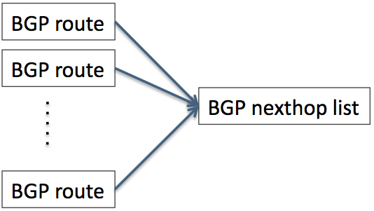


VPP v17.01: FIB 2.0 (Hierarchical FIB)
Operation
converging these BGP routes requires a single *in-place* modify of entry in BGP nexthop list
local BGP link failure (PE-CE)
BGP PIC local protection
remote BGP node failure
BGP PIC Edge
converging these BGP nexthops requires a single *in-place* modify of entry in IGP nexthop list
adjacent IGP link/node failure
IGP FC, BGP PIC core
slow
local link/node failure
TE-FRR, IP-FRR/LFA
converging these IGP nexthops requires a single *in-place* modify of entry in output interface list
VPP FIB 2.0 is a fast FIB implementation that provides for fast route updates, robust failure and fast routing decisions.
It provides an optimal implementation without the trade-off’s associated with a collapsed FIB (faster but slow updates) or a decoupled FIB/RIB (slow but faster updates )
Data plane FIB indirection enables route scale independent failure handling

Slide 23
VPP: future directions
Accelerating container networking
Accelerating IPSEC

Slide 24
Container networking: Current State
Container A
PID 1234
VPP
Container B
PID 4321
Overlays
ACL/Policy
User Space
send()
Layer 3
recv()
Layer 2
FIFO
FIFO
dpdk
af_packet
af_packet
TCP
TCP
IP (routing)
FIFO
FIFO
IP (routing)
Kernel Space
device
device
device
device

Slide 25
Smarter networking: Future State
Container A
PID 1234
Container B
PID 4321
send()
VPP
recv()
FIFO
FIFO
TCP/UDP
User Space
Overlays
ACL/Policy
Layer 3
Layer 2
dpdk
af_packet
af_packet

Slide 26




Accelerating IPSEC
VPP
Cryptodev API
DPDK
Vector/Crypto Instructions
Future On-core Accel
Future Accelerators
Quick Assist
2017
2018
2019

Slide 27
VPP: new features

Slide 28
Rapid Release Cadence – ~3 months
16-09
Release:
VPP, Honeycomb, NSH_SFC, ONE
17-01
Release:
VPP, Honeycomb, NSH_SFC, ONE
17-04
Release:
VPP, Honeycomb, NSH_SFC, ONE…
16-06
Release- VPP
16-06 New Features
16-09 New Features
17-01 New Features
17-04 New Features
Enhanced Switching & Routing
SRv6 spray use-case (IP-TV)
LISP xTR support
VXLAN over IPv6 underlay
per interface whitelists
shared adjacencies in FIB
Improves interface support
vhost-user – jumbo frames
Netmap interface support
AF_Packet interface support
Improved programmability
Python API bindings
Enhanced JVPP Java API bindings
Enhanced debugging cli
Hardware and Software Support
Support for ARM 32 targets
Support for Raspberry Pi
Support for DPDK 16.04
Enhanced LISP support for
L2 overlays
Multitenancy
Multihoming
Re-encapsulating Tunnel Routers (RTR) support
Map-Resolver failover algorithm
New plugins for
SNAT
MagLev-like Load
Identifier Locator Addressing
NSH SFC SFF’s & NSH Proxy
Port range ingress filtering
Dynamically ordered subgraphs
Hierarchical FIB
Performance Improvements
DPDK input and output nodes
L2 Path
IPv4 lookup node
IPSEC
SW and HW Crypto Support
HQoS support
Simple Port Analyzer (SPAN)
BFD
IPFIX Improvements
L2 GRE over IPSec tunnels
LLDP
LISP Enhancements
Source/Dest control plane
L2 over LISP and GRE
Map-Register/Map-Notify
RLOC-probing
ACL
Flow Per Packet
SNAT – Multithread, Flow Export
LUA API Bindings
….

Slide 29
Future Release Plans – 17.04 (Due Apr 19)
VPP Userspace Host Stack
Security Groups
Segment Routing v6
TCP stack
DHCPv4 relay multi-destination
DHCPv4 option 82
DHCPv6 relay multi-destination
DHPCv6 relay remote-id
ND Proxy
Routed interface support
L4 filters with IPv6 Extension Headers
SRv6 Network Programming
SR Traffic Engineering
SR LocalSIDs
Framework to expand LocalSIDs w/ plugins
API
Move to CFFI for Python binding
Python Packaging improvements
CLI over API
Improved C/C++ language binding
iOAM
SNAT
UDP Pinger w/path fault isolation
IOAM as type 2 metadata in NSH
IOAM raw IPFIX collector and analyzer
Anycast active server selection
CGN: Configurable port allocation
CGN: Configurable Address pooling
CPE: External interface
DHCP support
NAT64, LW46
IPFIX
Collect IPv6 information
Per flow state

Slide 30
VPP: performance

Slide 31
CSIT NDR Throughput VPP 16.09 v 17.01
>20% improvement in L2 performance
> 100% improvement in IPv6 performance
> 400% improvement in vHost performance

Slide 32
VPP Performance at Scale
Phy-VS-Phy
IPv6, 24 of 72 cores
IPv4+ 2k Whitelist, 36 of 72 cores
Zero-packet-loss Throughput
for 12 port 40GE
[Gbps]]
[Gbps]]
Hardware: Cisco UCS C460 M4
Intel® C610 series chipset
4 x Intel® Xeon® Processor E7-8890 v3 (18 cores, 2.5GHz, 45MB Cache)
2133 MHz, 512 GB Total
9 x 2p40GE Intel XL710 18 x 40GE = 720GE !!
480Gbps zero frame loss
IMIX => 342 Gbps,1518B => 462 Gbps
Latency
18 x 7.7trillion packets soak test
Average latency: <23 usec
Min Latency: 7…10 usec
Max Latency: 3.5 ms
[Mpps]
[Mpps]
Headroom
Average vector size ~24-27
Max vector size 255
Headroom for much more throughput/features
NIC/PCI bus is the limit not vpp
200Mpps zero frame loss
64B => 238 Mpps

Slide 33
VPP: Continuous Integration and Testing

Slide 34
Continuous Quality, Performance, Usability Built into the development process – patch by patch
Submit
Automated
Verify
Code Review
Merge
Publish Artifacts
Build/Unit Testing
120 Tests/Patch
System Functional Testing
252 Tests/Patch
Performance Testing
144 Tests/Patch, 841 Tests
Usability
Build binary packaging for
Ubuntu 14.04
Ubuntu 16.04
Centos 7
Automated Style Checking
Unit test :
IPFIX
BFD
Classifier
DHCP
FIB
GRE
IPv4
IPv4 IRB
IPv4 multi-VRF
DHCP – Client and Proxy
GRE Overlay Tunnels
L2BD Ethernet Switching
L2 Cross Connect Ethernet Switching
LISP Overlay Tunnels
IPv4-in-IPv6 Softwire Tunnels
Cop Address Security
IPSec
IPv6 Routing – NS/ND, RA, ICMPv6
uRPF Security
Tap Interface
Telemetry – IPFIX and Span
VRF Routed Forwarding
iACL Security – Ingress – IPv6/IPv6/Mac
IPv4 Routing
QoS Policer Metering
VLAN Tag Translation
VXLAN Overlay Tunnels
L2 Cross Connect
L2 Bridging
IPv4 Routing
IPv6 Routing
IPv4 Scale – 20k,200k,2M FIB Entries
IPv4 Scale - 20k,200k,2M FIB Entries
VM with vhost-userr
PHYS-VPP-VM-VPP-PHYS
L2 Cross Connect/Bridge
VXLAN w/L2 Bridge Domain
IPv4 Routing
COP – IPv4/IPv6 whiteless
iACL – ingress IPv4/IPv6 ACLs
LISP – IPv4-o-IPv6/IPv6-o-IPv4
VXLAN
QoS Policer
L2 Cross over
L2 Bridging
Merge-by-merge:
apt installable deb packaging
yum installable rpm packaging
autogenerated code documentation
autogenerated cli documentation
Per release:
autogenerated testing reports
report perf improvements
Puppet modules
Training/Tutorial videos
Hands-on-usecase documentation
IPv6
IP Multicast
L2 FIB
L2 Bridge Domain
MPLS
SNAT
SPAN
VXLAN
Merge-by-merge packaging feeds
Downstream consumer CI pipelines
Run on real hardware in fd.io Performance Lab

Slide 35
Summary
VPP is a fast, scalable and low latency network stack in user space.
VPP is trace-able, debug-able and fully featured layer 2, 3 ,4 implementation.
VPP is easy to integrate with your data-centre environment for both NFV and Cloud use cases.
VPP is always growing, innovating and getting faster.
VPP is a fast growing community of fellow travellers.
ML: vpp-dev@lists.fd.io Wiki: wiki.fd.io/view/VPP
Join us in FD.io & VPP - fellow travellers are always welcome.
Please reuse and contribute!

Slide 36
Questions?

Slide 37
VPP: Source Structure
Directory name | Description
build-data | Build metadata – package and platform specific build settings. e.g. vpp_lite, x86, cavium etc.
build-root | Build output directory build-vpp_lite_debug-native - build artifacts for vpp_lite, built with symbols. install-vpp_lite_debug-native – fakeroot for vpp_lite installation, built with symbols. deb – debian packages rpm – rpm packages vagrant – bootstrap a development environment
src/plugins | VPP bundled plugins directory - ila-plugin: Identifier Locator Addressing (ILA) - flowperpkt-plugin: Per-packet IPFIX record generation plugin - lb-plugin: MagLev-like Load Balancer, similar to Google's Maglev Load Balancer - snat-plugin: Simple ip4 NAT plugin - sample-plugin: Sample macswap plugin
src/vnet | VPP networking source - device: af-packet, dpdk pmd, ssvm - l2 : ethernet, mpls, lldp, ppp, l2tp, mcast - l3+: ip[4,6], ipsec, icmp, udp - overlays: vxlan, gre
src/vpp | VPP application source
src/vlib | VPP application library source;
src/vlib-api | VPP API library source
src/vpp-api | VPP application API source
src/vppapigen | VPP API generator source
src/vppinfra | VPP core library source

Slide 38
VPP: Build System
Make Targets | Description
bootstrap | prepare tree for build, setup paths and compilers etc
install-dep | install software dependencies, automatically apt-get build dependencies, used by vagrant provisioning scripts.
wipe, wipe-release | wipe all products of debug/release build
build, build-release | build debug/release binaries
plugins, plugins-release | build debug/release plugin binaries
rebuild, rebuild-release | wipe and build debug/release binaries
run, run-release | run debug/release binary in interactive mode
debug | run debug binary with debugger (gdb)
test, test-debug | build and run functional tests
build-vpp-api | build vpp-api
pkg-deb, pkg-rpm | build packages, build debian and rpm packaging for VPP, can be dpkg’ed or rpm’ed afterward.
ctags, gtags, cscope | (re)generate ctags/gtags/cscope databases
doxygen | (re)generate documentation
Make Variables | Description
V | 1 or 0, to switch on verbose builds
PLATFORM | Platform specific build, e.g. vpp_lite

Slide 39
Hierarchical FIB in Data plane – VPN-v4
BGP route
Load-balance
Label 44
Load-balance
Label 45
Adj0
Adjacency
Label 46
Eth0
Load-balance
BGP route
Load-balance
Ad1
Adjacency
Label 54
Eth1
Label 55
Label 56
Load-balance
Adj2
Adjacency
Eth2
BGP route
Load-balance
Label 64
Label 64
Label 66
A unique output label for each route on each path means that the load-balance choice for each route is different.
Different choices mean the load-balance objects are not shared.
No sharing means there is no common location where an in-place modify will affect all routes.
PIC is broken.

Slide 40
VPN-v4: Load-Balance Map
Hash
BGP route
Load-balance
Label 44
Load-balance
Label 45
Adj0
Adjacency
Label 46
Eth0
TX
Load-balance
BGP route
Load-balance
Ad1
Adjacency
Label 54
Eth1
Label 55
Label 56
Match
Hash
Load-balance
Adj2
Adjacency
Result = bucket 2
Eth2
BGP route
Load-balance
Label 64
Load-balance-Map
Label 64
input
Label 66
Bucket 1
Bucket 2
Bucket 3
Packet
Map
Output= bucket 2
Load-Balance Map translates from bucket indices that are unusable to bucket indices that are usable.

Slide 41
VPN-v4: Load-Balance Map: Path failure
Hash
BGP route
Load-balance
TX
Label 44
Load-balance
Label 45
Adj0
Adjacency
Label 46
Eth0
Path goes down
Load-balance
BGP route
Load-balance
Ad1
Adjacency
Label 54
Eth1
Label 55
Label 56
Match
Hash
Load-balance
Adj2
Adjacency
Result = bucket 2
Eth2
BGP route
Load-balance
Label 64
Load-balance-Map
Label 64
input
Label 66
Bucket 1
Map Fixup
Packet1
Bucket 2
Bucket 1
Bucket 3
Map
Output= Bucket 1
When a path becomes unusable the load-balance map is updated to replace that path with one that is usable.
Since it is a shared structure, this has the effect of making the path unusable for each route

Slide 42
VPN-v4: Load-Balance Map: LISP
Even in the absence of MPLS labels, unshared load-balance objects are used. This is so the result of the lookup in the FIB table produces an object specific to the route and hence an object that can collect per-route counters
TX
Adjacency
Eth0
Encap
Hash
BGP route
Load-balance
Adjacency
LISP-tunnel0
Load-balance
Adj0
Match
Hash
To reach tunnel‘s destination
Adjacency
Result = Bucket 1
LISP-tunnel1
Load-balance
Adj0
BGP route
Load-balance
input
Load-balance-Map
Map Fixup
Bucket 1
Adjacency
Packet1
Bucket 2
Eth0
Map
Output= Bucket1
Adjacencies on the LISP tunnel apply the LISP tunnel encapsulation.
They point to the load-balance object to reach the tunnel’s destination in the underlay.

Slide 43
VPN-v4: Path failure
Interface Down
Adjacency
Eth0
Fault Propagation
BGP route
Load-balance
Adjacency
LISP-tunnel0
Load-balance
Adj0
Encap
Match
Hash
Adjacency
To reach tunnel‘s destination
Result = Bucket 1
LISP-tunnel1
Load-balance
Adj0
BGP route
Load-balance
Map Fixup
Hash
input
Load-balance-Map
Bucket 1
Adjacency
Bucket 2
Packet1
Bucket 2
Eth0
Map
TX
Output= Bucket2
A failure of an interface in the LISP underlay is propagated up the hierarchy.
The underlay failure results in the LISP tunnel going down and the Map is updated to remove that tunnel from the ECMP set.

