Slide 1
The Redis API
Simple, Composable, Powerful
Akbar S. Ahmed
@DynomiteDB

Slide 2
Simple

Slide 3






GET
Redis API
ZUNION
LSET
SET
RESP (Redis protocol)
Redis server

Slide 4




GET
Redis API
ZUNION
LSET
SET
RESP
Pluggable backends
Pluggable backends
Pluggable backends

Slide 5
Schema

Slide 6
Schema
key
SELECT firstname
FROM user
where id = 7
user:id=7

Slide 7
Data types
String
List
Set
Sorted Set
Hash

Slide 8
String
greeting:english
h | e | l | l | o
X
Sequence of bytes

Slide 9
String
SET
GET
STRLEN
greeting:english
h | e | l | l | o
APPEND
SETRANGE
GETRANGE

Slide 10
String with Integer value
metrics:dau
INCR
3 | 5 | 7 | 8 | 4
DECR
INCRBY
DECRBY

Slide 11
String with Float value
pie
INCRBYFLOAT
3 | . | 1 | 4 | 1

Slide 12
List
web:signups
Bob | Barney | Ash
X
Ordered by insertion
X
Duplicates allowed
X
Fast head/tail operations

Slide 13
List commands
LPUSH
RPUSH
Bob | Barney | Ash
LPOP
RPOP
LRANGE
LTRIM

Slide 14
Set
employees
David
X
Unordered
Bob
X
Unique members
Set operations
Jane
X

Slide 15
Set
SADD
SREM
SPOP
SISMEMBER
SINTER
SDIFF
Bob
Pam
Sue
David
SCARD
Jane
SUNION

Slide 16
Sorted set
blog:posts:votes
RESP | 5
High availability | 24
Caching | 350
Redis API | 467
X
Ordered by score
X
Unique members
X
Set operations

Slide 17
Sorted set
ZINTERSTORE
ZUNIONSTORE
ZADD
ZRANGE
ZREVRANGE
ZRANGEBYLEX
ZRANGEBYSCORE
ZCOUNT
ZLEXCOUNT
ZRANK
ZSCORE
RESP | 5
High availability | 24
Caching | 350
Redis API | 467
ZINCRBY
ZCARD

Slide 18
Hash
company:id=7
Key | Value
Name | Apple
Revenue | 233B
State | CA
City | Cupertino
X
Unordered
X
Unique members

Slide 19
Hash
HGETALL
HKEYS
Key | Value
Name | Apple
Revenue | 233B
State | CA
City | Cupertino
HGET / HMGET
HSET / HMSET

Slide 20
 | Ordered | Unique | Best for
String | Index | No | Cache (text, JSON, binary) Counting
List | Insertion | No | Fast head/tail operations Recent items
Set | No | Yes | Existence / membership Set operations
Sorted set | Score | Yes | Top x items Set operations
Hash | No | Yes | Cache Database row / document

Slide 21
Simple, Composable, Powerful

Slide 22

Use case
CRM app
Redis API
Cache
Database

Slide 23
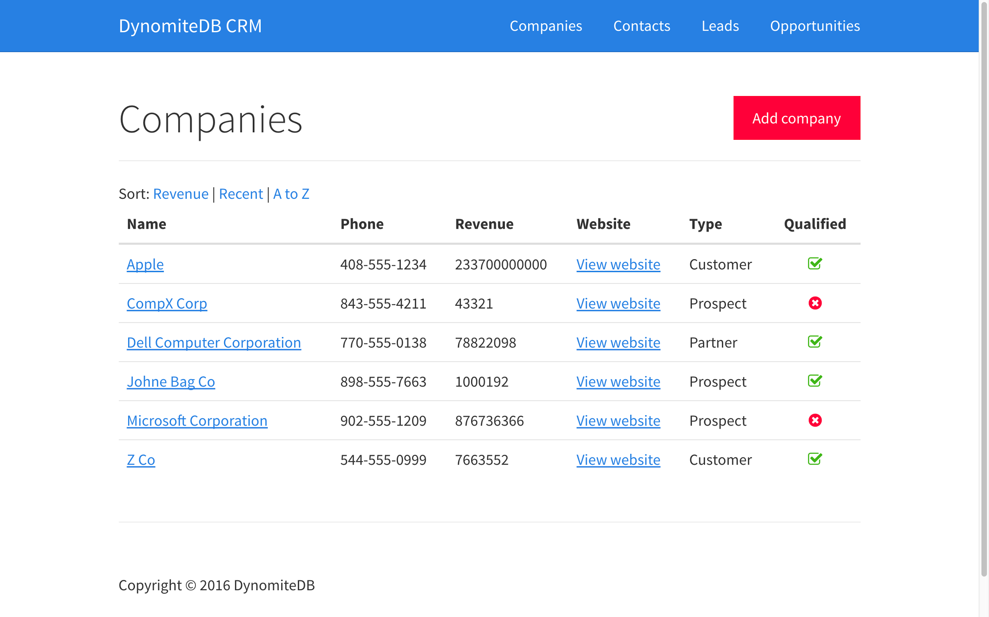
Copyright 2016 DynomiteDB

Slide 24

Copyright 2016 DynomiteDB

Slide 25

Copyright 2016 DynomiteDB

Slide 26
Copyright 2016 DynomiteDB

Slide 27
View Companies
if (sort === 'az') { // Get the first 10 companies sorted alphabetically cache.zrange(murmurhash.v2('companies:atoz'), 0, 9, handler); } else if (sort === 'revenue') { // Get the reverse range: sorted = high to low revenue cache.zrevrange(murmurhash.v2('companies:rev'), 0, 9, handler); } else if (sort === 'recent') { cache.lrange(murmurhash.v2('companies:recent'), 0, 9, handler); }

Slide 28
handler()
if (reply) {
async.map(reply, getDetails, displayCompanies);
} else {
if (sort === 'az') { db.zrange(murmurhash.v2('companies:atoz'), 0, 9, handler); } else if (sort === 'revenue') { db.zrevrange(murmurhash.v2('companies:rev'), 0, 9, handler); } else if (sort === 'recent') { db.lrange(murmurhash.v2('companies:recent'), 0, 9, handler); }
}

Slide 29
getDetails()
cache.hgetall(key.getKeyHash(company), function(err, reply) { if (reply) { reply.slug = slug(reply.name.toLowerCase()); reply.qualified = (reply.qualified === 'true'); } else {
db.hgetall(key.getKeyHash(company), ...);
} cb(null, reply) });

Slide 30
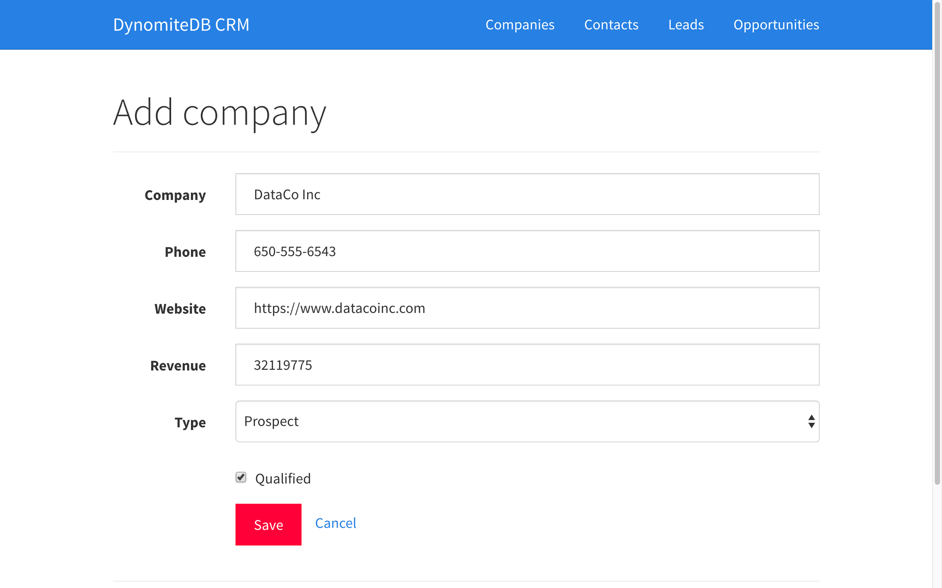
Copyright 2016 DynomiteDB

Slide 31
Generate key
// Generate text key var keyText = 'company:name=' + slug(company.name); // Generate hashed key var keyHash = murmurhash.v2(keyText);

Slide 32
Save company
cache.hmset(keyHash, 'name', company.name, 'phone', company.phone, 'website', company.website, 'revenue', company.revenue, 'step', company.step, 'qualified', company.qualified.toString(), saveToRecentCompanies );
db.hmset(....)

Slide 33
saveToRecentCompanies()
cache.lpush( murmurhash.v2('companies:recent'), company.name, saveToAlphabetical );
db.lpush( murmurhash.v2('companies:recent'), company.name, saveToAlphabetical );

Slide 34
saveToAlphabetical()
cache.zadd( murmurhash.v2('companies:alphabetical'), 1, company.name, saveToRevenue );
db.zadd( murmurhash.v2('companies:alphabetical'), 1, company.name, saveToRevenue );

Slide 35
saveToRevenue()
cache.zadd( murmurhash.v2('companies:revenue'), company.revenue, company.name, renderNextPage );
db.zadd( murmurhash.v2('companies:revenue'), company.revenue, Company.name, renderNextPage );

Slide 36
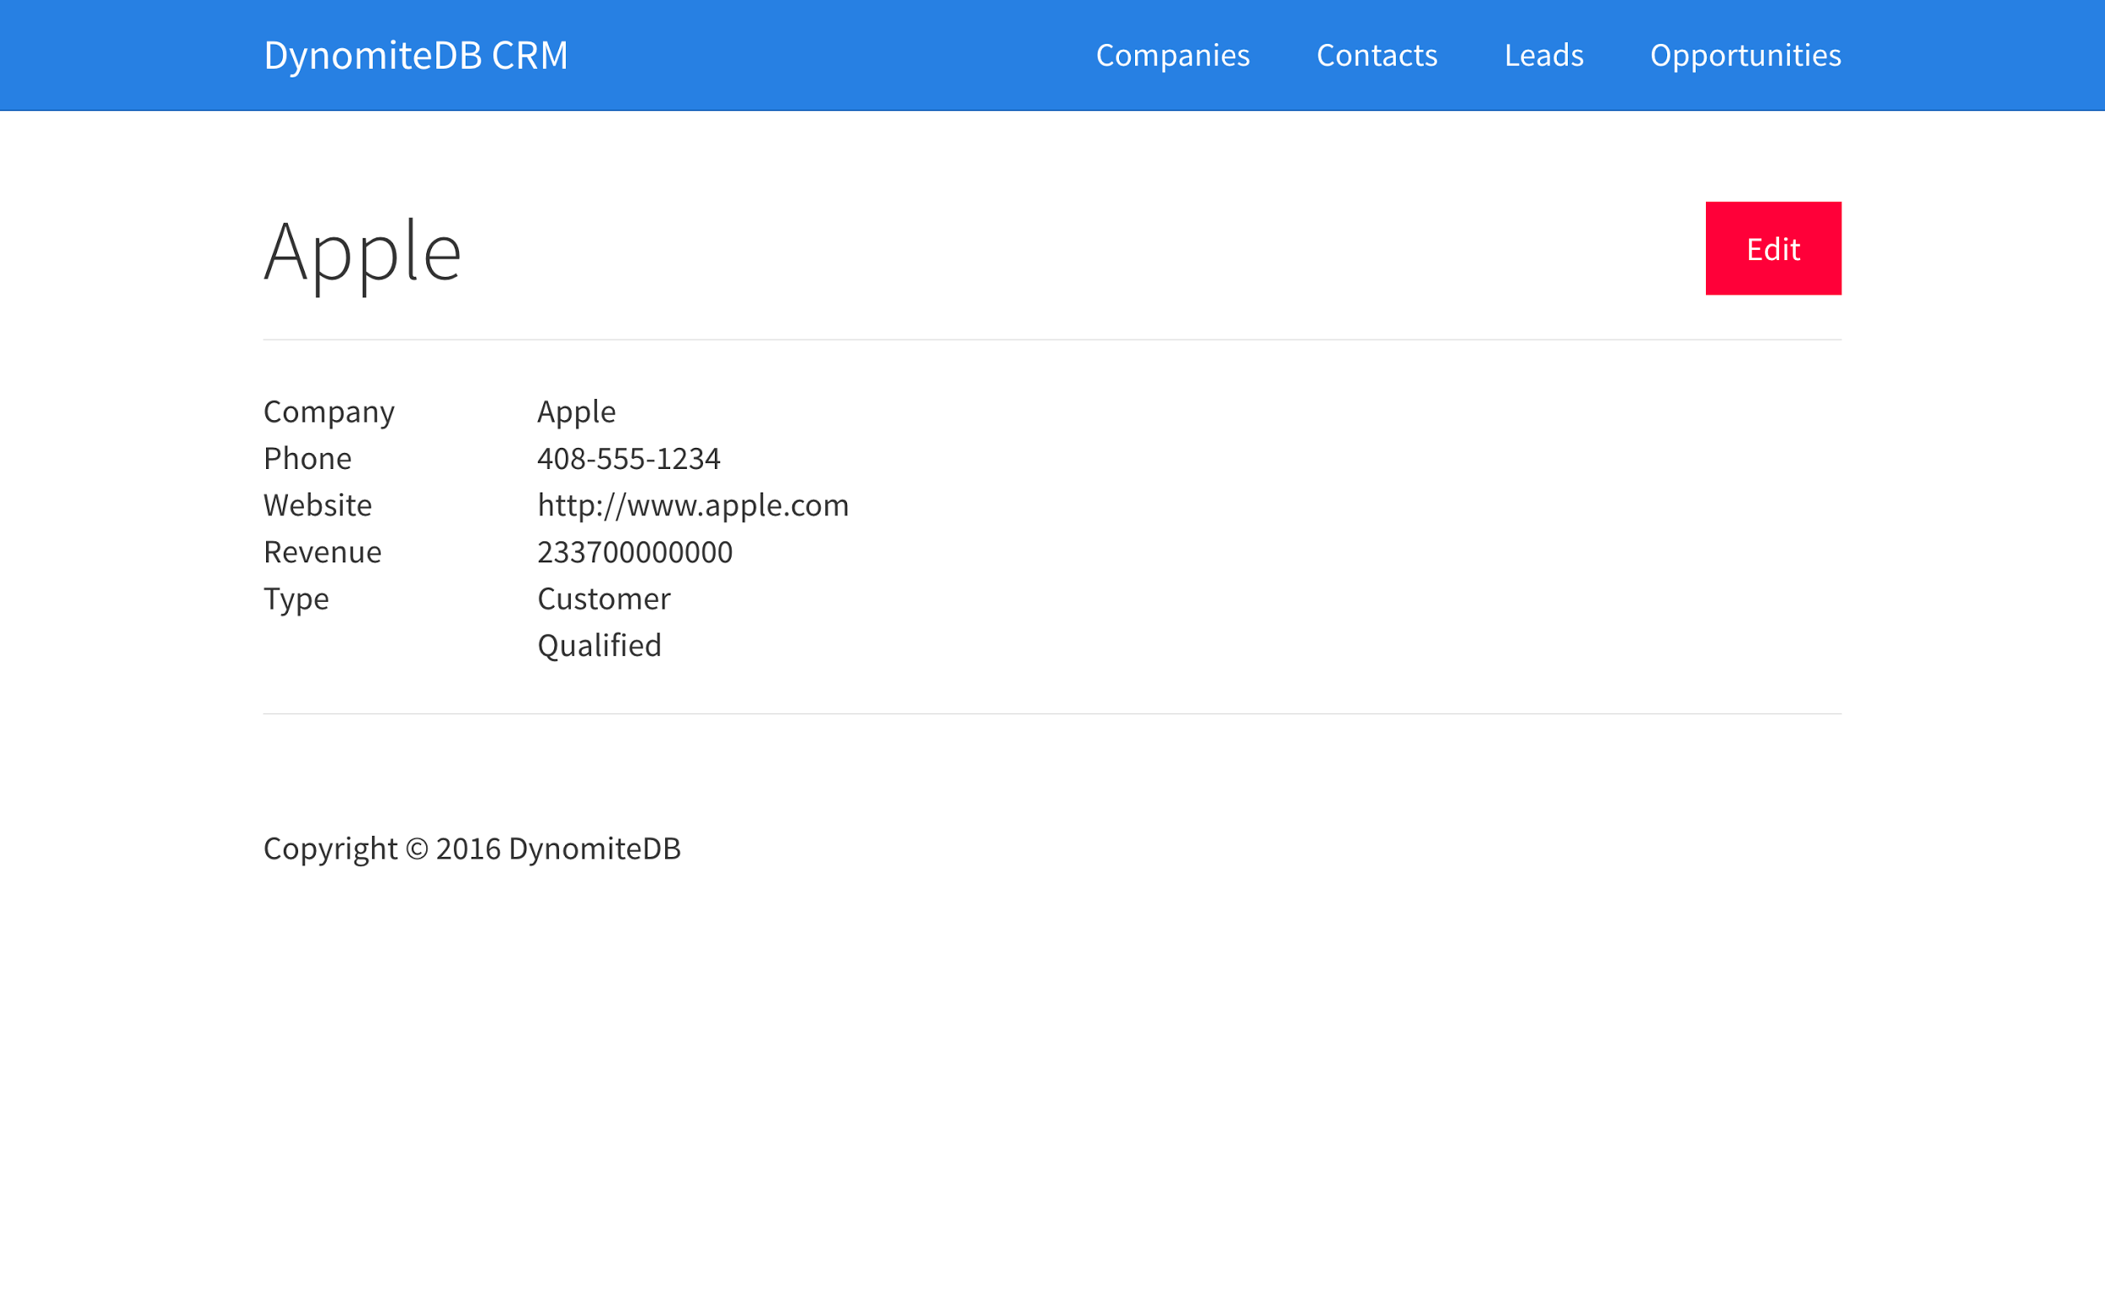
Copyright 2016 DynomiteDB

Slide 37
Company details
cache.hgetall(key.getKeyHash(req.params.slug), showCompany);

Slide 38
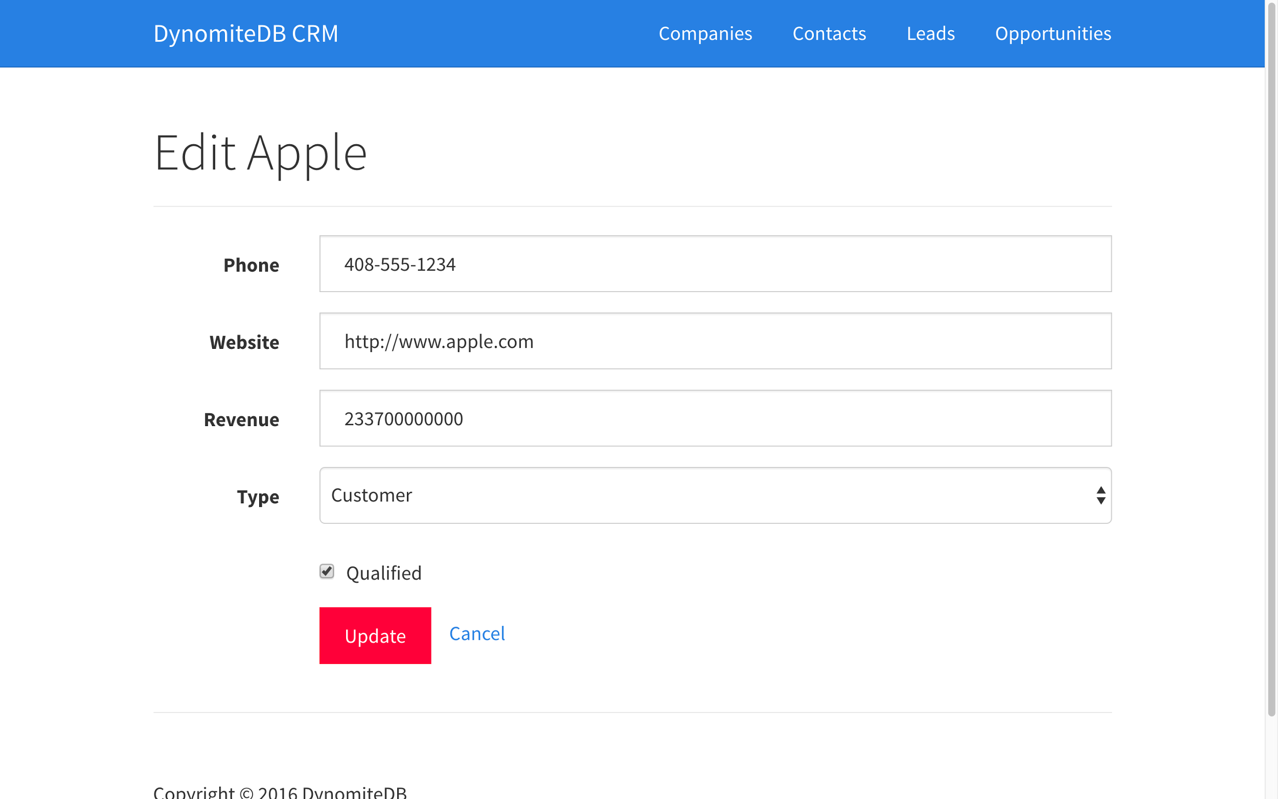
Copyright 2016 DynomiteDB

Slide 39
Edit company
Updating a company reuses 100% of the save company database and cache code.

Slide 40
Thank you
@DynomiteDB
https://github.com/DynomiteDB/redisconf-2016-nodejs
https://github.com/DynomiteDB/redisconf-2016-go (soon)
https://github.com/DynomiteDB/crm-nodejs (soon)
Java coming soon. Follow on Twitter for updates.

