Slide 1

Butler Accommodation Talk
By Lal Chadeesingh, Livers Out Officer

Slide 2
Introduction
House Hunting Presentation – Durham University Accommodation Office
Butler Accommodation Talk – Lal Chadeesingh, Livers Out Officer

Slide 3
Take your time
Take your time deciding who to live with
Landlords want you to sign as early as possible
Finding perfect housemates is better than finding the perfect house!
ASK YOURSELF: Who do I want to live with? Where do I want to live? Why do I want to live out/in?

Slide 4
Find a Housemate Evenings
Will be held at Butler Bar and in the DSU – January
More information soon
People who have no idea who to live with
Groups who still need one or two

Slide 5
Living Out: Positives
52 week contract, £2600 - £4700 + Bills
Can be closer to town/lectures
Better furnishings (Double Beds, etc.)
Learn valuable life skills
Greater independence

Slide 6
Living Out: Negatives
Bills usually not included
Landlords/residents
Strain of ‘group living’
Less security
Difficult to find nearby housing for extensive friendship groups

Slide 7
Returner Flats
Eighteen 6 beds, one four bed
£4521 for 38 weeks (£118.97 per week for 38 weeks) – Works out at £86.94 per week when spread out over 52 weeks!

Slide 8
Returner Flats: Positives
All bills included
Every room en suite
At the heart of college life
Cleaners
Porters
Guaranteed high-speed internet from the word go
Finalists get extra week
Returners get a sofa for their kitchen
Notes:
Will Kendall

Slide 9
Returner Flats: Negatives
Distance
Can’t stay over summer
Furnishings (Single Beds)
Can be more expensive
Notes:
Will Kendall

Slide 10
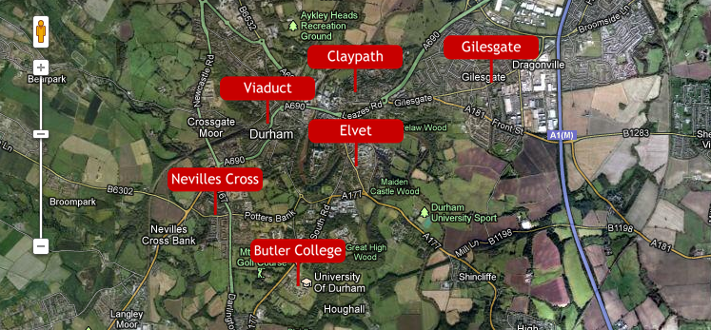
Areas of Durham

Slide 11
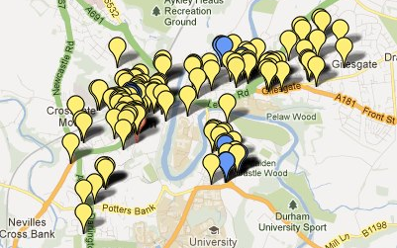
Where do Butlerites Live?

Slide 12
Average Price Range
Viaduct - £75 -85+
Elvet - £75 – 90+
Claypath - £70 – 80
Gilesgate - £45 – 60
Nevilles Cross - £55 – 65

Slide 13
Elvet
Pros:
Close to the Science site, the DSU and Elvet Riverside
Tends to be good quality accommodation
Close to Butler and both libraries
Cons:
Can be quite expensive
Plenty of drunk students walking past your house, and traffic!
Notes:
Siri Minsaas

Slide 14
Gilesgate
Pros:
The cheapest area in Durham
Quite a lot of the houses include bills
Cons:
Can be quite far from the centre of Durham
Can feel a little isolated compared to other areas
Far away from lectures and Butler
Notes:
Oliver Muir

Slide 15
Claypath
Pros:
Very close to the market square
Lots of takeaways
Close to the Gala, Loveshack and Freeman’s Quay
Cons:
Tends to be more of a local area
Houses tend to vary in quality
Far away from Butler
Notes:
Emily Baines

Slide 16
Nevilles Cross
Pros:
Most houses are cheap, and some are really nice
A lot closer to the science site than you might think
Close to Butler
Cons:
Quite far from town
It can feel a bit isolated
Expect to add taxi fares to your student budget
Notes:
Matthew Williams

Slide 17
Viaduct
Pros:
Popular Butler area
Very close to the train station
Close to Studio and Academy
Cons:
Some houses can be overpriced for what you get
Can be quite far from lectures
Can be noisy
Notes:
Simon Wheeldon

Slide 18
What to look for in a house
DSU Accredited
Take a checklist
Does it suit your needs? – Room size, location etc.
Furnishings – Double Beds? TV included?
Bills, Internet, TV license included?
Double glazing?
Deposit?

Slide 19
What to look for in a house
Don’t be afraid to ask questions
How much are bills?
What are the neighbours like?
Have you had any issues with the landlord?
Have you had any issues with the house?
What internet provider, price of line rental?

Slide 20
Butler Property Reviews
JCR Website
Livers Out Section
Live Demo

Slide 21
Valuable Resources
Livers Out Officer – l.d.chadeesingh@durham.ac.uk
Accommodation Office – Caroline.punton@durham.ac.uk, Veronique.peacock@durham.ac.uk
Websites – www.durhamstudentpad.co.uk,
Proctors – Dotted around in red and yellow so do approach and ask questions
Drop in sessions – Tuesdays and Thursdays 6 -7PM in the Quiet Room

