Slide 1

Butler Accommodation Talk
Ellie Hackney
Livers Out Officer 2013-2014

Slide 2
Introduction.
Grace Abel – DSU Community Officer
Accommodation talk – by the Durham University Accommodation Office.
Phil Raine – University Liaison Officer
Butler Accommodation talk.

Slide 3
“Take Your Time To Sign” Campaign.
You’ve only known each other for 7 weeks. Chill Out!
There’s more houses in Durham than there are students.
It’s about the people you live with at the end of the day. Not just the house.
Campaign endorsed by the DSU
81% of students seeking support in private accommodation signed for their property in November.
Posting a fact-a-day on the JCR Facebook.
Ask yourself: what do YOU want?

Slide 4
Find a Flatmate.
Event held in the DSU in January
Another held specifically for Butler students in the JCR, also in January.
More information closer to the time.
Open to students looking for a full flat or those in a group who want a few more people.
Worth checking out if you have no idea who you want to live with, or if you just want to live with new people!

Slide 5
Options for next year.
Living out isn’t the only option available!
Can still put name down to live in college again – forms can be filled in via this link: https://www.dur.ac.uk/butler.college/local/current/livingincollege/

Slide 6
Living Out: Pros.
Most houses are 52 week lets. Can get some which are 9 months only.
Cost between 2600-4600+ bills.
Can end up living closer to lectures/town.
Living in a more independent environment.
More space and better furniture.
Prepares you better for leaving uni.

Slide 7
Living Out: Cons.
The strain of “shared living” – it’s more difficult to shut yourself off from everything!
Dealing with problems is more difficult.
Dealing with local residents.
Be more security conscious.
Difficulty of splitting up larger friendship groups.
Make more of an effort to see other friends.

Slide 8
Living In: Pros.
At the heart of college life.
Rooms are pretty much self-contained.
Every room is the same – you know exactly what you get for your money.
Porters & Cleaners!
All bills included.
Fast internet from the word go.
Sofa in the kitchen.

Slide 9
Living In: Cons.
Can be more expensive than some livers out houses (38 week let works out at around £120 a week).
A bit distant from town and more central lectures.
All single beds.
Can’t stay over summer.

Slide 10
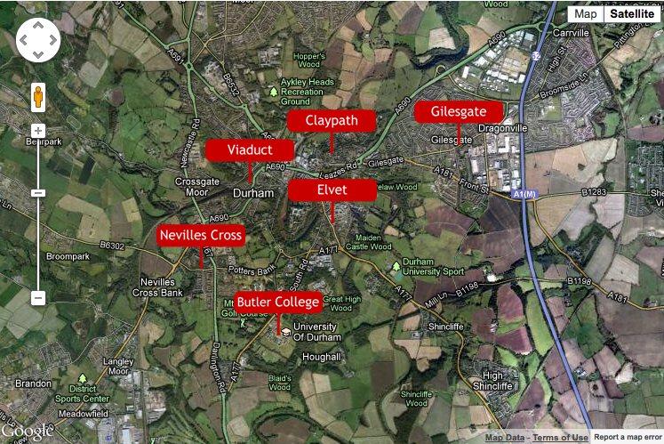
Areas of Durham
* The map makes Durham look big, when in fact you can walk across it in about 35 mins. It’s tiny.

Slide 11
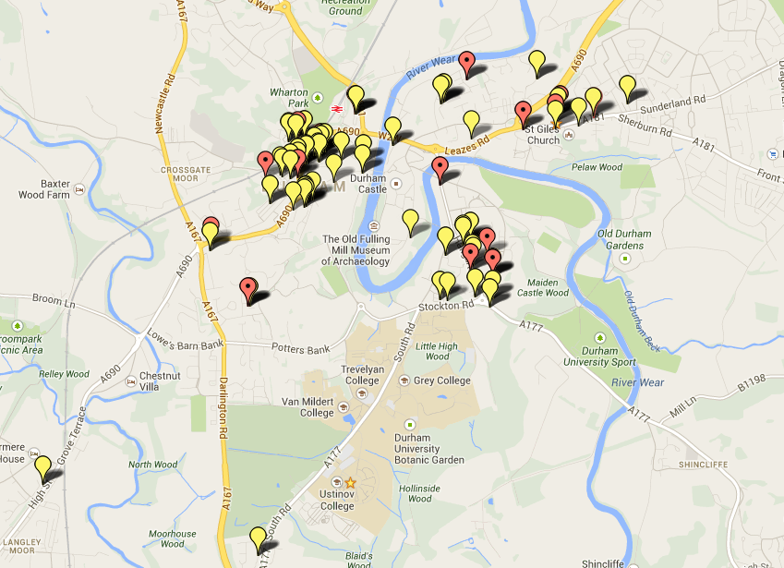
Butlerites are spread all over!

Slide 12
Elvet & Hallgarth.
Between £85 - £110 per week.
Pros:
Close to the Science site, the DSU and Elvet Riverside
Close to Butler and both libraries.
Cons:
Can be quite expensive for what you get.
Plenty of drunk students walking past your house, and traffic!

Slide 13
Viaduct.
Between £75 - £90 per week
Pros:
Popular Butler area – most houses are here this year.
Very close to the train station.
Close to Durham’s nightlife.
Cons:
Some houses can be overpriced for what you get.
Can be quite far from lectures.
Can be noisy due to the amount of students who live there.

Slide 14
Neville’s Cross.
Between £60 - £85 per week
Pros:
Houses are cheaper on average, and some are very modern.
A lot closer to the science site than you might think.
Closer to Butler.
Cons:
Quite far from town.
It can feel a bit isolated.
Expect to add taxi fares to your student budget!

Slide 15
Claypath.
Between £75 - £95 per week
Pros:
Very close to the market square.
Lots of takeaways!
Close to the Gala, Loveshack and Freeman’s Quay.
Cons:
Houses tend to vary in quality.
Some houses are overpriced.
Can be awkward for lectures, depending on how far into Claypath you are.

Slide 16
Gilesgate.
Between £55 - £85 per week.
Pros:
The cheapest area in Durham
Quite a lot of the houses include bills.
Closer to Sainsbury’s and the big Tesco.
Cons:
Can be quite far from the town centre.
Can feel a little isolated compared to other areas.
Further away from lectures and Butler

Slide 17
What to look for in a house. Take a checklist!
DSU Accredited?
Does it suit your needs? – Room size, location etc.
Furnishings – Double Beds? TV included?
Bills, Internet, TV license included?
Double glazing?
Deposit?
Don’t be afraid to ask questions!
How much are bills?
What are the neighbours like?
Have you had any issues with the landlord?
Have you had any issues with the house?

Slide 18
Valuable Resources.
Livers Out Officer: eleanor.hackney@durham.ac.uk (or just ping me a Facebook message)
Accommodation Office:
Caroline.punton@durham.ac.uk Veronique.peacock@durham.ac.uk
Websites: www.durhamstudentpad.co.uk
Butler Property Reviews: written by Butler students FOR Butler students! http://www.dur.ac.uk/butler.jcr/liversout/search/postcode/
Proctors: log onto the JCR website for a full list of proctors. Don’t be afraid to email them – they’re there to help!
Drop in sessions:
- Next Tuesday and Thursday (26th and 29th) 6:30 -7:30pm at Mentor Night – come along for a chat!
- There will be a drop in week during re-freshers in January.

Slide 19
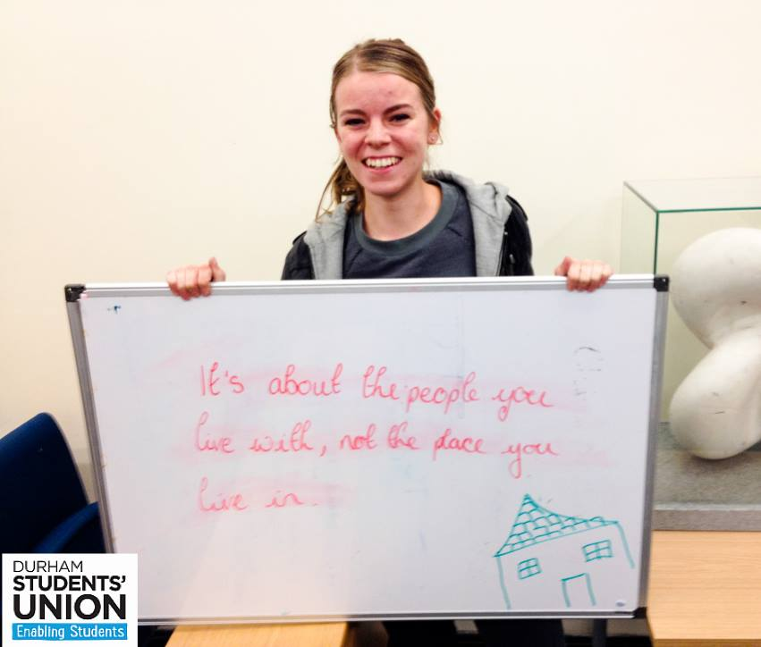
One final thing…

