Slide 1


DESIGN THE CONTROLLER AND MODELLING OF THREE-WHEELED OMNIDIRECTIONAL MOBILE ROBOT
Group 4
Dang Quang Vinh
Le Duc Phap Anh
Le Quang Canh
Tran Minh Hiep

Slide 2
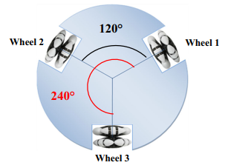
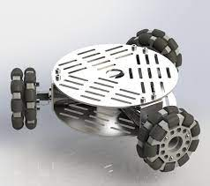
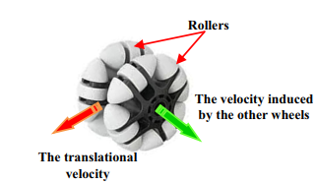
Robot’s description
[1] " Motion Analysis and Control of Three-Wheeled Omnidirectional Mobile Robot"

Slide 3
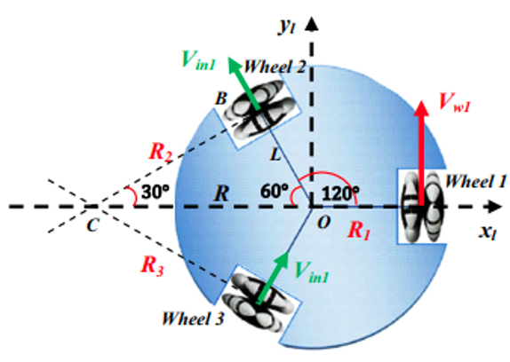
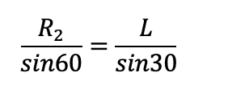
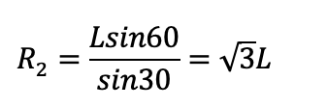
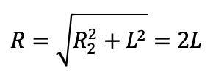

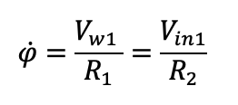
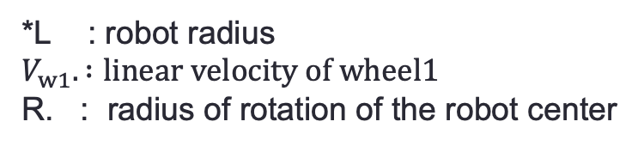
The induced Velocity
Calculation of the inducted velocity
*L : robot radius
$V_{w1}. :$ $linear velocity of wheel1$
R. : radius of rotation of the robot center

Slide 4
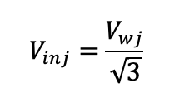
The induced Velocity
Calculation of the inducted velocity

Slide 5
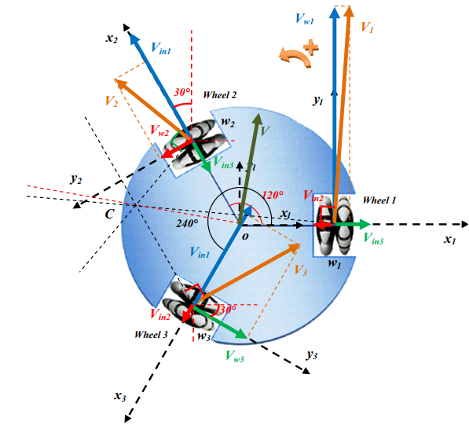
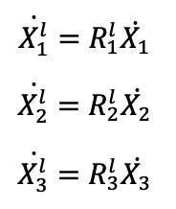
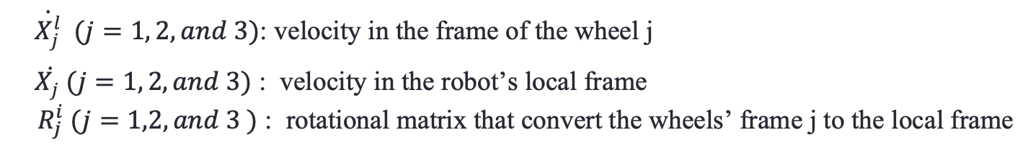
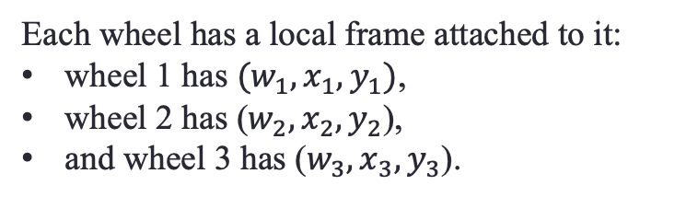
Analysis of the Robot Motion
Each wheel has a local frame attached to it:
wheel 1 has $(w_{1}, x_{1}, y_{1})$,
wheel 2 has ($w_{2}, x_{2}, y_{2}$),
and wheel 3 has ($w_{3}, x_{3}, y_{3}$).
The following represents the velocity transformations between the robot's local frame and the frames of its wheels:
$\dot{X_{j}^{l}} (j=1, 2, and 3)$: velocity in the frame of the wheel j
$\dot{X_{j} }(j=1, 2, and 3)$ : velocity in the robot’s local frame $R_{j}^{i} (j=1,2, and 3 )$ : rotational matrix that convert the wheels’ frame j to the local frame
Notes:
Change the parameter to maximize the reward

Slide 6
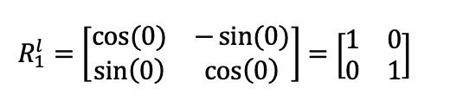
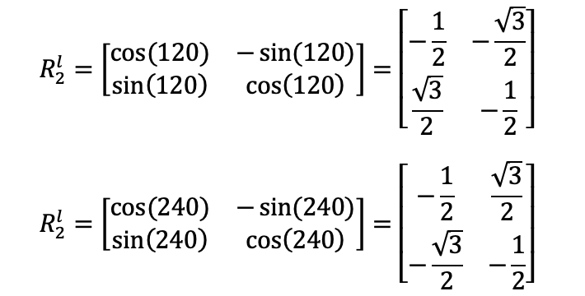

Analysis of the Robot Motion
The rotational matrices $R_{j}^{i}$ can be expressed :
Notes:
Change the parameter to maximize the reward

Slide 7
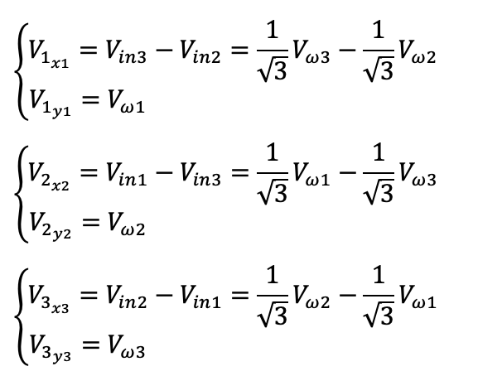
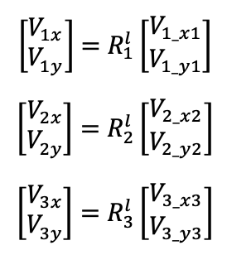
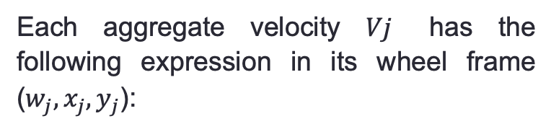
Analysis of the Robot Motion
Each aggregate velocity $Vj$ has the following expression in its wheel frame ($w_{j}, x_{j}, y_{j}$):
Convert to the local frame
Notes:
Change the parameter to maximize the reward

Slide 8
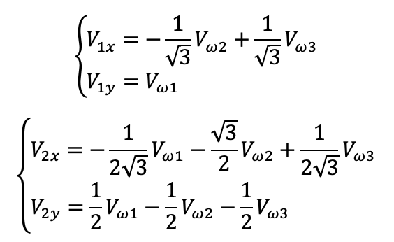
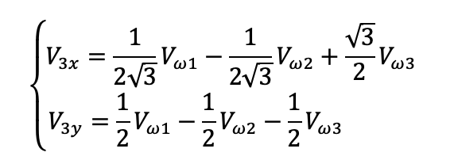
Analysis of the Robot Motion
Replace and rearrange:
Notes:
Change the parameter to maximize the reward

Slide 9

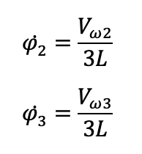
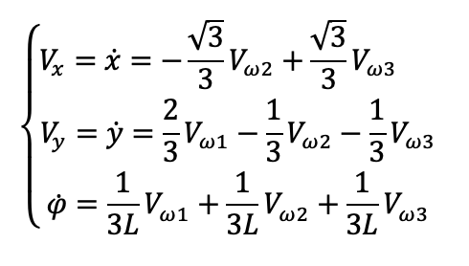
Analysis of the Robot Motion
Notes:
Change the parameter to maximize the reward

Slide 10
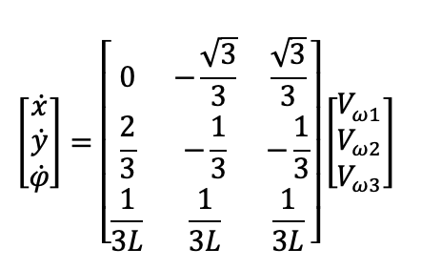
Analysis of the Robot Motion
Forward kinematics of the
Three-Wheeled Omnidirentional Mobile Robot,
can be express:
Notes:
Change the parameter to maximize the reward

Slide 11
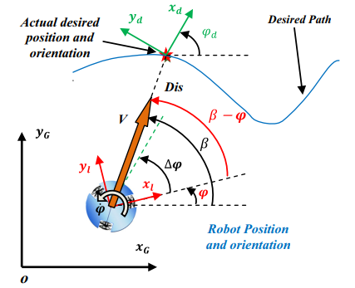
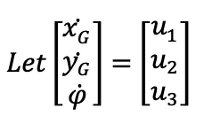
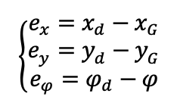
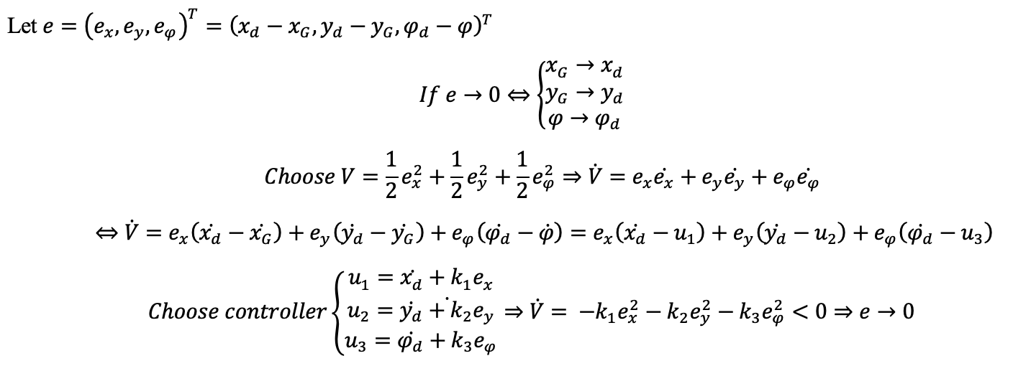
Controller design
The trajectory tracking problem:
Let the inputs of the controller are $e_{x}, e_{y}, e_{φ}$where:
Notes:
Change the parameter to maximize the reward

Slide 12
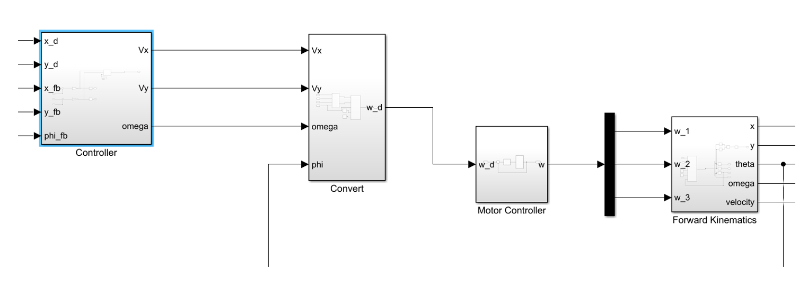
Simulation - matlab
Simulink block for each component of robot model
Notes:
Change the parameter to maximize the reward

Slide 13
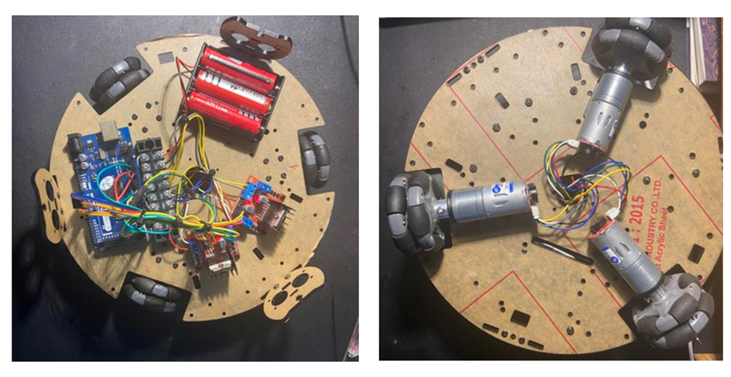
Realistic experiment
The three-wheeled omnidirectional robot
Notes:
Change the parameter to maximize the reward

Slide 14
Reference
[1] Nacer Hacene, Boubekeur Mendil, " Motion Analysis and Control of Three-Wheeled Omnidirectional Mobile Robot", 2 January 2019
Notes:
Change the parameter to maximize the reward

