Slide 1
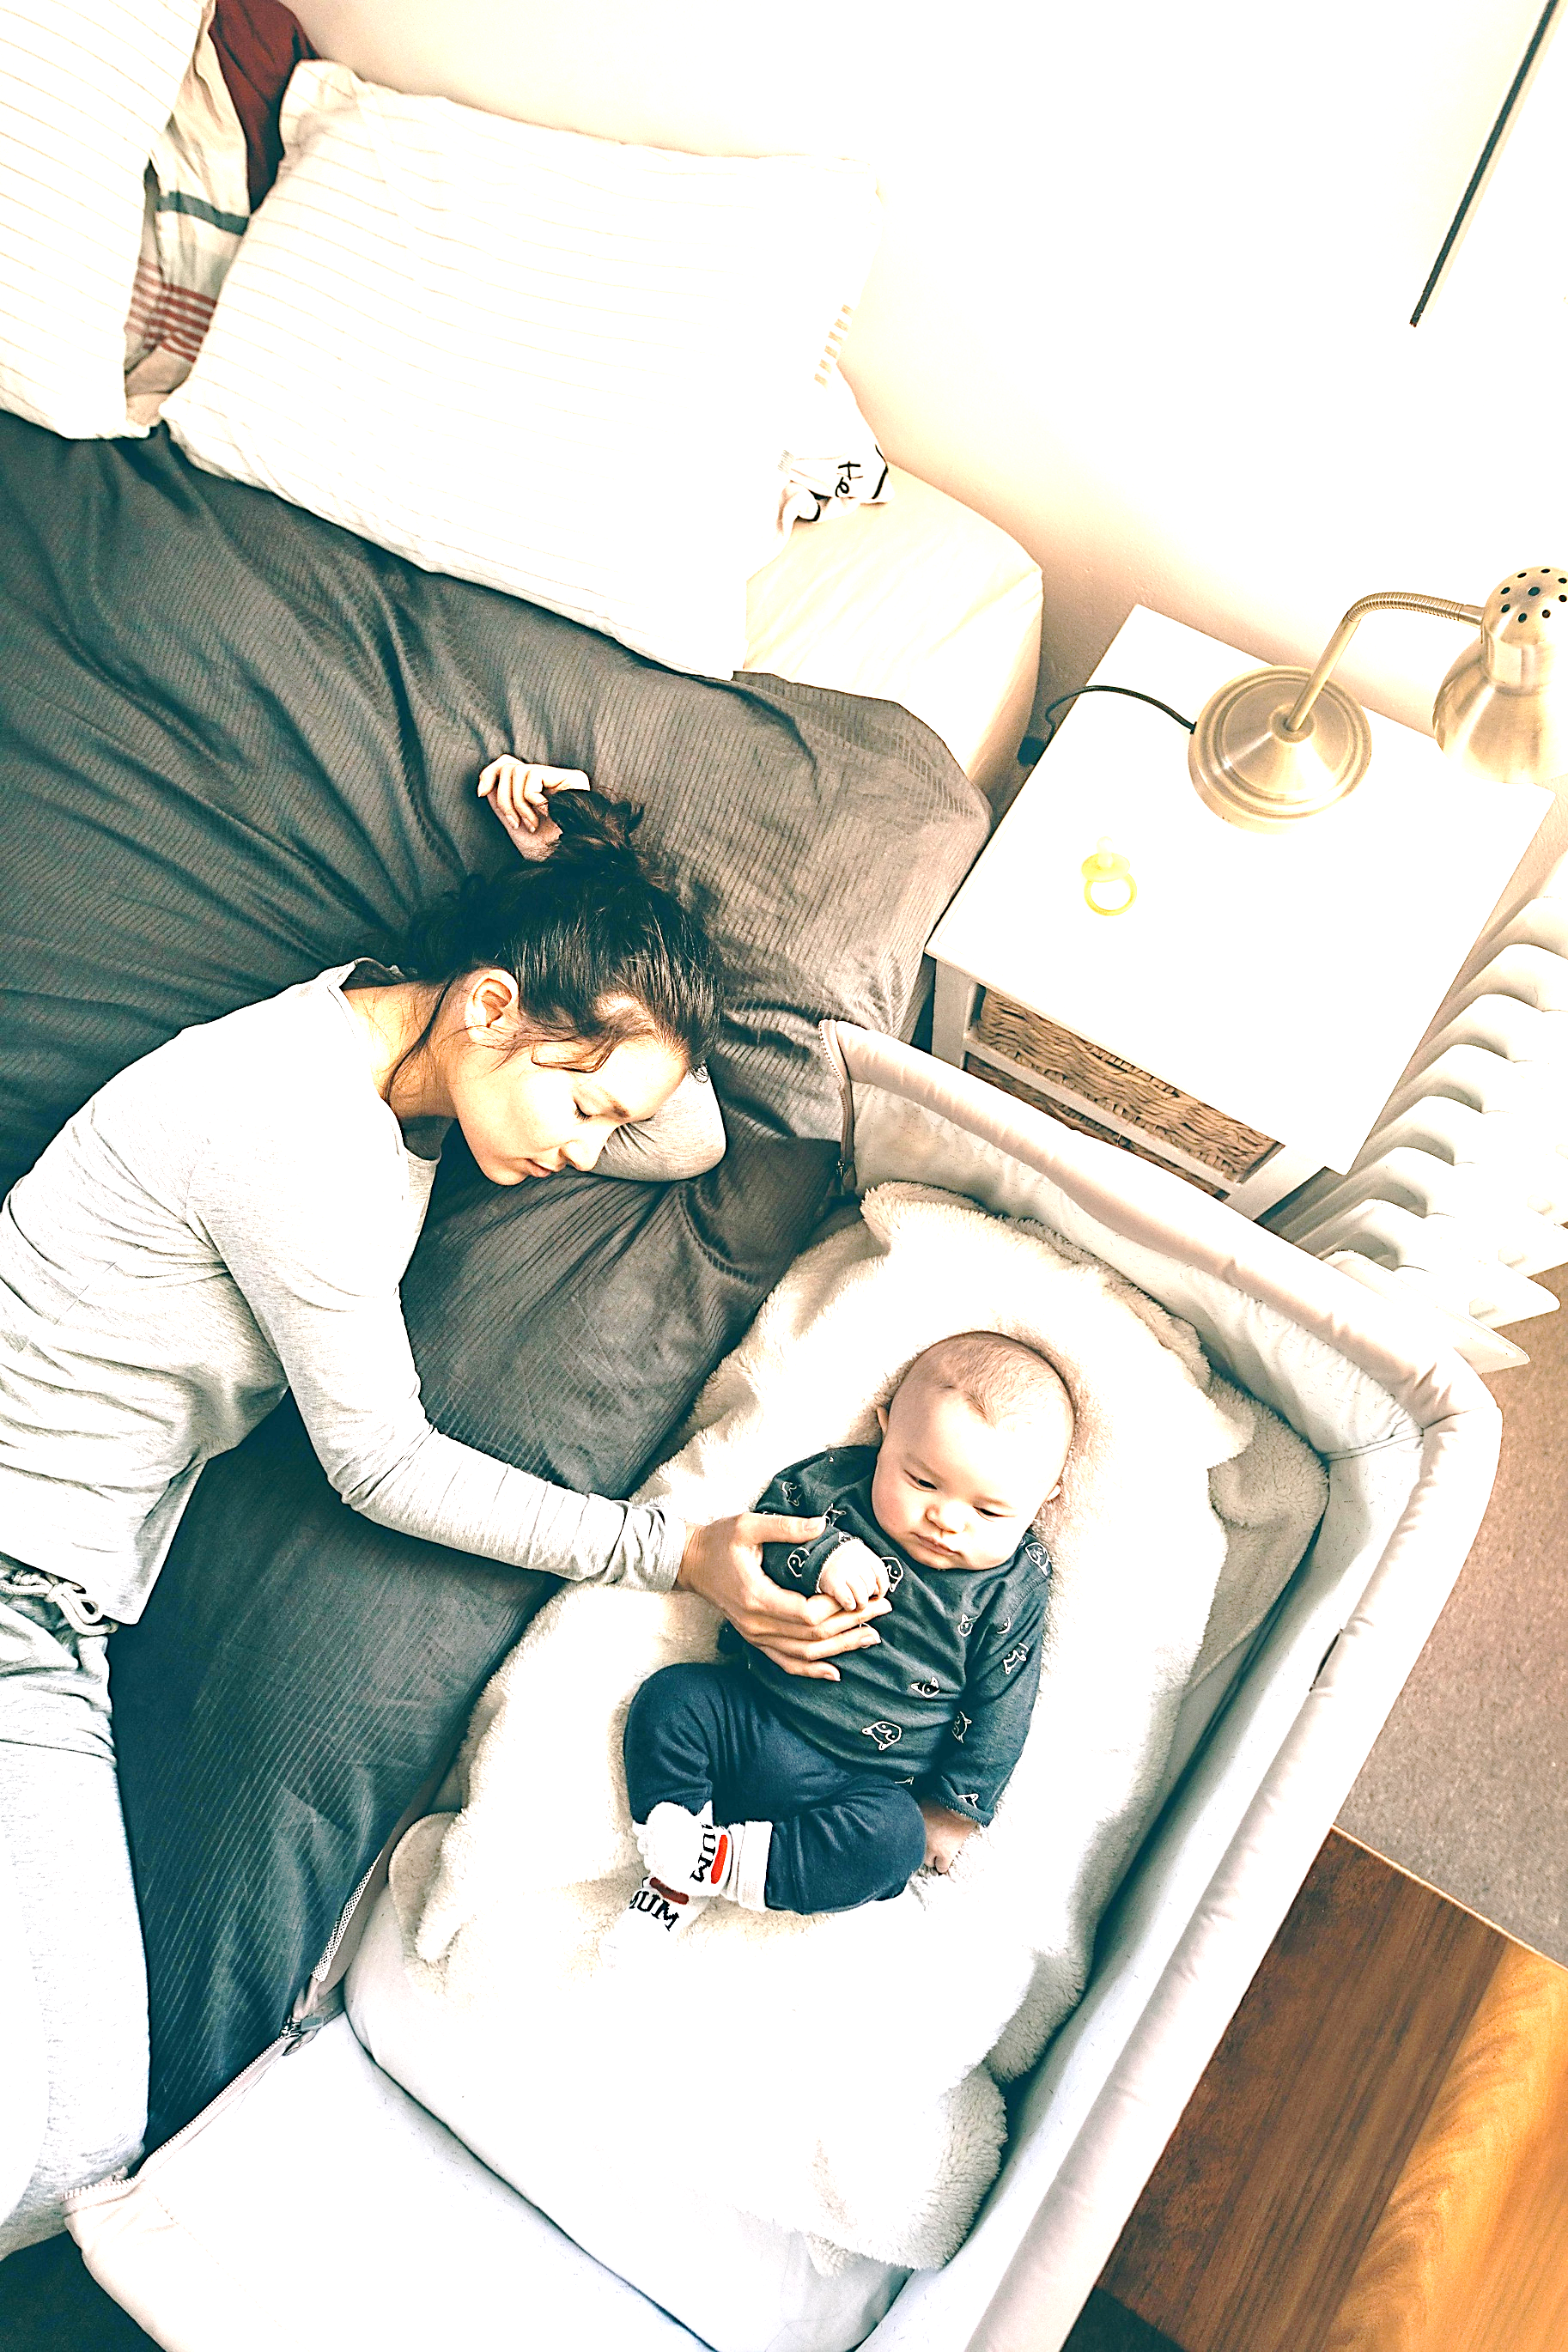
Multimodal Masked Autoencoders for Robust Videos and Signal Reconstruction
MA midterm
Leqiao Peng
Prof. Antink / Mr. Tizian Dege

Slide 2
Motivation & Research Problem
Clinical motivation: Physiological waveforms are usually measured with contact sensors.
Research problem: RGB and TIR videos contain weak, heterogeneous physiological signals.
Research question: Can multimodal atuoencoder help reconstruction of vital signs for unseen subjects?
RGB/TIR video -> representation -> BP/RESP waveform
Datei: figures/motivation_diagram.png

Slide 3
Dataset Overview
Corpus: BP4D+ multimodal spontaneous emotion corpus [3].
Subjects: 140 subjects, 8 sessions each, 40 clips per session.
Modalities: RGB, thermal infrared (TIR), depth, audio, and physiological signals (ECG, EMG, EDA, respiration).
Focus:** Different Auxiliary tasks (T1-T10): facial expression, head pose, gaze, and action units.
📊 [Abbildung / Visualisierung]
Datei: experiments/figures/...

Slide 4
Data & Physiological Targets
Current input: False-colour thermal infrared video cropped to a facial TIR. ROI extracted from the full frame using a pre-trained face detector.**
Current target: Continuous respiration waveform from the contact sensor.
Evaluation setting: Contactless reconstruction for strictly unseen subjects; RGB/BP remain comparison paths.
TIR-ROI video and respiration reference signal
Datei: experiments/figures/data_targets_overview.png

Slide 5
Method inspirated by work MultiMAE
MultiAME [2] is a multi-modal, multi-task masked autoencoder that can handle RGB, depth, and audio modalities.
MultiMAE architecture
Datei: experiments/figures/multimae_architecture.png

Slide 6
Method inspirated by work VideoMAE
VideoMAE [1] is a masked autoencoder for video representation learning.
VideoMAE architecture
Datei: experiments/figures/videomae_architecture.png

Slide 7
Architecture: Multi-Task Masked Autoencoder
Stage 1: Initialize the visual encoder with VideoMAE.
Stage 2: Masked multi-modal pre-training: visual masking 90 %, physiological stream 50 %, with span masking for the 1-D signal.
Stage 3: Reconstruct the respiration waveform from the TIR-ROI alone, simulating total contact-sensor failure.
Three stages: initialization -> pre-training -> fine-tuning
Datei: experiments/figures/architecture_overview.png

Slide 8
Current Experimental Focus
Primary path: Thermal infrared region of interest (TIR-ROI) -> respiration waveform.
HPC full run: Stage-2 pre-training and Stage-3 fine-tuning completed on the full corpus (~1,400 sessions discovered; ~97 % usable).
Matched setup: 8-second clips, 112 x 112 ROI input, 100 Hz target, and subject-disjoint splitting.
Infrastructure: An offline 112 x 112 ROI cache (1,385 shards, 91 GB) removes the decode bottleneck, so full-corpus training is compute-bound (loader share 84.5 % -> 0.0 %).
Completed HPC pipeline: TIR-ROI video -> respiration waveform
Datei: experiments/figures/tir_roi_resp_pipeline.png

Slide 9
First Full HPC Run Completed: TIR-ROI -> Respiration
Completed HPC run and preliminary subject-level evaluation
Datei: experiments/figures/pipeline_status.png

Slide 10
Preliminary HPC Results
Measure | Result | Interpretation
Evaluation volume | 28 subjects / 273 sessions / 5,143 clips | Held-out subject split
Band-limited Pearson | 0.569 | Median per subject; 95% CI [0.451, 0.624]
Single-tone baseline | 0.535 | Rate-only reference; 95% CI [0.499, 0.545]
Subjects beating baseline | 53.6% | Essentially at chance (50%)
Task-group ordering | +0.738 / +0.524 / +0.515 | Low clearly ahead; moderate = high

Slide 11
How to Interpret the First Run
Marginal edge: The median band-limited Pearson (0.569) edges the single-tone template (0.535), but the model CI [0.451, 0.624] overlaps the baseline CI [0.499, 0.545].
At chance level: Only 53.6 % of held-out subjects beat the rate-only baseline - essentially a coin flip.
Practical reading: The model recovers a breathing-rate-related pattern for part of the cohort, but does not establish reliable facial respiration reconstruction.
Status: An initial full-run result for debugging and scientific diagnosis, not a final generalisation claim.

Slide 12
Low-Distortion Tasks Score Clearly Better
Distortion group | Tasks | Median band-limited Pearson
Low | T2, T3 | +0.738
Moderate | T4, T7, T8, T10 | +0.524
High | T1, T5, T6, T9 | +0.515
Low - moderate / low - high | +0.214 / +0.223 | Clear, consistent gap

Slide 13
Why Low-Distortion Tasks Score Better
What the grouping is: A project-defined convention (config `task_groups`), not a BP4D+ annotation - shipped levels: low T2/T3, moderate T4/T7/T8/T10, high T1/T5/T6/T9.
Not a data-cleanliness effect: Rail/clipping prevalence is level-independent (mean file rail share 3.31 % / 3.02 % / 3.65 %), and clip supply only tracks recording length (T3 and T9 dominate).
Not an input-signal effect: The thermal-ROI detection gate is near-uniform across tasks and non-monotonic across groups - the low tasks do not carry more respiration in the pixels either.
Mechanism (hypothesis): The ROI is one static box unioned over the whole clip, so more head motion inflates it and the spatial mean pools pose/background instead of nostril temperature.
Local support: In a 4-subject session-split run only the two low tasks carried signal (T2 +0.69, T3 +0.23; T4-T9 at 0 or negative), and ROI area / landmark jitter track the failure (r ~ -0.5, n = 8 - suggestive, not established).

Slide 14
Why the Thermal Face ROI Does Not Carry Respiration
Off-face winners: The strongest respiration-correlated pixel in the frame sits on the chest, the hair, or a fixed background/rig band - never on the face.
Wrong reference on the face: On the face the strongest correlation is with head motion, not with the respiration belt.
Not the difficulty label: Detection is near-uniform across tasks and non-monotonic across distortion groups, so the task label is not the lever.
Representation-limited input: 8-bit palettised false colour, face near the saturated end, frontal view - the exhaled-air plume has almost no thermal contrast against equally warm skin.
Verdict: A controlled negative for facial thermal respiration at this geometry; the limiting factor is the input, not the architecture.

Slide 15
Scientific Qualification of the Result
Implication: A respiration-correlated prediction can reflect motion or the recording setup rather than a robust facial thermal signal.
Evaluation caveat: The reported checkpoint was selected using validation Pearson on the same subject-disjoint split used for the reported evaluation.
Amplitude caveat: The prediction is session-z-scored against a raw-volts reference, so only scale-invariant metrics are valid; amplitude errors need an oracle calibration.
Claim boundary: Present the run as a useful baseline, ablation and failure analysis; do not claim clinical validity or reliable whole-cohort reconstruction.

Slide 16
Why the Negative Is a Measurement, Not a Failure to Measure
Positive control (thermal): The same statistic detects head motion in 8/8 sessions at p<0.005 (|r| up to 0.98), while respiration is not detected in any session.
Palette is not the limit: In-band thermal modulation spans 2.9-36.2 palette levels (far above 1 level), so the render does carry variation.
Resolution is not the limit: Native-resolution and 64 x 64 probes reach the same verdict; downsampling is harmless for a spatially coherent signal.
Positive control (RGB): On the same corpus facial RGB carries a genuine skin-borne cardiac signal (CHROM/POS detected in 35/40 sessions, background control at chance).
Scope: Controls were run on a 4-subject / 8-session subset; the corpus-scale verdict is the subject-level report.

Slide 17
Evaluation: Preliminary Single-Split Test
Split: Training, validation and test subjects are strictly disjoint (split_by subject).
Unit of evaluation: A subject; all clips of a session are assembled into one continuous waveform (Hann overlap-add).
Headline metric: Band-limited Pearson (0.1-0.6 Hz), median per subject, against a single-tone template and a constant line.
Known gap: Checkpoint selection and reporting use the same validation split (selection leakage).
Next eval step: Separate selection from reporting (--test_subjects) and run the leave-one-subject-out sweep; k-fold is the follow-up.
Single subject-disjoint test split and baseline comparison
Datei: experiments/figures/evaluation_protocol.png

Slide 18
Roadmap & Milestones
Completed -> ongoing -> planned
Datei: experiments/figures/timeline_gantt.png

Slide 19
Interim Conclusions & Next Steps
Achieved: The first complete full-corpus HPC run for TIR-ROI -> respiration (Stage 2 + Stage 3).
Finding: The median rhythm score edges the single-tone baseline only marginally (0.569 vs. 0.535) and half the cohort does not beat it.
Mechanism: Whole-frame wins are off-face (chest / hair / rig); on the face the dominant reference is head motion, not the belt.
Ongoing A/B: Point-wise SmoothL1 instead of the amplitude-only StdLoss (same encoder, geometry and schedule) - tests whether the near-single-tone collapse is a loss artefact or an input limit.
Infrastructure: The offline TIR-ROI cache makes the full-corpus run compute-bound rather than decode-bound.
Next step: Separate checkpoint selection from reporting and run the LOSO sweep; k-fold cross-validation is the follow-up.

Slide 20
References
[1] K. He, X. Chen, S. Xie, Y. Li, P. Dollár, and R. Girshick, 'Masked Autoencoders Are Scalable Vision Learners,' CVPR, 2022.
[2] R. Bachmann, D. Mizrahi, A. Atanov, and A. Zamir, 'MultiMAE: Multi-modal Multi-task Masked Autoencoders,' ECCV, 2022.
[3] Z. Zhang et al., 'Multimodal Spontaneous Emotion Corpus (BP4D+),' IEEE FG, 2016.

Slide 21
Appendix: Current and Planned Configuration
Aspect | HPC Full Run | Evaluation Status
Input size | 112 x 112 pixels | Matched Stage-2/Stage-3 geometry
Clip geometry | 8 s, 100 Hz target | Time-aligned waveform output
Stage-2 checkpoint | checkpoint-0149.pth | Used for Stage-3 fine-tuning
Test set | 28 held-out subjects | Evaluated once
Cross-validation | Not performed | LOSO sweep is the next step
Signal normalisation | physio_norm: session | Whole-session z-score
Clip hygiene | rail_touch 9.90 V; spread 0.1 V | Drops railed / pinned windows
Task groups | low / moderate / high | T2-T3 / T4,T7,T8,T10 / T1,T5,T6,T9
L_time term | StdLoss (reported run) | SmoothL1 A/B arm in progress
ROI cache | 1,385 shards / 91 GB | Decode-bound -> compute-bound; serves Stage 2 and 3

