Slide 1
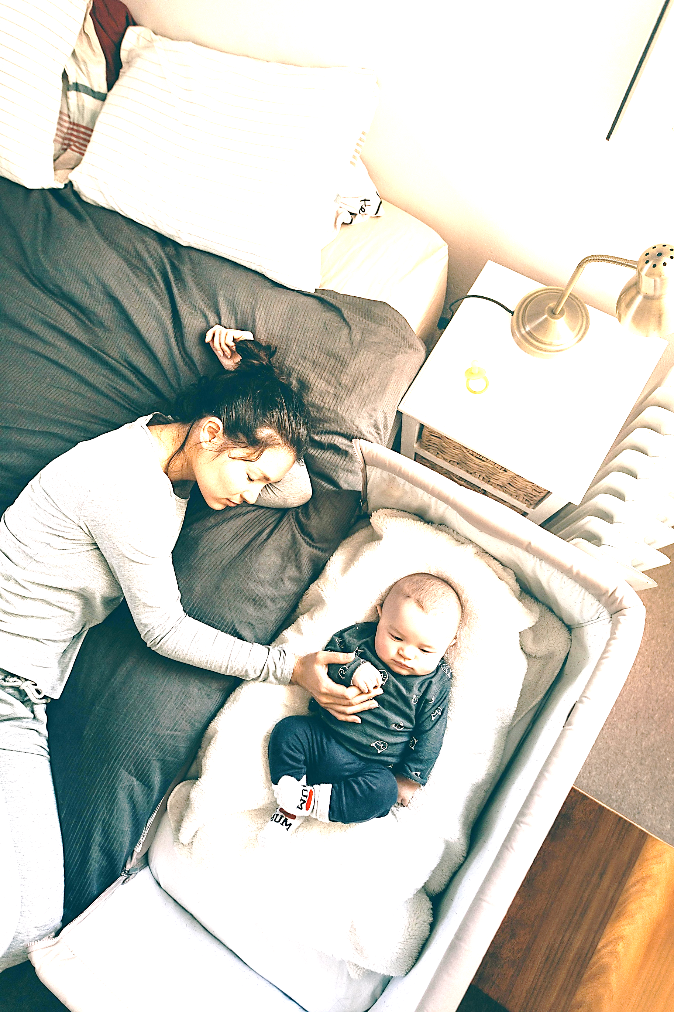
Multimodal Representation Learning with Masked Autoencoders
Zwischenvortrag Masterarbeit
Leqiao Peng
Tizian Dege

Slide 2
Motivation & Research Problem
Clinical motivation: Physiological waveforms are usually measured with contact sensors.
Research problem: RGB and TIR videos contain weak, heterogeneous physiological signals.
Research question: Can multimodal masked pre-training improve reconstruction for unseen subjects?
RGB/TIR video -> representation -> BP/RESP waveform
Datei: experiments/figures/motivation_diagram.png

Slide 3
Data & Physiological Targets
Inputs: 2D RGB video and false-colour thermal infrared video.
Targets: Blood-pressure and respiration waveforms as continuous 1D signals.
Evaluation setting: Contactless reconstruction for strictly unseen subjects.
2D video and physiological reference signals
Datei: experiments/figures/data_targets_overview.png

Slide 4
Architecture: Multi-Task Masked Autoencoder
Stage 1: Initialize the visual encoder with VideoMAE.
Stage 2: Mask and jointly reconstruct heterogeneous modalities.
Stage 3: Fine-tune the encoder for direct waveform reconstruction.
Three stages: initialization -> pre-training -> fine-tuning
Datei: experiments/figures/architecture_overview.png

Slide 5
Current Status: Pipeline Validated, Evaluation Ongoing
Implementation, local validation, and ongoing evaluation
Datei: experiments/figures/pipeline_status.png

Slide 6
Evaluation: Reconstruction for Unseen Subjects
Split: Training, validation, and test subjects are strictly disjoint.
Headline metric: Band-limited Pearson correlation of the reconstructed waveform.
Baselines: The model must outperform a constant line and a single-tone reference.
Subject-disjoint split and baseline comparison
Datei: experiments/figures/evaluation_protocol.png

Slide 7
Roadmap & Milestones
Completed -> ongoing -> planned
Datei: experiments/figures/timeline_gantt.png

Slide 8
Interim Conclusions & Next Steps
Established: A complete pipeline for multimodal pre-training and waveform fine-tuning is implemented.
Still open: Generalization to unseen subjects and a fair comparison with trivial baselines.
Next step: Subject-disjoint evaluation and ablations of each modality's contribution.

Slide 9
References
[1] K. He, X. Chen, S. Xie, Y. Li, P. Dollár, and R. Girshick, 'Masked Autoencoders Are Scalable Vision Learners,' CVPR, 2022.
[2] R. Bachmann, D. Mizrahi, A. Atanov, and A. Zamir, 'MultiMAE: Multi-modal Multi-task Masked Autoencoders,' ECCV, 2022.
[3] Z. Zhang et al., 'Multimodal Spontaneous Emotion Corpus (BP4D+),' IEEE FG, 2016.

Slide 10
Appendix: Current and Planned Configuration
Aspect | Local Validation | Thesis-Scale Experiment
Input size | 64 x 64 pixels | 112 x 112 pixels
Dataset scope | 11 local sessions | Full BP4D+ dataset
Batch size | 2 | HPC configuration
Purpose | Engineering validation | Scientific evaluation

