Slide 1
Mother Earth
Colin, Max

Slide 2
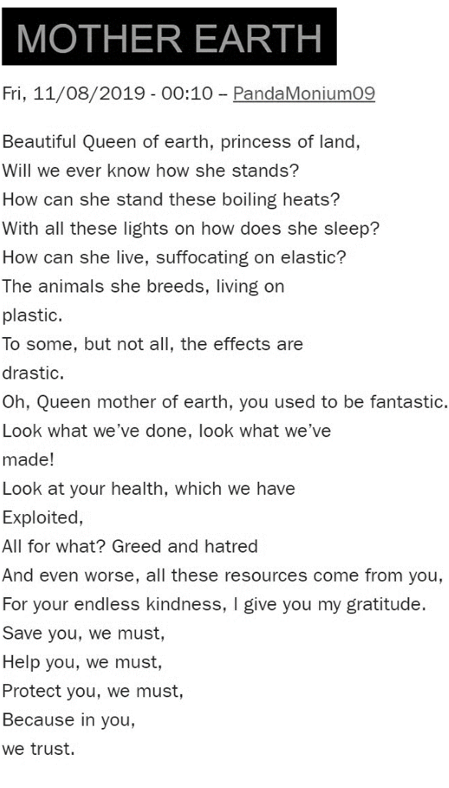

Slide 3
Author
Pandamonium09
Markus Pretorious
https://www.youtube.com/watch?v=n1So6wFGpIo

Slide 4
Topics
of this poem

Slide 5
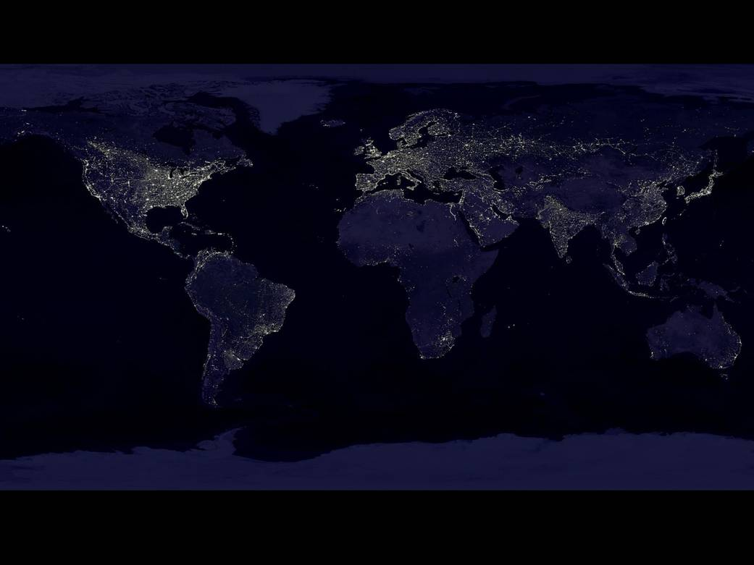
Light

Slide 6
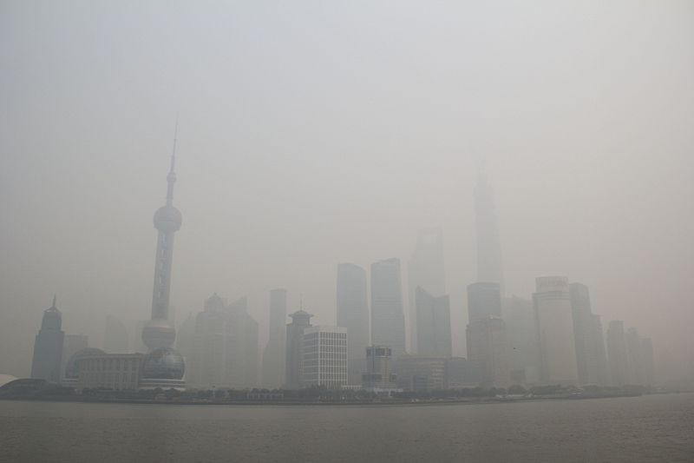
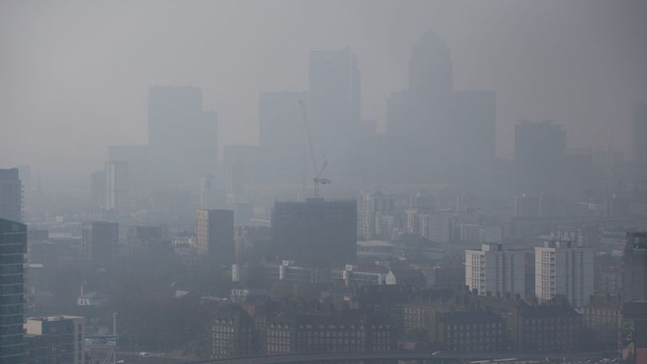
Pollution

Slide 7
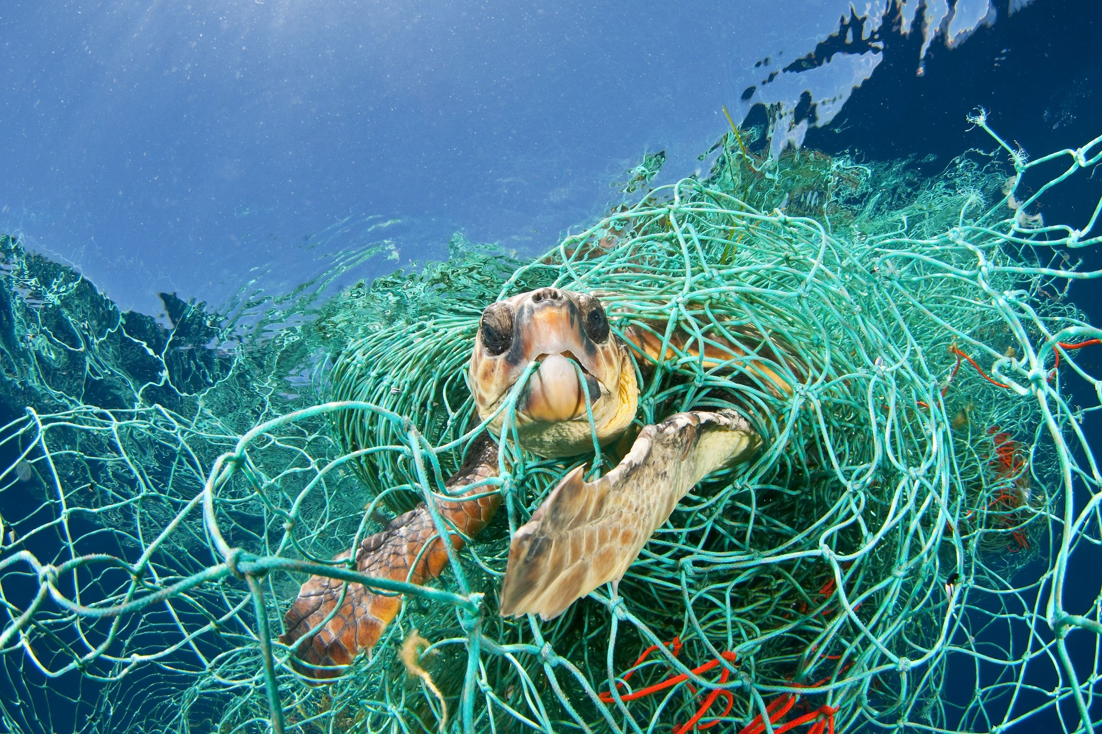
Ocean Trash

Slide 8
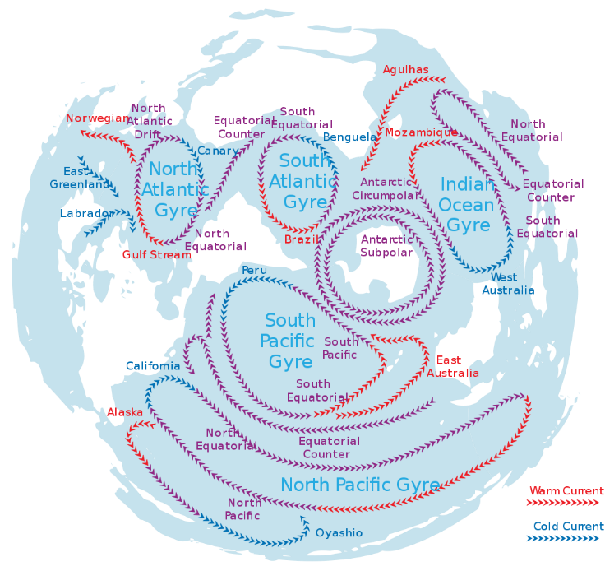
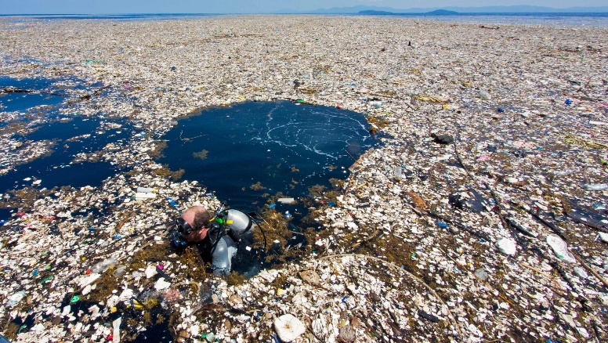
Island of plastic

Slide 9
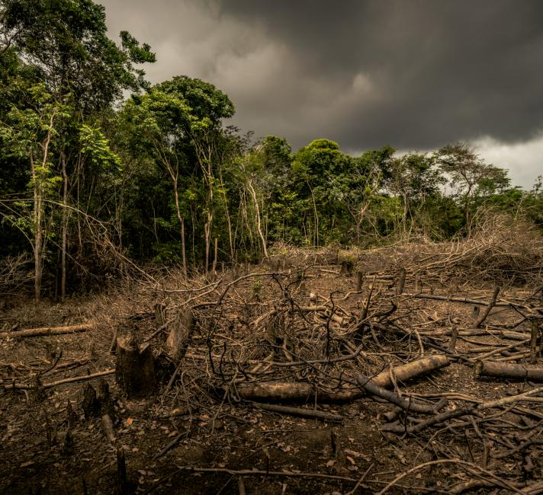
Deforestation

Slide 10
Discussion

