Slide 1
NonNewtonian Physicists - sample deck

Slide 2
Chapter 9: Work and Kinetic Energy

Slide 3
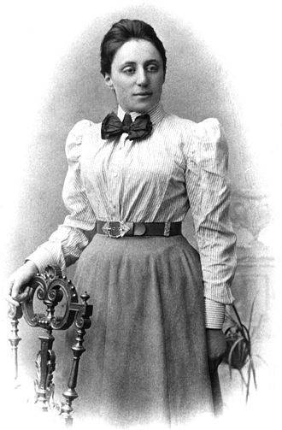
Emmy Noether
Notes:
Emmy Noether
Placements:
Knight, Physics for Scientists and Engineers: A Strategic Approach with Modern Physics, 3rd Edition, Chapter 9
Knight, Physics for Scientists and Engineers: A Strategic Approach with Modern Physics, 3rd Edition, Chapter 10
Amalie Emmy Noether was a German mathematician and physicist known for her landmark contributions to abstract algebra and theoretical physics. One of her most remarkable discoveries in physics was Noether's theorem. The theorem states that every differentiable symmetry of the action of a physical system has a corresponding conservation law. In 1915, Noether was helping two other scientists, David Hilbert and Felix Klein, to understand Albert Einstein's general relativity theory when she proved Noether's first theorem. Upon receiving her work, Einstein wrote to Hilbert: "Yesterday I received from Miss Noether a very interesting paper... I'm impressed that such things can be understood in such a general way. The old guard at Göttingen should take some lessons from Miss Noether! She seems to know her stuff."
Noether's theorem has become a fundamental tool of modern theoretical physics because of the insight it gives into conservation laws and also being practical calculation tool. For example, suppose that a new physical phenomenon is discovered. Noether's theorem provides a test for theoretical models of the phenomenon: if the theory has a continuous symmetry, then Noether's theorem guarantees that the theory has a conserved quantity, and for the theory to be correct, this conservation must be observable in experiments.
Sources:
https://en.wikipedia.org/wiki/Emmy_Noether
Photos:
https://upload.wikimedia.org/wikipedia/commons/thumb/e/e5/Noether.jpg/330px-Noether.jpg
Contributed by: Mai Hoang

Slide 4
Chapter 10: Interactions and Potential Energy

Slide 5
Emmy Noether
Notes:
Emmy Noether
Placements:
Knight, Physics for Scientists and Engineers: A Strategic Approach with Modern Physics, 3rd Edition, Chapter 9
Knight, Physics for Scientists and Engineers: A Strategic Approach with Modern Physics, 3rd Edition, Chapter 10
Amalie Emmy Noether was a German mathematician and physicist known for her landmark contributions to abstract algebra and theoretical physics. One of her most remarkable discoveries in physics was Noether's theorem. The theorem states that every differentiable symmetry of the action of a physical system has a corresponding conservation law. In 1915, Noether was helping two other scientists, David Hilbert and Felix Klein, to understand Albert Einstein's general relativity theory when she proved Noether's first theorem. Upon receiving her work, Einstein wrote to Hilbert: "Yesterday I received from Miss Noether a very interesting paper... I'm impressed that such things can be understood in such a general way. The old guard at Göttingen should take some lessons from Miss Noether! She seems to know her stuff."
Noether's theorem has become a fundamental tool of modern theoretical physics because of the insight it gives into conservation laws and also being practical calculation tool. For example, suppose that a new physical phenomenon is discovered. Noether's theorem provides a test for theoretical models of the phenomenon: if the theory has a continuous symmetry, then Noether's theorem guarantees that the theory has a conserved quantity, and for the theory to be correct, this conservation must be observable in experiments.
Sources:
https://en.wikipedia.org/wiki/Emmy_Noether
Photos:
https://upload.wikimedia.org/wikipedia/commons/thumb/e/e5/Noether.jpg/330px-Noether.jpg
Contributed by: Mai Hoang

Slide 6
Ursula Franklin
Ursula Martius Franklin, CC OOnt FRSC (16 September 1921 – 22 July 2016), was a German-Canadian metallurgist, research physicist, author, and educator who taught at the University of Toronto for more than 40 years. Franklin was a pioneer in the field of archaeometry, which applies modern materials analysis to archaeology. She worked for example, on the dating of prehistoric bronze, copper and ceramic artifacts. In the early 1960s Franklin was one of a number of scientists who participated in the Baby Tooth Survey, a project founded by Eric and Louise Reiss along with other scientists such as Barry Commoner, which investigated levels of strontium-90—a radioactive isotope in fallout from nuclear weapons testing—in children's teeth. This research contributed to the cessation of atmospheric weapons testing. Franklin published more than a hundred scientific papers and contributions to books on the structure and properties of metals and alloys as well as on the history and social effects of technology.
Notes:
Ursula Franklin
Placements:
Knight, Physics for Scientists and Engineers: A Strategic Approach with Modern Physics, 3rd Edition, Chapter 42
Ursula Martius Franklin, CC OOnt FRSC (16 September 1921 – 22 July 2016), was a German-Canadian metallurgist, research physicist, author, and educator who taught at the University of Toronto for more than 40 years. Franklin was a pioneer in the field of archaeometry, which applies modern materials analysis to archaeology. She worked for example, on the dating of prehistoric bronze, copper and ceramic artifacts. In the early 1960s Franklin was one of a number of scientists who participated in the Baby Tooth Survey, a project founded by Eric and Louise Reiss along with other scientists such as Barry Commoner, which investigated levels of strontium-90—a radioactive isotope in fallout from nuclear weapons testing—in children's teeth. This research contributed to the cessation of atmospheric weapons testing. Franklin published more than a hundred scientific papers and contributions to books on the structure and properties of metals and alloys as well as on the history and social effects of technology.
Sources:
https://en.wikipedia.org/wiki/Ursula_Franklin#Scientific_research

Slide 7
Chapter 30: Nuclear Physics

Slide 8
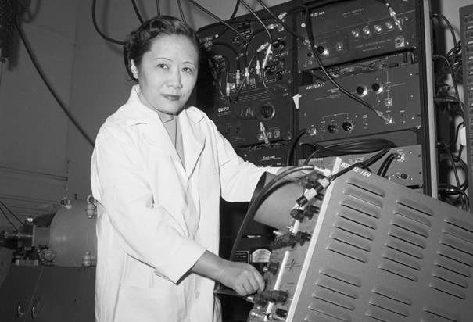
Chien-Shiung Wu
Notes:
Chien-Shiung Wu
Placements:
Knight, Physics for Scientists and Engineers: A Strategic Approach with Modern Physics, 3rd Edition, Chapter 42, Section 2
Knight, 2nd edition, Chapter 30 (Nuclear Physics), section 5
Chien-Shiung Wu (1912-1997) was a Chinese-American experimental physicist who made significant contributions in the field of nuclear physics1 (Wikipedia). Wu worked on the infamous Manhattan Project where she developed the process of separating uranium metal to uranium-235 and uranium-238 by gaseous diffusion1 (Wikipedia). Her work was credited to contradict the hypothetical Law of Conservation of Parity, which at the time was a well-established law and basically entailed a very complicated way of proving the idea of symmetry, where particles that are mirror images of each other will act in identical ways3 (ListVerse). Her experiments were incredibly significant in that she was able to show that one particle was more likely to eject an electron than the other and they were therefore not symmetrical and that observation overturned a 30-year belief and shattered the conservation of parity law3 (ListVerse). The discovery of parity violation was a major contribution to particle physics and the development of the Standard Model which is a paradigm of the modern quantum field theory2 (Wikipedia). It is little wonder that Wu is now hailed as “The First Lady of Physics” and the “Chinese Marie Curie”1(Wikipedia). However, unfortunately, like many of her contemporary female scientists, Wu’s work was discredited and her male co-workers Lee and Yang got awarded the Nobel Prize for Physics for ‘her’ experiment3 (ListVerse). In fact, she received no mention or credit for her significant contribution to the project until 1978, when she was awarded the inaugural Wolf Prize for Physics two decades after her ground-breaking experiment1(Wikipedia).
[Commentary from a second student:]
Wu was born in 1912. She got her B.E. from the National Central University of Nanking, China. She then got her Ph.D from University of California, Berkeley. Wu disproved the law of conservation of parity. She found that parity was not conserved in nuclear beta decay. She has many other achievements, such as working on the Manhattan Project and helped in the development of a more sensitive Geiger counter.
Sources:
Chien-Shiung Wu. Wikipedia. The Free Encyclopedia. Wikimedia Foundation, Inc. 20 September 2017. Web. 06 October 2017. https://en.wikipedia.org/wiki/Chien-Shiung_Wu Standard Model. Wikipedia. The Free Encyclopedia. Wikimedia Foundation, Inc. 16 September 2017. Web. 06 October 2017. https://en.wikipedia.org/wiki/Standard_Model 10 Groundbreaking Women Scientists Written Off By History. Shelby Hoebee. October 14, 2013. ListVerse. http://listverse.com/2013/10/14/10-groundbreaking-women-scientists-written-off-by-history/. Accessed 06 October 2017.
Johnson, L. (2018). CWP at physics.UCLA.edu // Chien-Shiung Wu. Cwp.library.ucla.edu. Retrieved 21 February 2018, from http://cwp.library.ucla.edu/Phase2/Wu,_Chien_Shiung@841234567.html Parity | particle physics. (2018). Encyclopedia Britannica. Retrieved 21 February 2018, from https://www.britannica.com/science/parity-particle-physics
Photos:
http://www.history.com/images/media/slideshow/women-in-science-and-health/chien-shiung-wu.jpg
http://www.uwastudentguild.com/wp-content/uploads/2017/03/20-Chien-Shiung-Wu.jpeg
Contributed by: Khyrul Khan, Chien-Shiung Wu

Slide 9
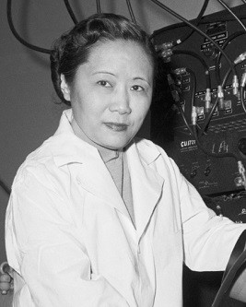
Chien-Shiung Wu
Notes:
Chien-Shiung Wu
Placements:
Knight, Physics for Scientists and Engineers: A Strategic Approach with Modern Physics, 3rd Edition, Chapter 42, Section 2
Knight, 2nd edition, Chapter 30 (Nuclear Physics), section 5
Chien-Shiung Wu (1912-1997) was a Chinese-American experimental physicist who made significant contributions in the field of nuclear physics1 (Wikipedia). Wu worked on the infamous Manhattan Project where she developed the process of separating uranium metal to uranium-235 and uranium-238 by gaseous diffusion1 (Wikipedia). Her work was credited to contradict the hypothetical Law of Conservation of Parity, which at the time was a well-established law and basically entailed a very complicated way of proving the idea of symmetry, where particles that are mirror images of each other will act in identical ways3 (ListVerse). Her experiments were incredibly significant in that she was able to show that one particle was more likely to eject an electron than the other and they were therefore not symmetrical and that observation overturned a 30-year belief and shattered the conservation of parity law3 (ListVerse). The discovery of parity violation was a major contribution to particle physics and the development of the Standard Model which is a paradigm of the modern quantum field theory2 (Wikipedia). It is little wonder that Wu is now hailed as “The First Lady of Physics” and the “Chinese Marie Curie”1(Wikipedia). However, unfortunately, like many of her contemporary female scientists, Wu’s work was discredited and her male co-workers Lee and Yang got awarded the Nobel Prize for Physics for ‘her’ experiment3 (ListVerse). In fact, she received no mention or credit for her significant contribution to the project until 1978, when she was awarded the inaugural Wolf Prize for Physics two decades after her ground-breaking experiment1(Wikipedia).
[Commentary from a second student:]
Wu was born in 1912. She got her B.E. from the National Central University of Nanking, China. She then got her Ph.D from University of California, Berkeley. Wu disproved the law of conservation of parity. She found that parity was not conserved in nuclear beta decay. She has many other achievements, such as working on the Manhattan Project and helped in the development of a more sensitive Geiger counter.
Sources:
Chien-Shiung Wu. Wikipedia. The Free Encyclopedia. Wikimedia Foundation, Inc. 20 September 2017. Web. 06 October 2017. https://en.wikipedia.org/wiki/Chien-Shiung_Wu Standard Model. Wikipedia. The Free Encyclopedia. Wikimedia Foundation, Inc. 16 September 2017. Web. 06 October 2017. https://en.wikipedia.org/wiki/Standard_Model 10 Groundbreaking Women Scientists Written Off By History. Shelby Hoebee. October 14, 2013. ListVerse. http://listverse.com/2013/10/14/10-groundbreaking-women-scientists-written-off-by-history/. Accessed 06 October 2017.
Johnson, L. (2018). CWP at physics.UCLA.edu // Chien-Shiung Wu. Cwp.library.ucla.edu. Retrieved 21 February 2018, from http://cwp.library.ucla.edu/Phase2/Wu,_Chien_Shiung@841234567.html Parity | particle physics. (2018). Encyclopedia Britannica. Retrieved 21 February 2018, from https://www.britannica.com/science/parity-particle-physics
Photos:
http://www.history.com/images/media/slideshow/women-in-science-and-health/chien-shiung-wu.jpg
http://www.uwastudentguild.com/wp-content/uploads/2017/03/20-Chien-Shiung-Wu.jpeg
Contributed by: Khyrul Khan, Chien-Shiung Wu

