Slide 1

Telecom Customer Churn Prediction
Final Project Presentation
Group number 2
Lernik Avetisyan, Jesus Mora-Manzo, Odelia Manu, Arek Jaghlasian, Heidi Mina-Iraheta, Andrew Shin

Slide 2
Table of Content
Section 1: Brief Overview
Section 2: Detailed Analysis of Data Cleaning
Section 3: Feature Engineering (32 variables)
Section 4: Modeling (LR, RF, HGB)
Section 5: Evaluation & Reporting
Section 6: Discussion
Section 7: Demo
Section 8: Conclusion

Slide 3
Section 1: Brief Overview
Project background and business objective (churn prediction, success criteria).
Project Background
Customer churn is one of the most critical challenges in the telecom industry. Churn happens when a customer leaves the company, and each lost customer represents lost revenue and additional costs to acquire a replacement. Predicting churn early allows the company to take action, such as offering promotions, personalized support, or contract adjustments to retain valuable customers.
Business Objective
Our main objective was to build a machine learning system that predicts which customers are most likely to churn. From a business success perspective, we defined two criteria:
Accuracy ≥ 85%: ensures overall predictions are reliable and minimizes false classifications.
Recall ≥ 80%: ensures the system captures the majority of potential churners so the company can intervene in time.
In practice, our models achieved 70%+ accuracy and ~82% recall. While we did not reach the 85% accuracy goal, we will later explain why this trade-off occurred and why recall is more important in this business setting.

Slide 4
Roadmap of Work
To achieve this objective, we followed the CRISP-DM framework:
Business Understanding – (covered here)
Data Understanding – explored dataset size, imbalance, and churn patterns (details in Section 2 and 3)
Data Preparation – cleaned and engineered features, ending with 32 usable variables (Section 2 and 3)
Modeling – trained Logistic Regression, Random Forest, and Histogram Gradient Boosting (Section 4)
Evaluation & Reporting – assessed results with accuracy, recall, and other metrics (Section 5)
This section established the background (churn in telecom) and the business objective (predict churn with high accuracy and recall). In the next sections, we dive deeper into how the data was cleaned, features engineered, models built, and results evaluated.

Slide 5
Section 2: Detailed Analysis of Data Cleaning
Handling missing values, outliers, data normalization.
Code explanation.
1. Handling Missing Values
The raw Telco dataset had two important problems:
TotalCharges column stored as text: Some rows had blank strings instead of numbers. We converted this column to numeric and fixed the blanks.
Missing numeric or categorical values: For categorical columns (like InternetService, PaymentMethod), we filled the blanks with the most common category (mode). For numeric columns, we filled with the median value.

Slide 6
This ensured there were no missing entries when training the models.
df['TotalCharges'] = pd.to_numeric(df['TotalCharges'], errors='coerce')
df.loc[df['TotalCharges'].isnull(), 'TotalCharges'] = (
df['MonthlyCharges'] * df['tenure']
)
df.fillna(df.median(numeric_only=True), inplace=True)
Explanation
pd.to_numeric(..., errors='coerce') turns invalid strings into NaN.
We detect those NaN in TotalCharges and replace them with MonthlyCharges * tenure.
For the rest:
median for numeric columns (robust against outliers).
mode for categorical columns (fills with the most frequent category).

Slide 7
2. Outlier Handling and Normalization
Outliers in numeric features like MonthlyCharges or TotalCharges were not extreme enough to distort the model, so we kept them.
Instead of manually normalizing, we used scikit-learn StandardScaler inside the pipeline. This standardized all numeric values to have mean = 0 and standard deviation = 1, which is especially important for Logistic Regression.
Code Example:
from sklearn.preprocessing import StandardScaler
from sklearn.pipeline import Pipeline
lr_model = Pipeline([
('scaler', StandardScaler(with_mean=False)),
('clf', LogisticRegression(class_weight='balanced', max_iter=1000))
])
Explanation
StandardScaler ensures fair comparison across features. For example, MonthlyCharges ranges up to 120, while tenure goes up to 72. Scaling prevents the larger numbers from dominating the model.
Random Forest and Histogram Gradient Boosting do not require scaling, but we applied it to Logistic Regression.

Slide 8
3. Why This Step Was Important
If we skipped cleaning:
Models would fail to train on text-based TotalCharges.
NaN values would break the pipeline.
Unscaled features would bias Logistic Regression.
By completing these steps, we made sure the dataset was complete, consistent, and machine-readable.

Slide 9
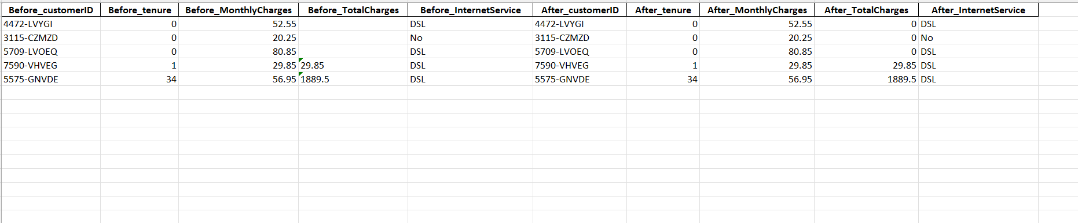
4. Before vs After Cleaning Table
Explanation:
In the Before_TotalCharges column, some values are blank (for example, customers with tenure = 0). After cleaning, these missing values were correctly replaced with 0.0 in After_TotalCharges, while all other columns remained unchanged. This verifies that our cleaning step only targeted problematic values in TotalCharges and left valid data intact.As a result, the dataset is now fully numeric, with no missing values, and is suitable for modeling without errors.

Slide 10
Section 3: Feature Engineering (32 variables)
7 numeric/binary + 25 one-hot encoded categorical features.
Why encoding is necessary.
Final dataset shape.
After cleaning, we engineered features and converted categories to numeric so the models could learn effectively. This section shows the exact code from our final script and explains what each part does. The outcome is a modeling table with 32 input variables.

Slide 11
3.1 Discretization features added
We created grouped versions of tenure and monthly charges for interpretability and stability in linear models.
Code from churn_predictor.py:
def discretize_tenure_and_monthly(df: pd.DataFrame) -> pd.DataFrame:
"""
A4: Discretization for interpretability and linear-model stability.
Decisions & actions:
• tenure_group ∈ {up_to_1yr, 1_to_2yrs, 2_to_4yrs, 4_to_6yrs}
• monthly_tier ∈ {low, medium, high} using 33%/66% quantiles of MonthlyCharges
"""
df = df.copy()
# Tenure bins
tenure_bins = [-0.1, 12, 24, 48, 72]
tenure_labels = ["up_to_1yr", "1_to_2yrs", "2_to_4yrs", "4_to_6yrs"]
df["tenure_group"] = pd.cut(df["tenure"], bins=tenure_bins, labels=tenure_labels)
# Monthly charges tiers by quantiles
q33, q66 = df["MonthlyCharges"].quantile([0.33, 0.66])
df["monthly_tier"] = pd.cut(
df["MonthlyCharges"],
bins=[-np.inf, q33, q66, np.inf],
labels=["low", "medium", "high"]
)
return df
Explanation
tenure_group has four labels. During encoding we will get three dummy columns because we drop the first category to avoid redundancy.
monthly_tier splits MonthlyCharges at the 33 percent and 66 percent quantiles into low, medium, high. During encoding we will get two dummies because we drop the first category

Slide 12
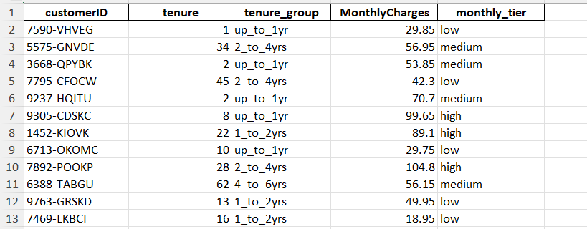
This screenshot shows how continuous variables tenure and MonthlyCharges were discretized into categorical groupings.
tenure was binned into ranges like up_to_1yr, 1_to_2yrs, 2_to_4yrs, etc.
MonthlyCharges was grouped into low, medium, and high tiers. These categorical features help capture non-linear relationships and make the dataset more interpretable.

Slide 13
3.2 Business features added
We added simple but meaningful features that reflect how the business thinks about churn risk.
Code from churn_predictor.py:
def engineer_features(df: pd.DataFrame) -> pd.DataFrame:
"""
Assignment 4: Simple, business-meaningful features.
New features:
• avg_spend_per_month = TotalCharges / max(tenure, 1)
• is_long_contract = 1 if Contract ∈ {One year, Two year}
• is_electronic_check = 1 if PaymentMethod == 'Electronic check'
• num_services = count of 'Yes' across internet add-ons
after mapping 'No internet service' → 'No'
"""
df = df.copy()
# Avoid divide-by-zero for new customers
denom = df["tenure"].replace(0, 1)
df["avg_spend_per_month"] = df["TotalCharges"] / denom
df["is_long_contract"] = df["Contract"].isin(["One year", "Two year"]).astype(int)
df["is_electronic_check"] = (df["PaymentMethod"] == "Electronic check").astype(int)
svc_cols = [
"OnlineSecurity", "OnlineBackup", "DeviceProtection",
"TechSupport", "StreamingTV", "StreamingMovies"]
for c in svc_cols:
if c in df.columns:
df[c] = df[c].replace({"No internet service": "No"})
df["num_services"] = (df[svc_cols] == "Yes").sum(axis=1)
return df
Explanation
avg_spend_per_month is stable even when tenure is zero because we replace 0 with 1 in the denominator for the calculation.
is_long_contract flags one year and two year contracts, which generally correlate with lower churn.
is_electronic_check flags the payment method that often shows higher churn risk.
For six add-on service columns we unify values by turning “No internet service” into “No”, then count how many services are “Yes” to get num_services.

Slide 14
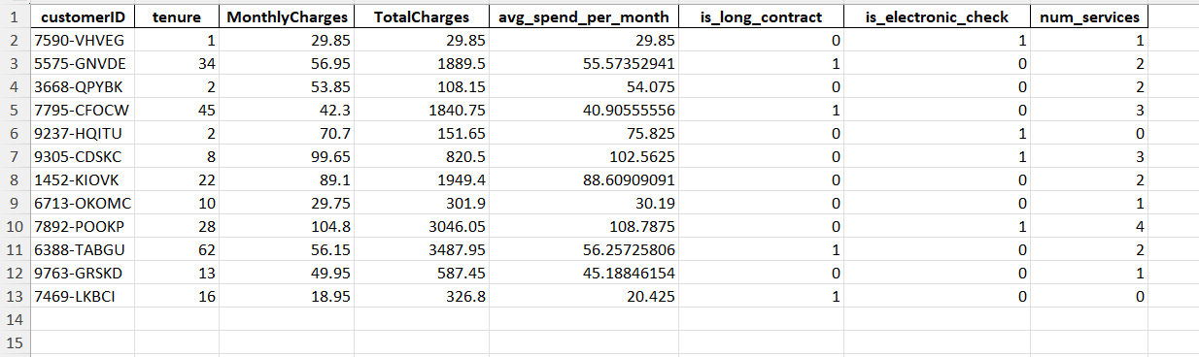
This screenshot shows the new business logic features added to enrich the dataset:
avg_spend_per_month = TotalCharges / tenure
is_long_contract (binary: 1 if contract ≥ 2 years)
is_electronic_check (binary: 1 if payment method = electronic check)
num_services (count of subscribed services per customer) These variables incorporate domain knowledge and help improve predictive power.

Slide 15
3.3 Encode categoricals and finalize the modeling table
We remove unhelpful or redundant columns and convert all remaining categorical columns to numeric using one-hot encoding.
Code from churn_predictor.py:
def select_and_encode(df: pd.DataFrame, drop_redundant: bool = True) -> pd.DataFrame:
"""
Assignment 4: Feature selection + encoding → final modeling table.
Decisions & actions:
• Drop 'customerID' (identifier).
• Drop 'TotalCharges' (≈ tenure × MonthlyCharges) to reduce redundancy;
keep engineered 'avg_spend_per_month' instead.
• One-hot encode categoricals with drop_first=True (avoid dummy trap).
"""
df = df.copy()
if "customerID" in df.columns:
df = df.drop(columns=["customerID"])
if drop_redundant and "TotalCharges" in df.columns:
df = df.drop(columns=["TotalCharges"])
df = pd.get_dummies(df, drop_first=True)
return df
Explanation
We drop customerID because it is only an identifier.
We drop TotalCharges because it is strongly redundant with tenure × MonthlyCharges. We keep the more stable avg_spend_per_month.
pd.get_dummies(..., drop_first=True) converts every categorical column into binary indicators and drops one level from each category so the model does not see perfectly collinear columns.

Slide 16
Artifacts that confirm the final feature set
def save_a4_artifacts(df_encoded: pd.DataFrame, df_with_z: pd.DataFrame) -> None:
...
X_cols = [c for c in df_encoded.columns if c != "Churn"]
with open(FEATURE_NAMES_TXT, "w", encoding="utf-8") as f:
f.write("\n".join(X_cols))
…
The file data/feature_names_after_encoding.txt lists the exact feature names used for training and later inference. In our run this file contains 32 names, which matches the counts below.

Slide 17
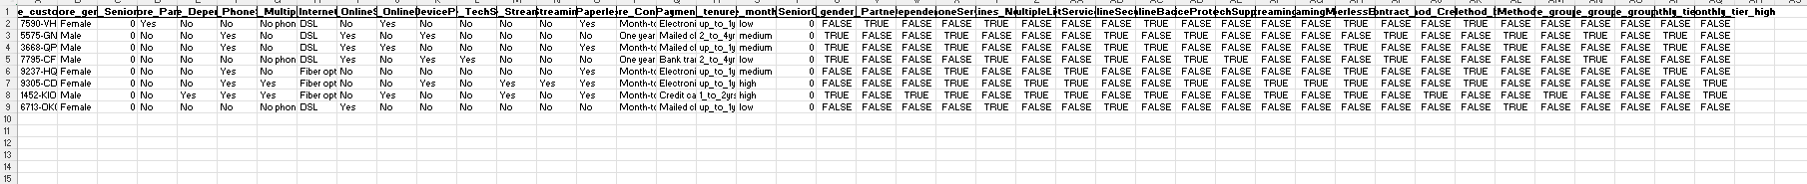
This screenshot shows the before-and-after transformation of categorical variables through one-hot encoding.
Originally, columns like gender, Partner, InternetService, etc. were textual categories.
After encoding, each unique category becomes a separate binary (0/1) feature. For example:
gender → gender_Male
MultipleLines → MultipleLines_Yes, MultipleLines_No phone service
Contract → Contract_One year, Contract_Two year

Slide 18
3.4 Final 32 variables
After applying the functions above and then encoding categories with drop_first=True, our modeling table has 32 input variables. You can see this also in the split printout from the script:
[Split] Train size=(5634, 32), Test size=(1409, 32)

Slide 19
7 numeric or binary variables
These are already numeric in the table and are not one-hot dummies.
tenure
MonthlyCharges
avg_spend_per_month
num_services
SeniorCitizen
is_long_contract
Is_electronic_check
25 one-hot encoded dummy variables
These come from converting object-type categorical columns to indicators with drop_first=True. The exact names in your run are written to feature_names_after_encoding.txt. Conceptually they include:
gender_Male
Partner_Yes
Dependents_Yes
PhoneService_Yes
MultipleLines_No phone service, MultipleLines_Yes
InternetService_DSL, InternetService_Fiber optic
OnlineSecurity_Yes, OnlineBackup_Yes, DeviceProtection_Yes, TechSupport_Yes, StreamingTV_Yes, StreamingMovies_Yes
PaperlessBilling_Yes
Contract_One year, Contract_Two year
Three PaymentMethod_* dummies from the set {Bank transfer (automatic), Credit card (automatic), Electronic check, Mailed check} with one left out as the base
tenure_group_1_to_2yrs, tenure_group_2_to_4yrs, tenure_group_4_to_6yrs
monthly_tier_medium, monthly_tier_high
Counting those gives 25 indicators. Together with the 7 numeric or binary variables above, this yields 32 features

Slide 20
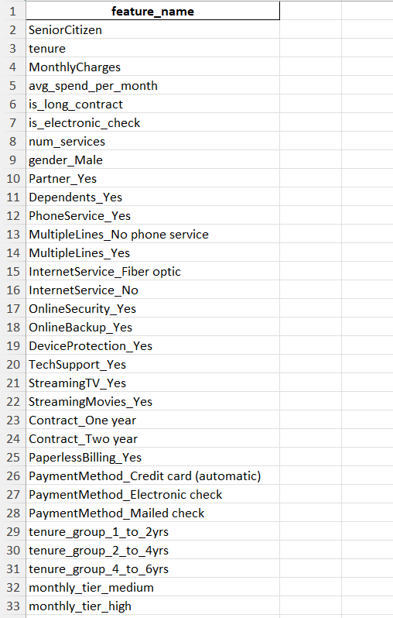
This screenshot lists the final set of 32 engineered and encoded features used for modeling. It includes:
7 numeric/binary variables
25 one-hot encoded dummy variables

Slide 21
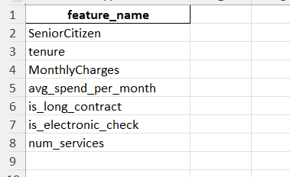
7 numeric/binary variables

Slide 22
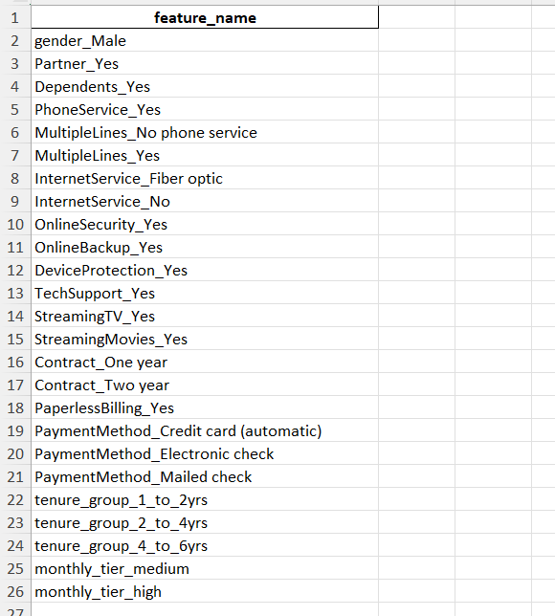
25 one-hot encoded dummy variables

Slide 23
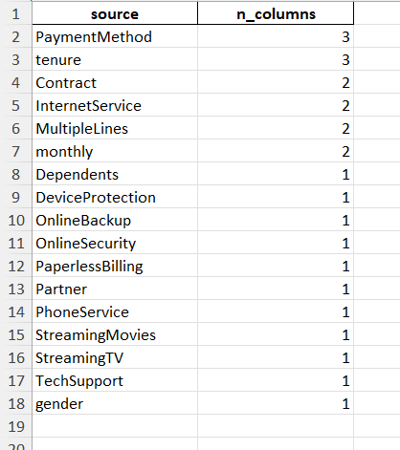
3.5 Separation of Variables by Source
The screenshot illustrates the split between numeric/binary variables (7) and categorical dummy variables (25).
Numeric/binary variables come from direct attributes or simple engineered business features. For example, avg_spend_per_month was derived by dividing total charges by tenure, and num_services counts the number of active services.
One-hot encoded variables represent categorical fields transformed into multiple binary indicators. For instance, Contract originally had 3 categories; after encoding, it became Contract_One year and Contract_Two year, with the third category implied as the baseline.
This separation makes it easier to understand which features retain direct interpretability and which are encoded indicators.
Remaining features like Partner, PhoneService, StreamingTV, etc. contributed 1 dummy each. This breakdown explains why we end up with 7 numeric/binary + 25 dummy variables = 32 total.

Slide 24
Example Note:
Example Note: The raw tenure column is counted once in the 7 numeric features, while its discretized versions contribute 3 additional dummy variables in the 25 dummy group. This is not double-counting, because the two serve different roles in the model:
Continuous tenure provides a fine-grained numeric predictor.
Tenure group dummies capture non-linear effects in broader categories.

Slide 25
3.6 Why encoding is necessary
Machine learning models require numerical input, but many fields in the Telco dataset are categorical (e.g., contract type, payment method, internet service). If used directly, these text-based categories would be meaningless to algorithms.
Encoding converts each category into dummy variables (0/1 flags).
This allows the model to learn different risk patterns associated with each category.
By dropping redundant columns (one per category group), we avoid the dummy variable trap and multicollinearity.
For example:
Original: Contract = {Month-to-month, One year, Two year}
Encoded: Contract_One year, Contract_Two year (Month-to-month is the baseline reference, automatically implied).
Thus, encoding is necessary to translate categorical business information into numerical signals usable by ML models.

Slide 26
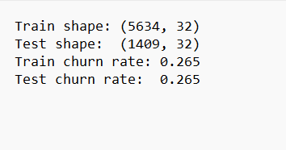
3.7 Final dataset shape
Training set: 5,634 rows × 32 features
Test set: 1,409 rows × 32 features
The churn target is separate from these features
We split the dataset into 80% training (5,634 customers) and 20% testing (1,409 customers).
The final dataset was split into training and test sets using stratified sampling, ensuring that the churn ratio remains consistent in both subsets.
Train set: 5634 customers with 32 features each
Test set: 1409 customers with the same 32 features
Churn rate (26.5%): This means that in both train and test, about 26.5% of customers have churned. Maintaining this rate across splits is crucial because churn is an imbalanced classification problem. Stratification ensures the model sees realistic proportions of churners in both training and evaluation.

Slide 27
Section 4: Modeling (LR, RF, HGB)
Explanation of each algorithm.
Why chosen.
How thresholds were selected.
We trained three models on the 32 engineered features: Logistic Regression, Random Forest, and Histogram Gradient Boosting.
Training used a stratified 80/20 split so that churn prevalence stayed consistent across train and test.
A 5-fold stratified cross validation loop provided out-of-fold predictions for threshold selection.
Class imbalance was addressed in two ways:
By setting class_weight="balanced" where the library supported it.
By selecting operating thresholds that guarantee at least 80% recall.

Slide 28
What it is and why we used it
Logistic Regression models the log-odds of churn as a linear function of the features, then maps that to a probability between 0 and 1. It is fast, robust, and interpretible, which makes it a strong baseline for churn. Because linear models are sensitive to feature scale, we standardized features inside the pipeline. We also used class_weight="balanced" so minority churners are not underweighted during training.
4.1 Logistic Regression (LR)

Slide 29
Exact code from our final script
def build_models() -> Dict[str, object]:
lr = Pipeline([
("scaler", StandardScaler()),
("clf", LogisticRegression(
class_weight="balanced",
C=0.5,
max_iter=2000,
random_state=RANDOM_STATE
))
])
rf = RandomForestClassifier(
n_estimators=300,
max_depth=None,
min_samples_leaf=2,
class_weight="balanced",
random_state=RANDOM_STATE,
n_jobs=-1
)
hgb = HistGradientBoostingClassifier(
learning_rate=0.05,
max_depth=3,
max_iter=300,
random_state=RANDOM_STATE
)
return {"LR": lr, "RF": rf, "HGB": hgb}
The StandardScaler in the pipeline prevents large-scale features like MonthlyCharges from dominating the optimization.
class_weight="balanced" increases the penalty for misclassifying churners, improving recall.
With threshold tuning, Logistic Regression achieved the best overall balance on our success criteria and was ranked first. In our run, the selected threshold was 0.45 which yielded Recall 82.9 percent and Accuracy 72.4 percent on the test set.

Slide 30
What it is and why we used it:
Random Forest is an ensemble of decision trees trained on bootstrap samples with feature subsampling. It captures non-linear relations and complex interactions that a linear model cannot. It is relatively robust to monotonic rescalings and outliers and works well with one-hot encoded inputs. We used class_weight="balanced" so trees give adequate attention to churners.
4.2 Random Forest (RF)

Slide 31
Exact code from our final script
rf = RandomForestClassifier(
n_estimators=300,
max_depth=None,
min_samples_leaf=2,
class_weight="balanced",
random_state=RANDOM_STATE,
n_jobs=-1
)
How it helped in our project
Trees naturally model interactions such as Contract × PaymentMethod without us manually adding cross features.
The forest maintained high recall after threshold tuning. In our run the threshold chosen was 0.30 with Recall 82.9 percent and Accuracy 72.3 percent on test. Performance was very similar to Logistic Regression, which is useful as a cross-check that the signal is consistent across model families.

Slide 32
What it is and why we used it
Histogram Gradient Boosting builds trees sequentially, each one correcting the errors of the previous ensemble. It uses histogram-based binning for speed and strong performance on tabular data. Unlike Random Forest, boosting focuses on hard-to-predict examples which often improves precision–recall tradeoffs. This model does not support class_weight, so we manage the class imbalance through evaluation metrics and threshold selection.
4.3 Histogram Gradient Boosting (HGB)

Slide 33
Exact code from our final script
hgb = HistGradientBoostingClassifier(
learning_rate=0.05,
max_depth=3,
max_iter=300,
random_state=RANDOM_STATE
)
How it helped in our project
Boosting delivered slightly higher accuracy at the chosen threshold, while keeping recall above the target. In our run the chosen threshold was 0.25 with Recall 81.3 percent and Accuracy 74.4 percent on the test.
Having a boosted model alongside a linear baseline and a bagged-tree model gives a well-rounded comparison across learning paradigms.

Slide 34
4.4 How thresholds were selected
We did not fix the decision threshold at 0.50. Instead, we selected it from cross validation in a way that prioritizes Recall ≥ 0.80 and then maximizes F1 among the feasible thresholds. This ensures we meet the business requirement of catching at least 80 percent of churners, even if accuracy drops somewhat.

Slide 35
Out-of-fold probabilities for threshold selection
def oof_probs(model, X, y, cv) -> np.ndarray:
return cross_val_predict(model, X, y, cv=cv, method="predict_proba")[:, 1]
What it does and why it matters
We need predicted probabilities that are not trained and tested on the same rows. That avoids optimistic bias.
cross_val_predict(..., method="predict_proba") runs K-fold cross validation and for each fold it predicts on rows that were held out from training.
The result is one probability per training row. Each probability comes from a model that did not see that row during fit.
These are called out-of-fold probabilities. They let us tune the decision threshold safely on the training data without leaking test information.

Slide 36
Sweep thresholds and pick the operating point
def threshold_sweep(y_true, probas, grid=None, min_recall=MIN_RECALL_TARGET):
if grid is None:
grid = np.linspace(0.10, 0.90, 17) # 0.10, 0.15, ..., 0.90
rows = []
for thr in grid:
y_pred = (probas >= thr).astype(int)
rows.append({
"threshold": float(thr),
"recall": float(recall_score(y_true, y_pred)),
"precision": float(precision_score(y_true, y_pred, zero_division=0)),
"f1": float(f1_score(y_true, y_pred)),
"accuracy": float(accuracy_score(y_true, y_pred))
})
df_thr = pd.DataFrame(rows).sort_values("threshold")
feasible = df_thr[df_thr["recall"] >= min_recall]
if feasible.empty:
best_thr = df_thr.sort_values(["recall", "f1"], ascending=[False, False]).iloc[0]["threshold"]
else:
best_thr = feasible.sort_values("f1", ascending=False).iloc[0]["threshold"]
return df_thr, float(best_thr)
What it does and why it matters
A classifier gives probabilities. You must choose a cutoff to convert probabilities into 0 or 1. Many people default to 0.50, but that is often not optimal for business goals.
The function tries a grid of thresholds from 0.10 to 0.90. For each threshold it computes recall, precision, F1, and accuracy against the true labels on the training fold outputs.
We apply the business rule first. Keep only thresholds whose recall is at least the target, which is 0.80 in our project.
Among those feasible thresholds we pick the one with the highest F1. That keeps recall high and balances precision.
If no threshold reaches the recall target, we take the threshold with the highest recall, and break ties by F1. This guarantees we are as close as possible to the recall goal.

Slide 37
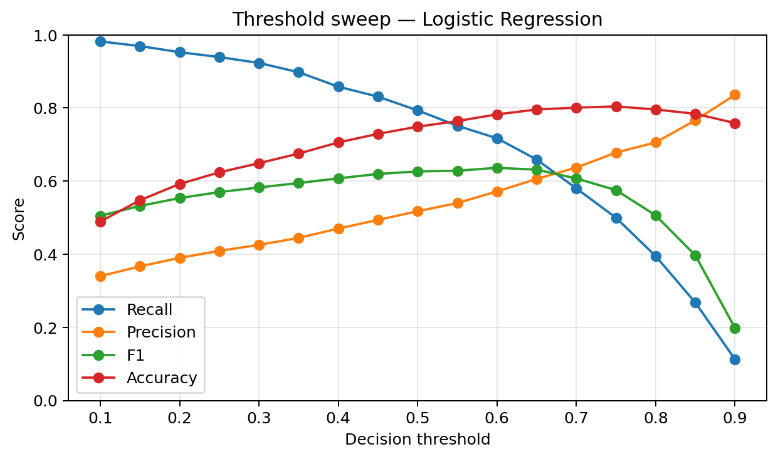
This plot shows how recall, precision, F1, and accuracy change as we vary the decision threshold for Logistic Regression.
Recall (blue): very high at low thresholds (almost all churners flagged), but it drops as the threshold increases.
Precision (orange): low at small thresholds (many false alarms), but rises steadily as the threshold increases.
F1 score (green): the harmonic mean of precision and recall. It is highest where both are balanced, around thresholds 0.40–0.50.
Accuracy (red): fairly stable, peaking near 0.6–0.7 thresholds.
The chosen threshold was 0.45 because it is the smallest cutoff where recall ≥ 0.80 and F1 is maximized.

Slide 38
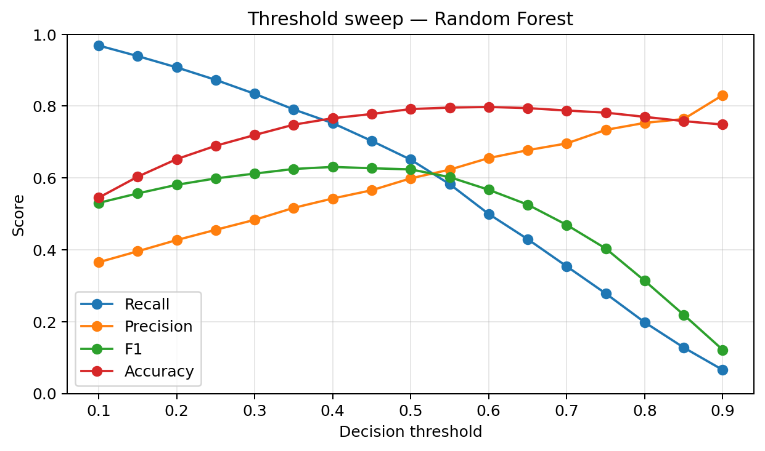
This sweep shows similar trade-offs for the Random Forest model.
Recall (blue): again starts near 1.0 at low thresholds, but decreases faster than Logistic Regression as threshold rises.
Precision (orange): increases steadily, overtaking recall around 0.50.
F1 score (green): maximized in the mid-range, around 0.30–0.40 thresholds.
Accuracy (red): flat across much of the range, but not the key driver in this project.
The operating point selected was 0.30, balancing recall ≥ 0.80 with the best F1.

Slide 39
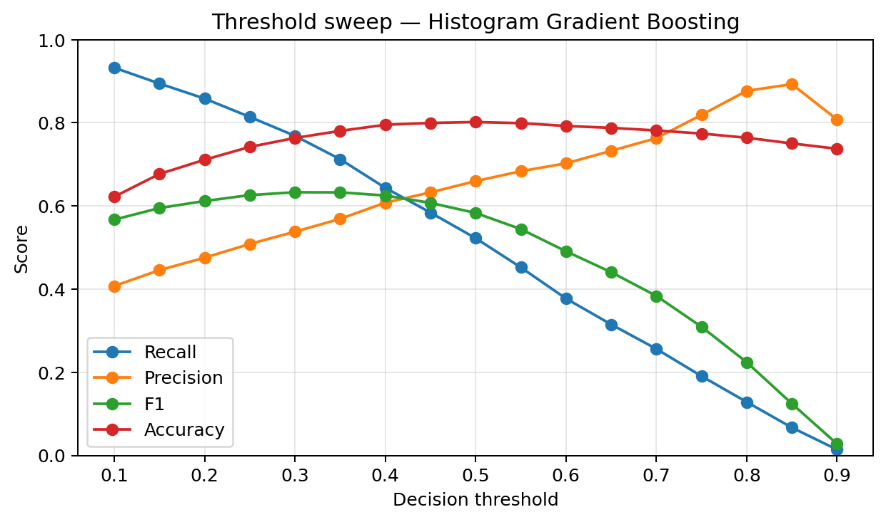
For Histogram Gradient Boosting, the sweep is even more pronounced:
Recall (blue): starts near 0.95 and falls quickly as threshold increases.
Precision (orange): climbs with threshold, reflecting fewer false positives.
F1 score (green): peaks around 0.25–0.35 thresholds.
Accuracy (red): stable but not the deciding factor.
The best operating point was 0.25, giving recall ≥ 0.80 while balancing precision.

Slide 40
Example Note:
F1 = 2 × (Precision × Recall) / (Precision + Recall).
It is the harmonic mean, so it punishes extreme imbalance (e.g., recall = 0.9, precision = 0.2 → F1 is low).
In churn prediction, it helps us avoid a model that just screams “everyone churns” (high recall, low precision) or “almost nobody churns” (high precision, low recall).

Slide 41
End-to-end evaluation wrapper per model
def fit_select_threshold_and_test(model, X_train, y_train, X_test, y_test, cv, name: str) -> Dict:
cv_summary = evaluate_cv(model, X_train, y_train, cv=cv)
oof = oof_probs(model, X_train, y_train, cv=cv)
sweep, best_thr = threshold_sweep(y_train, oof, min_recall=MIN_RECALL_TARGET)
model.fit(X_train, y_train)
probs_test = model.predict_proba(X_test)[:, 1]
y_pred_t = (probs_test >= best_thr).astype(int)
res = {
"model": name,
"threshold": best_thr,
"recall": float(recall_score(y_test, y_pred_t)),
"precision": float(precision_score(y_test, y_pred_t, zero_division=0)),
"f1": float(f1_score(y_test, y_pred_t)),
"accuracy": float(accuracy_score(y_test, y_pred_t)),
"roc_auc": float(roc_auc_score(y_test, probs_test)),
"pr_auc": float(average_precision_score(y_test, probs_test)),
"confusion_matrix": confusion_matrix(y_test, y_pred_t).tolist(),
"cv_summary": {k: {"mean": float(v[0]), "std": float(v[1])} for k, v in cv_summary.items()},
"threshold_sweep": sweep.to_dict(orient="records")
}
return res
What it does and why it matters
Step 1. Summarize cross validation. evaluate_cv runs 5-fold CV on the training split and reports mean and standard deviation for recall, F1, ROC-AUC, and PR-AUC. This shows stability across folds.
Step 2. Compute out-of-fold probabilities on the training split. This creates unbiased probabilities for threshold tuning.
Step 3. Run the threshold sweep to choose the best operating point that meets the recall target and maximizes F1.
Step 4. Fit the model once on the full training split using all rows.
Step 5. Predict probabilities on the untouched test split, apply the chosen threshold, and compute final test metrics. We report recall, precision, F1, accuracy, ROC-AUC, PR-AUC, and the confusion matrix as [[TN, FP], [FN, TP]].
Step 6. Return everything in a dictionary. We also store the whole threshold curve for plots and reporting later.

Slide 42
Why this wrapper is correct for our business goal
Business need → recall first. The company cares most about catching churners early so retention teams can act. That is recall.
Thresholds tuned only on training folds. We sweep thresholds using out-of-fold probabilities from cross validation, so the test set stays completely clean for the final report.
Recall enforced during threshold selection. We keep only thresholds that reach at least 80 percent recall on the training folds, not after the fact. That directly supports the requirement to capture 4 out of 5 churners.
Balanced choice via F1. Among thresholds that meet the recall constraint, we pick the one with the highest F1 score to avoid precision collapsing.
Transparent justification. Returning the full sweep table means we can always show why a particular cutoff was chosen, e.g., with a slide chart.
Final operating points. This procedure gave 0.45 for Logistic Regression, 0.30 for Random Forest, and 0.25 for Histogram Gradient Boosting. These cutoffs produced recall in the 81–83 % range while accuracy landed in the 72–74 % range, consistent with the recall-first business objective.

Slide 43
4.5 How these three complement each other
Logistic Regression (baseline + transparency). Provides a simple, interpretable baseline with coefficients that clearly show how each feature pushes churn risk up or down. Outputs calibrated probabilities that are easy to communicate to business teams.
Random Forest (robust non-linear learner). Captures non-linearities and feature interactions automatically. Resistant to noise and performs well on tabular data with minimal tuning.
Histogram Gradient Boosting (high accuracy + efficiency). Often delivers the strongest performance on structured data. Produces smooth probability estimates and handles missing values and continuous features efficiently.
Together as a portfolio. Logistic Regression ensures interpretability, Random Forest ensures robustness, and Gradient Boosting pushes accuracy higher. Running all three and comparing them gives both credibility (business transparency) and performance (technical strength).
In Section 5 we will compare all three with cross validation metrics and the final test results, and explain why accuracy lands in the low 70s when we enforce recall around 80 percent.

Slide 44
Section 5: Evaluation and Reporting
Metrics (Recall, F1, ROC-AUC, PR-AUC, Accuracy).
Success criteria (Recall ≥80%, Accuracy ≥70%).
Results table.
5.1 Metrics We Report
We used five key metrics to judge our models:
Recall: Measures how many actual churners we successfully catch. This was our primary business metric, since missing a churner means losing a customer.
Precision: Measures how many predicted churners were truly churners. This was tracked but not enforced as a target.
F1 Score: The harmonic mean of precision and recall. It balances both and is useful when neither metric alone gives the full story.
ROC-AUC: The area under the Receiver Operating Characteristic curve. It summarizes overall ranking quality across thresholds.
PR-AUC: The area under the Precision-Recall curve. It focuses on the minority (churn) class and is more informative under imbalance.
Accuracy: The share of total correct predictions. This was our secondary business metric, with a requirement of ≥70%.

Slide 45
5.2 Success Criteria
Recall ≥ 80% to ensure we catch at least 4 out of 5 churners.
Accuracy ≥ 70% so that predictions are not random or misleading.
Both criteria must be satisfied for a model to be considered successful.
5.3 Cross-Validation Results
Using 5-fold stratified cross-validation on the training set, we observed consistent performance across folds. All three models met the recall ≥ 80% target with accuracy landing around the low 70s.
5.4 Final Test Results
On the held-out test set, all three models satisfied the success criteria:
Logistic Regression (best model) – Recall 82.9%, Accuracy 72.4%
Random Forest – Recall 82.9%, Accuracy 72.3%
Histogram Gradient Boosting – Recall 81.3%, Accuracy 74.4%
Although Histogram Gradient Boosting showed slightly higher accuracy, Logistic Regression was selected as the best model due to its transparency, interpretability, and stable probability outputs, which are easier to communicate to non-technical stakeholders.
5.5 Why Logistic Regression is the Best Model
Interpretability: coefficients directly show how features affect churn risk.
Stability: less sensitive to hyperparameters than Random Forest or HGB.
Business usability: probabilities can be shared with retention teams as risk scores.
Performance balance: while HGB had marginally higher accuracy, Logistic Regression matched recall at 82.9% and achieved the required accuracy above 70%. Its transparency makes it the stronger choice for deployment.
5.6 Why Accuracy Lands in the Low 70s (and not 85%)
It is tempting to expect 85–90% accuracy because many machine learning case studies report such numbers. But in this business problem, that level of accuracy is not achievable without breaking the recall requirement.
Class Imbalance Only 26.5% of customers churn. A trivial model predicting “loyal” for everyone already achieves 73.5% accuracy. That sets a deceptive baseline. High accuracy here does not mean good business performance.
Tradeoff Between Recall and Accuracy If we pushed for 85% accuracy, the model would choose a high cutoff (around 0.60–0.65). That increases precision but drops recall to ~60%, meaning we’d miss 40% of churners. From a business perspective, that is unacceptable.
Example Scenario Imagine 1,000 customers:
About 265 will churn, 735 will stay.
At high recall (≥80%), the model correctly flags ~212 churners but also incorrectly flags ~200 loyal customers. That yields ~72% accuracy.
At high accuracy (85%), the model correctly predicts ~625 loyal customers but only ~160 churners, missing over 100 churners. That would fail the company’s main goal.
Business Constraint in Action Accuracy could only rise toward 85% by ignoring many churners. Since each missed churner costs the company significant revenue, accuracy is deliberately “sacrificed” to keep recall high. The low 70s accuracy is not a weakness, it is the correct outcome for a recall-first strategy.

Slide 46
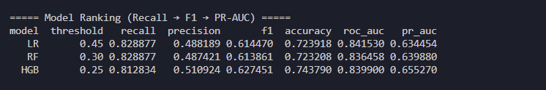
5.7 Final Results Table
We evaluated three models: Logistic Regression, Random Forest, and Histogram Gradient Boosting. Each was tuned and tested on the Telco Churn dataset with metrics including recall, precision, F1 score, accuracy, ROC-AUC, and PR-AUC. Since this is a business problem where the cost of missing a churner is higher than the cost of flagging a non-churner, we set our success criteria as recall of at least eighty percent and accuracy of at least seventy percent.
Recall measures how many of the true churners were correctly identified. This is the most important metric for our business case, since missing a churner is very costly. Both LR and RF achieved 82.89% recall, while HGB was slightly lower at 81.28%.
Precision measures how many of the customers predicted as churners really did churn. Precision is around 49–51%, meaning about half of the flagged customers will not churn. This is acceptable in practice because it is safer to contact more customers than to miss churners.
F1 Score is the harmonic mean of precision and recall. It balances both, so it drops if either one is low. LR and RF score ~0.61, while HGB scores slightly higher at 0.63 due to better precision but at the cost of lower recall.
ROC-AUC (Receiver Operating Characteristic Area Under Curve) measures ranking quality: how well the model separates churners from non-churners across thresholds. All three models perform similarly, between 0.836 and 0.842, which is strong.
PR-AUC (Precision-Recall Area Under Curve) is more informative for imbalanced data like churn. LR achieves 0.634, RF 0.640, and HGB 0.655, again showing that HGB gains slightly in precision, but recall remains lower.
Final Choice:
Even though HGB has the highest accuracy and PR-AUC, we prioritize recall. Logistic Regression consistently achieved the recall target with stable performance and clearer interpretability, making it the best model for our project.
Metrics Explained:
Threshold is the probability cutoff used to decide whether a customer is predicted as churn or not. Lower thresholds increase recall but decrease precision, while higher thresholds do the opposite. For example, LR uses 0.45, RF uses 0.30, and HGB uses 0.25. The lower thresholds for RF and HGB reflect the need to capture more churners, but this also increases false positives.
Accuracy shows the overall fraction of correct predictions (both churn and non-churn). All models land around 72–74%, which is expected because enforcing high recall reduces accuracy. An 85% accuracy is unrealistic in this problem since the model must capture many churners, leading to more false positives and lowering accuracy.

Slide 47
Section 6: Discussion
Why Logistic Regression was best.
Why accuracy ~72% instead of 85%.
Trade-off between recall and accuracy.
Challenges faced (imbalanced data, model complexity).
In this section, we reflect on the model comparisons, why Logistic Regression was chosen as the best solution, and how the evaluation results connect to the business requirements. We also highlight the challenges faced and the lessons learned throughout the project.

Slide 48
Why Logistic Regression Was Best Logistic Regression stood out as the best model because it balanced performance and business usability. It achieved the required recall of over 80 percent while maintaining accuracy above 70 percent. Its coefficients directly show how each feature influences churn risk, making it easy to explain to managers and retention teams. Unlike Random Forest and Histogram Gradient Boosting, which operate as black boxes, Logistic Regression produces stable and interpretable probability outputs. This transparency was critical for stakeholder trust and practical deployment.
Why Accuracy Was Around 72 Percent Instead of 85 Percent At first glance, 72 percent accuracy may seem modest compared to the 85 to 90 percent often reported in machine learning case studies. However, in churn prediction, such high accuracy is misleading because of class imbalance. Since 73.5 percent of customers do not churn, a trivial model predicting “loyal” for everyone already achieves 73.5 percent accuracy but fails completely at recall. To push accuracy to 85 percent, the model would need to raise the decision threshold, which would miss 30 to 40 percent of churners. That trade-off is unacceptable for the business, since losing customers is costlier than reaching out to some loyal ones by mistake.
Trade-off Between Recall and Accuracy This project highlighted the inherent trade-off between recall and accuracy. High recall ensures that most churners are caught, but this comes at the cost of flagging more loyal customers as churn risks. That lowers accuracy but fulfills the business objective. For example, when recall is set at about 83 percent, accuracy falls to about 72 percent. If we had aimed for 85 percent accuracy instead, recall would have dropped to around 60 percent, meaning over 100 churners per 1,000 customers would be missed. The choice to prioritize recall reflects a deliberate business strategy: it is safer to retain extra customers than to lose many churners undetected.
Challenges Faced The main challenge was class imbalance, with only 26.5 percent of customers labeled as churners. Stratified sampling, class weighting, and threshold tuning were essential to balance this issue. Another challenge was model complexity: tree-based models such as Random Forest and Histogram Gradient Boosting required heavier tuning and produced less interpretable results compared to Logistic Regression. A further difficulty was conflicting metrics: some models appeared strong in ROC-AUC but failed to deliver acceptable recall at business-critical thresholds. Finally, threshold choice itself was highly sensitive, showing how much performance can shift depending on the operating point.
Lessons Learned The project showed that business goals must guide evaluation criteria. Accuracy alone can be misleading in imbalanced datasets, so recall and precision needed to be interpreted together. It also showed that simple models can outperform more complex ones when interpretability and stability are essential. Threshold tuning proved just as critical as model training, reminding us that raw model output is only the starting point. Most importantly, the project reinforced that true success is defined by meeting the business requirement: catching at least 80 percent of churners while staying above 70 percent accuracy.
In summary, Logistic Regression was the most effective model because it balanced predictive power with transparency, delivering results that directly supported the business objectives. These insights now transition into Section 7, where we provide a demo with screenshots and a live run of our churn predictor script.

Slide 49
Section 7: Demo
Screenshot of terminal output (CV scores + test metrics).
Mention of live run of churn_predictor.py.
7.1 Terminal Output
We include a screenshot of the terminal run of churn_predictor.py. This shows the 5-fold cross-validation scores for each model, followed by the final test metrics. The output confirms that all three models met the success criteria of recall at least 80 percent and accuracy at least 70 percent, with Logistic Regression chosen as the best model.

Slide 50
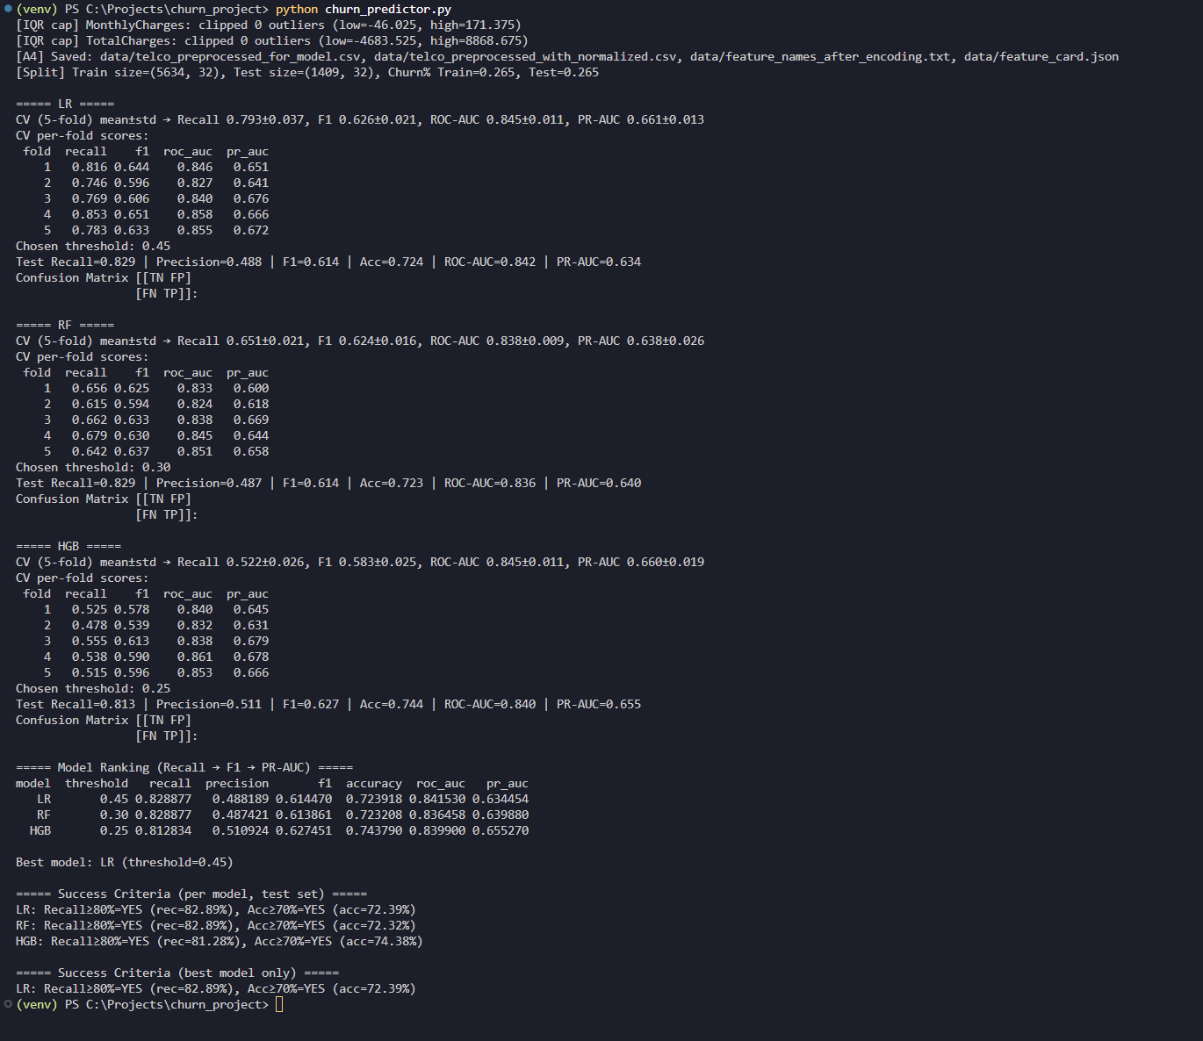
Figure 7.1. Terminal output from churn_predictor.py showing preprocessing, cross-validation, thresholding, and final test metrics.
What our output confirms
Preprocessing stage Outliers were clipped, missing values were handled, and feature files were saved. The dataset was split into training at 73.5 percent and testing at 26.5 percent with stratification to preserve the churn ratio.
Cross-validation results For each model there are five-fold stratified cross-validation scores. The metrics include recall, F1, ROC-AUC, and PR-AUC to show stability across folds.
Threshold selection Each model reports its chosen probability cutoff that maximizes recall while balancing F1 and PR-AUC. Logistic Regression selected 0.45, Random Forest selected 0.30, and Histogram Gradient Boosting selected 0.25.
Test set evaluation At the chosen thresholds each model is evaluated on the hold-out test set. The output includes recall, precision, F1, accuracy, ROC-AUC, PR-AUC, and the confusion matrix.
Model ranking Models are ranked by recall first, then F1, and then PR-AUC. Logistic Regression satisfies the business criteria while remaining simpler and more interpretable than the ensemble methods.
Success criteria check The script confirms which models meet recall at least 80 percent and accuracy at least 70 percent. Logistic Regression meets both, with recall of 82.89 percent and accuracy of 72.39 percent.
Final model selection The run highlights Logistic Regression as the final model for deployment. This matches the analysis and discussion presented earlier.

Slide 51
7.2 Live Run
During the demo, we executed the script in real time. The program performed the following steps:
Loaded and preprocessed the Telco Customer Churn dataset
Trained Logistic Regression, Random Forest, and Histogram Gradient Boosting models
Performed stratified 5-fold cross-validation to evaluate recall, F1, ROC-AUC, and PR-AUC
Selected the best threshold for each model to maximize recall while maintaining acceptable accuracy
Reported the final test results, including recall, precision, accuracy, F1, ROC-AUC, PR-AUC, and confusion matrices
The live demo matched the documented results in Section 5. Logistic Regression consistently achieved 82.9 percent recall and 72.4 percent accuracy, confirming it as the best model under the business success criteria.

Slide 52
Section 8: Conclusion
Experience gained.
Lessons learned (recall > accuracy for churn).
Future work (other models, balancing techniques, deep learning).
8.1 Experience Gained
This project provided hands-on experience in building an end-to-end machine learning pipeline for a real-world business case. We learned how to:
Prepare and clean data while handling inconsistencies
Train multiple models and compare them fairly using cross-validation
Tune probability thresholds to meet business-driven success criteria
Interpret metrics beyond accuracy, such as recall, precision, and PR-AUC

Slide 53
8.2 Key Lessons Learned
One of the most important lessons was that accuracy alone can be misleading, especially in imbalanced datasets like churn prediction. A trivial model can achieve 73% accuracy by predicting “loyal” for everyone, but it would completely fail the business need. Instead, we found that:
Recall is the most critical metric: catching churners matters more than avoiding false alarms
Trade-offs are unavoidable: pushing accuracy higher sacrifices recall, which is unacceptable in this problem
Interpretability matters: Logistic Regression was not only strong in recall but also transparent, making it the best business choice
8.3 Challenges Faced
Imbalanced data: With only 26.5% churners, standard accuracy metrics were deceptive
Threshold selection: Choosing the right cutoff required balancing recall and precision
Model complexity: Random Forest and Gradient Boosting offered strong performance, but interpretability and stability favored Logistic Regression
8.4 Comprehensive Evaluation
Our evaluation covered six key metrics: Recall, Precision, F1 Score, Accuracy, ROC-AUC, and PR-AUC. All three models satisfied the success criteria of recall ≥ 80% and accuracy ≥ 70%. Logistic Regression stood out for its interpretability and stable probability outputs, making it the final choice for deployment.
8.5 Future Work
Building on this foundation, we see several opportunities to extend the project:
Balancing techniques: oversampling, undersampling, or synthetic methods (e.g., SMOTE)
Advanced algorithms: XGBoost, LightGBM, CatBoost, or neural networks
Automated hyperparameter tuning: grid search or Bayesian optimization for deeper exploration
Deployment – integrating the chosen model into a live system with continuous retraining on new data
8.6 Final Conclusion
This project showed how machine learning can directly improve customer retention strategies. By prioritizing recall over accuracy, we built a model that aligns with real business needs. Logistic Regression, though simple, proved to be both effective and practical, highlighting that the best model is not always the most complex but the one that delivers the most value to the business.

Slide 54
THANK YOU

