Slide 1

Classification of frog calls
Can we infer the specie of a frog just from its call ?

Slide 2
Summary
1. Presentation of the dataset
1.1 Overview
1.2. What are MFCCs ?
1.3. Characteristics of the dataset
1.4. Normalisation
2. Classification
2.1. The state-of-the-art algorithms
2.2. How do they work ?
2.3. Using Linnaeus taxonomy
3. Results

Slide 3
Summary
1. Presentation of the dataset
1.1 Overview
1.2. What are MFCCs ?
1.3. Characteristics of the dataset
1.4. Normalisation

Slide 4
The Frogs

Slide 5
The Frogs
Leptodactylidae
Hylidae
Dendrobatidae
Bufonidae

Slide 6
The Frogs
Leptodactylidae
Hylidae
Dendrobatidae
Bufonidae
Adenomera
Leptodactylus
Osteocephalus
Hypsiboas
Dendropsophus
Scinax
Ameeraga
Rhinella

Slide 7
The Frogs
Leptodactylidae
Hylidae
Dendrobatidae
Bufonidae
Adenomera
Leptodactylus
Osteocephalus
Hypsiboas
Dendropsophus
Scinax
Ameeraga
Rhinella
Andre
Hylaedactae
Fuscus
Oopha
Cordobae
Minuta
Cinerascens
Ruber
Trivittata
Granulosa

Slide 8
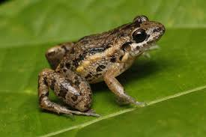
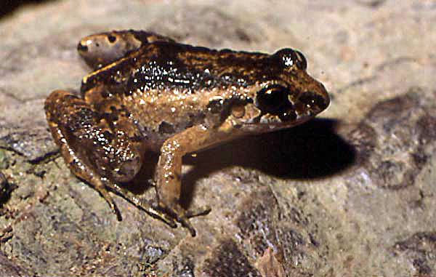
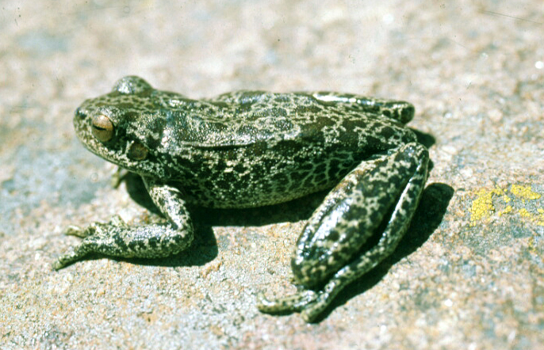
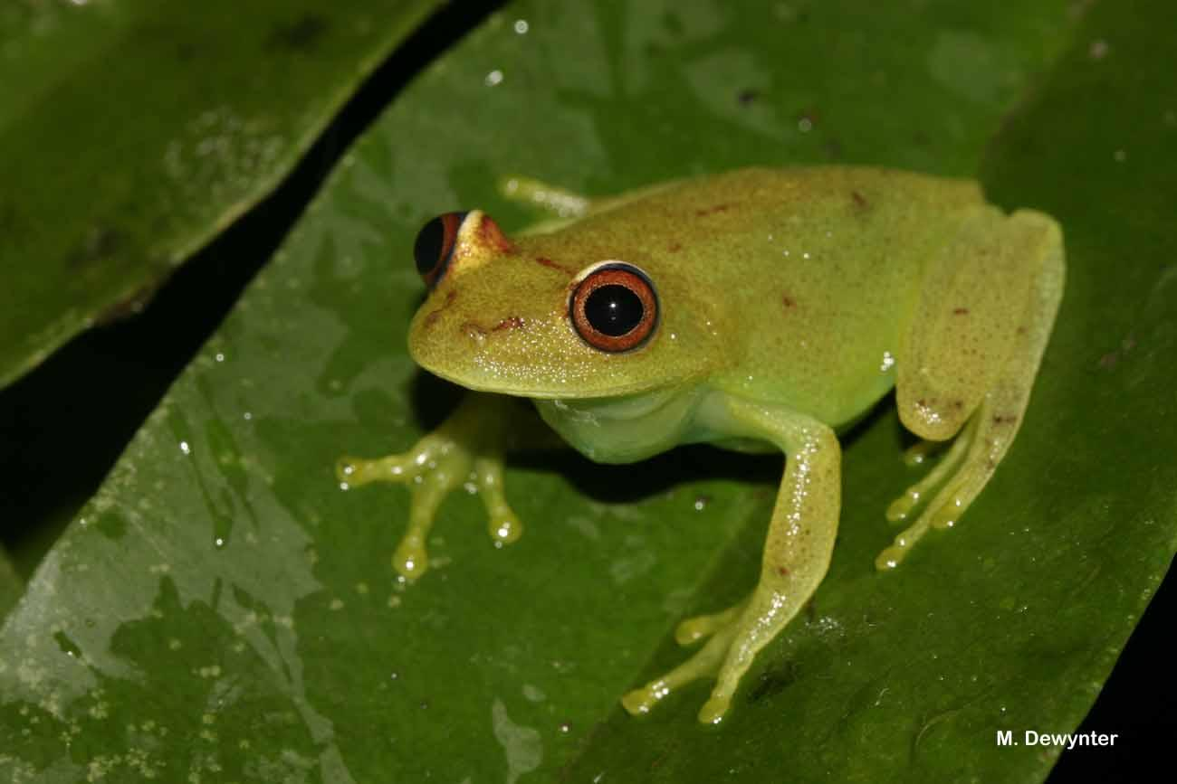
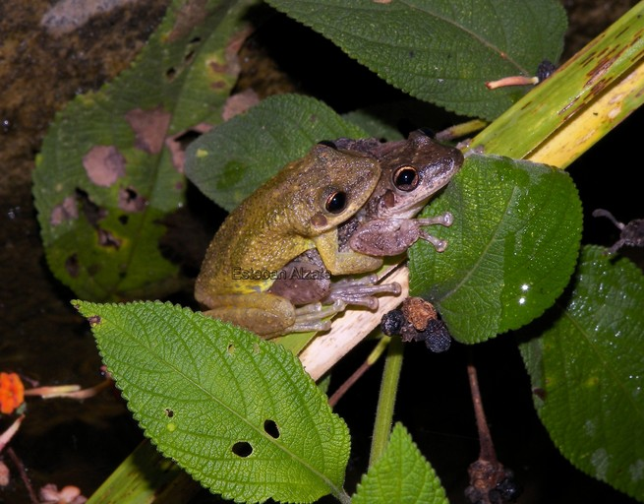
The Frogs
Leptodactylidae
Hylidae
Dendrobatidae
Bufonidae
Adenomera
Leptodactylus
Osteocephalus
Hypsiboas
Dendropsophus
Scinax
Ameeraga
Rhinella
Andre
Hylaedactae
Fuscus
Oopha
Cordobae
Minuta
Cinerascens
Ruber
Trivittata
Granulosa
Look at these cute froggy bois !

Slide 9
The Frogs
For each specie, 6 instances of one syllable of their call
The audio of the syllable is transformed into MFCCs
Andre
Hylaedactae
Fuscus
Oopha
Cordobae
Minuta
Cinerascens
Ruber
Trivittata
Granulosa
Look at these cute froggy bois !

Slide 10
What are MFCCs ?
How are MFCCs obtained ?
1. Decompose the signal into components with Fourier Transform
2. Project the powers of the components onto the mel scale
3. Take the logs of the powers at each of the mel frequencies.
4. Take the discrete cosine transform of the list of mel log powers, as if it were a signal.
5. The MFCCs are the amplitudes of the resulting spectrum.
MFCCs stands for Mel-Frequency Cepstral Coefficients
They are commonly used in sound classification
What does this mean ? How much information is retained from the original audio ?

Slide 11
What are MFCCs ?
MFCCs are very common because they represent tone
This aspect of sound is very useful to interpret speech

Slide 12

How much of the information is retained ?
We converted the MFCCs into an audio signal
Each sound represents a syllab, a component of a frog call:
Adenomera Hylaedactylus
AdenomeraAndre
HypsiboasCordobae
A lot of characteristics of the signal are lost in the process. Do we have enough to classify species ?

Slide 13
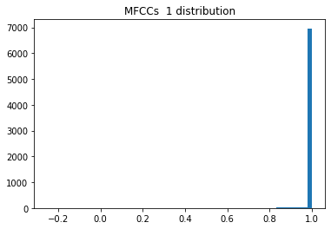
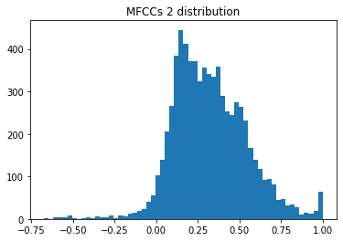
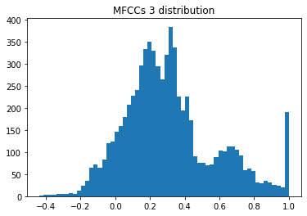
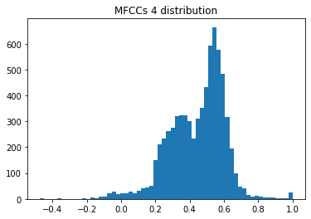
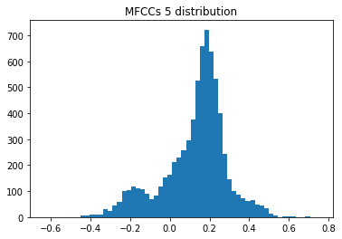
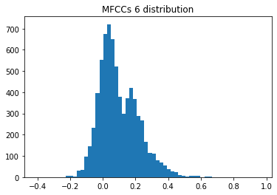
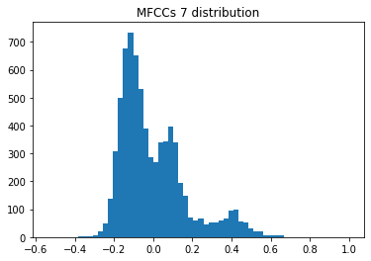
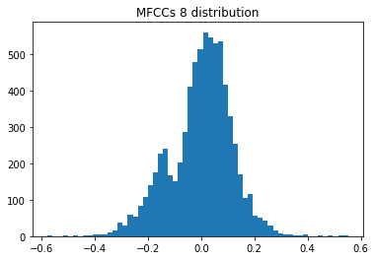
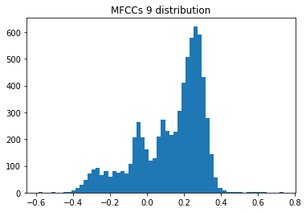
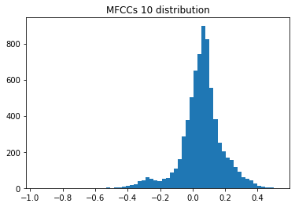
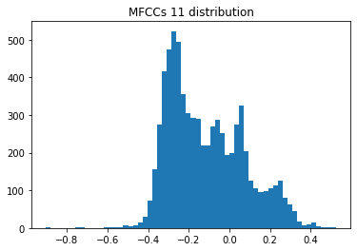
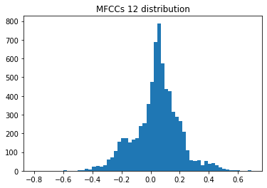
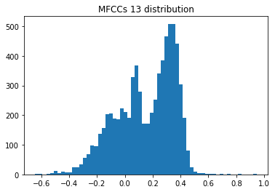
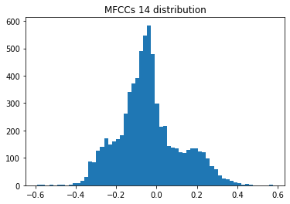
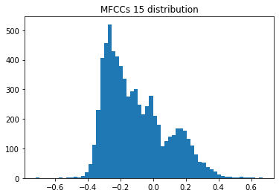
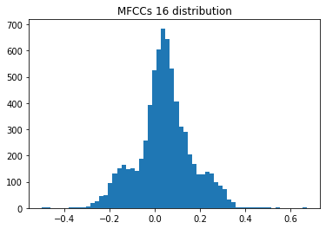
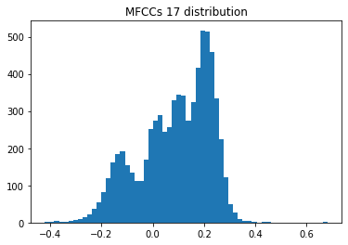
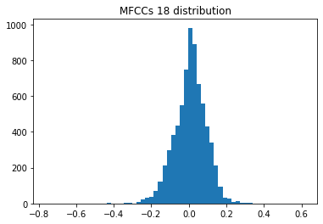
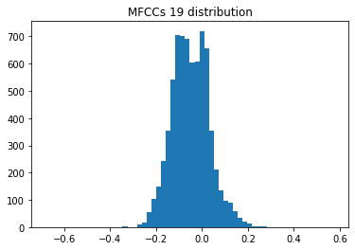
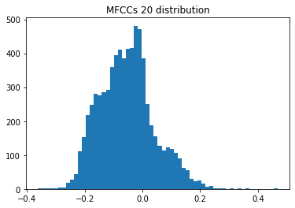
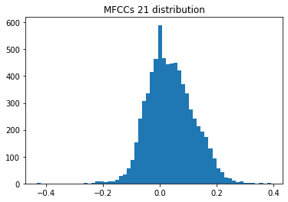
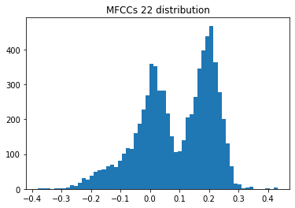
How much of the information is retained ?
The MFCC 1 has been removed because it was too homogeneous.

Slide 14
Summary
1. Presentation of the dataset
1.1 Overview
1.2. What are MFCCs ?
1.3. Characteristics of the dataset
1.4. Normalisation
2. Classification
2.1. The state-of-the-art algorithms
2.2. How do they work ?
2.3. Using Linnaeus taxonomy

Slide 15
Three state-of-the-art algorithms
Random Forest
Advantages
Really fast to set up
Versatile
Rarely over-fitting.
RF is very effective performance wise.
Fast, simple and flexible tool to develop

Slide 16
Three state-of-the-art algorithms
Random Forest
Support Vector Machine
Advantages
Really fast to set up
Versatile
Rarely over-fitting.
RF is very effective performance wise.
Advantages
Often used with MFCCs
Rarely over-fitting
More effective in high dimensional spaces.
Drawbacks
Not suitable for large datasets
Fast, simple and flexible tool to develop
Particularly suited for sound applications

Slide 17
Three state-of-the-art algorithms
Random Forest
Support Vector Machine
K-NN
Advantages
Really fast to set up
Versatile
Rarely over-fitting.
RF is very effective performance wise.
Advantages
Often used with MFCCs
Rarely over-fitting
More effective in high dimensional spaces.
Drawbacks
Not suitable for large datasets
Advantages
It has no assumptions to be used.
Very easy to implement for multi-class problem.
Drawbacks
Not suitable in high dimensional spaces.
Fast, simple and flexible tool to develop
Particularly suited for sound applications
It has no training period

Slide 18
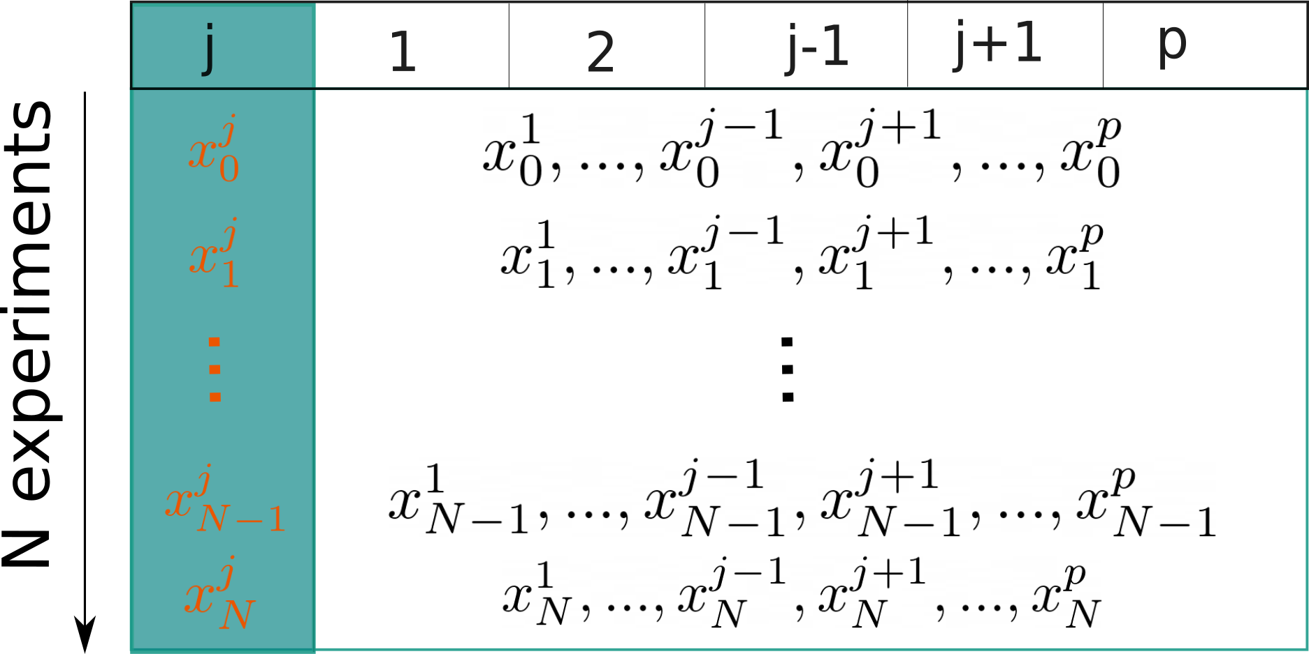
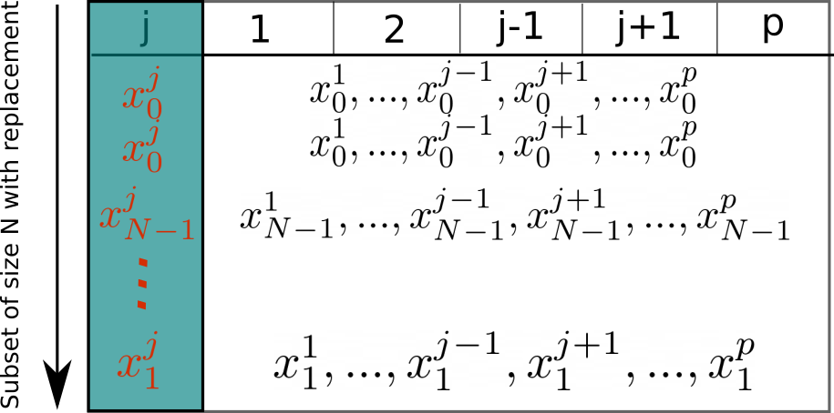
Random Forest
Step 1: Create a bootstrap dataset:

Slide 19
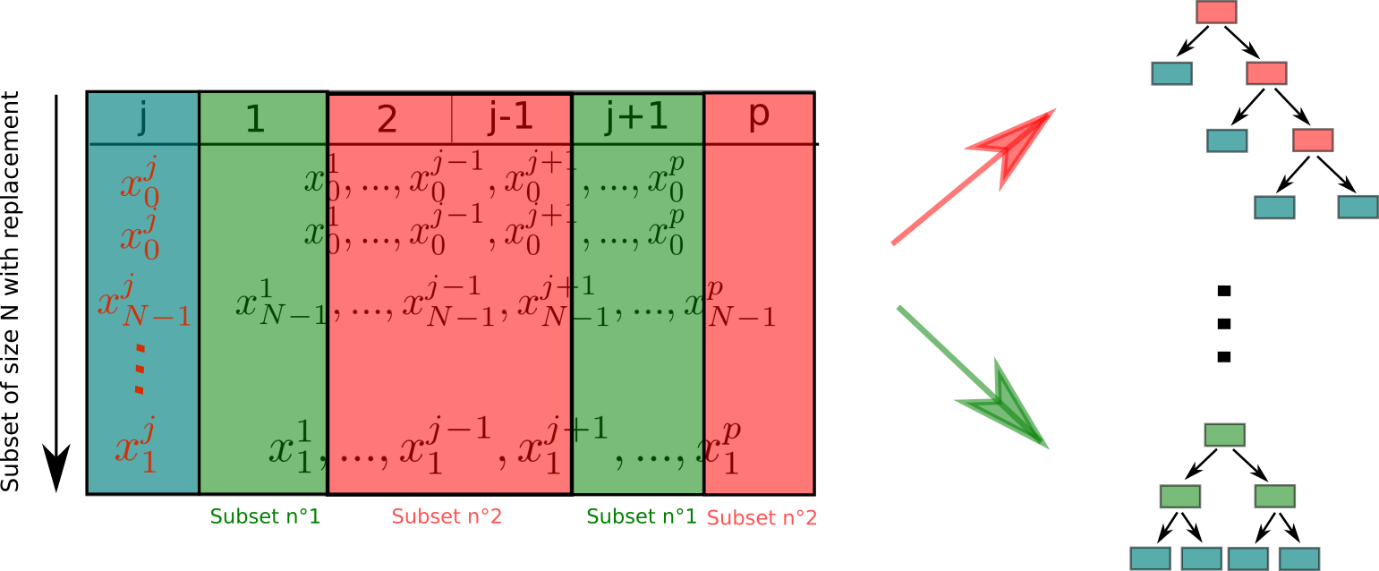
Random Forest
Step 2: Create decision trees from subsets of the dimensions of the dataset
Step 3: Given a new sample, we take the label predicted by the majority of the trees

Slide 20
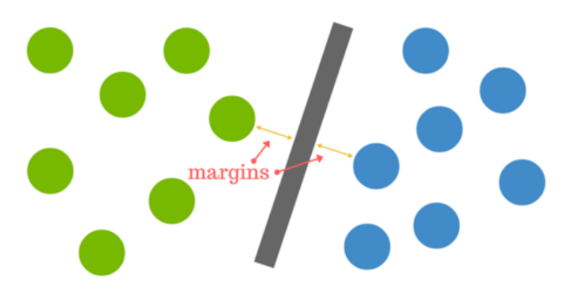
Support Vector Machine
Goal: optimise the hyperplane that separate our datas by optimizing the margin between the individuals and the hyperplane.

Slide 21
Support Vector Machine
If datas are nearly linearly separable, the algorithm will make a trade-off between minimization of the margin and minimization of the classification errors.

Slide 22
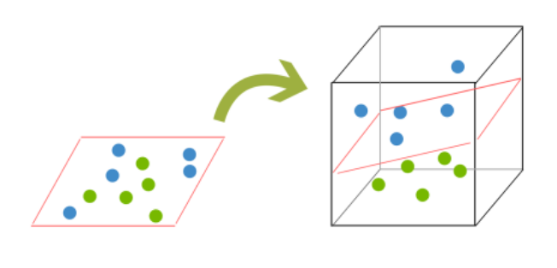
Support Vector Machine
If datas are far from linearly separable, it will redefine the space of description in a space with more dimensions.

Slide 23
Improvements using Linnaeus taxonomy
Leptodactylidae
Hylidae
Dendrobatidae
Bufonidae
Adenomera
Leptodactylus
Osteocephalus
Hypsiboas
Dendropsophus
Scinax
Ameerag
Rhinella
Andre
Hylaedactae
Fuscus
Oopha
Cordobae
Minuta
Cinerascens
Ruber
Trivittata
Granulos
How does it work ?

Slide 24
Improvements using Linnaeus taxonomy
Leptodactylidae
Hylidae
Dendrobatidae
Bufonidae
Adenomera
Leptodactylus
Osteocephalus
Hypsiboas
Dendropsophus
Scinax
Ameerag
Rhinella
Andre
Hylaedactae
Fuscus
Oopha
Cordobae
Minuta
Cinerascens
Ruber
Trivittata
Granulos
How does it work ?
A first classifier trained on families will tell the family of the individual.

Slide 25
Improvements using Linnaeus taxonomy
Leptodactylidae
Hylidae
Dendrobatidae
Bufonidae
Adenomera
Leptodactylus
Osteocephalus
Hypsiboas
Dendropsophus
Scinax
Ameerag
Rhinella
Andre
Hylaedactae
Fuscus
Oopha
Cordobae
Minuta
Cinerascens
Ruber
Trivittata
Granulos
How does it work ?
A first classifier trained on families will tell the family of the individual.
A second classifier is used, trained only on this family, predicting the genus.

Slide 26
Improvements using Linnaeus taxonomy
Leptodactylidae
Hylidae
Dendrobatidae
Bufonidae
Adenomera
Leptodactylus
Osteocephalus
Hypsiboas
Dendropsophus
Scinax
Ameerag
Rhinella
Andre
Hylaedactae
Fuscus
Oopha
Cordobae
Minuta
Cinerascens
Ruber
Trivittata
Granulos
How does it work ?
A first classifier trained on families will tell the family of the individual.
A second classifier is used, trained only on this family, predicting the genus.
A third classifier is used, trained only on this genus, predicting the specie.

Slide 27
Summary
1. Presentation of the dataset
1.1 Overview
1.2. What are MFCCs ?
1.3. Characteristics of the dataset
1.4. Normalisation
2. Classification
2.1. The state-of-the-art algorithms
2.2. How do they work ?
2.3. Using Linnaeus taxonomy
3. Results

Slide 28
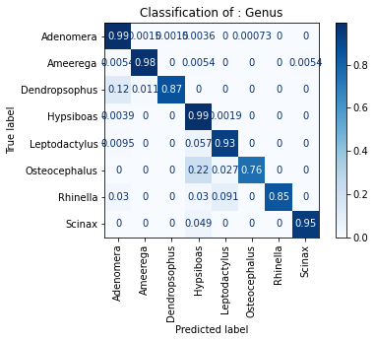
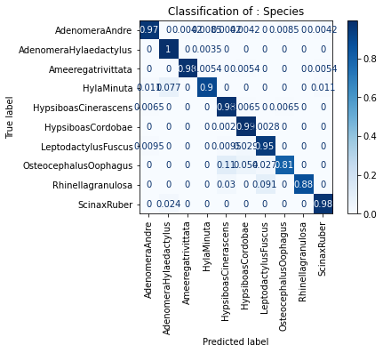
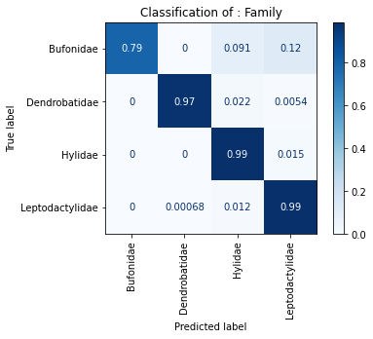
Random Forest
Regardless of the level of classification, RF classifier has pretty good results, with some issues.
Confusion Matrix at the family level
Confusion Matrix at the genera level
Confusion Matrix at the specie level
Accuracy : 0.953

Slide 29
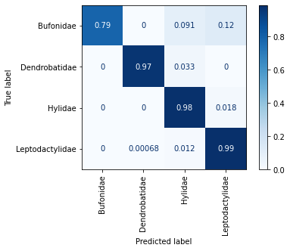
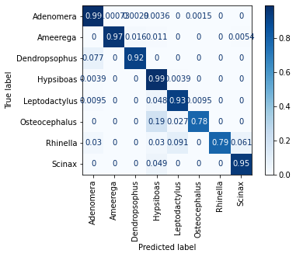
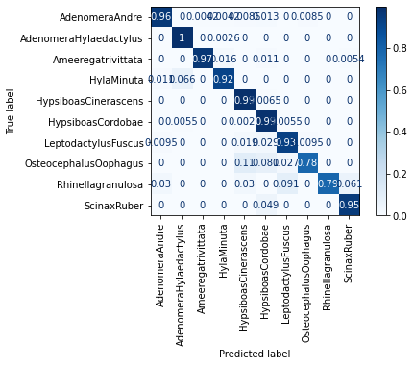
Hierarchical Random Forest
Accuracy : 0.974

Slide 30
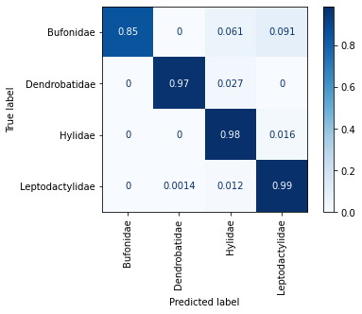
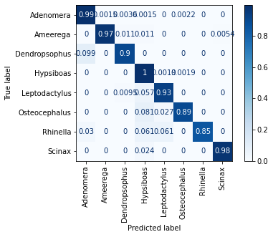
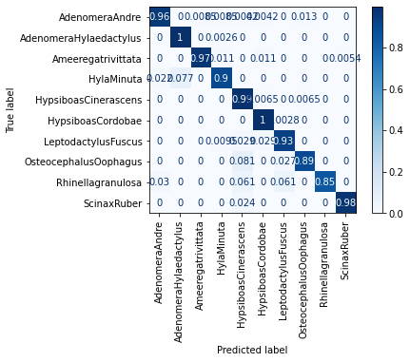
SVM
The majority of the individuals are well segregated. Most of the predictions match with the true label of the individual.
Confusion Matrix at the family level
Confusion Matrix at the genera level
Confusion Matrix at the specie level
Accuracy : 0.978

Slide 31
Hierarchical SVM
It is still a really good classifier, but the overall accuracy is only improved by 0.2%.
Confusion Matrix at the family level
Confusion Matrix at the genera level
Confusion Matrix at the specie level
Accuracy : 0.981

Slide 32
Conclusion

Slide 33
Hierarchical SVM
A big part of the information is lost during MFCC computation, which makes classification harder.
Using MFCCs, SVM appears to be a better classifier than RF.
Leveraging the topology of Linnaeus taxonomy seems to increase the viability of a sub optimal classifier.
There is almost no improvement when the classifier does well already

Slide 34
Thank you, froggy friend
Any questions?

Slide 35
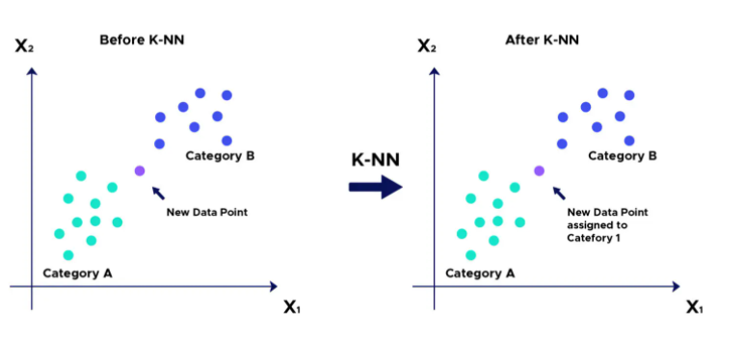
K-Nearest-Neighbor
Goal : Infer the class of a new individual based on the K nearest neighbor (the name is pretty descriptive)
The training dataset is placed in a space.

Slide 36
K-Nearest-Neighbor
The test individual is placed in this space and the K elements that are the nearest from it are selected.
Because we are in a case of classification, our test individual’s class will be the most frequent class among the K elements.

Slide 37
KNN
Confusion Matrix at the family level
Confusion Matrix at the genera level
Confusion Matrix at the specie level

