Slide 1
Welcome to Pearl Coast Aquarium
Discover the sea life of the Gulf

Slide 2

Menu
Our Exhibits
Opening Times and Tickets
Getting Here
Contact Us

Slide 3
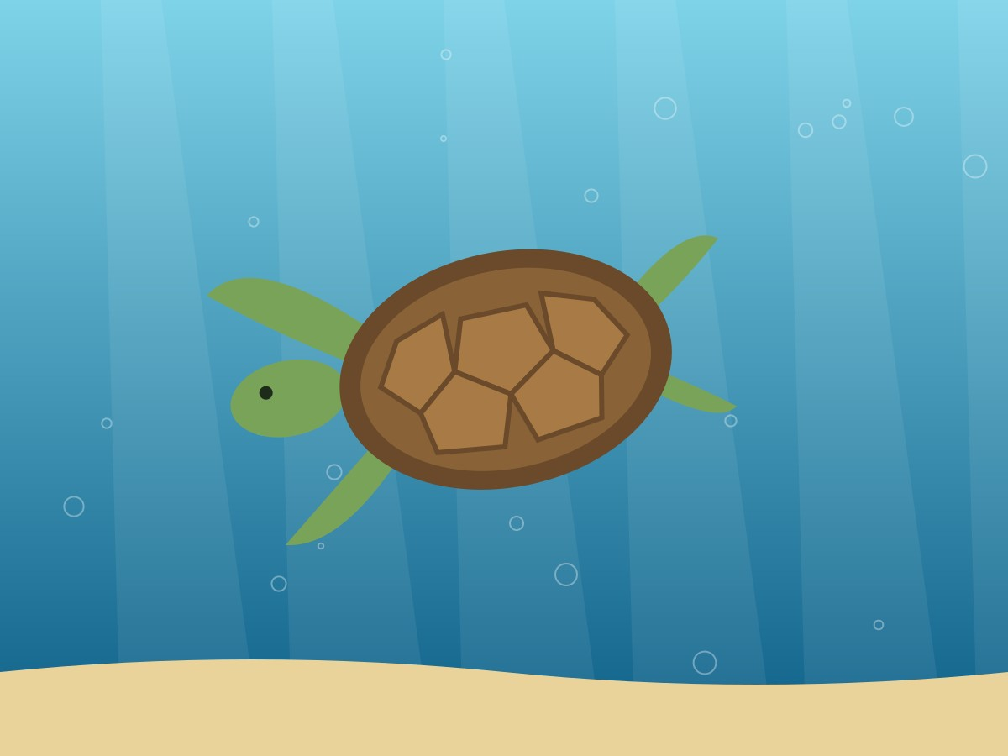
Our Exhibits
Turtle Cove
Shark Tunnel
Jellyfish Gallery

Slide 4
Opening Times and Tickets
Open daily 9:00–21:00
Friday 14:00–22:00
Last entry one hour before closing
Adult SAR 60 · Child SAR 35 · Under 3 free
Family ticket SAR 160
See all ticket prices
Notes:
Remind visitors that the aquarium opens late on Fridays. Tell them that school groups must book at least two weeks before their visit and that the full price list can be opened from the link on this slide.

Slide 5
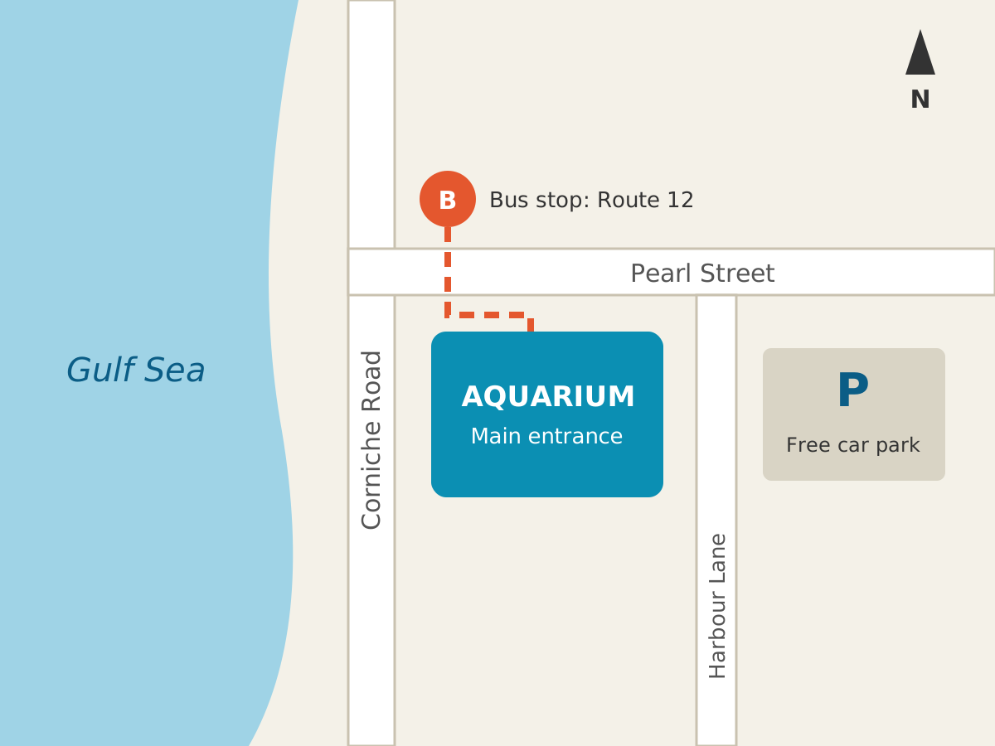
Getting Here

Slide 6
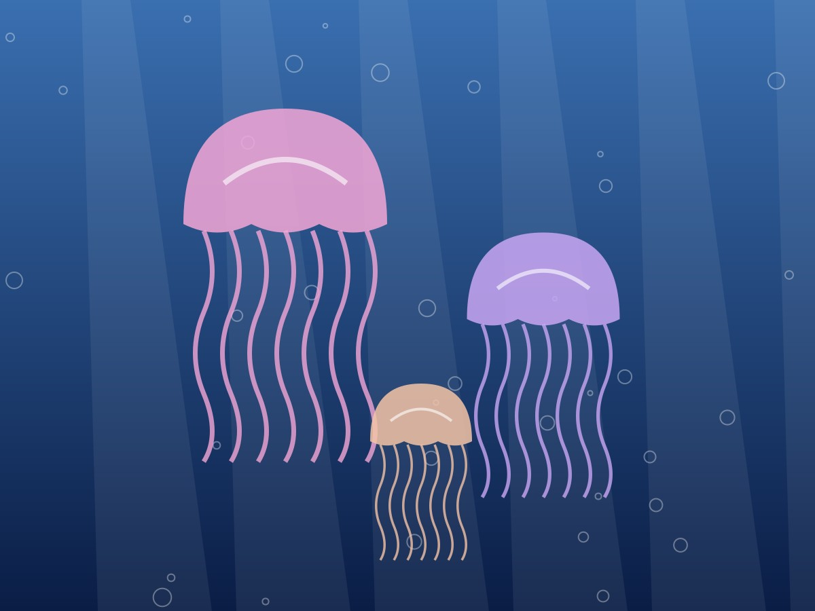
Contact Us
Website: www.pearlcoast.service
Email: visit@pearlcoast.service

