Slide 1





ATmega32 MCU
Project 13
8 MHz internal RC
Asynchronous Timer2
Low-Power Timekeeping
32.768 kHz Crystal
TOSC1 / TOSC2
Power-Save Sleep
µA-level idle
ATmega32 Microcontroller · 32.768 kHz Watch Crystal · Power-Save Sleep Mode
Timer2 Async
SimulIDE Simulation · KiCad Schematic & PCB · MPLAB for VS Code
1-second ISR
Bare-Metal C
AVR-GCC firmware
Embedded Systems
Computer Engineering
Notes:
Introduce the project: low-power timekeeping using ATmega32 Timer2 in asynchronous mode with a 32.768 kHz watch crystal. The big idea is that Timer2 can run from its own independent clock while the CPU sleeps.

Slide 2


The Problem & The Solution
The Problem
The Solution
Battery devices need to keep time 24/7
CPU at 8 MHz draws 8–12 mA constantly
Software timers drift when CPU is busy or interrupted
Hours of battery life instead of months
Timer2 runs from a 32.768 kHz watch crystal
Crystal is completely independent from the CPU clock
CPU sleeps in Power-Save mode — wakes once per second
Average current drops to ~100 µA → months of battery life
→
32.768 kHz crystal = 2¹⁵ Hz → divides to exactly 1 Hz with no rounding error
Notes:
The core insight: every battery-powered clock needs a way to keep time while the main processor sleeps. The 32.768 kHz crystal is used because it's 2^15 Hz — binary division to exactly 1 Hz with zero rounding error. Timer2 can be wired to this crystal independently of the CPU clock.

Slide 3

How Timer2 Async Mode Works
CPU Clock Domain
Timer2 Async Domain
Power-Save Sleep
8 MHz internal RC
Drives CPU, Timer0, Timer1
Stops during Power-Save sleep
≠
32.768 kHz TOSC crystal
Runs ONLY Timer2
Never stops — even while CPU sleeps
→
CPU halts
Synchronous clocks stop
Only async Timer2 stays alive
Key register: ASSR |= (1 << AS2) — switches Timer2 from CPU clock to TOSC1/TOSC2 pins
Notes:
Timer0 and Timer1 always use the CPU clock. Timer2 is special — setting AS2 in ASSR disconnects it from the CPU clock and connects it to whatever crystal you put on TOSC1/TOSC2 pins. This is the hardware feature at the heart of the project.

Slide 4
System Architecture
ATmega32 CPU
8 MHz internal RC
(Power-Save sleep)
PB0 → LED (330Ω) · Wake every 10s
32.768 kHz
Watch Crystal
(TOSC1/TOSC2)
async clk
Timer2
Async Mode
÷128 → 1s OVF
ISR
PB1 → Buzzer · Alarm for 3s
Buttons (active-LOW + internal pull-ups)
PA0: Reset time · PA1: Set alarm mode · PA2: Increment field
PD1 → SerialTerm @ 9600 baud 8N1
TIME: HH:MM:SS · ALRM: HH:MM:SS · MODE: LOW POWER
Power-Save Sleep Cycle
CPU wakes
(ISR fires)
Update clock
Check alarm
Toggle LED
Set flag
Return
Main loop
Refreshes display
enter_sleep()
CPU halts
1 second
passes
→
→
→
→
→
← repeats every second (CPU active <1ms out of 1000ms)
Notes:
Walk through the system architecture. Key point: the 32.768 kHz crystal feeds ONLY Timer2 via TOSC1/TOSC2 pins. The CPU wakes once per second, does its work in under a millisecond, then sleeps again. This is what makes the system low-power.

Slide 5
Timer2 Timing Calculation
Crystal frequency
32768
f_TOSC = 32,768 Hz
Timer2 is 8-bit → counts 0–255
256 counts per overflow
Hz
= 2¹⁵
Prescaler needed
N = 32768 ÷ 256 = 128
Only frequency that divides to exactly 1 Hz using binary prescalers alone
TCCR2 bits CS2[2:0]
= 0b101 (prescaler /128)
Overflow period
T = (256 × 128) ÷ 32768 = 1.000 s ✓
Load caps C1 & C2 = 12 pF match the crystal's specified load capacitance for stable oscillation
Notes:
Walk through the math. Timer2 has 256 counts before overflow. 32768 ÷ 256 = 128 exactly. So prescaler /128 gives exactly one overflow per second with no rounding error ever. The load capacitors must match the crystal's datasheet spec (typically 7-12 pF for watch crystals).

Slide 6
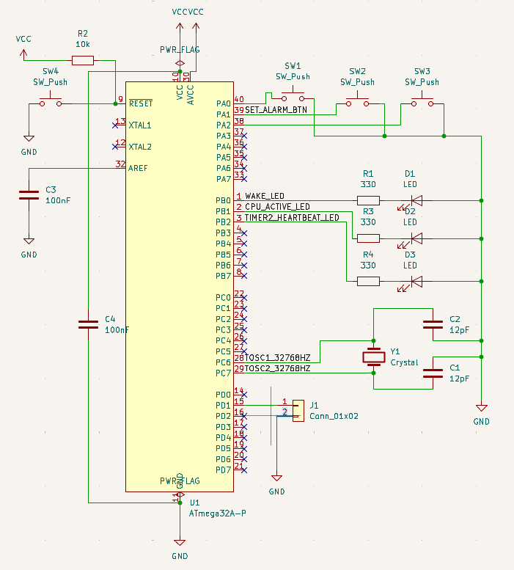
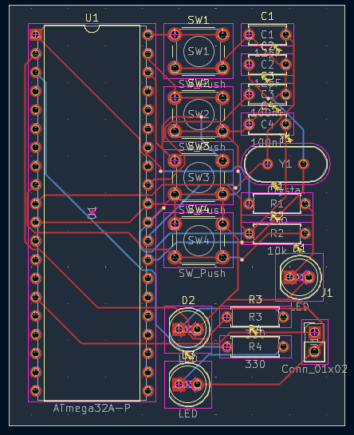
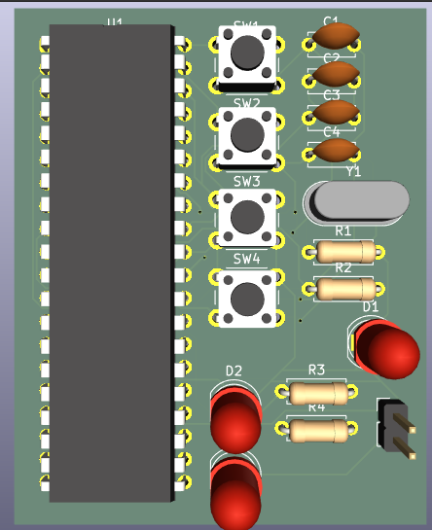
KiCad Schematic & PCB Design
✔ Y1 placed as close as possible to PC6/PC7 — minimises TOSC trace length
✔ C1 & C2 (12 pF) immediately adjacent to crystal — short GND routes
✔ TOSC1/TOSC2 traces routed away from LED switching outputs
Figure 3.1 — KiCad Schematic
Figure 3.4 — KiCad 3D PCB Render
ERC: 0 errors · DRC: 0 violations · Gerber files generated
Notes:
The schematic has all five required net labels: TOSC1_32768HZ, TOSC2_32768HZ, WAKE_LED, ALARM_BUZZER, SET_ALARM_BTN. The PCB follows the crystal placement rules: crystal close to TOSC pins, load caps adjacent, TOSC traces away from switching outputs.

Slide 7
Firmware: The Heart — Timer2 ISR
ISR(TIMER2_OVF_vect) { g_seconds++;
// roll over at 60/60/24
if (g_seconds % 10 == 0)
PORTB ^= (1<<PB0); // toggle LED
if (time == alarm_time) {
PORTB |= (1<<PB1); // buzzer ON
g_buzz_countdown = 3;
}
g_time_updated = true;
}
✓
Runs exactly once per second — no drift
✓
Increments seconds → minutes → hours with midnight rollover
✓
Toggles PB0 (LED) every WAKEUP_INTERVAL=10 seconds
✓
Activates buzzer (PB1) for ALARM_BUZZ_DURATION=3s on alarm match
✓
Sets g_time_updated flag — wakes main loop to refresh serial output
!
All variables volatile — modified in ISR, read in main
!
cli()/sei() around multi-byte reads to prevent torn reads
Notes:
The ISR is the heart of the firmware. It fires exactly once per second (on real hardware). Inside it: increment the clock, check for 10-second LED toggle, check alarm condition, manage buzzer countdown, then set the flag that wakes the main loop to print to serial.

Slide 8

Two Critical Details
Async Register Sync (MANDATORY)
Sleep Mode Selection
Timer2 registers cross two clock domains.
After writing, you MUST wait for ASSR busy flags to clear:
Real hardware
SLEEP_MODE_PWR_SAVE
while (ASSR & (TCN2UB|OCR2UB|TCR2UB));
Stops CPU + sync clocks.
Async Timer2 keeps running from crystal.
Skipping this loop silently corrupts
Timer2 configuration — no error, no warning, just a timer that doesn't work correctly. The ATmega32 datasheet mandates this wait.
SimulIDE fallback
SLEEP_MODE_IDLE
Stops only CPU.
Keeps sync clocks — needed for CTC fallback.
Notes:
Two non-obvious implementation details. First: the ASSR busy flags MUST be waited on after any Timer2 register write — skipping this is a silent bug. Second: Power-Save stops the synchronous clock, which is perfect for the real hardware path but breaks the SimulIDE fallback that uses the synchronous clock for Timer2.

Slide 9
SimulIDE: Limitation & Fallback Solution
SimulIDE Cannot Model TOSC
SIMULIDE_MODE Fallback
Without SIMULIDE_MODE flag:
• Timer2 waits for crystal that never starts
• ASSR busy flags never clear
• enter_sleep() → CPU parks permanently
• Serial output stops after one line
Compile with: make simulide
• Timer2 → CTC mode, internal 8 MHz clock
• OCR2=77, /1024 → ~100 ticks/second
• ISR accumulates 100 ticks = 1 second
• SLEEP_MODE_IDLE keeps sync clock alive
What's different vs. what stays the same
Real Hardware
SimulIDE Fallback
Timer2 clock source
32.768 kHz TOSC crystal
8 MHz internal CPU clock
Timer2 mode
Normal (overflow)
CTC (compare match)
Sleep mode
SLEEP_MODE_PWR_SAVE
SLEEP_MODE_IDLE
All application logic (clock/alarm/LED/buzzer/USART/buttons)
✓ IDENTICAL
✓ IDENTICAL
Notes:
Two separate bugs that had to be understood and fixed for the SimulIDE simulation to work. The firmware has two compile-time paths. Everything the user sees — clock counting, alarm, LED, buzzer, buttons — is identical. Only the clock source and sleep depth change.

Slide 10
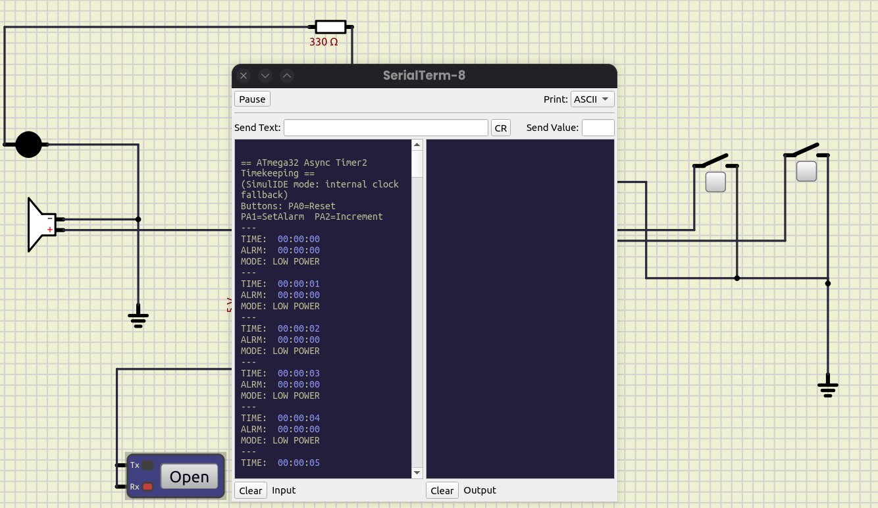
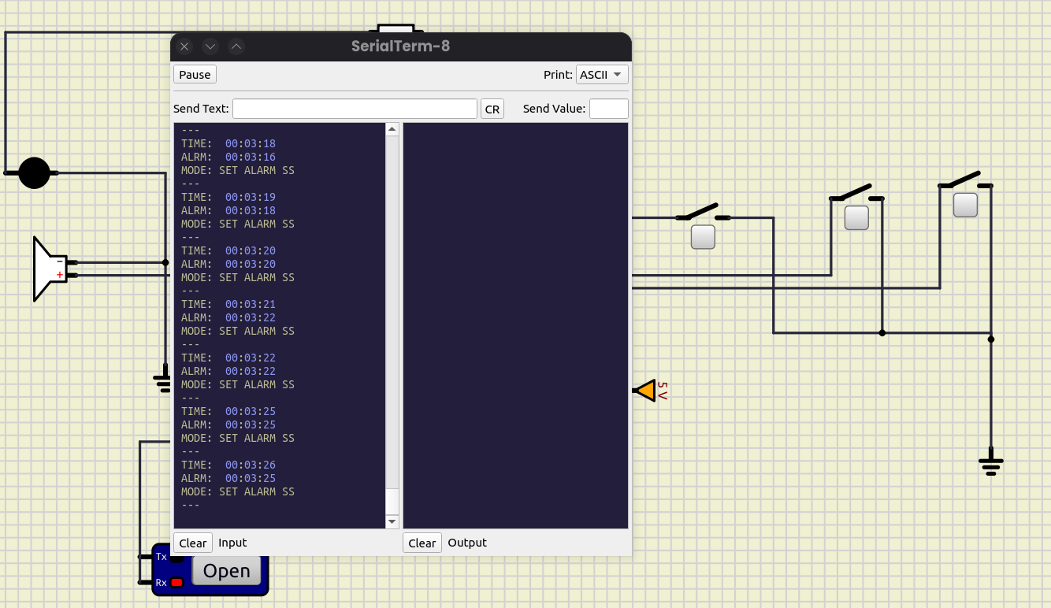
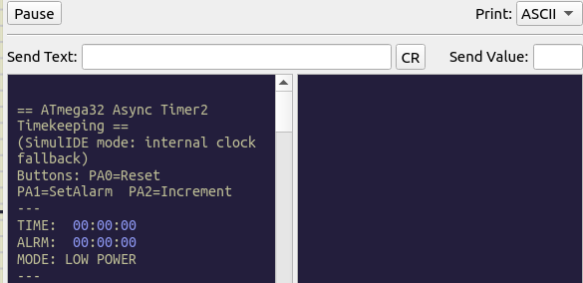
Simulation Results
TC-01: Boot + 00:00:00
TC-02: Seconds increment
TC-04: SET ALARM mode
System initialises correctly
Timer2 counting in real time
Alarm set and buzzer fires
✓ PASS
✓ PASS
✓ PASS
✓ PASS
✓ PASS
✓ PASS
TC-01
Boot / Reset
TC-02
Clock counts
TC-03
LED heartbeat
TC-04
Alarm / buzzer
TC-05
Reset button
TC-06
Sleep (docs)
Notes:
All six test cases passed. TC-06 is documented rather than a traditional pass/fail since SimulIDE doesn't fully model sleep modes — the workaround (SLEEP_MODE_IDLE in simulation) is explained and justified.

Slide 11

Key Learning Outcomes
01
02
Async Peripheral Operation
Clock Domain Crossing
Timer2 is unique among ATmega32 timers — only it can be decoupled from the CPU clock via TOSC pins. This decoupling enables hardware timekeeping independent of CPU state.
Registers that cross clock domains require explicit synchronisation. The ASSR busy-flag wait loop is mandatory; skipping it produces a silent, hard-to-diagnose bug.
03
04
Sleep Mode Mechanics
USART Baud Rate Sensitivity
SLEEP_MODE_PWR_SAVE stops all synchronous clocks but preserves the async Timer2 domain. Pairing it with a synchronous-clocked Timer2 (fallback) creates a deadlock — the correct fix is SLEEP_MODE_IDLE.
UBRR is computed from F_CPU. A MCU clock mismatch between firmware and simulator (16 MHz vs 8 MHz) garbles every byte. Matching both values is the first debug step for garbled serial.
Notes:
Four takeaways from the project. Most important: Timer2's unique async capability is the enabler for everything else. The register sync and sleep mode mechanics are the two 'gotchas' that separate a working implementation from a subtly broken one.

Slide 12
EXTENSION TASK
Periodic Sensor Logging
Extend the base system: wake every N seconds → read ADC sensor → log to EEPROM → sleep again
Power-Save
Sleep
Timer2
Overflow
Normal ISR
(clock/alarm)
Every 60s:
g_log_pending
ADC read
(sensor value)
Write to
EEPROM
Back to
Sleep
→
→
→
→
→
→
EEPROM Log Record (10 bytes)
Power Budget (60s log interval)
Offset 0
Hours (0–23)
Power-Save sleep
~59.9 s / min
~16 µA
Offset 1
Minutes (0–59)
ISR (1s × 60)
~50 µs × 60
~8 mA (brief)
Offset 2
Seconds (0–59)
ADC + USART log
~5 ms
~12 mA
Offset 3–4
ADC value (0–1023, 10-bit)
EEPROM write
~3.4 ms
~5 mA
Offset 5–9
Reserved / checksum
Average current
whole minute
~100 µA
≈ 10,000 hours (1 yr+) on a 1000 mAh battery
Notes:
Optional extension task. The base system already has the infrastructure: Timer2 fires every second. Adding a log_countdown counter means every 60 seconds you enable the ADC, read a sensor, write 10 bytes to EEPROM, and go back to sleep. The power impact is minimal.

Slide 13

Project Complete
Asynchronous Timer2
Low-Power Timekeeping
KiCad Schematic
Firmware (C)
SimulIDE Verified
KiCad PCB
Crystal on TOSC1/TOSC2
All net labels present
ERC: 0 errors
Async Timer2 ISR
Power-Save sleep
SimulIDE fallback
6/6 test cases PASS
Bug root-causes documented
Fallback path working
Crystal near TOSC pins
Noise separation
DRC: 0 violations
GitHub: ATmega32_Asynchronous_Timer2_Timekeeping · [ insert repository URL ]
Notes:
Closing slide. Summarise the four deliverables. The project demonstrates a complete embedded systems design cycle: concept → schematic → PCB → firmware → simulation → documentation. The GitHub repository link goes here.

