Slide 1
Use Git
Or any other version control system

Slide 2
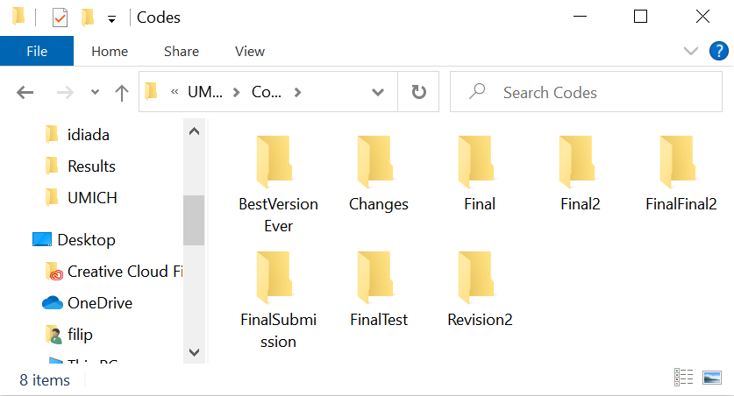
Get organized!

Slide 3
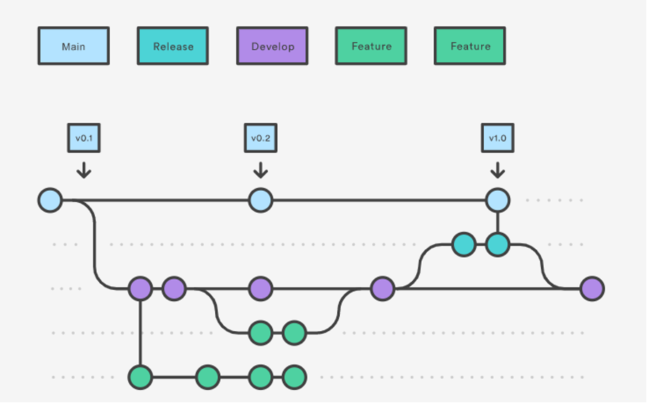
More versions of the same project
Some experiments are dead ends
Still good to keep track of them
Hell to maintain

Slide 4
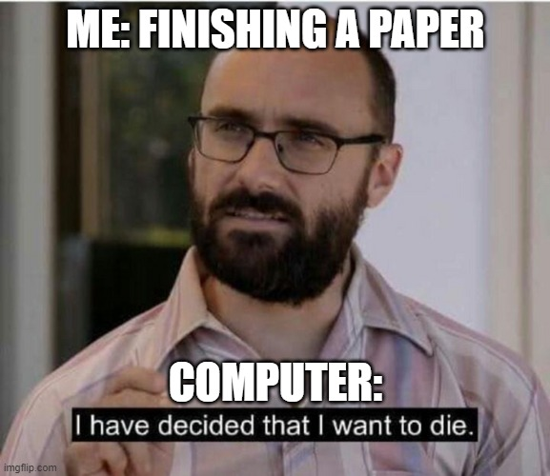
Get backed up!

Slide 5
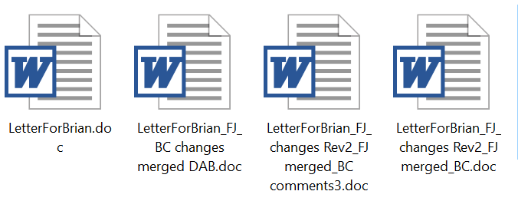

Collaborate!

Slide 6
Make your research public
Science must be repeatable
Describe methods, attach source code
Bug in the methods or in the code
80 % of the modeling papers can’t be replicated without the source codes
links to old, hard-to-find papers
Missing equations
Missing values
Typos
“The model enclosed is the earliest I have in my files, so it may not duplicate what is in my paper.”
Undisclosed author, personal communication, 01/05/2022

Slide 7
Version control system
Tracks all the revisions, creates safe „Checkpoints“
Allows organizing the project in multiple (concurrent) branches
Simplifies cooperation
Tag the release version and back it up!
“The model enclosed is the earliest I have in my files, so it may not duplicate what is in my paper.”
Undisclosed author, 01/05/2022

Slide 8
Version control systems
Source Code Control System (1972)
CVS (1985)
Subversion (SVN)
…
BitKeeper
GNU Bazaar
Mercurial (2005)
Git (2005)

Slide 9

Use Git!
an unpleasant or contemptible person.
"that mean old git"
Global information tracker (or goddamn idiotic truckload of ****)
Developed to support Linux core development in 2005
Most popular Version control system with collaboration
Don’t get lost in your versions, name them and store them!
Backup and recovery
Sharing and dissemination
It’s easy, it’s open-source, it’s free

Slide 10
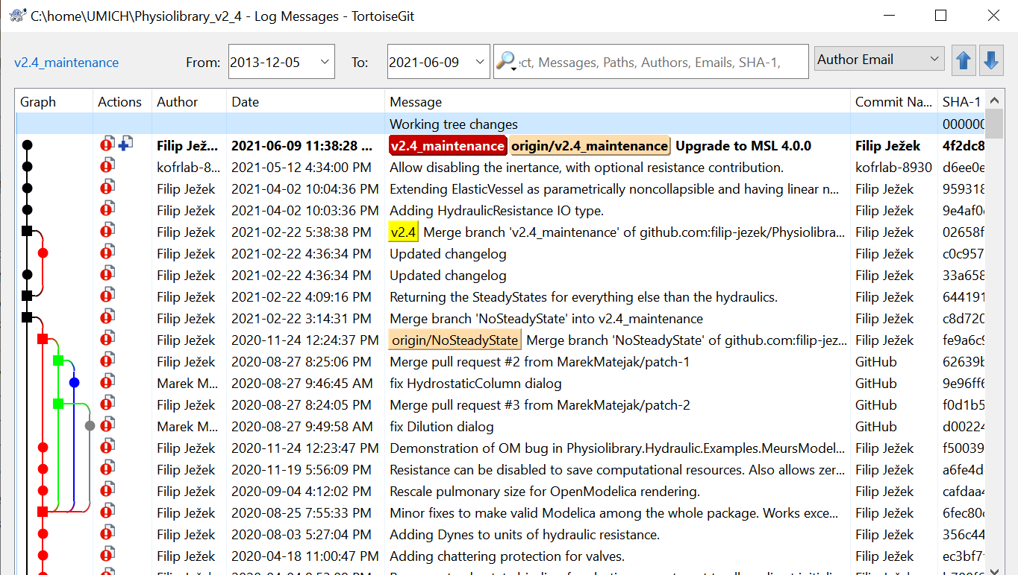
Repository log – take me to the past and back

Slide 11
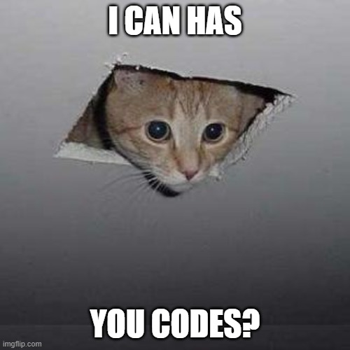
What to version control?
Anything plaintext, that you develop in time
Track your progress, tag a release
Public stuff vs Private stuf (GitHub)
Top secret stuff? (own Git server?)
Have codes? Make a repository!
Working on a codes? Commit and push!
“Publish only finished” ?
A project is never final

Slide 12
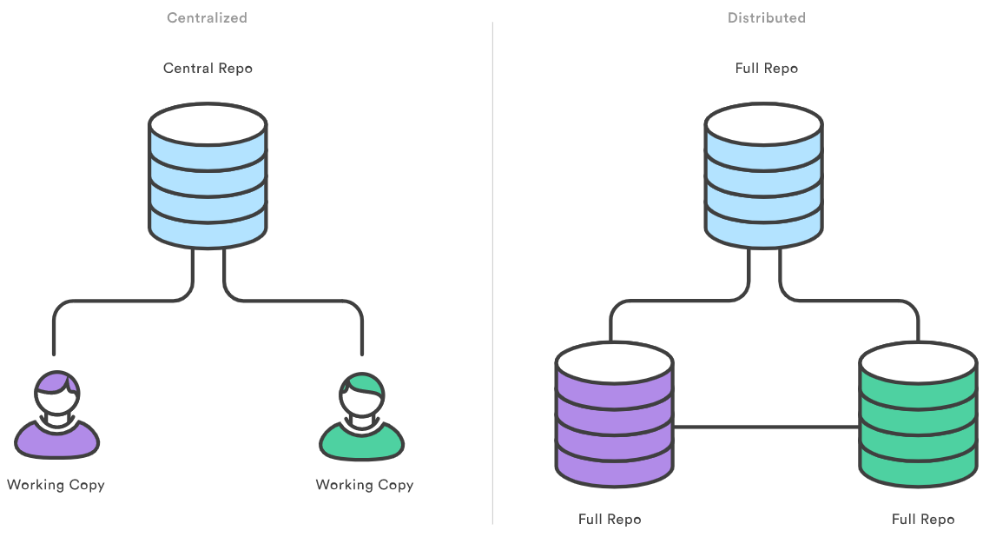

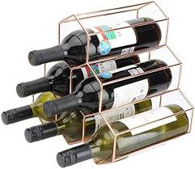

What is a Repository?
Repository: history and branches
Working copy: files on the drive
(usually in hidden subfolder, e.g. .Git)

Slide 13
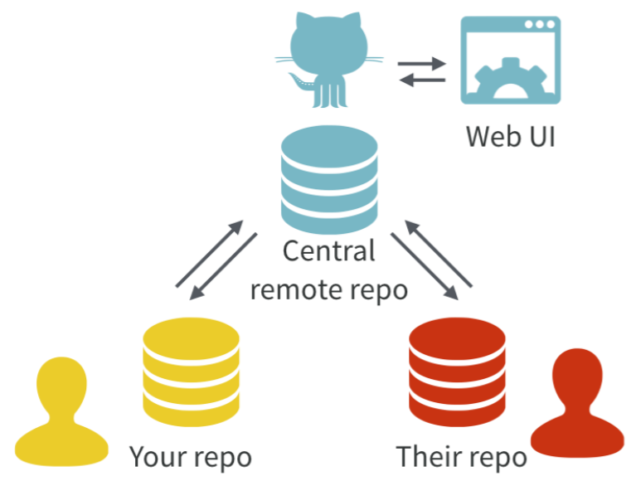
Centralized and distributed repositories and GitHub
Centralized repositories: All history on ONE place (CVS, SVN…)
Users pull working copies
Distributed repositories: Full history locally (local repositories)
Users synchronize their versions using pull / push
(Git, Mercurial…)
GitHub (GitLab) adds WebUI to the server
https://www.atlassian.com/git/tutorials/why-git
https://doi.org/10.7287/peerj.preprints.3159v2

Slide 14

Centralized and distributed repositories and GitHub
Centralized repositories: All history on ONE place (CVS, SVN…)
Users pull working copies
Distributed repositories: Full history locally (local repositories)
Users synchronize their versions using pull / push
(Git, Mercurial…)
GitHub (GitLab) adds WebUI to the server
https://www.atlassian.com/git/tutorials/why-git
https://doi.org/10.7287/peerj.preprints.3159v2

Slide 15
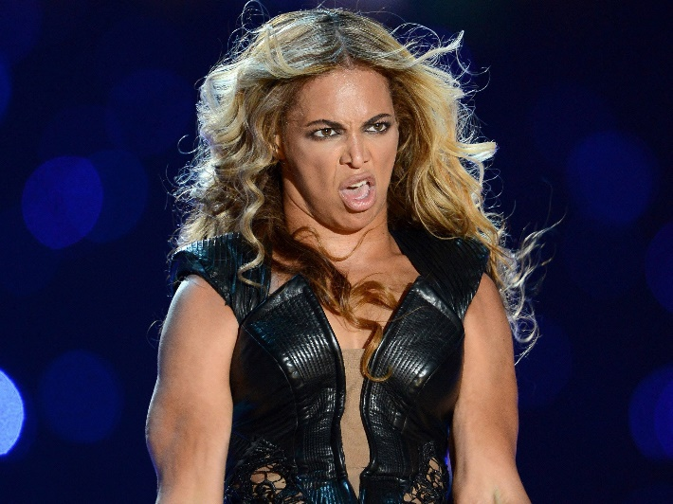
Distributed repositories
Everyone retains a copy of ALL history
What has been done, can’t be undone*
Careful with passwords etc. – Internet never forgets!
Synchronization
1) Pull – update local repo
2) Merge local – sort out the conflicts
3) Push – update server, conflict-free
Pic of Beyonce, legally removed from the internet
* Terms and conditions apply – e.g. force push etc

Slide 16

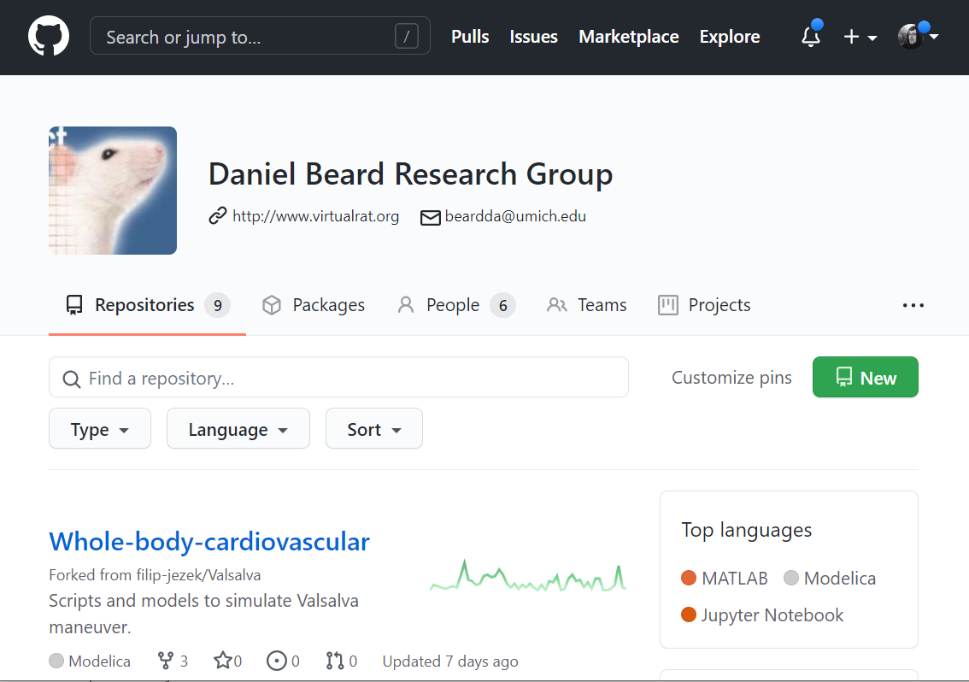
GitHub
A public, free git repository hosting (one of many)
Reliable, trusted, recently bought by Microsoft
Public repositories with unlimited collaborators
Limited private repositories
We already have https://github.com/beards-lab
UMICH has enterprise license https://its.umich.edu/communication/collaboration/github

Slide 17

GitLab
Open source repository hosting, Hosted by many free and paid services
Unlimited private repositories, collaborators, etc..
UMICH used to have one, now transferred to GitHub

Slide 18
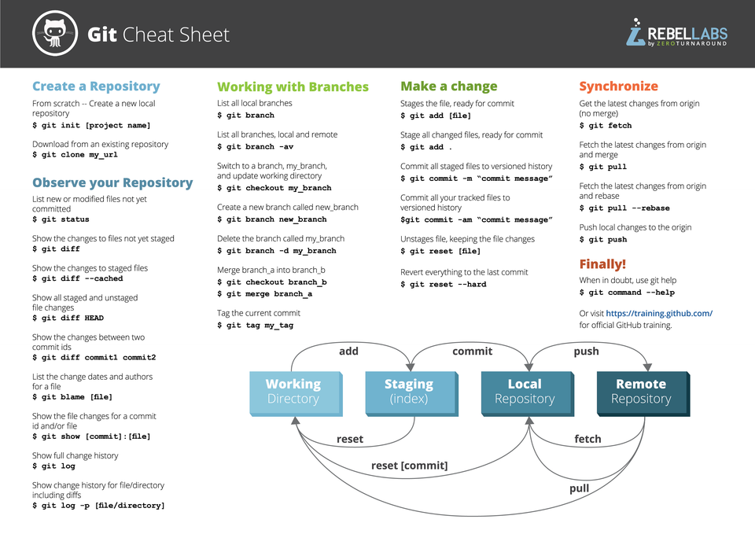
Client tools
http://git-scm.com/ downloads/guis
Command line?
https://git-scm.com/
Windows
TortoiseGit + Git for Windows https://tortoisegit.org/
GitHub Desktop https://desktop.github.com/
MacOs
GitHub Desktop https://desktop.github.com/
…
Integrated into Matlab, VS Code…

Slide 19



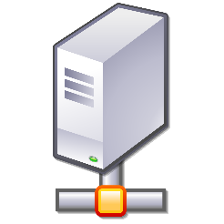

Process
DO THIS AS OFTEN AS POSSIBLE
File system
Local
Repository
Remote
Repository
Stage
Commit
Pull
Push
Do this for collaboration and backup

Slide 20
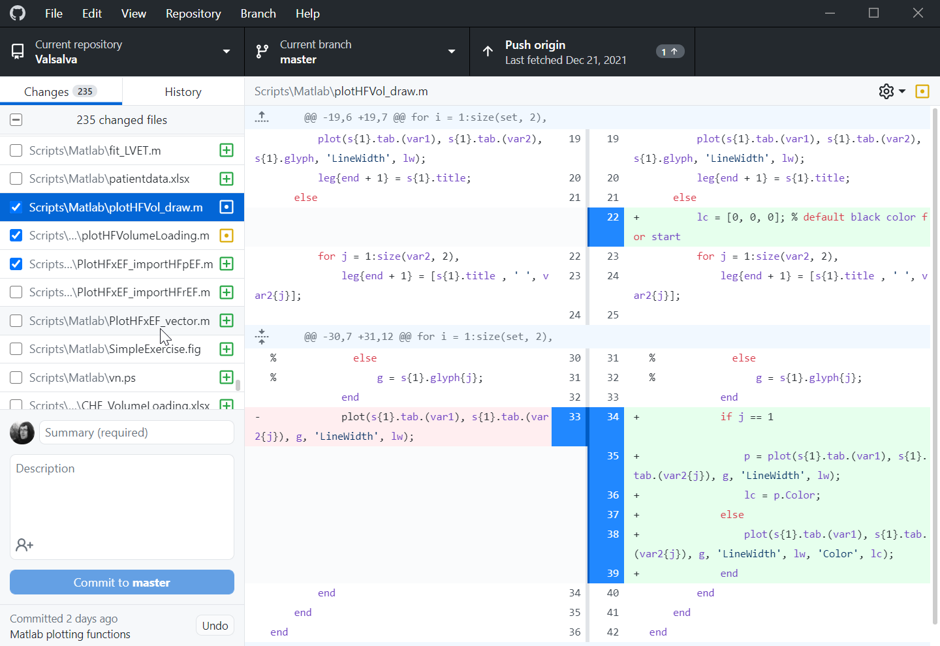
Process - stage
Selecting changes
Adding new files
Selecting changed files (or parts)

Slide 21
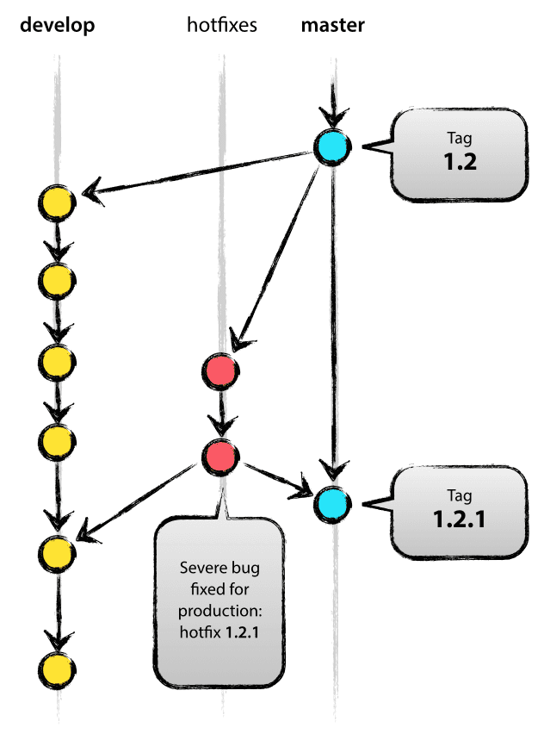
Process – COMMIT
Add a commit summary*
Commiting the changes into LOCAL repository
Safe checkpoint
On top of current BRANCH
Or to a NEW branch
Roll back to any previous commit
Compare with any previous commit

Slide 22

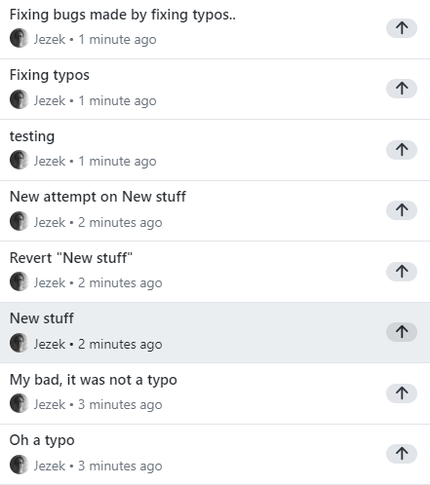
Process – COMMIT = safe checkpoint
DO NOT be afraid of dumb commits
All of them might be useful checkpoints
All opensource projects do that – it is no shame
You can use squash before pushing

Slide 23
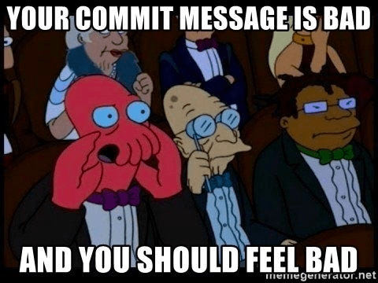
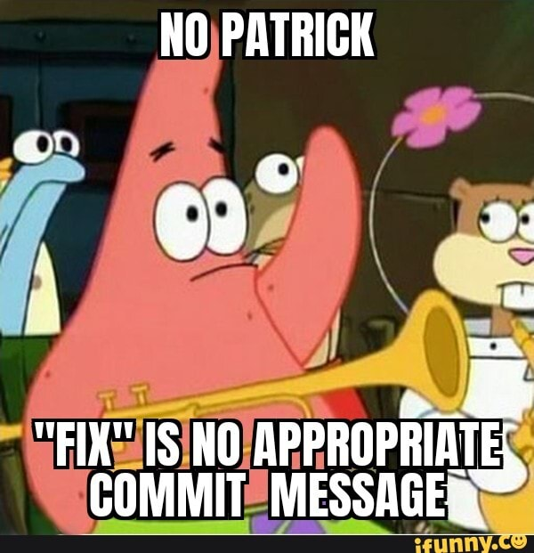
Process – COMMIT: Summary
Commit message (Summary) required
Try to be specific and concise, your future self will thank you
E.g. Fix typo in ReadMe Adding project1 data files Fix crashing during simulation
Use Description to provide further context, e.g. Setting step size > 0.2 results in a crash

Slide 24
Process - PUSH
Pushing our LOCAL repository to the REMOTE repository
Could have more remotes
What if the REMOTE version is newer?
Need to pull (aka fetch) first
Merge and sort the conflicts on OUR side

Slide 25
Process - PULL
Pulling from the REMOTE server into LOCAL repository, updating the files
Can have more remotes
What if we made some changes?
(Fetch just sync’s the repo)

Slide 26
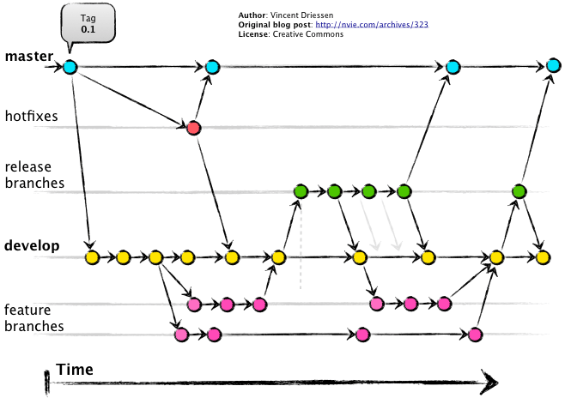
Branching
Each commit is a snapshot in time
Everything is checksummed with a SHA hash, with a custom label (commit name)
Has one or two parents
Branch is a pointer to a commit
Most recent commit in a branch
Default name: “master”, “main” or “CommitMcCommitFace:
Branches are meant to merge
Do not have to overuse with GitHub

Slide 27
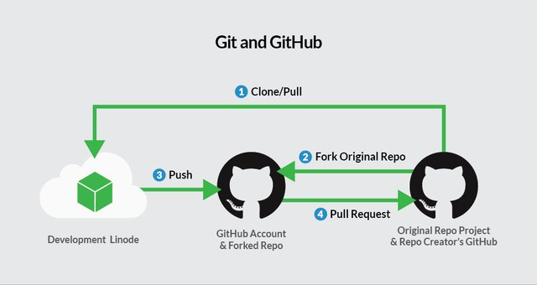
Collaboration
Collaborators in your group share the same remote
Write access?
Outside collaborators for open-source project
Use GitHub’s pull request features:
Collaborator:
Makes a copy (Fork) of the repo
Commits his changes
Issues pull request
Maintainer:
Reviews and merges the changes

Slide 28
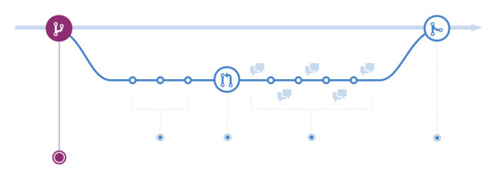
Pull requests
Open the code to wide public, incl. non-collaborators
Still prevent them from messing your code
“Hey, I fixed your code, wanna merge?”
You are sharing your code, Bob checks it out (forks).
Fork is Bobs version (= Bob’s branch)
Bob makes some changes and commits to his repository (which is a branch of your repository). Bob finalizes his codes.
Bob can’t rewrite your code, issues a pull request
You check his changes and merge

Slide 29
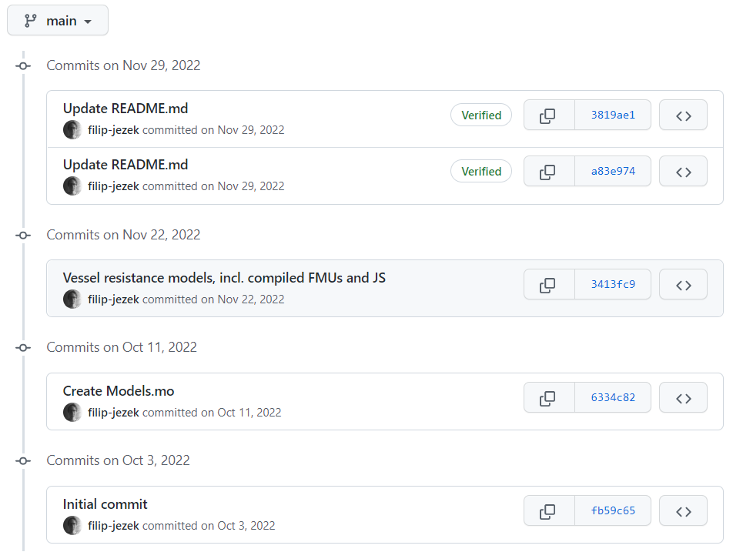
GIT: Get organized!

Slide 30
GIT: More versions of the same project
Hell to maintain?
Branches might merge back when successful, or die out

Slide 31

GIT: Get backed up!
GitHub:

Slide 32
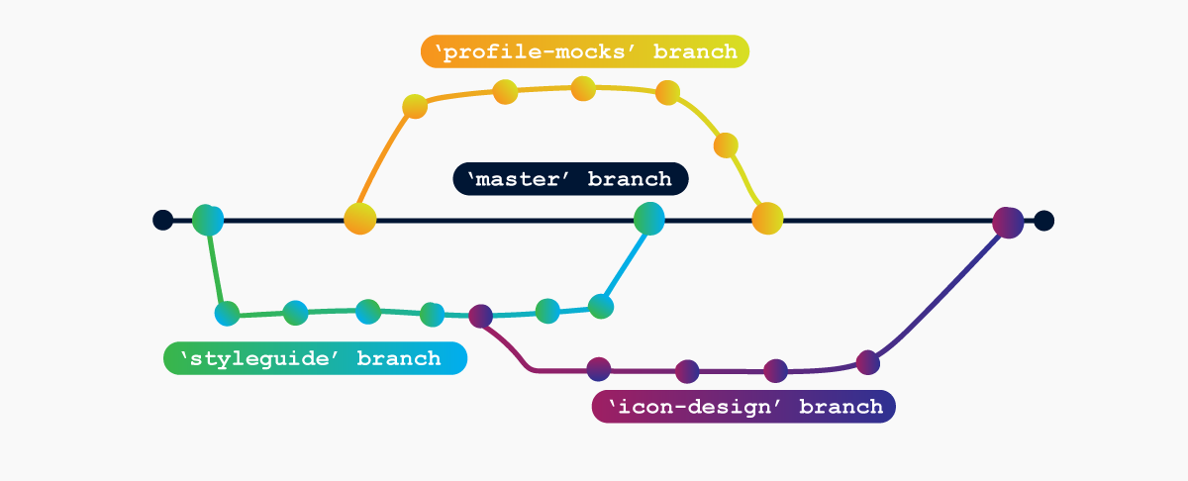
Git: Collaborate!
Invited collaborators
Pull requests from wide public

Slide 33
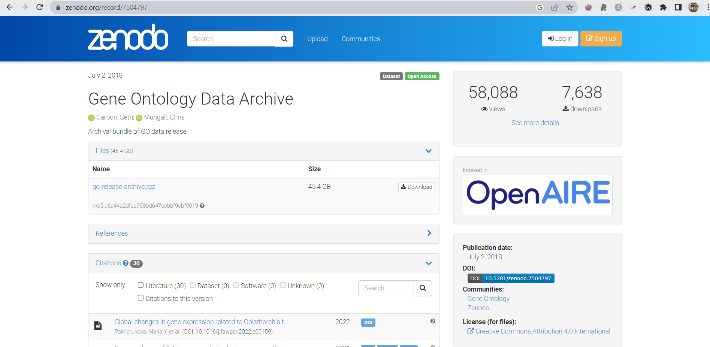
Git: Make your research public
A link to GitHub would do too
Dedicated storage repository - https://zenodo.org/ - pin a release

Slide 34

Next on: the hands-on

Slide 35

Assignment for Wednesday
Get GitHub desktop (or some other git client)

