Slide 1
System
State
Layer
Separator system
Fault
Layer
BLOCK_{g}
LEAK_{g}
......
AFC_{w}
Fault
Symptom
Layer
WL
WOR
......
WOR
OVO

Slide 2
Fault
Layer
BLOCK_{g}
LEAK_{g}
......
AFC_{w}
Fault
Symptom
Layer
......
WL
WOR
WOR
OVO

Slide 3
PID
Inlet Flow
Gas Outlet Rate
Gas Valve
Gas Phase
Inlet Valve
Weir Board
Room I Oil Phase
Water Phase
Room Ⅱ Oil Phase
PID
Oil Valve
Oil Outlet Rate
PID
Water Valve
Water Outlet Rate

Slide 4
P(A=0) | P(A=1)
0.5 | 0.5
A
B
P(B=0) | P(B=1)
0.8 | 0.2
C
A | B | P(C=0) | P(C=1)
0 | 0 | 1 | 0
0 | 1 | 0.1 | 0.9
1 | 0 | 0.9 | 0.1
1 | 1 | 0 | 1

Slide 5
A
0
B
0
C
0
Note:
—— Unit Transfer
—— Failure Status
System(A,B,C)
0

Slide 6
Physical Model System
Operating Condition
Modify boundary conditions
Fault Symptoms
Fuzzy Processing
Normal
Fault Symptom 1
Very High
Fault 1
Simulation Model
Fault Symptom 2
High
......
......
......
Fault n
Fault Symptom n
Very Low
Noisy-MAX
Noisy-OR
Noisy-AND
Defuzzification
BNs Structure Determination
BNs Parameter Determination
Fault Diagnosis
Fault Symptom Layer
Probability Table PM Provided
Posterior Probability
System State Layer
Probability Table SMC Provided
Diagnostic Rules
Fault Layer
Data Source
Life Distribution
Unit State
Discrete Dataset
Feild Data
Exponential
Normal
Simulation Model
Paper Data
Normal
Fault 1
......
......
......
Discretization
Classic Database
Weibull
Fault n
Sequential Monte Carlo Simulation

Slide 7
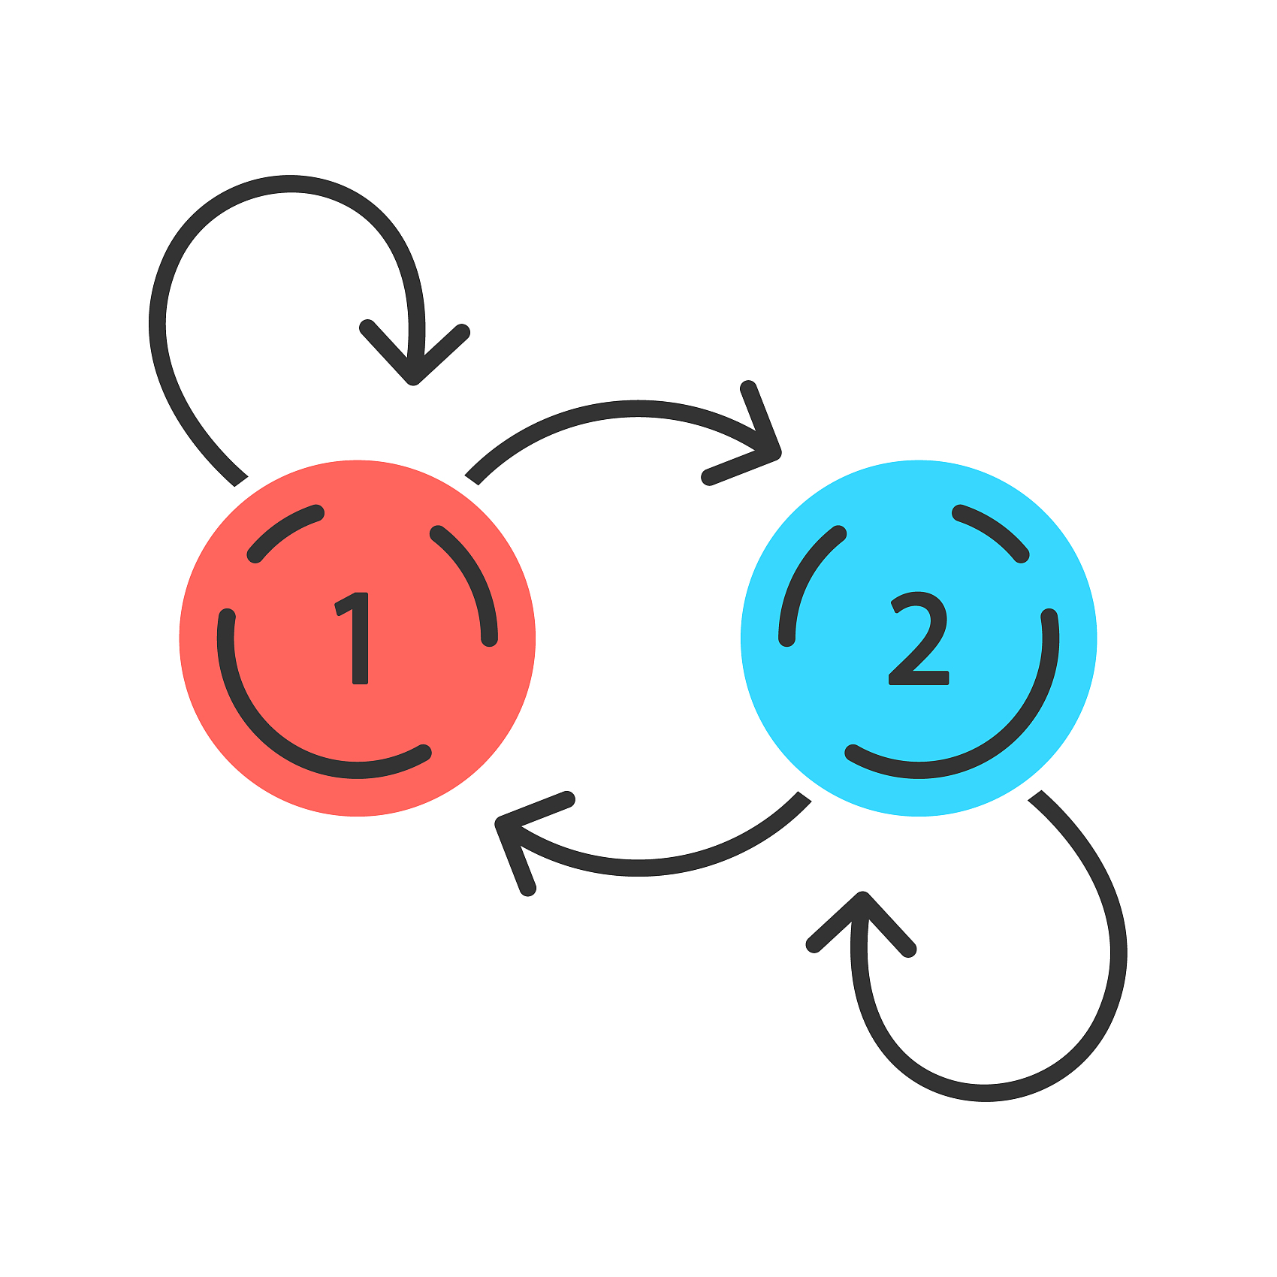





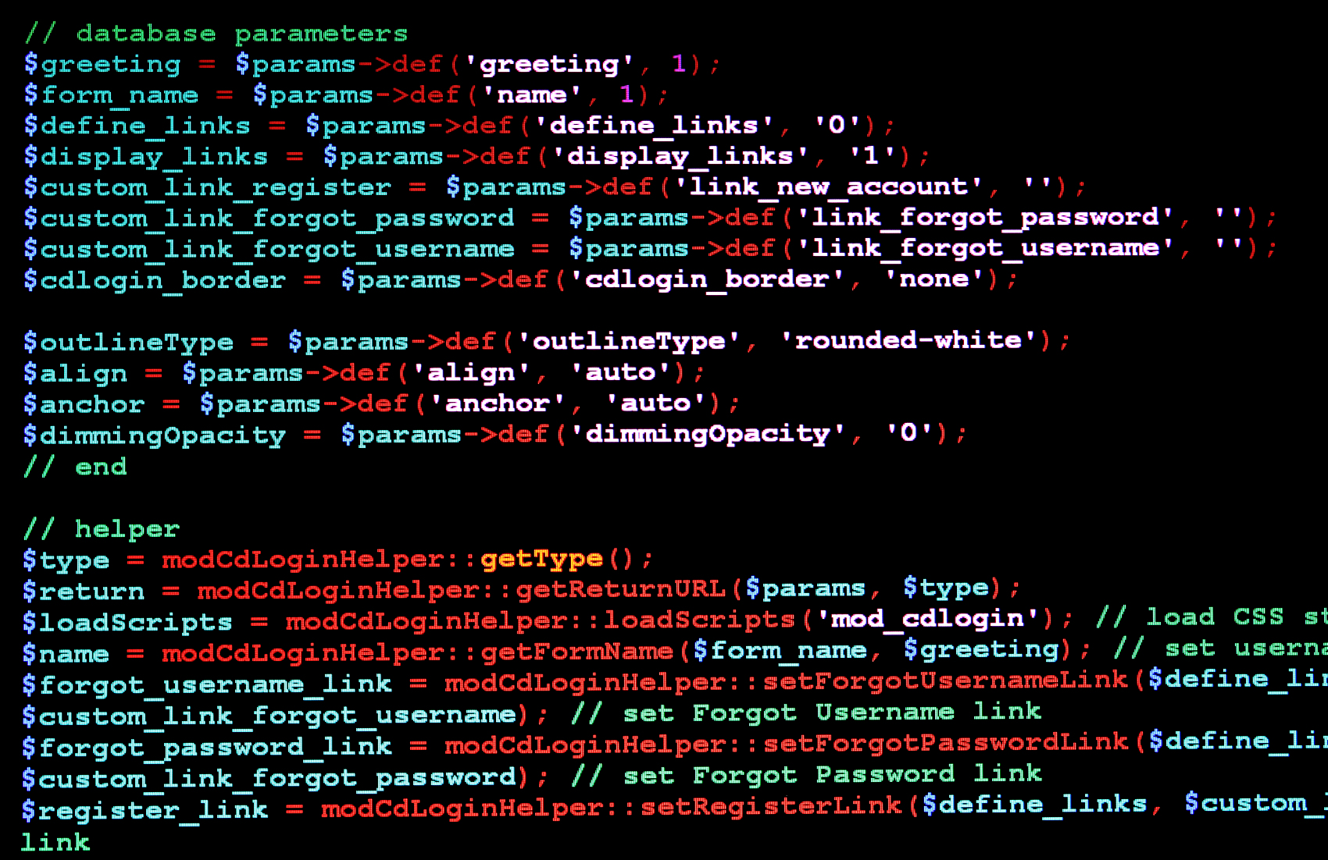











1 BNs Structures Determination
2 Fault Diagnosis Model Parameters Determination Based on SMC
Step 2.1 Basic Data Collection
Step 2.2 Life Distribution Collection
Step 2.3 Operating States Collection
Failure and Repair Data
......
Normal
Exponential
Separator
NORMAL
ID
Real Data
Database
Expert
Weibull
Gamma
LEAK_{g}
......
BLOCK_{w}
......
LEAK_{o}
AFO_{g}
AFO_{w}
......
AFO_{g}
Step 2.7 CPT Calculation
Step 2.6 Discretization Dataset
Step 2.5 Simulation
Step 2.4 Sequential Monte
Carlo Simulation
Bayesian Estimate
...
Node CPTs
...
3 Fault Diagnosis Model Parameters Determination Based on PM
4 BNs Parameters Determination
Step 3.1 Operating States Collection
Step 3.2 Simulation
System State Layer
Separator
NORMAL
ID
Simulate many times
Fault Layer
LEAK_{g}
......
BLOCK_{w}
LEAK_{o}
AFO_{g}
AFO_{w}
......
AFO_{g}
(Reducing serendipity)
Fault Symptom Layer
Step 3.5 CPT Calculation
Step 3.4 Fuzzy Process
Step 3.3 Fault Symptoms Collection
PM’s Semantics
5 Diagnostic Rules Determination
Noisy-MAX
......
Node CPTs
Basic Probability
Fault Symptoms
......
6 Fault Diagnosis

Slide 8
1 BNs Structures Determination
2 Fault Diagnosis Model Parameters Determination Based on SMC
Step 2.1 Operating States Collection
Step 2.2 Basic Data Collection
Step 2.3 Life Distribution Collection
Separator
NORMAL
ID
Failure and Repair Data
......
Normal
Exponential
LEAK_{g}
......
BLOCK_{w}
Real Data
Database
Expert
Weibull
Gamma
LEAK_{o}
AFO_{g}
AFO_{w}
......
AFO_{g}
......
Step 2.7 CPT Calculation
Step 2.6 Discretization Dataset
Step 2.5 Simulation
Step 2.4 Sequential Monte Carlo Simulation
Bayesian Estimate
Analyse Fault Symptoms
Alter Boundary Conditions
Input Unit‘s State Transition Matrix
Determine Simulation Duration
Node CPTs
Continuous Dataset
Discretization Dataset
Obtain Continuous Dataset
Obtain Simulation Results
3 Fault Diagnosis Model Parameters Determination Based on PM
4 BNs Parameters Determination
Step 3.1 Operating States Collection
Step 3.2 Simulation
System State Layer
Separator
NORMAL
ID
Alter Boundary Conditions
Fault Layer
Simulate many times
LEAK_{g}
......
BLOCK_{w}
Obtain Continuous Dataset
LEAK_{o}
AFO_{g}
AFO_{w}
......
AFO_{g}
(Reducing serendipity)
Fault Symptom Layer
Step 3.5 CPT Calculation
Step 3.4 Fuzzy Process
Step 3.3 Fault Symptoms Collection
PM’s Semantics
5 Diagnostic Rules Determination
Noisy-MAX
Normal
High
Node CPTs
Basic Probability
Low
Shock
6 Fault Diagnosis

Slide 9
1 BNs Structures Determination
2 Fault Diagnosis Model Parameters Determination Based on SMC
Step 2.1 Operating States Collection
Step 2.2 Basic Data Collection
Step 2.3 Life Distribution Collection
Separator
NORMAL
Failure and Repair Data
......
Normal
Exponential
FAULTS
Real Data
Database
Expert
Weibull
Gamma
......
Step 2.7 CPT Calculation
Step 2.6 Data Discretisation
Step 2.5 Simulation
Step 2.4 Sequential Monte
Carlo Simulation
Bayesian Estimate
...
Alter Boundary Conditions
Node CPTs
Obtain Simulation Data
...
3 Fault Diagnosis Model Parameters Determination Based on PM
4 BNs Parameters Determination
Step 3.1 Operating States Collection
Step 3.2 Simulation
System State Layer
Separator
NORMAL
Alter Boundary Conditions
Fault Layer
Simulate many times
FAULTS
(Reducing serendipity)
Obtain Simulation Data
Fault Symptom Layer
Step 3.5 CPT Calculation
Step 3.4 Fuzzy Process
Step 3.3 Fault Symptoms Collection
PM’s Semantics
5 Diagnostic Rules Determination
Noisy-MAX
Normal
High
Node CPTs
Basic Probability
Low
Shock
6 Fault Diagnosis

Slide 10
Start
Analysis
Discrete Dataset
CPTs of Fault Symptom Layer Nodes
Consulting the PM
N
Conditions
Exist
Fuzzy Theory
Y
Get the Parameters
from Discrete Dataset
Noisy-MAX
Obtain the Parameters from PM
Final CPTs of Fault Symptom Layer Nodes
End

Slide 12
