Slide 1

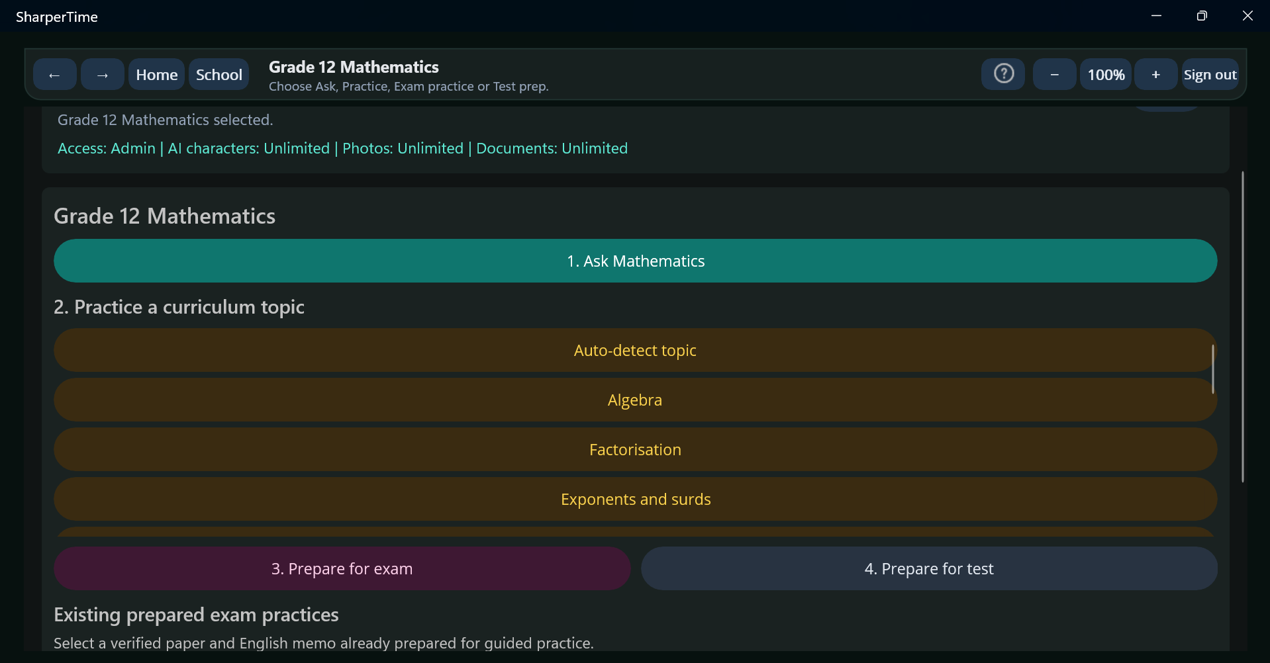
SharperTime
AI-powered Grade 12 Mathematics tutoring for African learners
A working Windows and Android platform for practice, hints, diagnostic marking, multimodal input and lesson videos.
Sharper X (Pty) Ltd
Founder: Lesego Mohaule
Johannesburg, South Africa
Application deck for Google Africa Applied AI Lab

Slide 2
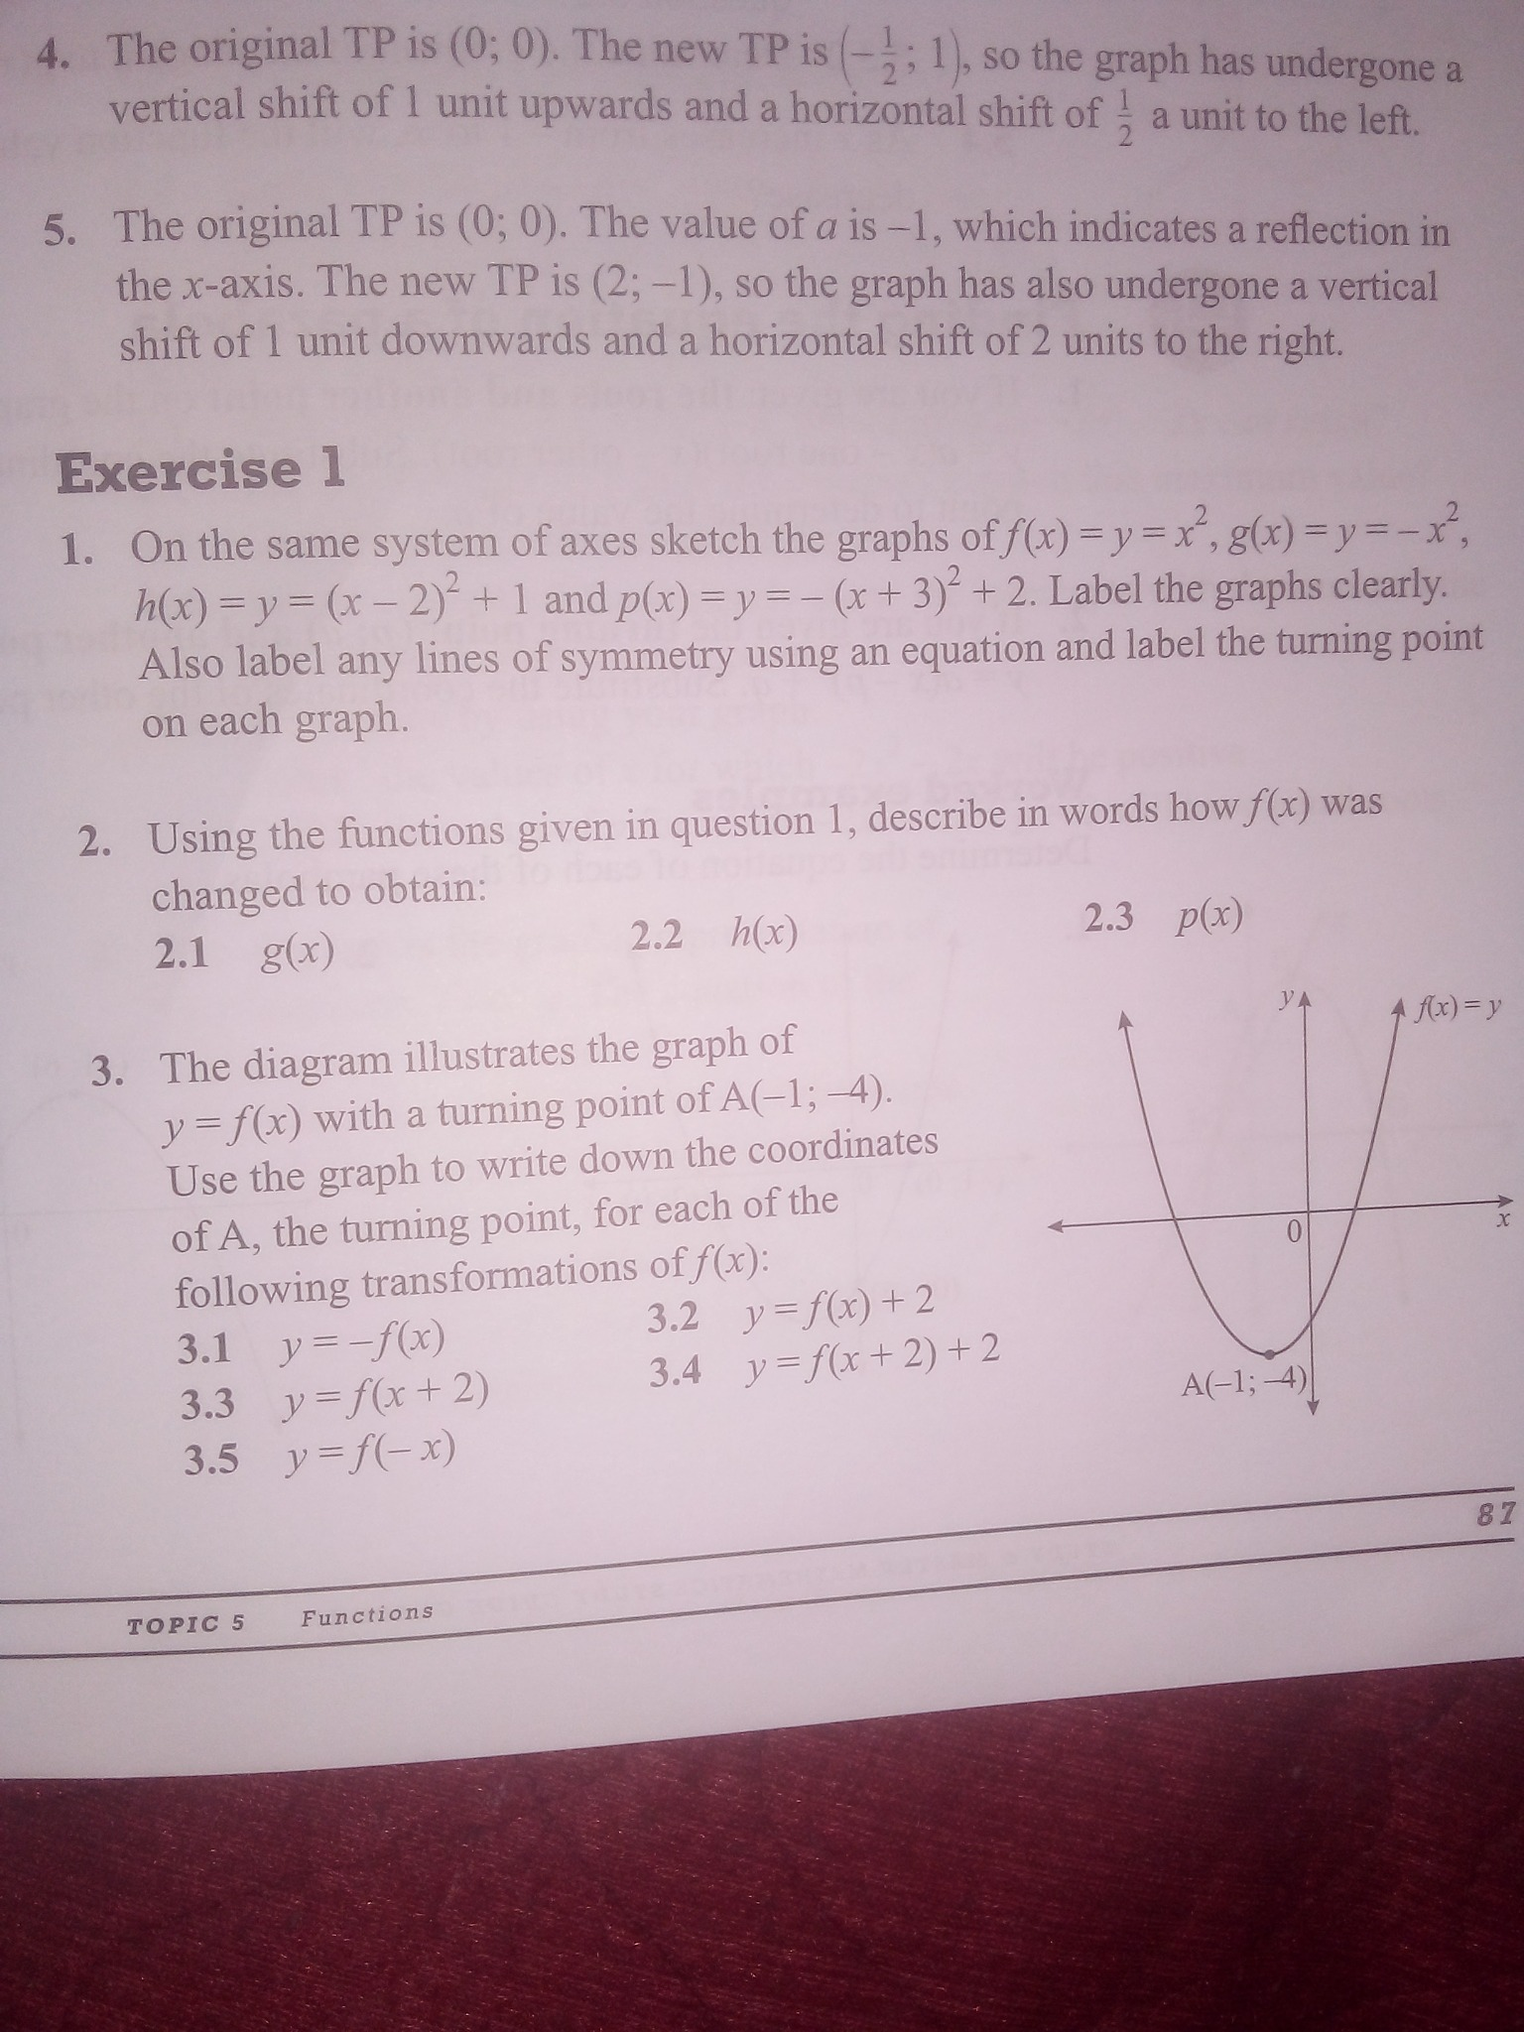
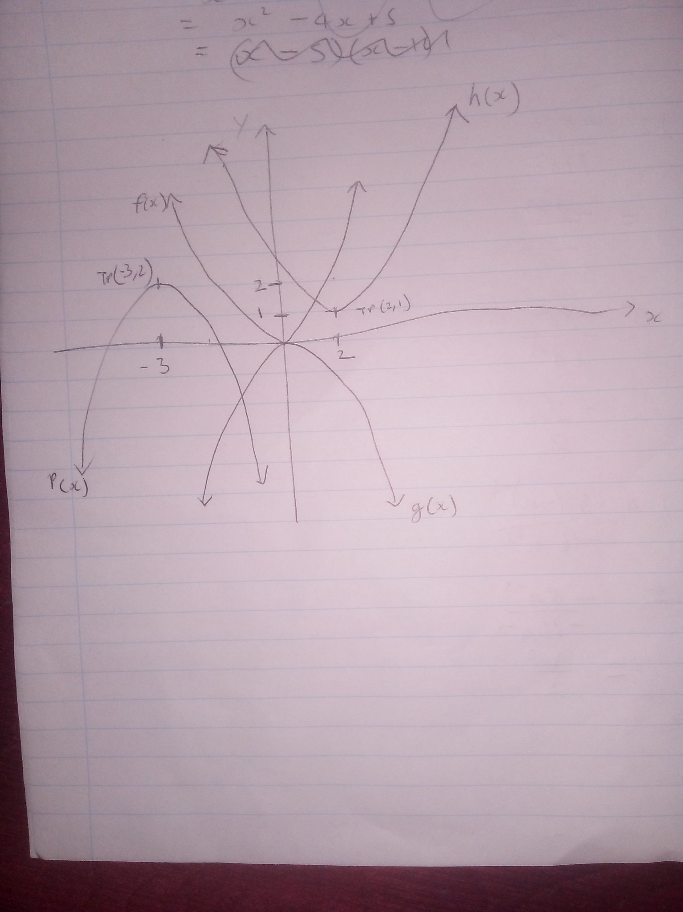
The problem
SharperTime
Affordable, personalised mathematics help is still difficult to access.
Google Africa Applied AI Lab
Many learners need help exactly when they are studying alone.
Private tutoring is effective but too expensive for many families.
School mathematics is multimodal: equations, working, graphs and diagrams.
Generic AI tools do not provide a structured learning flow, marking and feedback.
Learners need immediate correction, not only final answers.
R35–R50
Grade 12
Local → Africa
Target 30-day price
Initial launch focus
Expansion path
Textbook question
Handwritten graph

Slide 3
The solution
SharperTime
A focused AI tutor built around real mathematics workflows.
Google Africa Applied AI Lab
SharperTime combines structured learning with multimodal AI.
Ask
Learners ask mathematics questions naturally.
Practice
Difficulty-based practice with hints and guided feedback.
Mark
The app checks answers and explains mistakes.
Capture
Textbook images, handwritten work, voice and graphs.
Learn
Short lesson videos connected to revision and practice.
Not a generic chatbot — a learning platform designed for a focused Grade 12 Mathematics launch.

Slide 4
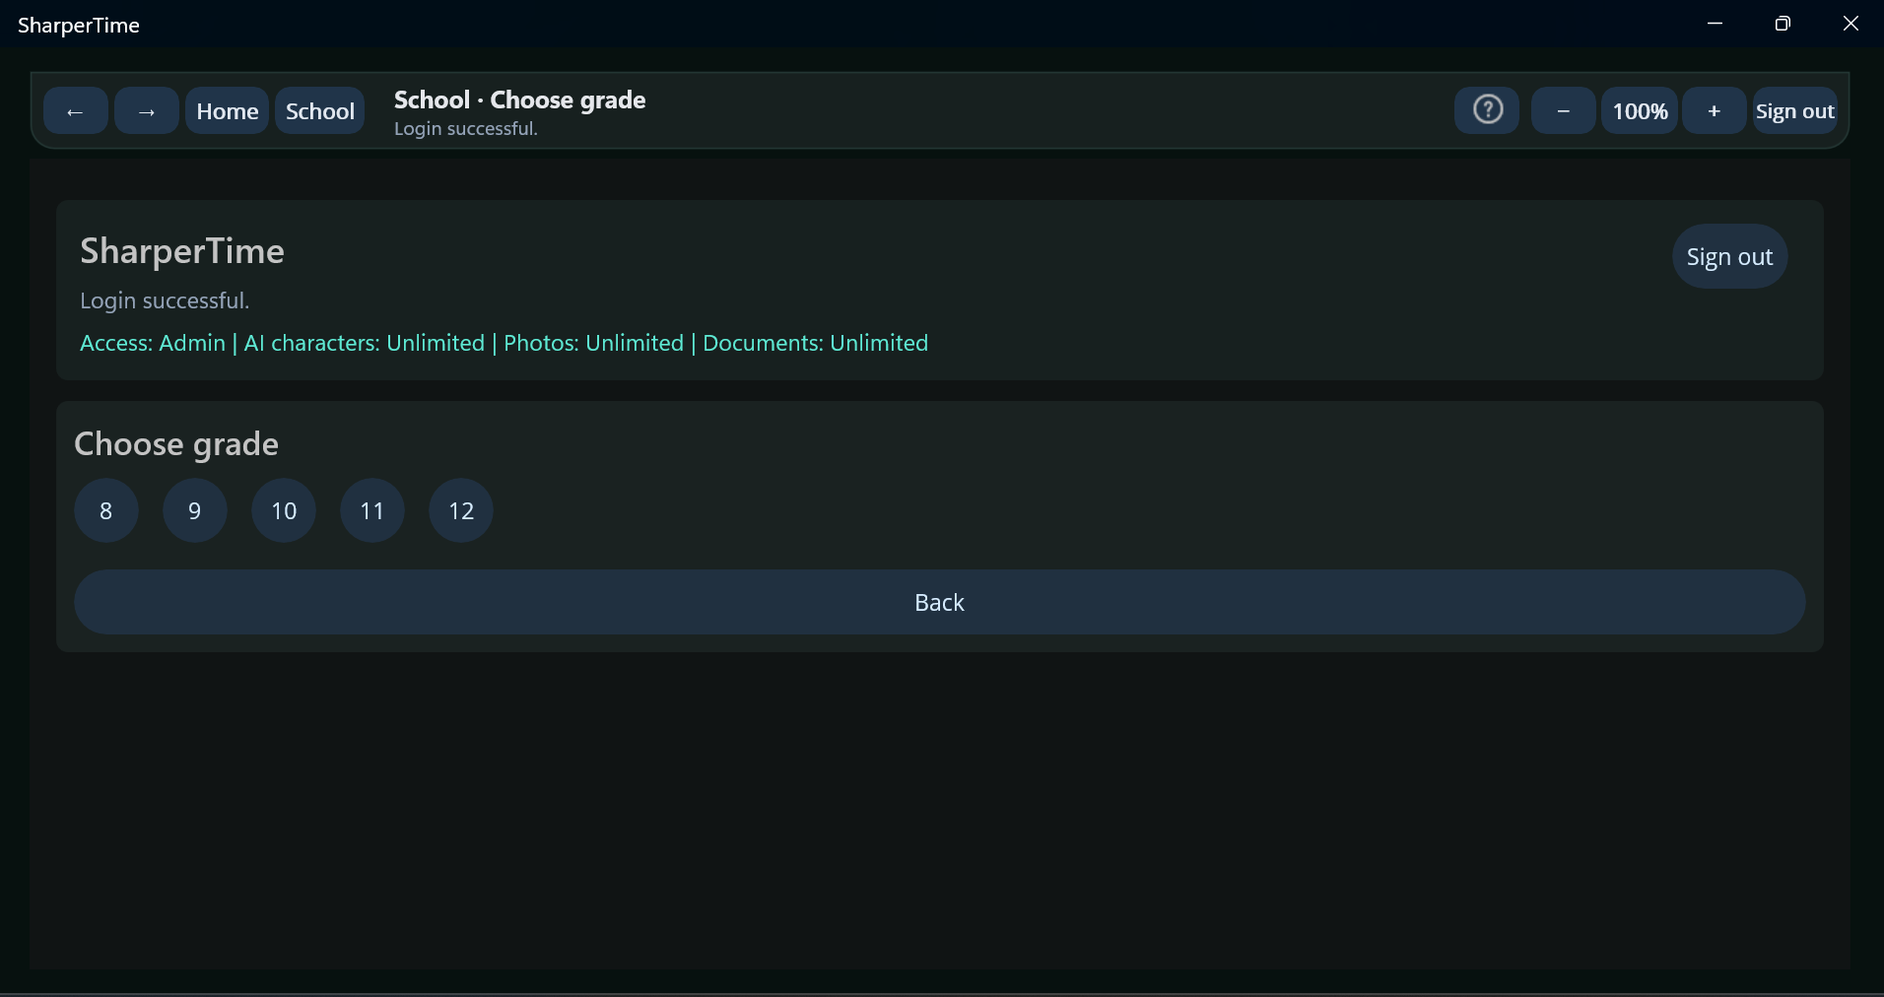
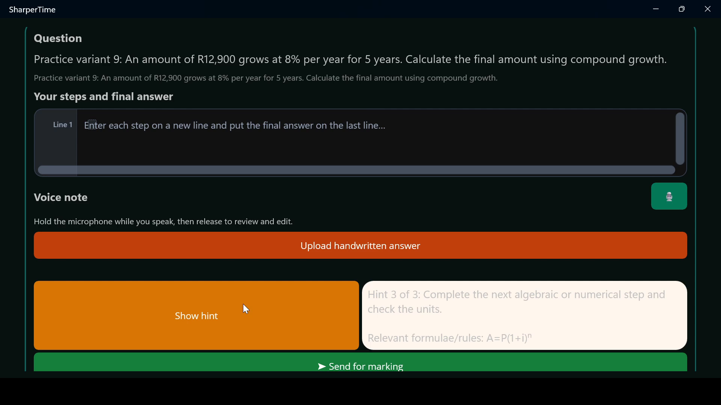
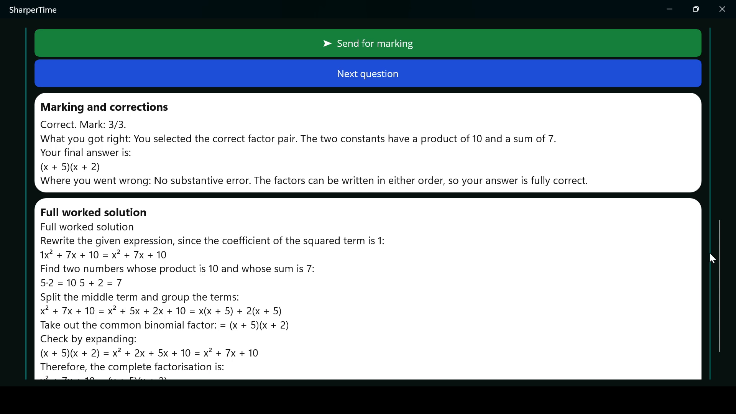
Product already working
SharperTime
A real app experience has been recorded and demonstrated.
Google Africa Applied AI Lab
Choose grade
Select topic / mode
Get a hint
Receive marking
The product demo shows the actual app: topic choice, difficulty selection, hints, answer entry and diagnostic correction feedback.

Slide 5
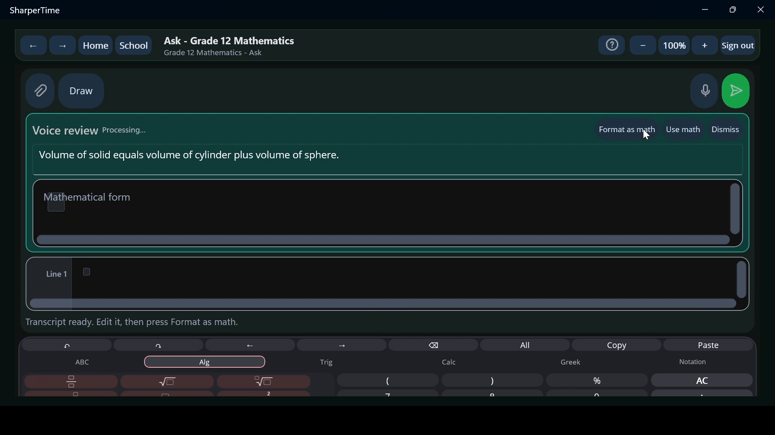
AI tutoring and practice workflow
SharperTime
The learner does the work; the app guides, checks and explains.
Google Africa Applied AI Lab
Optional hints and formulas
Diagnostic marking
Review before sending
Select topic and difficulty
Attempt a real question
Ask for hint when needed
Receive marking and correction
1
2
3
4
The current product focuses on user-selected difficulty, hints and corrective feedback rather than giving full solutions as the default learner experience.

Slide 6
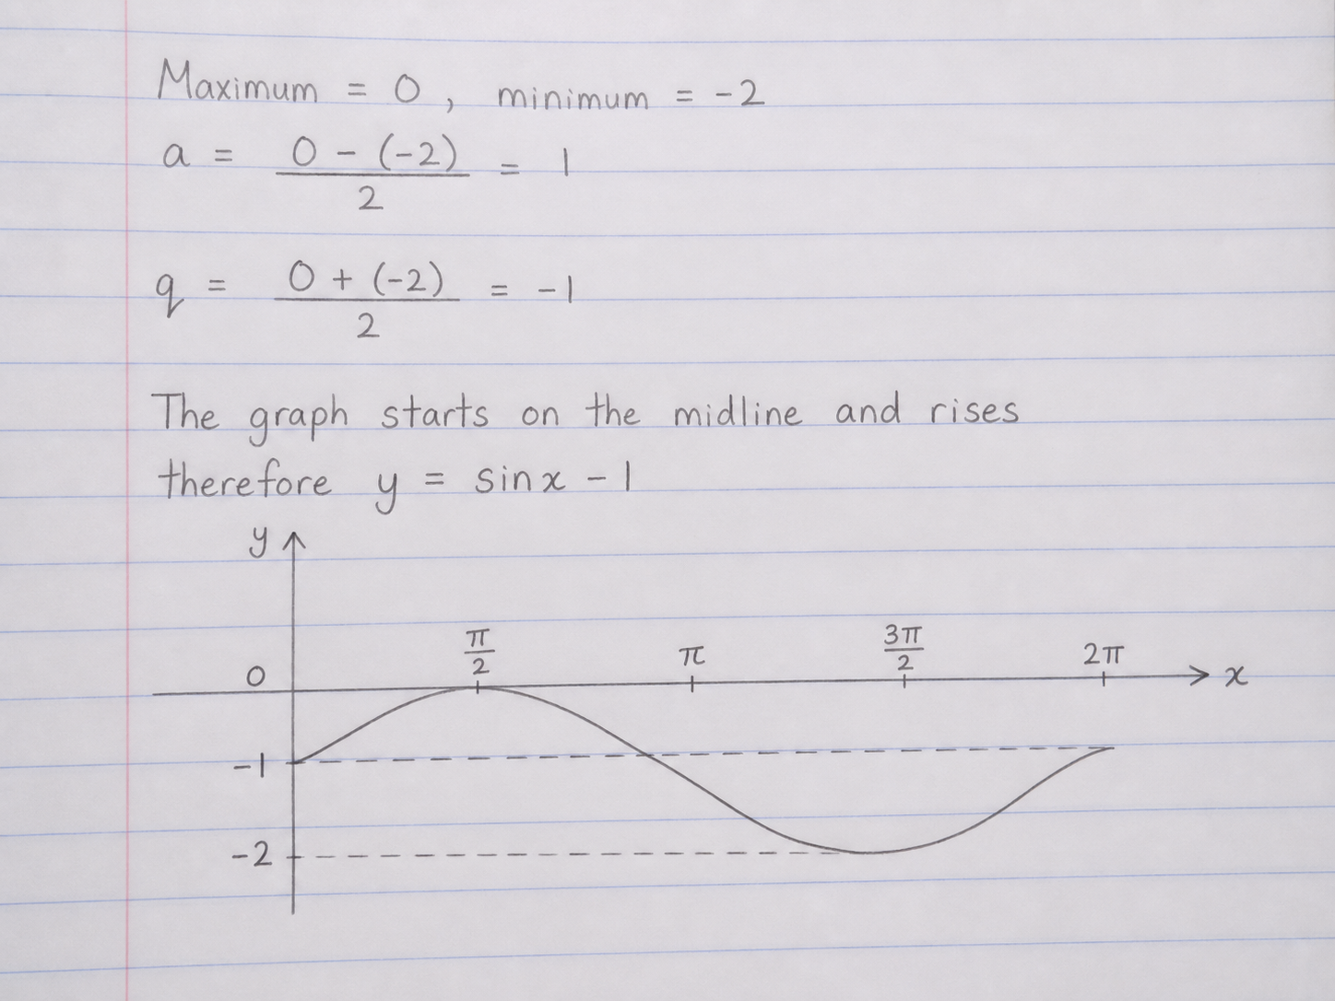
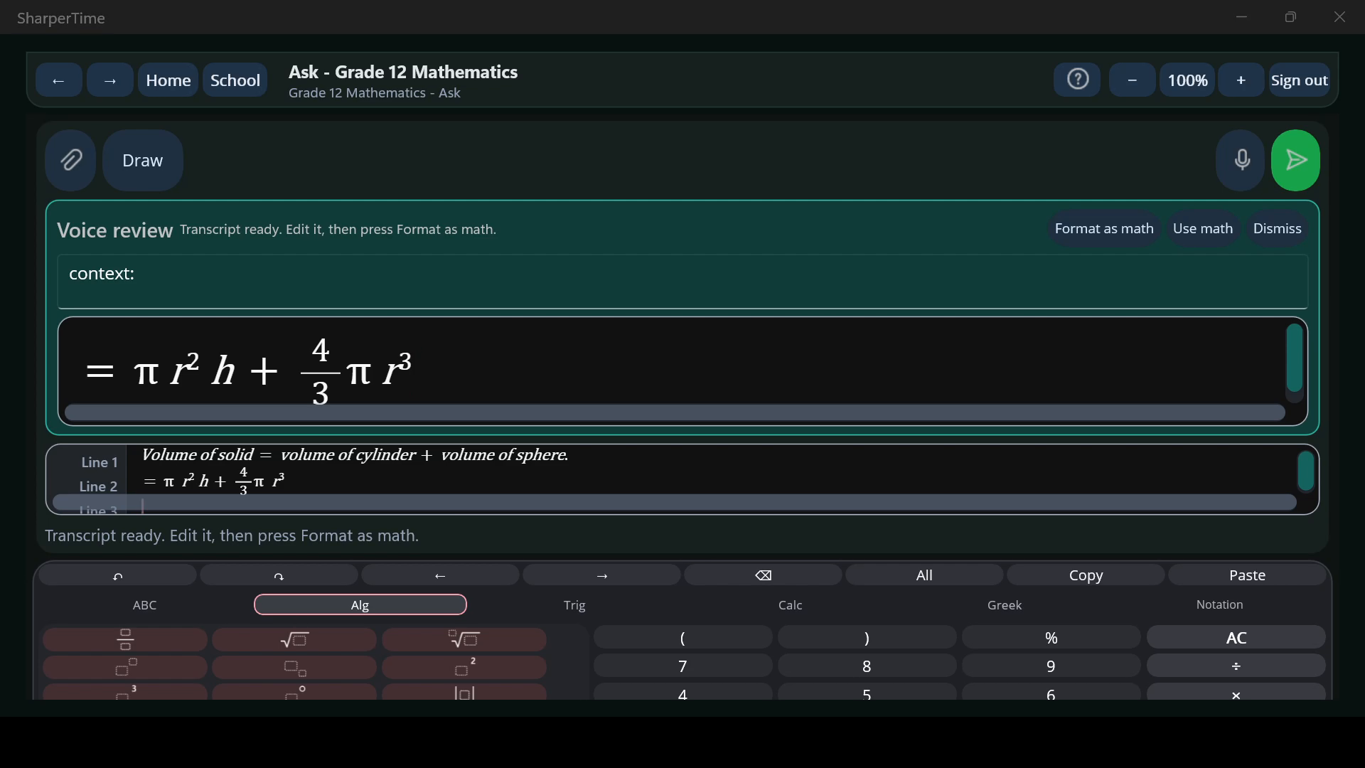
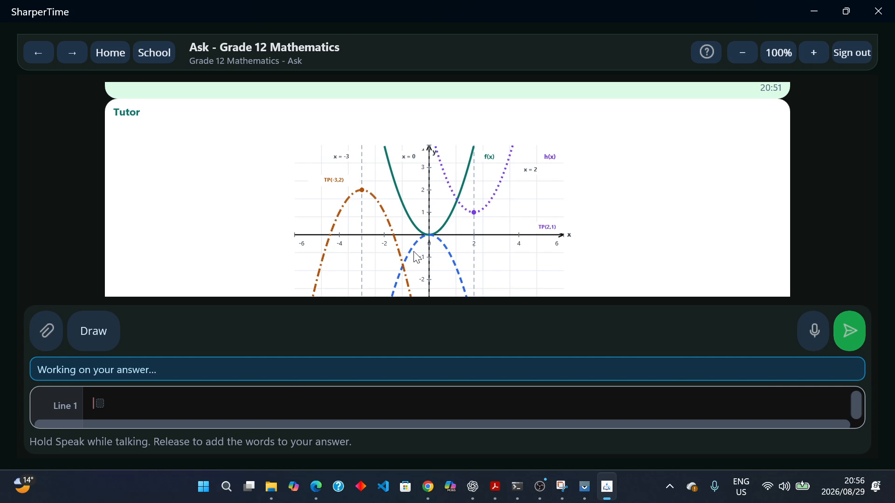
Multimodal AI learning
SharperTime
SharperTime works with the way learners actually produce mathematics.
Google Africa Applied AI Lab
Inputs
Typed mathematics
Voice converted into mathematical notation
Handwritten solution
Voice to maths
Textbook and photo uploads
Handwritten working and graphs
Outputs
Editable transcription and confirmation
Mathematics reasoning and marking
Specific feedback and correction
Hand-drawn graph
Image upload and analysis
Graph-aware responses
This matters because school mathematics is not just a text-chat problem.

Slide 7
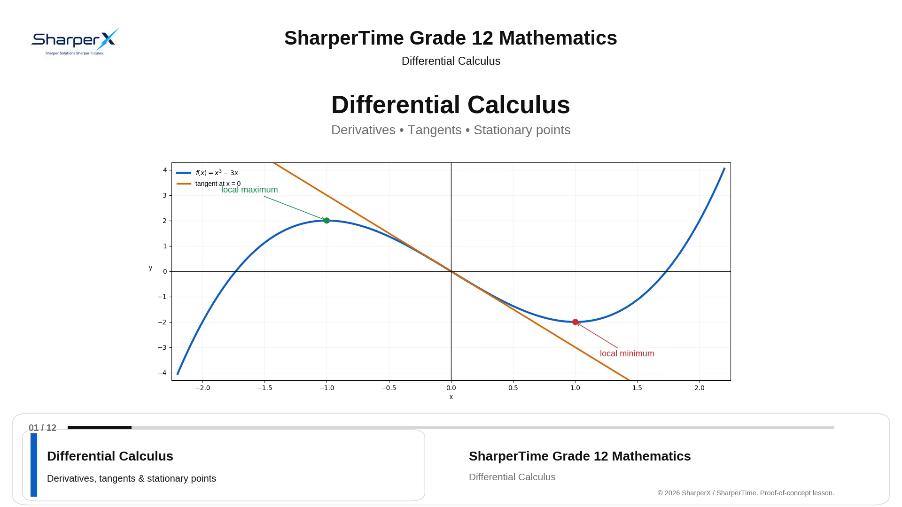
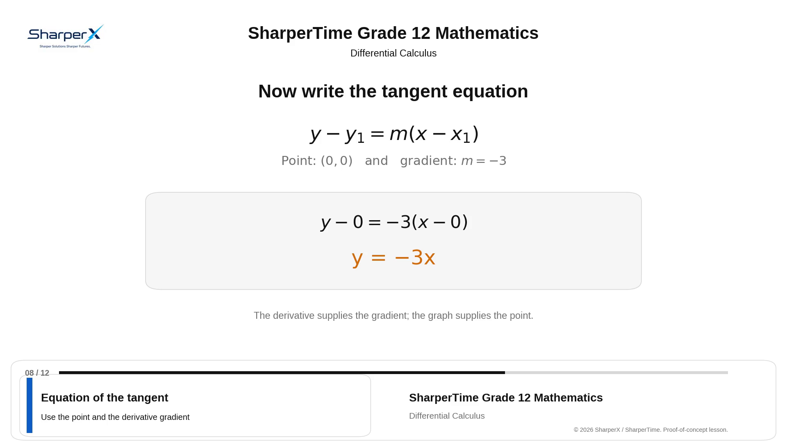
Lesson-video content engine
SharperTime
Google AI tools can help create, refine and expand short CAPS-aligned lessons.
Google Africa Applied AI Lab
Differential Calculus lesson sample
Worked-example teaching style
Initial focus
Content expansion
Future scope
High-school Mathematics, starting with Grade 12.
All topics, subtopics and sections for each grade.
Other high-school subjects and TVET engineering.

Slide 8
Why Google AI can accelerate SharperTime
SharperTime
Google AI can become materially impactful across product quality and scale.
Google Africa Applied AI Lab
Gemini
Gemma / efficient models
Google tooling
Stronger multimodal maths understanding
Lower-cost routing for routine tasks
Lesson-video creation and content iteration
Better handling of handwriting, images, diagrams and graphs
Potential support for low-connectivity environments
Question refinement and evaluation workflows
Richer explanations and tutoring interactions
Reusable feedback and question-classification workflows
Support for Apple/Mac expansion and cloud-scale delivery
Goal: improve multimodal accuracy, question quality, lesson-content scale, latency and cost while keeping the learner experience simple.

Slide 9
Checkout offer at launch
SharperTime
One clear checkout option combines tutor access, lesson-video access and a defined AI usage allowance.
Google Africa Applied AI Lab
R35 plan
30 days of combined
Grade 12 Mathematics
tutor access and lesson-
video access, together
with a standard AI usage
allowance with a service
value of R5.
The R35 plan includes tutor access and lesson videos; the included standard AI usage allowance has a service value of R5.
Learners may top up the AI usage balance on a pay-as-you-go basis during the month. Top-ups increase the in-platform AI usage balance and do not create a separate access product.

Slide 10
Go-to-market
SharperTime
Start locally, prove renewals, then expand outward.
Google Africa Applied AI Lab
Beachhead
Digital channels
Launch path
Marikana and surrounding communities in North West
YouTube ads and lesson videos
September launch on website and Google Play Store
Gauteng school and community outreach
X / Twitter and Facebook
Focused on Grade 12 Mathematics first
Direct school visits, demos and local trust-building
Website launch page, product demo and community sharing
Expand across Africa after the core model is proven

Slide 11
Product roadmap
SharperTime
Focused Grade 12 Mathematics launch first, then disciplined expansion.
Google Africa Applied AI Lab
Now
Sep 2026
2027
Next
Platform
Later
Windows and Android app
Grade 12 Mathematics
Launch on website
and Google Play Store
Add other grades
and high-school subjects
Expand to Apple, Mac
and more devices
Add SIP live tutoring
and a shared canvas
TVET engineering
and broader Africa rollout
Future SIP service: AI-assisted private tutoring with video/audio calls similar to Meet, Teams and Zoom, plus a shared maths/text canvas for tutors and learners.

Slide 12
Founder advantage
SharperTime
Technical founder with QA, AI/data, engineering and teaching experience.
Google Africa Applied AI Lab
Software QA
Lesego Mohaule
Functional, regression, usability, web and mobile testing; Appium and Selenium experience.
Founder & Director
Sharper X (Pty) Ltd
AI & data capability
Python, C#, Java, SQL, TensorFlow, PyTorch and data-analysis tools.
Johannesburg, South Africa
BSc (Hons) Big Data Analytics
BSc Geo-Informatics
National Diploma Electrical Engineering
ISTQB Certified Tester Foundation Level
Education link
Former computer-science lab assistant and practical learner-support experience.
Builder mindset
Can build, test, iterate and launch the product rather than only outsource development.
The founder profile matches SharperTime’s immediate needs: build, test, launch, measure and improve.

Slide 13
Personalised AI tutoring that can scale from smartphones to schools across Africa.
Why Google Africa Applied AI Lab
Technical support, venture-building and Google AI tooling can help SharperTime improve multimodal performance, scale lesson content, refine questions and expand distribution.
Sharper Solutions. Sharper Futures.
Sharper X (Pty) Ltd

