Slide 1




The Grid Balance Maintenance App: A Solution for South Africa's Energy Challenges
by Oratile Mashabathakga

Slide 2

Understanding South Africa's Energy Crisis
Load Shedding
Load shedding is a regular occurrence, impacting homes and businesses with unpredictable power outages.
Grid Instability
The aging infrastructure struggles to handle the increasing demand and integration of renewables.
Energy Inefficiency
Wasteful energy consumption contributes to the strain on the grid and increases the cost of electricity.

Slide 3
AI-Driven Load Management: The Key to Efficient Energy Use
AI Algorithm
Demand Response
User Benefits
Analyzes data from smart devices and predicts energy demand patterns.
Optimizes energy usage by automatically adjusting appliances and devices.
Users gain control over energy consumption and can reduce their energy bills.
Identifies peak hours
Reduces power consumption during peak hours
Enhanced energy awareness
Predicts potential overloads
Personalized energy-saving tips
Shifts energy use to off-peak hours

Slide 4
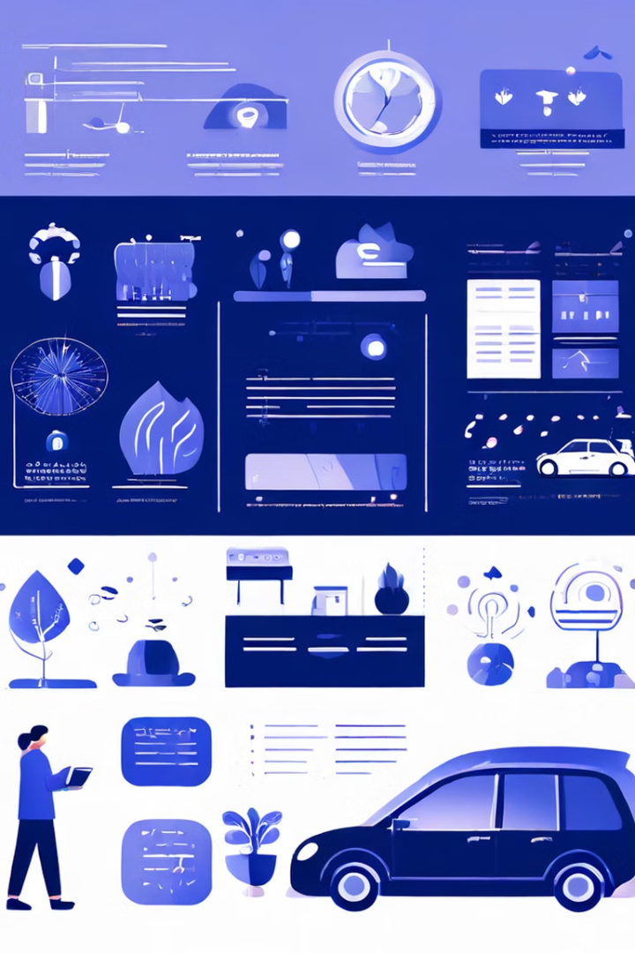
Understanding User Behavior for Smarter Energy Management
1
Learning User Habits
The app analyzes energy usage patterns to understand daily routines.
2
Predictive Analytics
Uses data to predict future energy consumption and potential grid strain.
3
Personalized Suggestions
Offers customized recommendations for adjusting energy usage to avoid disruptions.
4
Adaptive Optimization
Continuously learns and adapts to user behavior to improve energy management.

Slide 5

Virtual Batteries and Virtual Power Plants: A New Approach to Grid Stability
1
Virtual Batteries
Aggregates small-scale home batteries to form a large-scale energy storage network.
2
Virtual Power Plants
Coordinates distributed renewable energy resources to function as a single power generation facility.
3
Benefits
Balances grid load, stabilizes the grid, and improves the utilization of renewable energy.
4
Flexibility
Adapts to fluctuating energy demand, ensuring a stable energy supply even during peak hours.

Slide 6
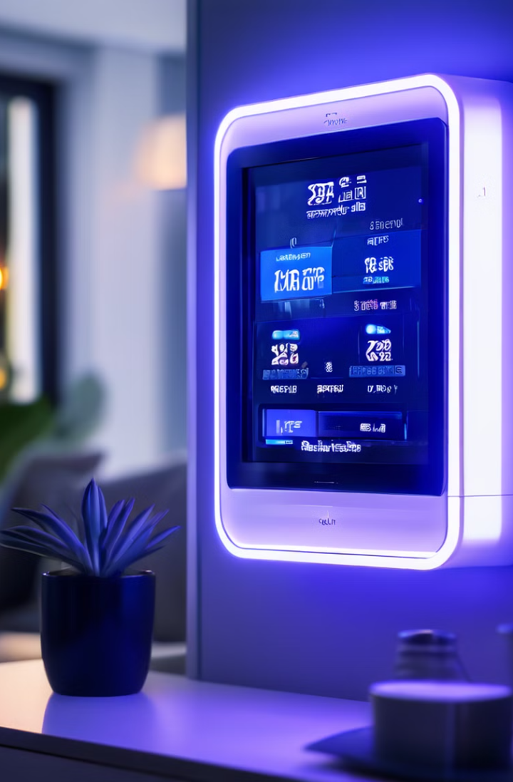




Smart Meters and IoT Devices: Real-Time Data for Improved Grid Management
Real-Time Monitoring
Collects and analyzes data from smart meters and IoT devices.
Predictive Analytics
Uses real-time data to anticipate potential grid imbalances.
Early Detection
Identifies potential grid issues before they become critical.
Proactive Response
Provides early warnings to users and utilities to prevent disruptions.

Slide 7
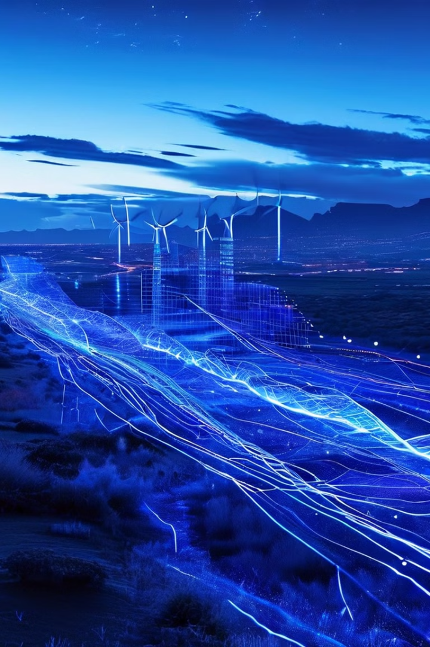
Advanced Analytics for Grid Optimization: Ensuring a Sustainable Energy Future
Data Analysis
Energy Flow Optimization
Renewable Energy Integration
Predicts energy demand
Distributes energy efficiently
Minimizes energy waste
Identifies grid bottlenecks
Reduces energy losses
Maximizes renewable energy use
Monitors grid performance
Enhances grid resilience
Promotes a sustainable energy system

Slide 8





The Impact of the Grid Balance Maintenance App on South Africa
Reduced Load Shedding
Provides more reliable and consistent power to homes and businesses.
Enhanced Renewable Energy Utilization
Promotes a cleaner and more sustainable energy system.
Empowered Consumers
Provides users with greater control over their energy consumption and cost savings.
Improved Grid Reliability
Ensures a more robust and resilient energy infrastructure for a brighter future.

