Slide 1
Design Document for Project 3 (PowerPoint Format)
Donna Jackson, Leshan Zhao, (Ravindra, Mehnaz Tabassum)

Slide 2
How to use: User case 1 (buyer)
Architecture Implementation
MVC and Presentation Layer (Project 2 & 3) - Jump to
Android and Web Server (Project 3) - Jump to

Slide 3
How to use
We made a welcome screen to be the starting point of application
in addition to the user case

Slide 4
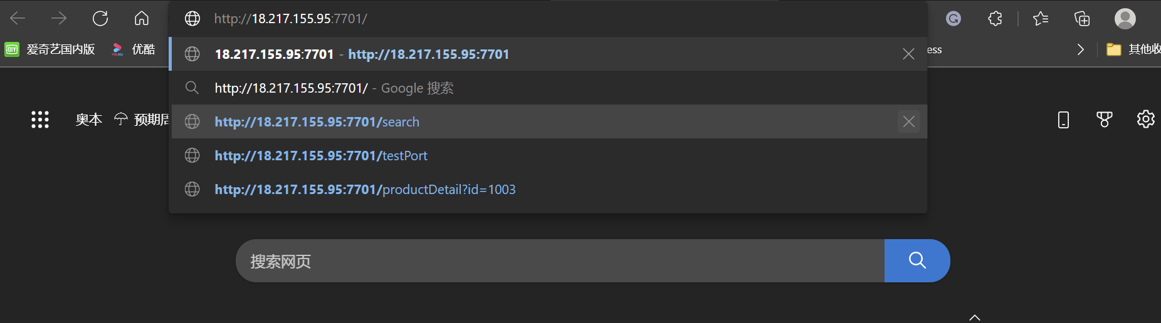
How to use
browse:
18.217.155.95:7701

Slide 5
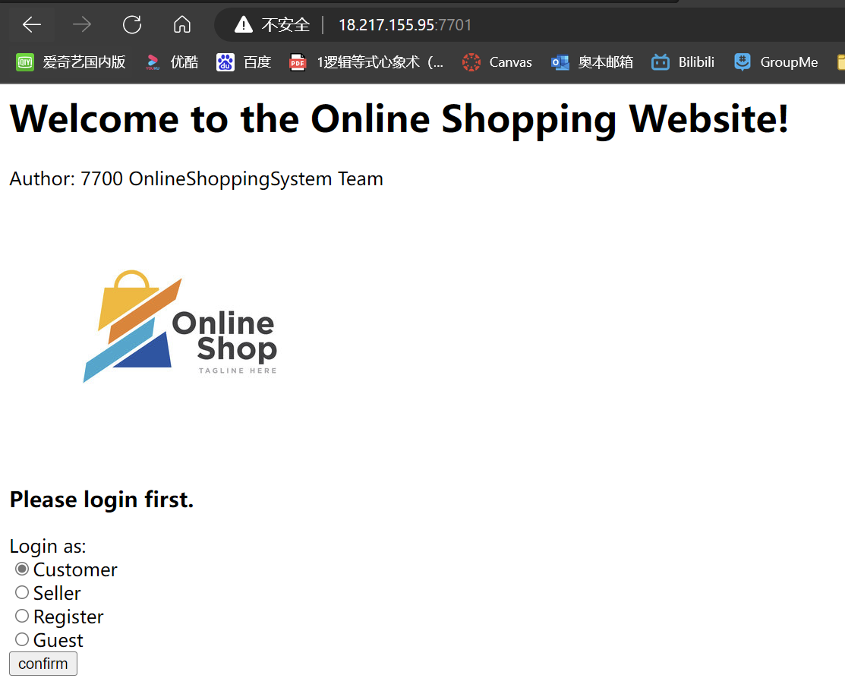
How to use
browse:
18.217.155.95:7701
Being implemented
Being implemented

Slide 6
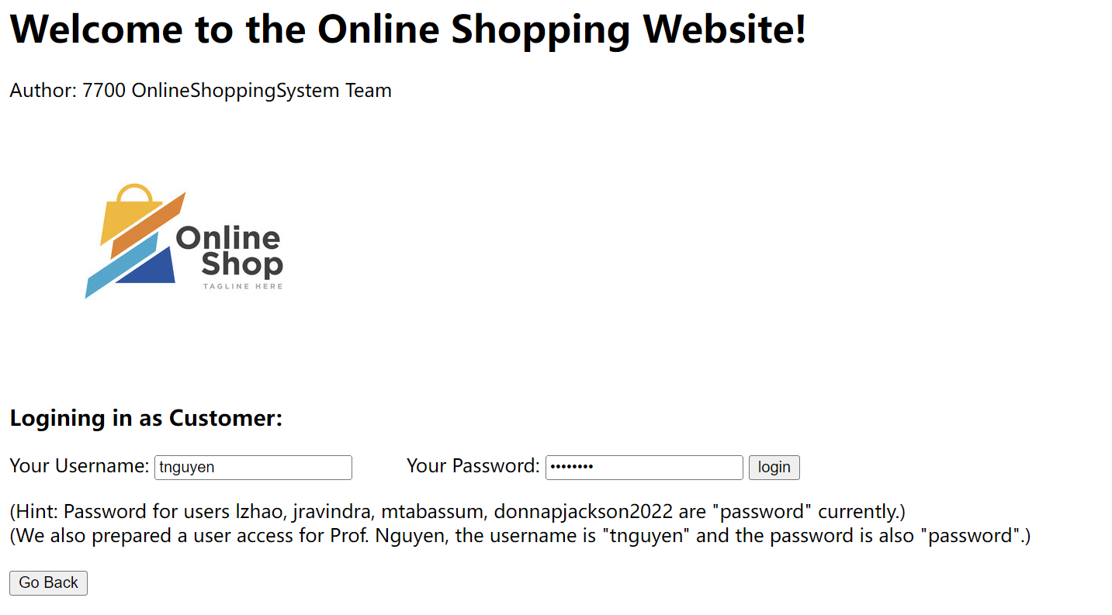
How to use
or browse
18.217.155.95:7701/UserLogin?UserRole=Guest
18.217.155.95:7701/UserLogin?UserRole=Customer

Slide 7
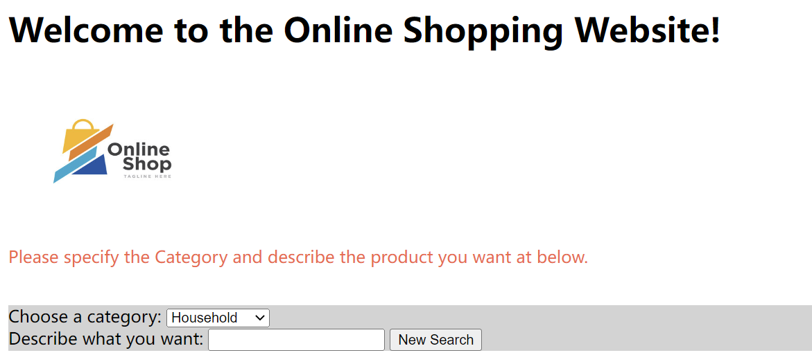
or browse 18.217.155.95:7701/search?username=lzhao&password=password 18.217.155.95:7701/search
How to use
User case 1

Slide 8
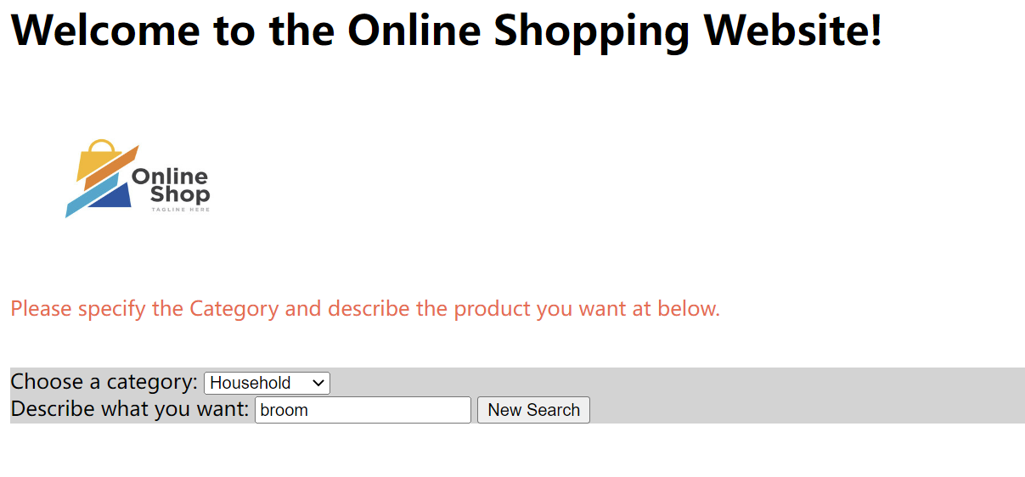
or browse 18.217.155.95:7701/search?category=Household&description=broom
How to use
User case 1

Slide 9
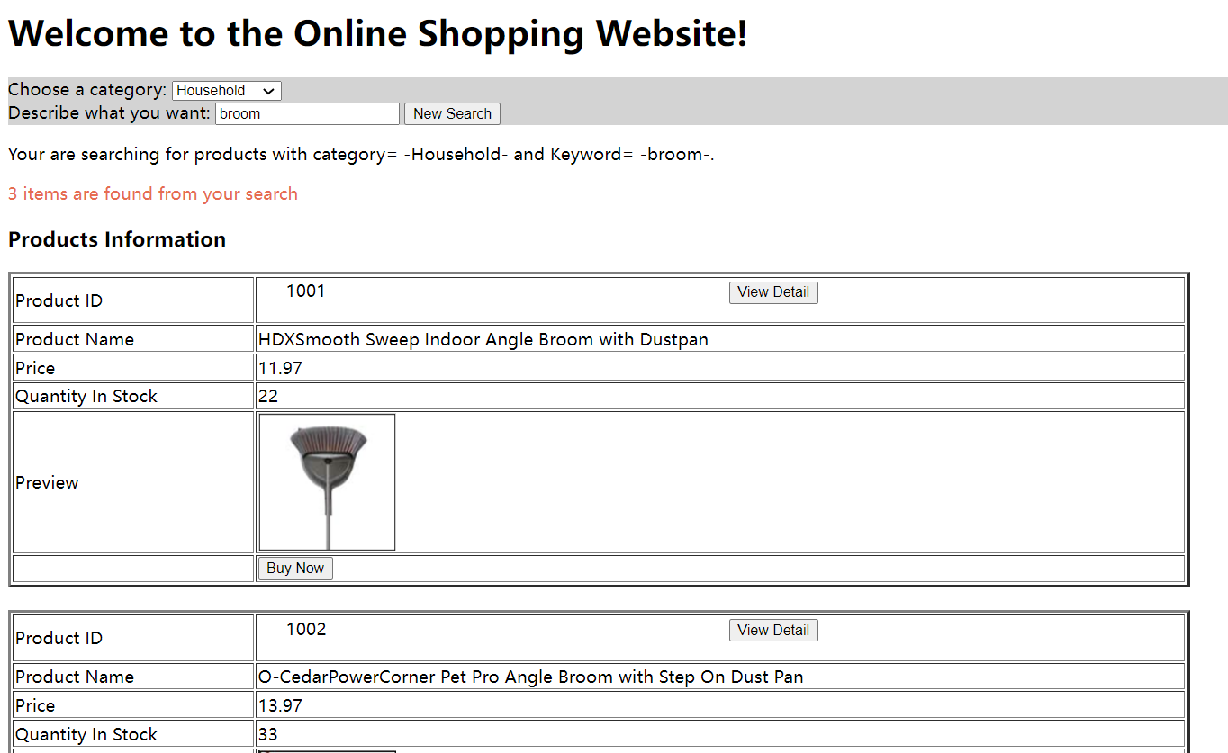
How to use
User case 1
or browse 18.217.155.95:7701/search?category=Household&description=broom

Slide 10
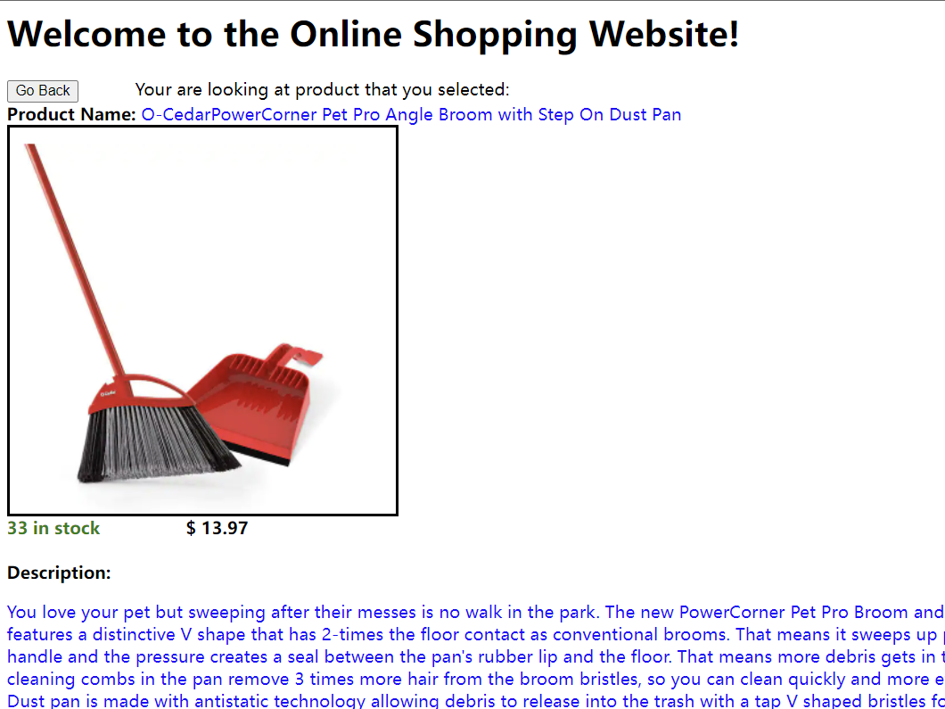
How to use
User case 1
or browse
18.217.155.95:7701/productDetail?id=1002

Slide 11
Architecture Implementation
MVC and Presentation Layer (Project 2 & 3) - Jump to
Android and Web Server (Project 3) - Jump to

Slide 12
MVC and Presentation Layer (Project 2 & 3)
Jump to Android and Web Server (Project 3)

Slide 13
Models:
(consistent between
client and server)
Models for
Remote Data Access:
RequestModel
ResponseModel
ProductModel
ProductImageModel
Models for
Information Storage:
Product
ProductDetails
Order
OrderDetails
Shipper
ShipperMethod
Types
Supplier
Shipper
Users
UserRole
ContactInfo
Authorization
AuthorizationLevels
Views:
WelcomeView (start screen)
LoginScreenView
For Buyer:
SearchView
- SearchInputBoxPanel
- SearchResultPanel
- ItemDetailPanel
- CheckoutView (being implemented)
ShipperView (Not included, To be implemented)
ShoppintCartView (Not included, To be implemented)
For Seller: (Being Implemented)
SellerView
ProductMaintenanceView
For SuperUser: (Not included, To be implemented)
SuperUserView
RegisterViewScreen
Controllers:
WelcomeController
LoginController
For Buyer screen:
SearchController
(no controller for search input box panel because it’s too simple)
SearchResultController
ItemDetailController
CheckoutController (being implemented)
ShipperController (Not included, To be implemented)
ShoppintCartController (Not included, To be implemented)
For Seller screen: (Being Implemented)
SellerController
ProductController
For SuperUser Screen: (Not included, To be implemented)
SuperUserController
RegisterController
Application.java:
starting point of the app
Presentation Layer

Slide 14
Application Layer, Business Logic Layer, and Data Access Layer

Slide 15
Application Layer
(In fact also a Data Access Layer,
used to create query)
DataAccess (interface)
Methods:
For Login Screen:
GetUserWithUsernamePassword
GetUserWithUserID
GetUserRoleWithUserRoleID
GetUser
GetAllUsers
GetContactInfoByUser
GetContactInfo
For Buyer Search View:
GetProductByID
GetAllProducts
GetAllProductByCategoryAndSearchString
GetAllProductsByProductDetails
GetAllProductDetailsForProduct
FillProductObject
GetAllShippers
SaveOrder
GetNextOrdersDetailID
GetShipperMethodByShipperIDAndMethod
GetNextOrderID
GetSupplierForProduct
GetAllOrdersForUser
GetOrderDetailsForUser
GetOrderDetailsForOrder
GetOrders
GetTypesByTypeName
GetTypesByTypeValue
GetType
For Seller View: (being Implemented)
saveProduct
……
Business Logic Layer
RemoteDataAdaptor (implements) DataAccess
(i.e. DataAccess at Client side)
Extra Methods:
cast_ProductModels_ToProducts
saveImages_FromProductImgModel_ToProduct
load_Product
DataAdaptor (implements) DataAccess
(i.e. DataAccess at Server Side)
Extra Methods:
cast_Products_ToProductModels
saveImages_FromProduct_ToProductImgModel
getDetailImage_FromProductDetailList
ImportImgFromPath
Data Access Layer
Database (at cloud):
OnLineShoppingDb.sqlite
DataServer (Client Handler) (at Cloud)
ClientHandler

Slide 16
How the architectures works and cooperate

Slide 17
Views:
Listen to
Controllers:
Set data to
(According to results from
Bussiness logic)
Presentation
Layer
Load data from
Call
DataAccess (interface)
RemoteDataAdaptor (implements) DataAccess (i.e. DataAccess at Client side)
Functions to wrap models in request model,
create socket to get result from remote server
unwrap response model to models
Models:
Remote Data Access
Models
- RequestModel
- ResponseModel
Other models
Application
Layer
(In fact also a
Data Access
Layer, used to
create query)
Parse models between
Response
Socket
Listen to
Request
Socket
DataServer (Client Handler) (at Cloud)
- ClientHandler
Save data in
Call
DataAccess (interface)
DataAdaptor (implements) DataAccess (i.e. DataAccess at Server Side)
Provide methods to create query to fetch data from database
according to business logic
and save results in models
Query
Database (at cloud):
OnLineShoppingDb.sqlite
Result
Business Logic
Layer
Data Access Layer

Slide 18
An elaborated example

Slide 19
Starting point
of Client App
a user clicked the “search” button at SearchView
Controllers:
SearchController
SearchResultController
ItemDetailController
Views:
SearchView
- ItemDetailPanel
- SearchResultPanel
1. listen to view: “search” Clicked
Presentation
Layer
Application
Layer
(In fact also a
Data Access
Layer, used to
create query)
DataAccess (interface)
RemoteDataAdaptor (implements) DataAccess (i.e. DataAccess at Client side)
- GetAllProductByCategoryAndSearchString(category, searchString)
Models:
RequestModel
ResponseModel
Product
(consistent between
client and server)
Run infinite loop
to listen to Query
DataServer (Client Handler) (at Cloud)
ClientHandler
Starting point
of Server App
Data Access Layer
DataAccess (interface)
DataAdaptor (implements) DataAccess (i.e. DataAccess at Server Side)
- GetAllProductByCategoryAndSearchString(category, searchString)
Database (at cloud):
OnLineShoppingDb.sqlite
Business Logic
Layer

Slide 20
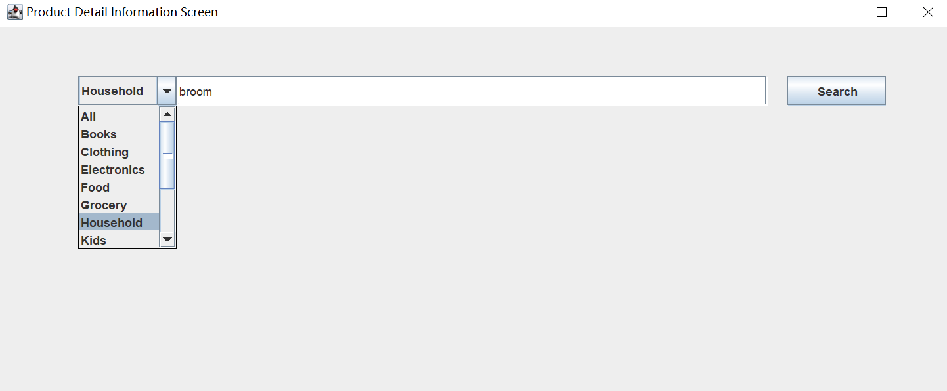
Starting point
of Client App
a user clicked the “search” button at SearchView
Controllers:
SearchController
SearchResultController
ItemDetailController
Views:
SearchView
- ItemDetailPanel
- SearchResultPanel
1. listen to view: “search” Clicked
Presentation
Layer
Application
Layer
(In fact also a
Data Access
Layer, used to
create query)
DataAccess (interface)
RemoteDataAdaptor (implements) DataAccess (i.e. DataAccess at Client side)
- GetAllProductByCategoryAndSearchString(category, searchString)
Models:
RequestModel
ResponseModel
Product
(consistent between
client and server)
Run infinite loop
to listen to Query
DataServer (Client Handler) (at Cloud)
ClientHandler
Starting point
of Server App
Data Access Layer
DataAccess (interface)
DataAdaptor (implements) DataAccess (i.e. DataAccess at Server Side)
- GetAllProductByCategoryAndSearchString(category, searchString)
Database (at cloud):
OnLineShoppingDb.sqlite
Business Logic
Layer

Slide 21
Starting point
of Client App
a user clicked the “search” button at SearchView
Controllers:
SearchController
SearchResultController
ItemDetailController
Views:
SearchView
- ItemDetailPanel
- SearchResultPanel
1. listen to view: “search” Clicked
2. Controller fetch “Category” and “Description” from view
Presentation
Layer
3. SearchController call the function at remote data adaptor
GetAllProductByCategoryAndSearchString(category, searchString)
4. the remote data adaptor at Client
generate the request model and create the
query (socket) to get data from cloud Server
Models:
RequestModel
ResponseModel
Product
(consistent between
client and server)
Application
Layer
(In fact also a
Data Access
Layer, used to
create query)
DataAccess (interface)
RemoteDataAdaptor (implements) DataAccess (i.e. DataAccess at Client side)
- GetAllProductByCategoryAndSearchString(category, searchString)
5. Server observed request socket from client
Run infinite loop
to listen to Query
DataServer (Client Handler) (at Cloud)
ClientHandler
Starting point
of Server App
Data Access Layer
DataAccess (interface)
DataAdaptor (implements) DataAccess (i.e. DataAccess at Server Side)
- GetAllProductByCategoryAndSearchString(category, searchString)
Database (at cloud):
OnLineShoppingDb.sqlite
Business Logic
Layer

Slide 22
Starting point
of Client App
a user clicked the “search” button at SearchView
Controllers:
SearchController
SearchResultController
ItemDetailController
Views:
SearchView
- ItemDetailPanel
- SearchResultPanel
1. listen to view: “search” Clicked
2. Controller fetch “Category” and “Description” from view
Presentation
Layer
3. SearchController call the function at remote data adaptor
GetAllProductByCategoryAndSearchString(category, searchString)
4. the remote data adaptor at Client
generate the request model and create the
query (socket) to get data from cloud Server
Models:
RequestModel
ResponseModel
Product
(consistent between
client and server)
Application
Layer
(In fact also a
Data Access
Layer, used to
create query)
DataAccess (interface)
RemoteDataAdaptor (implements) DataAccess (i.e. DataAccess at Client side)
- GetAllProductByCategoryAndSearchString(category, searchString)
5. Server observed request socket from client
Run infinite loop
to listen to Query
DataServer (Client Handler) (at Cloud)
ClientHandler
Starting point
of Server App
Data Access Layer
DataAccess (interface)
DataAdaptor (implements) DataAccess (i.e. DataAccess at Server Side)
- GetAllProductByCategoryAndSearchString(category, searchString)
Database (at cloud):
OnLineShoppingDb.sqlite
Business Logic
Layer

Slide 23
Views:
SearchView
- ItemDetailPanel
- SearchResultPanel
Controllers:
SearchController
SearchResultController
ItemDetailController
Presentation
Layer
Application
Layer
(In fact also a
Data Access
Layer, used to
create query)
DataAccess (interface)
RemoteDataAdaptor (implements) DataAccess (i.e. DataAccess at Client side)
- GetAllProductByCategoryAndSearchString(category, searchString)
Models:
RequestModel
ResponseModel
Product
(consistent between
client and server)
5. Server observed request socket from client
Run infinite loop
to listen to Query
DataServer (Client Handler) (at Cloud)
ClientHandler
Starting point
of Server App
6. Create threads to
handle clients’ request
7. Call the business logic function
GetAllProductByCategoryAndSearchString(category, searchString)
Data Access Layer
DataAccess (interface)
DataAdaptor (implements) DataAccess (i.e. DataAccess at Server Side)
- GetAllProductByCategoryAndSearchString(category, searchString)
8. Generate Query to
get data from database
according to the business logic
Database (at cloud):
OnLineShoppingDb.sqlite
Business Logic
Layer

Slide 24
Views:
SearchView
- ItemDetailPanel
- SearchResultPanel
Controllers:
SearchController
SearchResultController
ItemDetailController
Presentation
Layer
Application
Layer
(In fact also a
Data Access
Layer, used to
create query)
DataAccess (interface)
RemoteDataAdaptor (implements) DataAccess (i.e. DataAccess at Client side)
- GetAllProductByCategoryAndSearchString(category, searchString)
Models:
RequestModel
ResponseModel
Product
(consistent between
client and server)
13. Client observed response socket from Server
12. the data server wrap the list of product into response model
Run infinite loop
to listen to Query
DataServer (Client Handler) (at Cloud)
ClientHandler
Starting point
of Server App
11. The business logic return the list of desired products to data server
10. The business logic Parse the sql result into a list of Product Model
Data Access Layer
DataAccess (interface)
DataAdaptor (implements) DataAccess (i.e. DataAccess at Server Side)
- GetAllProductByCategoryAndSearchString(category, searchString)
8. Generate Query to
get data from database
according to the business logic
Database (at cloud):
OnLineShoppingDb.sqlite
9. get the sql result set
Business Logic
Layer

Slide 25
Controllers:
SearchController
SearchResultController
ItemDetailController
16. the controller ask the search View
to present the product model
Views:
SearchView
- ItemDetailPanel
- SearchResultPanel
the user see the products
at the screen (SearchView)
End point of
this set of behavior
15. Application return
a list of product as result
Presentation
Layer
Application
Layer
(In fact also a
Data Access
Layer, used to
create query)
DataAccess (interface)
RemoteDataAdaptor (implements) DataAccess (i.e. DataAccess at Client side)
- GetAllProductByCategoryAndSearchString(category, searchString)
Models:
RequestModel
ResponseModel
Product
(consistent between
client and server)
13. Client observed response socket from Server
14. Application parse the ResponseModel to a list of Product
Run infinite loop
to listen to Query
DataServer (Client Handler) (at Cloud)
ClientHandler
Starting point
of Server App
Data Access Layer
DataAccess (interface)
DataAdaptor (implements) DataAccess (i.e. DataAccess at Server Side)
- GetAllProductByCategoryAndSearchString(category, searchString)
Database (at cloud):
OnLineShoppingDb.sqlite
Business Logic
Layer

Slide 26
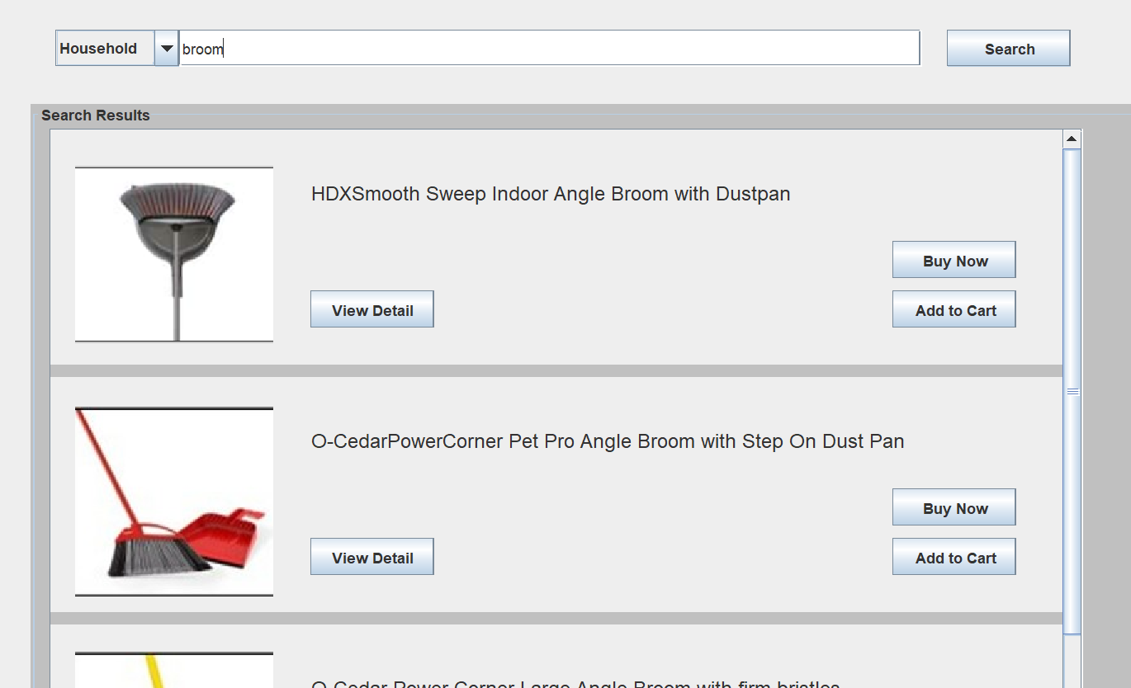
Controllers:
SearchController
SearchResultController
ItemDetailController
16. the controller ask the search View
to present the product model
Views:
SearchView
- ItemDetailPanel
- SearchResultPanel
the user see the products
at the screen (SearchView)
End point of
this set of behavior
15. Application return
a list of product as result
Presentation
Layer
Application
Layer
(In fact also a
Data Access
Layer, used to
create query)
DataAccess (interface)
RemoteDataAdaptor (implements) DataAccess (i.e. DataAccess at Client side)
- GetAllProductByCategoryAndSearchString(category, searchString)
Models:
RequestModel
ResponseModel
Product
(consistent between
client and server)
13. Client observed response socket from Server
14. Application parse the ResponseModel to a list of Product
Run infinite loop
to listen to Query
DataServer (Client Handler) (at Cloud)
ClientHandler
Starting point
of Server App
Data Access Layer
DataAccess (interface)
DataAdaptor (implements) DataAccess (i.e. DataAccess at Server Side)
- GetAllProductByCategoryAndSearchString(category, searchString)
Database (at cloud):
OnLineShoppingDb.sqlite
Business Logic
Layer

Slide 27
Starting point
of Client App
a user clicked the “search” button at SearchView
Controllers:
SearchController
SearchResultController
ItemDetailController
Views:
SearchView
- ItemDetailPanel
- SearchResultPanel
1. listen to view: “search” Clicked
the user see the products
at the screen (SearchView)
End point of
this set of behavior
Presentation
Layer
Application
Layer
(In fact also a
Data Access
Layer, used to
create query)
DataAccess (interface)
RemoteDataAdaptor (implements) DataAccess (i.e. DataAccess at Client side)
- GetAllProductByCategoryAndSearchString(category, searchString)
Models:
RequestModel
ResponseModel
Product
(consistent between
client and server)
Run infinite loop
to listen to Query
DataServer (Client Handler) (at Cloud)
ClientHandler
Starting point
of Server App
Data Access Layer
DataAccess (interface)
DataAdaptor (implements) DataAccess (i.e. DataAccess at Server Side)
- GetAllProductByCategoryAndSearchString(category, searchString)
Database (at cloud):
OnLineShoppingDb.sqlite
Business Logic
Layer

Slide 28
Bring together

Slide 29
Starting point
of Client App
a user clicked the “search” button at SearchView
Controllers:
SearchController
SearchResultController
ItemDetailController
16. the controller ask the search View
to present the product model
Views:
SearchView
- ItemDetailPanel
- SearchResultPanel
1. listen to view: “search” Clicked
the user see the products
at the screen (SearchView)
2. Controller fetch “Category” and “Description” from view
End point of
this set of behavior
15. Application return
a list of product as result
Presentation
Layer
3. SearchController call the function at remote data adaptor
GetAllProductByCategoryAndSearchString(category, searchString)
4. the remote data adaptor at Client
generate the request model and create the
query (socket) to get data from cloud Server
Models:
RequestModel
ResponseModel
Product
(consistent between
client and server)
Application
Layer
(In fact also a
Data Access
Layer, used to
create query)
DataAccess (interface)
RemoteDataAdaptor (implements) DataAccess (i.e. DataAccess at Client side)
- GetAllProductByCategoryAndSearchString(category, searchString)
13. Client observed response socket from Server
14. Application parse the ResponseModel to a list of Product
5. Server observed request socket from client
12. the data server wrap the list of product into response model
Run infinite loop
to listen to Query
DataServer (Client Handler) (at Cloud)
ClientHandler
Starting point
of Server App
6. Create threads to
handle clients’ request
11. The business logic return the list of desired products to data server
10. The business logic Parse the sql result into a list of Product Model
7. Call the business logic function
GetAllProductByCategoryAndSearchString(category, searchString)
Data Access Layer
DataAccess (interface)
DataAdaptor (implements) DataAccess (i.e. DataAccess at Server Side)
- GetAllProductByCategoryAndSearchString(category, searchString)
8. Generate Query to
get data from database
according to the business logic
Database (at cloud):
OnLineShoppingDb.sqlite
9. get the sql result set
Business Logic
Layer

Slide 30
Android and Web Server (Project 3)
Android (implemented by Ms. Jackson)
Web Server

Slide 31
Web Server
Project 2 (Simplified presentation)
Project 3 (Simplified presentation)
HTTP Requests (Browser)
Java UI Client
StoreWebServer
DataServer (DataServer.java)
database

Slide 32
Web Server
HTTP Requests (Browser)
(Simplified presentation)
POST & GET
StoreWebServer
Web Programming Language
Microservices
handle UserLoginRequest
handle SearchProductRequest
handle ProductDetailRequest
handle
Sellers
handle
Registers
…
SQLiteDatabase
Since it’s just a very small database, we make it local and only one

Slide 33
handle UserLoginRequest
Bussiness Logic
handle GuestLoginRequest
handle CustomerRequest
handle RegisterLoginRequest
handle SellerLoginRequest
WebDataAdaptor
Data Access
getHtmlString_ForGuestLogin
getHtmlString_ForCustomerLogin
getHtmlString_ForRegisterLogin
getHtmlString_ForRegisterLogin
SQLiteDatabase
Views

